Slide 1
Broadband Ground Motion Simulations for a Mw 7.8 Southern San Andreas Earthquake: ShakeOut
Robert W. Graves (URS Corporation)
Brad Aagaard (US Geological Survey, Menlo Park)
Ken Hudnut (US Geological Survey, Pasadena)
Support:
SCEC (USGS, NSF)
USGS
High Performance Computing & Communications (USC)

Slide 2
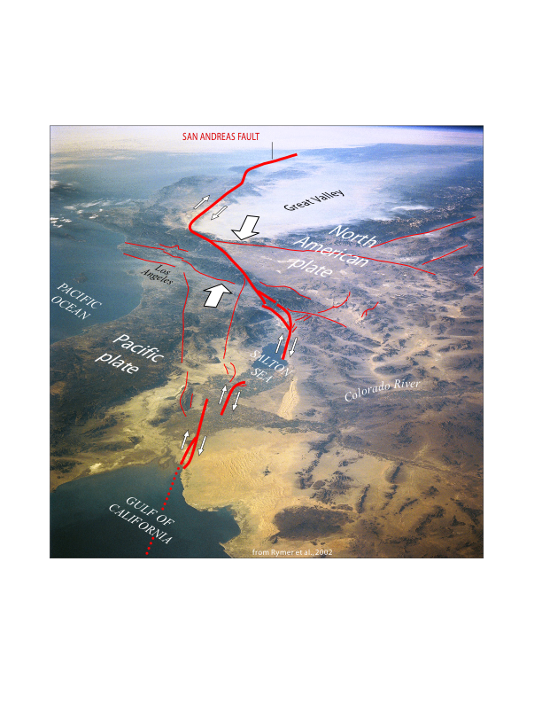
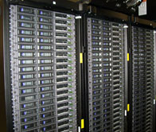
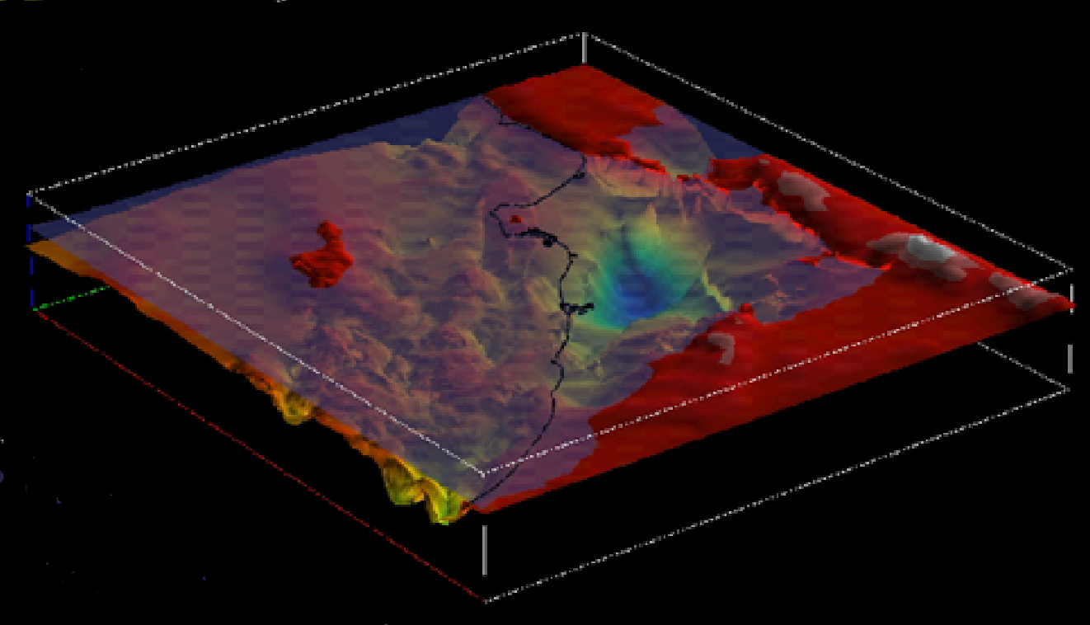
Highly Complex Geologic Structure
Large Computational Demands
HPCC Linux Cluster @ USC
FAULTS
VELOCITY STRUCTURE
John Shaw, Harvard

Slide 3
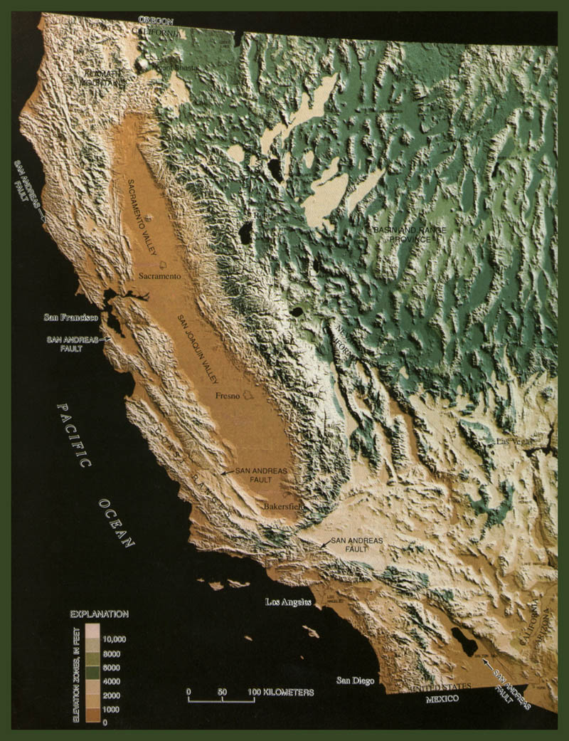
Scenario Earthquake on the Southern San Andreas Fault
Not a prediction - a plausible event
Average time between previous events: 150 years
First step: define rupture characteristics
  Rupture Length
  Magnitude
  Slip distribution
  Slip function
  Rupture velocity
  Hypocenter
1906
Creeping
section
?
1857
1680

Slide 4
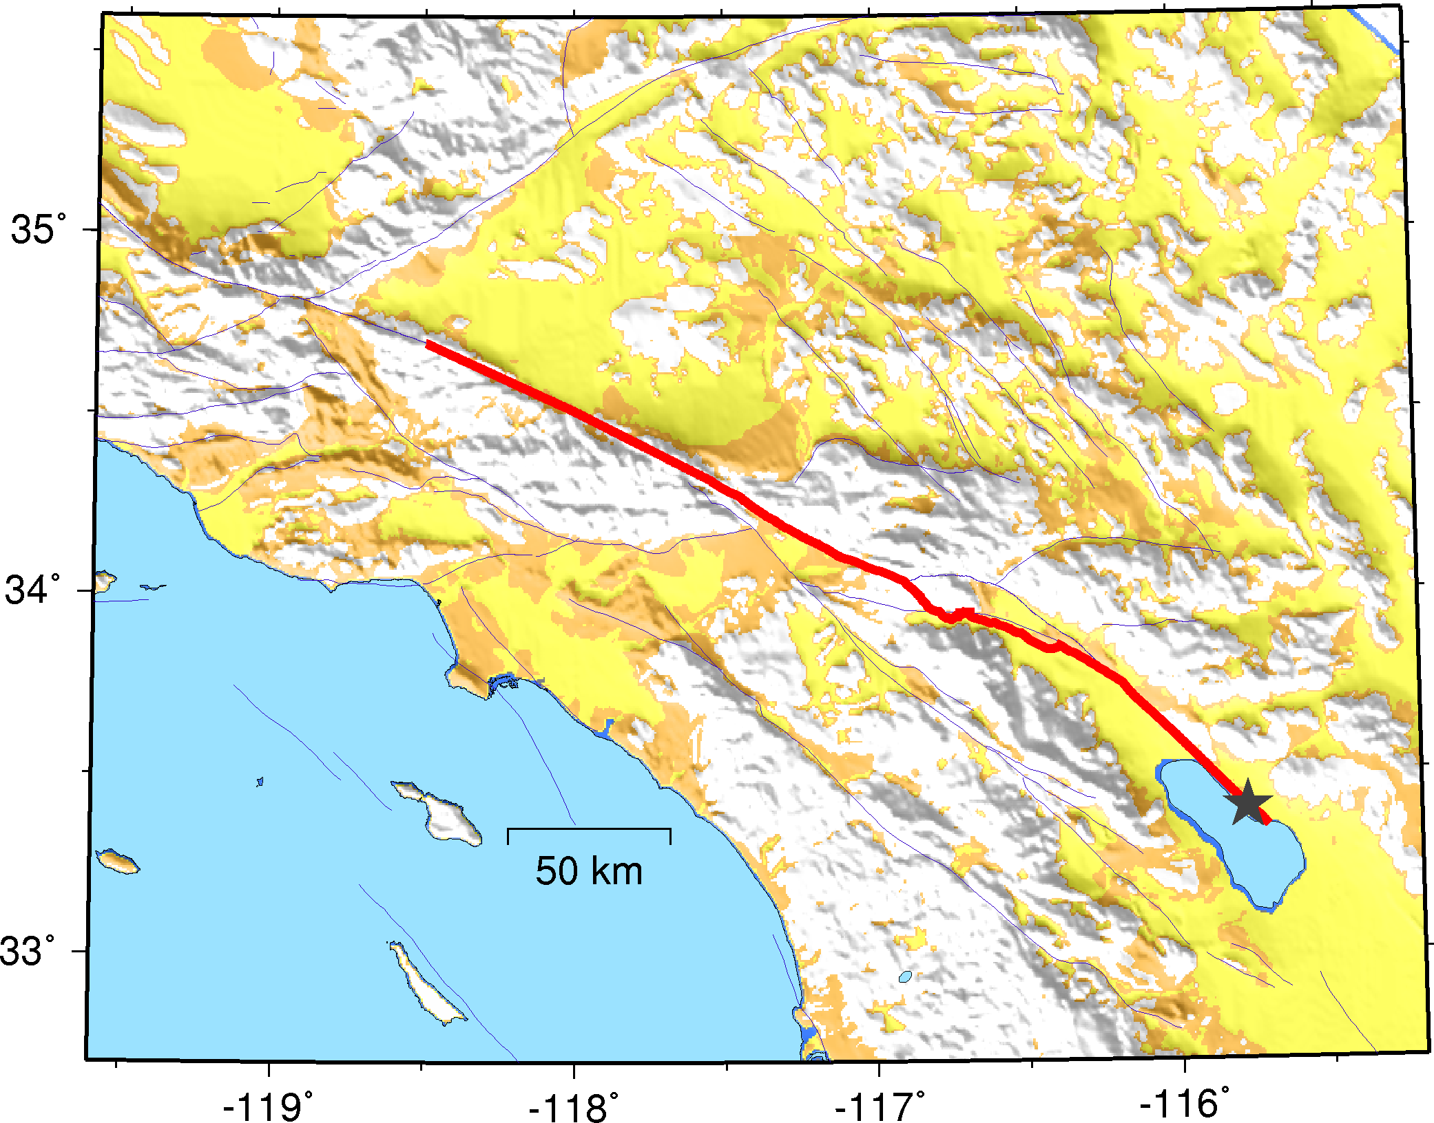
Fault / Rupture Characterization
Length = 300 km
Mw 7.8
2D fault surface (SCEC CFM)
Southern hypocenter
Mojave
San Gergonio Pass
Coachella Valley

Slide 5
Deterministic Methodology (f < 1 Hz)
Kinematic representation of heterogeneous rupture on a finite-fault
  slip amplitude
  slip direction (rake)
  rupture velocity from scaling relation
  generic slip function and rise time
Visco-elastic wave propagation using full waveform Green’s functions calculated for 3D velocity structure
Site-specific non-linear amplification factors based on Vs30 (Campbell and Bozorgnia, 2006)

Slide 6
Semi-Stochastic Methodology (f > 1 Hz)
Limited kinematic representation of heterogeneous rupture on a finite-fault (extension of Boore, 1983)
  slip amplitude (stress parameter = 50)
  frequency dependent radiation pattern
  rupture velocity from scaling relation
  stochastic phase
  empirical rupture duration
Simplified Green’s functions for 1D velocity structure
  amplitude decays as inverse of ray path
  gross impedance effects based on square-root impedance amplifications (Boore and Joyner, 1997)
Site-specific non-linear amplification factors based on Vs30 (Campbell and Bozorgnia, 2006)

Slide 7
Merge low- & high-frequency motions
Use tapered, matching filters

Slide 8
Semi-Stochastic Methodology (f > 1 Hz)
S_{i}(w) = source radiation and path scattering (stochastic phase)
G_{ij}(w) = simplified wave propagation and radiation pattern

Slide 9
Source Term:
Boore (1983) ...
Frankel (1995)
subfault moment:
subfault corner frequency:

Slide 10
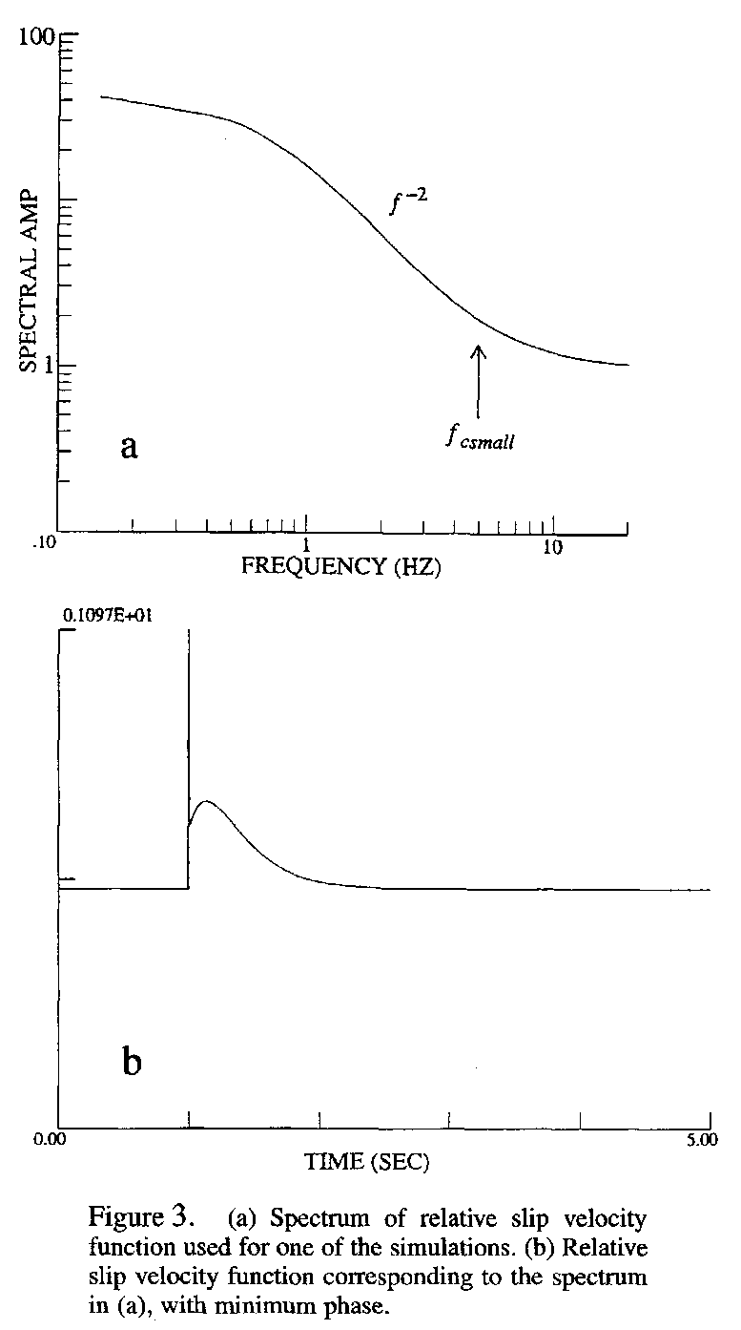
F(w) extends corner frequency of small event to match the big event
Frankel (1995)

Slide 11
Main HF Approximations
Stochastic phasing of S(w) accounts for
  Fine scale variability of source radiation
  Path scattering
Assumes w⁻² falloff
Simplified 1D GF’s
  Direct + Moho rays (1/ray_path)
  Quarter-wavelength impedance effects
Simplified radiation pattern

Slide 12
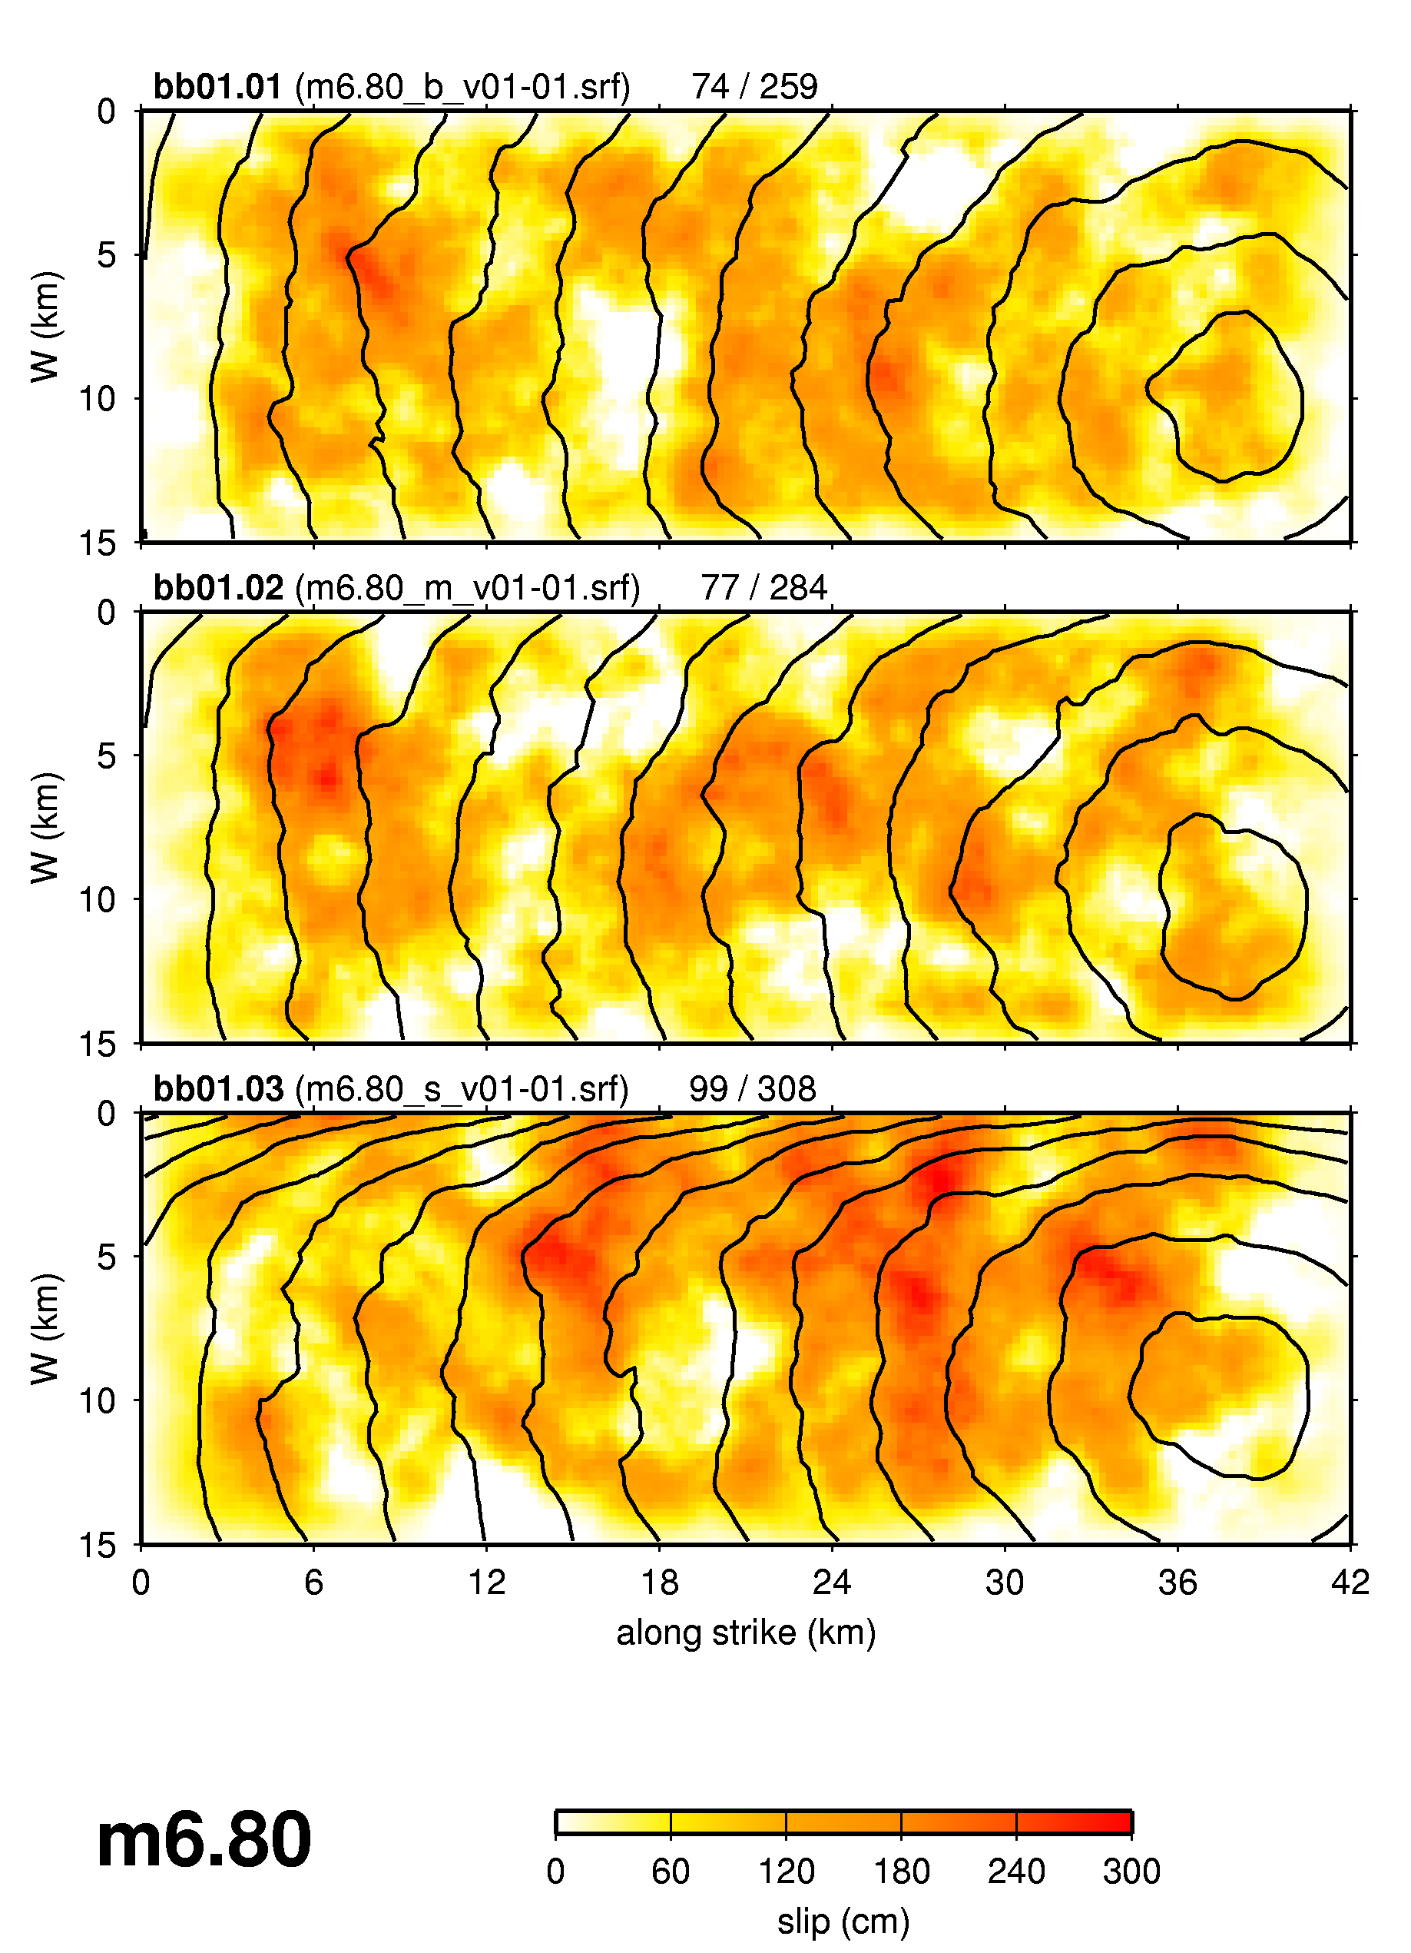
Original rupture models (dx=0.5 km)

Slide 13
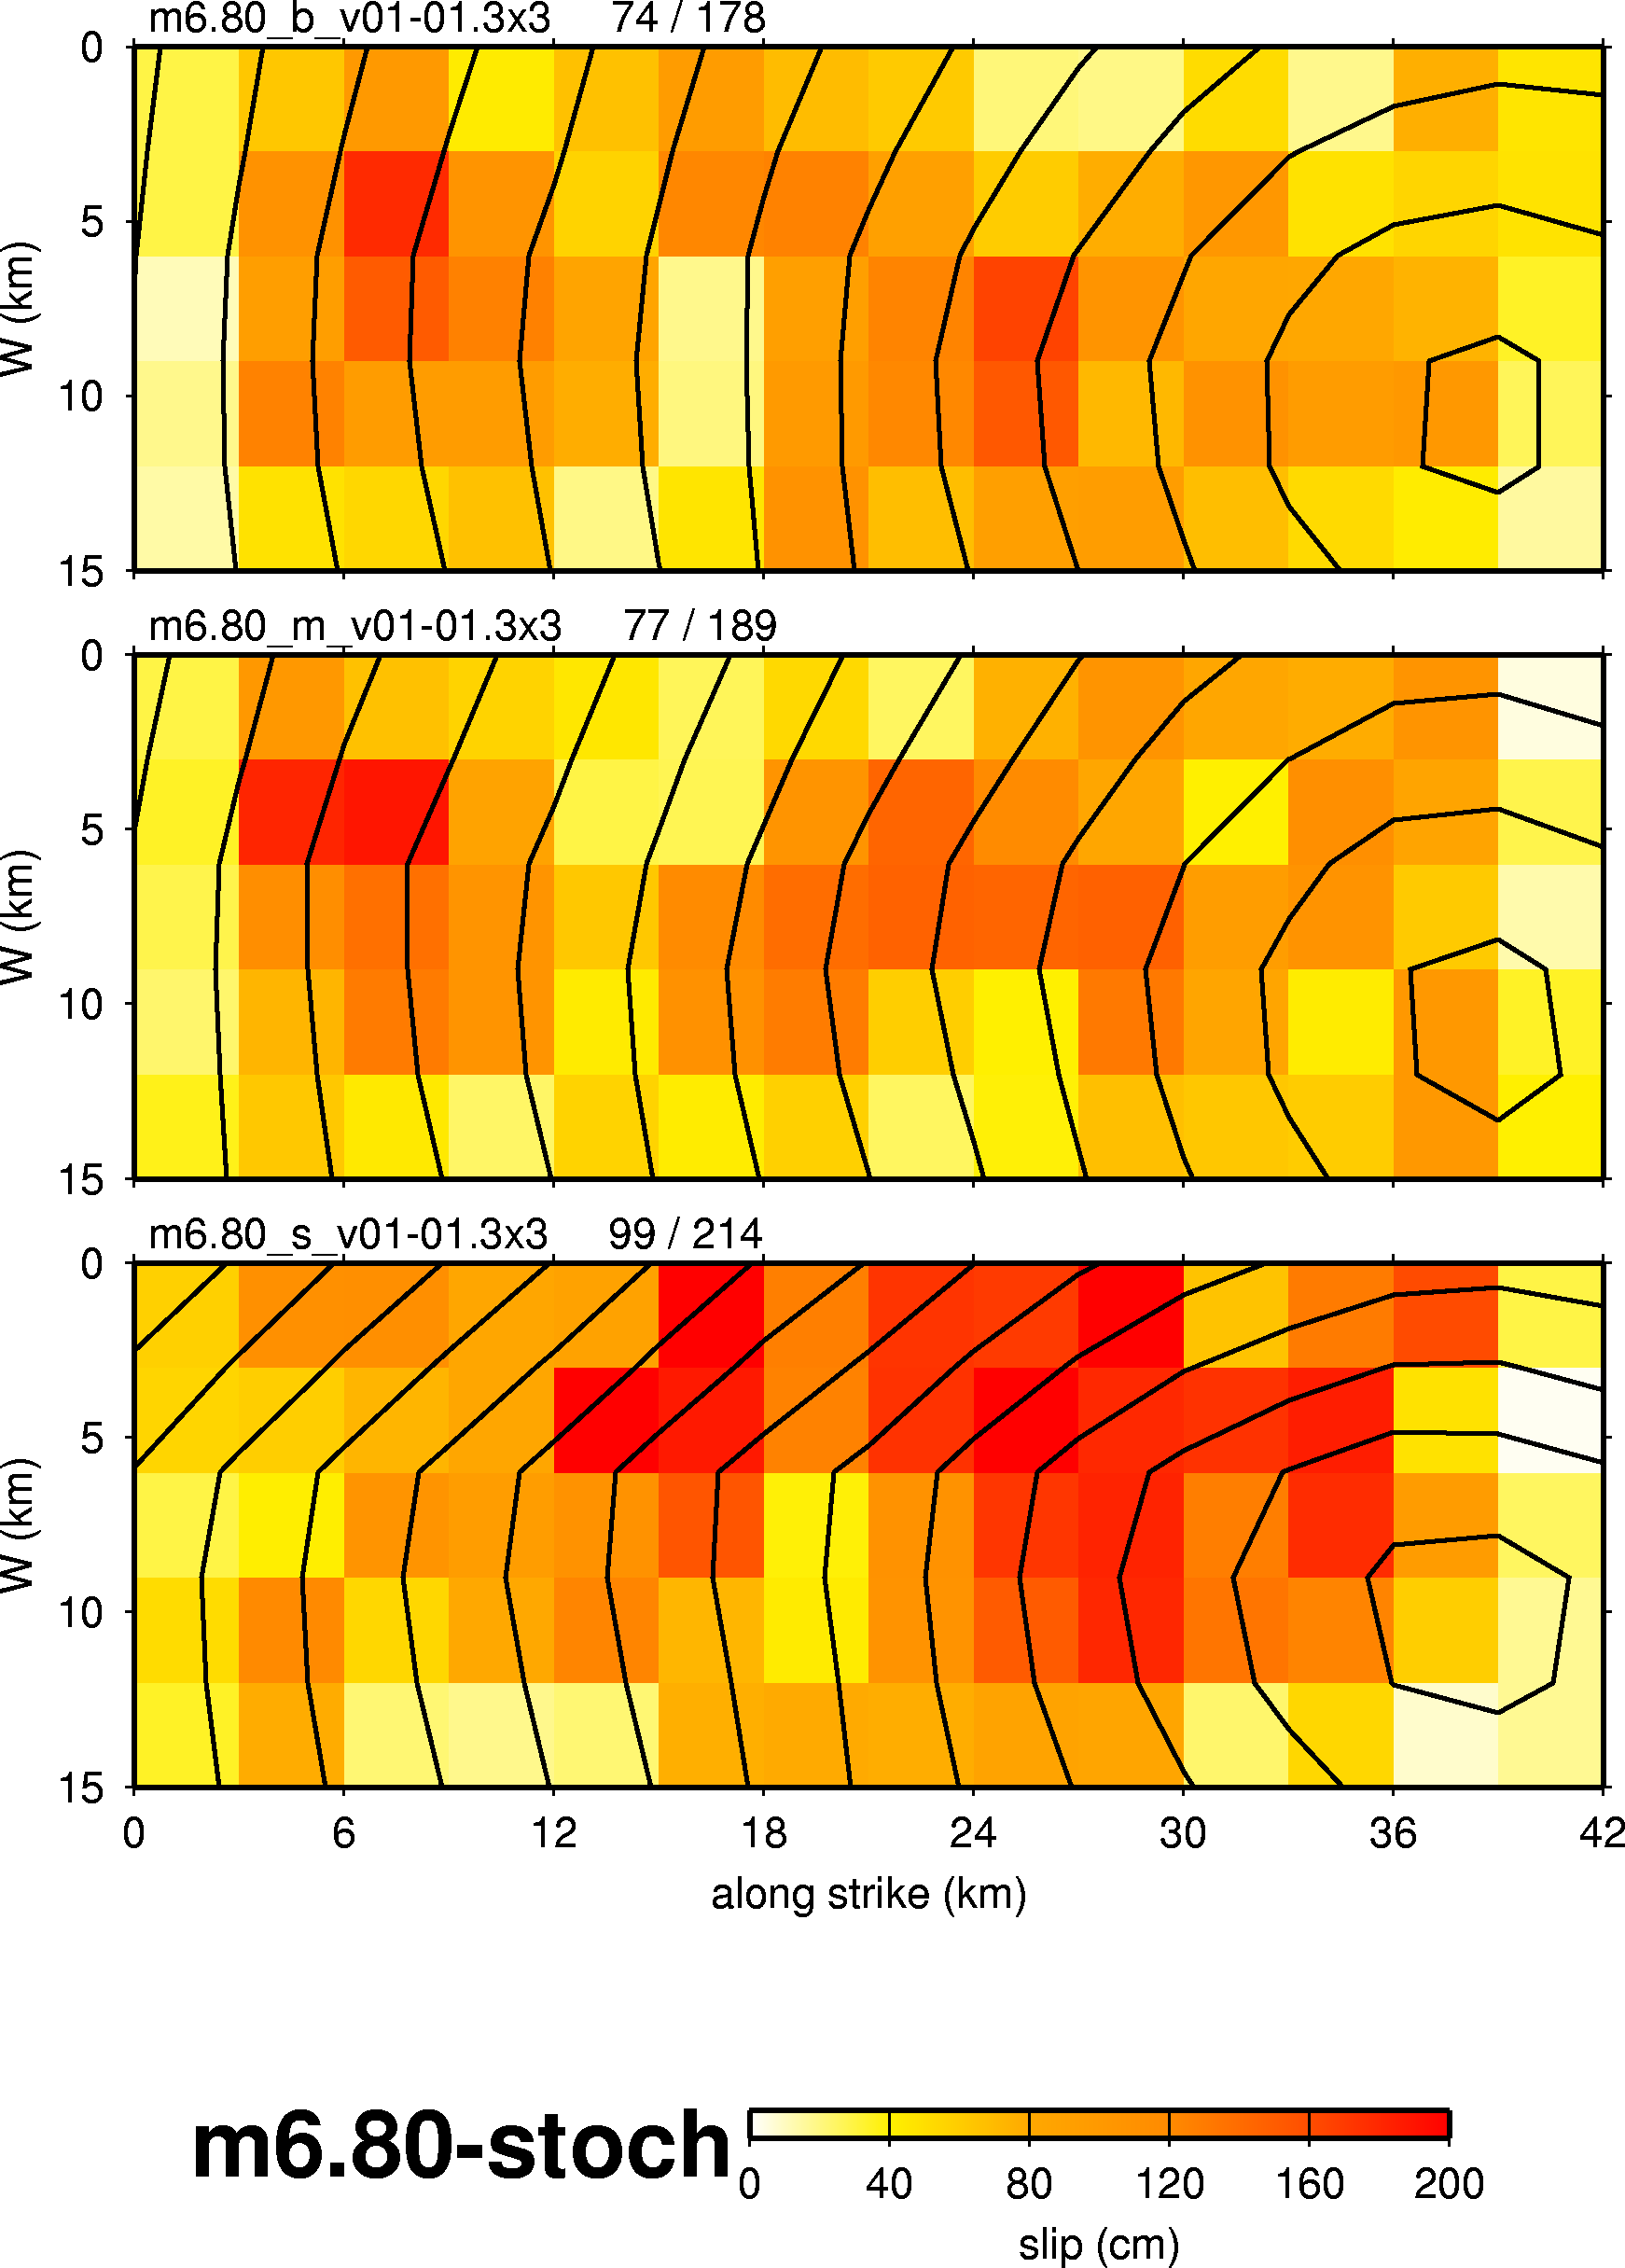
High frequency rupture models (dx=3 km)
Fine scale variability is accommodated through stochastic phasing of S(w)

Slide 14
Simulation Parameters
Low Frequency
  3D FD model using 2.33 x 10⁹ grid nodes
  (450 km x 225 km x 45 km @ h=0.125 km)
  24 hours run-time on 520 CPUs of HPCC Linux cluster at USC
  (260 GB RAM)
  3 component time histories saved at 25,500 locations
  (2 km x 2 km grid)
High Frequency
  24 hours run-time using single Linux PC
  3 component time histories saved at 25,500 locations
Post-Processing
  24 hours to process and sum HF and LF into Broadband response
  Broadband (0 – 10 Hz) 3 component time histories at 25,500 locations

Slide 15
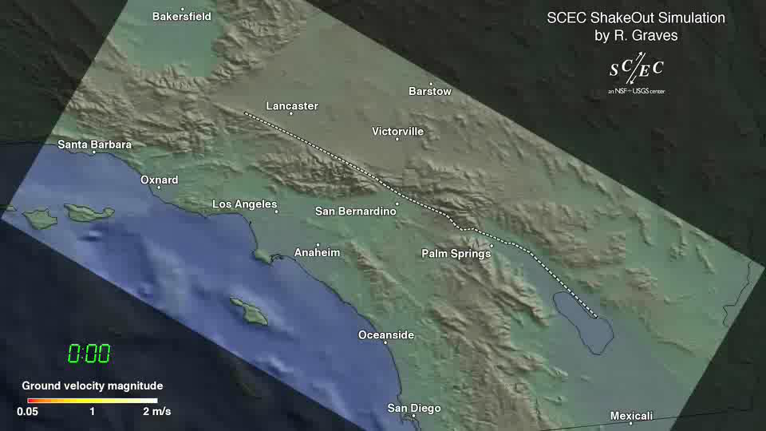
Click graph to start
magnitude_7.9_simulation.wmv

Slide 16
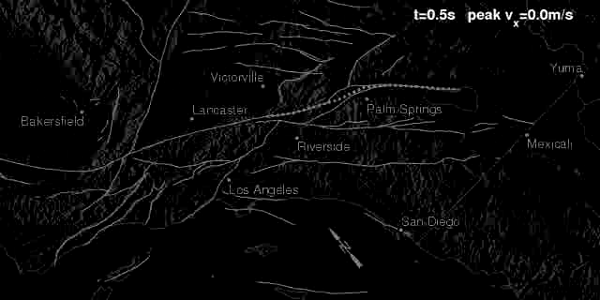
Southeast epicenter (southeast epicenter svx.mpeg)
Click graph to start

Slide 17
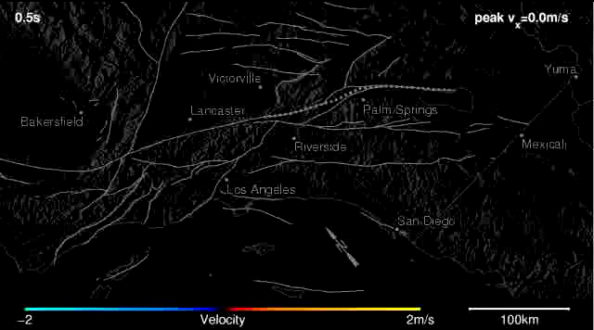
Northwest epicenter (northwest epicenter svx.mpeg)
Click graph to start

Slide 18
Broadband ShakeOut Simulation Summary
Strong shaking over large area of southern California
Strong rupture directivity effects (near fault)
Significant basin amplification at longer periods (T > 1 sec), strongly coupled with directivity (even > 50 km from fault)
Multiple realizations (hypocenters) allow for quantification of average response and variability about mean
Median response similar to empirical models at shorter periods (T < 1 sec), larger than empirical models at longer periods
Research in progress …
  Damage and loss estimates using HAZUS
  Landslide/liquefaction hazards
  Lifeline (pipelines/highways/railroads) impacts
  Structural analysis of tall buildings

Slide 19
A few more animations

Slide 20
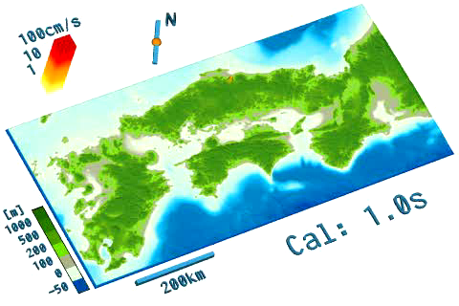
Click graph to start
Tottori: Simulations (TOTTORI_CAL.MPEG)

Slide 21

Click graph to start
Tottori: Observed (TOTTORI_OBS.MPEG)

Slide 22
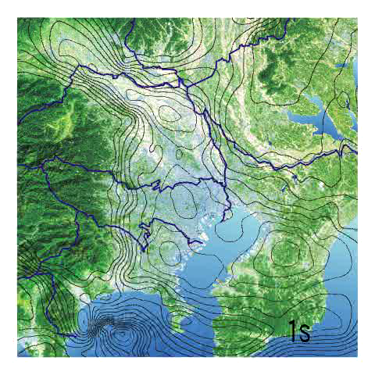
Chuetsu: Simulations in Tokyo basin (Chuetsu_simu_Tokyo.mpeg)
Click graph to start

