Slide 1
FUNDAMENTALS of ENGINEERING SEISMOLOGY
    GROUND MOTIONS FROM SIMULATIONS

Slide 2
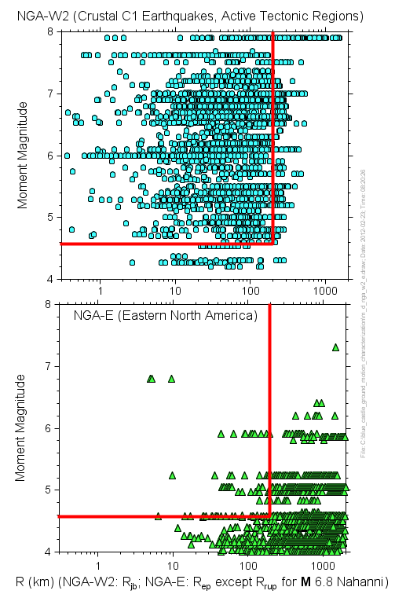
Observed data adequate for regression except
close to large ‘quakes
Observed data not adequate for regression, use simulated data

Slide 3
Ground-Motions for Regions Lacking Data from Earthquakes in Magnitude-Distance Region of Engineering Interest
Most predictions based on the stochastic method, using data from smaller earthquakes to constrain such things as path and site effects

Slide 4
Simulation of ground motions
representation theorem
source
  dynamic
  kinematic
path & site
  wave propagation
  represent with simple functions

Slide 5
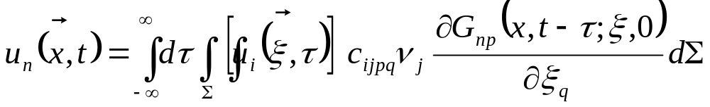
Representation Theorem
Computed ground displacement

Slide 6
Representation Theorem
Model for the slip on the fault

Slide 7
Representation Theorem
Green’s function

Slide 8
Types of simulations
Deterministic
  Purely theoretical
  Deterministic description of source
  Wave propagation in layered media
  Used for lower frequency motions
Stochastic
  Not purely theoretical
  Random source properties
  Capture wave propagation by simple functional forms
  Can use deterministic calculations for some parts
  Primarily for higher frequencies (of most engineering concern)

Slide 9
Types of simulations
Hybrid
  Meaning 1: Deterministic at low frequencies, stochastic at high frequencies
  Meaning 2: Combine empirical ground-motion prediction equations with stochastic simulations to account for differences in source and path properties (Campbell, ENA).
  Meaning 3: Stochastic source, empirical Green’s function for path and site

Slide 10
Stochastic simulations
Point source
  With appropriate choice of source scaling, duration, geometrical spreading, and distance can capture some effects of finite source
Finite source
  Many models, no consensus on the best (blind prediction experiments show large variability)
  Usually use point-source stochastic model
  Can be theoretical (many types: deterministic and/or stochastic, and can also use empirical Green’s functions)

Slide 11
The stochastic method
Overview of the stochastic method
  Time-series simulations
  Random-vibration simulations
Target amplitude spectrum
  Source: M₀, f₀, Ds, source duration
  Path: Q(f), G(R), path duration
  Site: k, generic amplification
Some practical points
Notes:
Maybe change layout of this summary; insist more on methodology for input parameters; less limitations

Slide 12
Stochastic modelling of ground-motion: Point Source
Deterministic modelling of high-frequency waves not possible (lack of Earth detail and computational limitations)
Treat high-frequency motions as filtered white noise (Hanks & McGuire , 1981).
combine deterministic target amplitude obtained from simple seismological model and quasi-random phase to obtain high-frequency motion. Try to capture the essence of the physics using simple functional forms for the seismological model. Use empirical data when possible to determine the parameters.

Slide 13
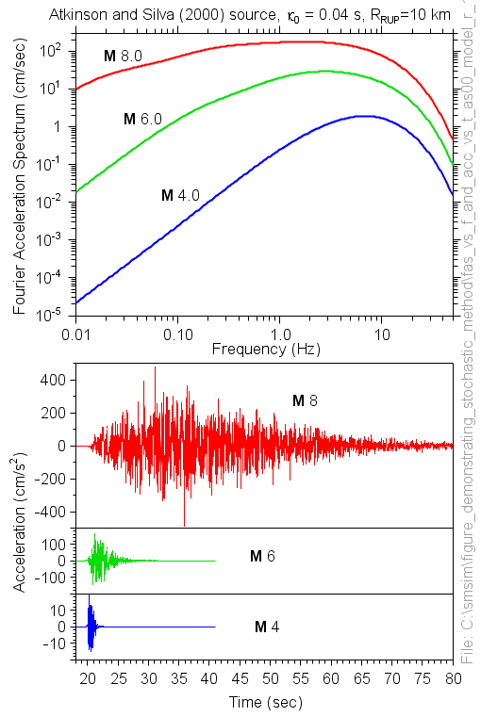
Basis of stochastic method
Radiated energy described by the spectra in the top graph is assumed to be distributed randomly over a duration given by the addition of the source duration and a distant-dependent duration that captures the effect of wave propagation and scattering of energy
These are the results of actual simulations; the only thing that changed in the input to the computer program was the moment magnitude (4, 6, and 8)

Slide 14
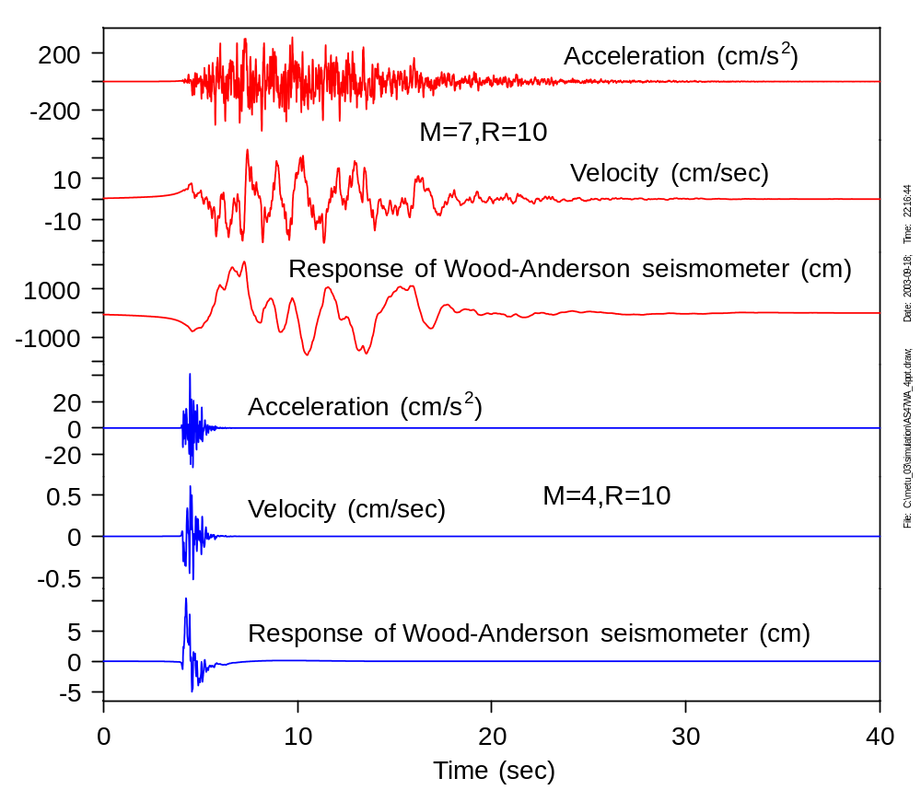
Acceleration, velocity, oscillator response for two very different magnitudes, changing only the magnitude in the input file

Slide 15
Ground motion and response parameters can be obtained via two separate approaches:
  Time-series simulation:
    Superimpose a quasi-random phase spectrum on a deterministic amplitude spectrum and compute synthetic record
    All measures of ground motion can be obtained
  Random vibration simulation:
    Probability distribution of peaks is used to obtain peak parameters directly from the target spectrum
    Very fast
    Can be used in cases when very long time series, requiring very large Fourier transforms, are expected (large distances, large magnitudes)
    Elastic response spectra, PGA, PGV, PGD, equivalent linear (SHAKE-like) soil response can be obtained

Slide 16
“The Stochastic method has a long history of performing better than it should in terms of matching observed ground-motion characteristics. It is a simple tool that combines a good deal of empiricism with a little seismology and yet has been as successful as more sophisticated methods in predicting ground-motion amplitudes over a broad range of magnitudes, distances, frequencies, and tectonic environments. It has the considerable advantage of being simple and versatile and requiring little advance information on the slip distribution or details of the Earth structure. For this reason, it is not only a good modeling tool for past earthquakes, but a valuable tool for predicting ground motion for future events with unknown slip distributions.”
--Motazedian and Atkinson (2005)

Slide 17
Time-domain simulation

Slide 18
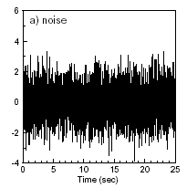
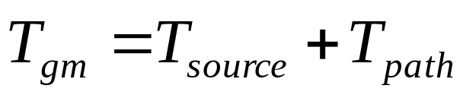
Step 1: Generation of random white noise
Aim: Signal with random phase characteristics
Probability distribution for amplitude
  Gaussian (usual choice)
  Uniform
Array size from
  Target duration
  Time step (explicit input parameter)

Slide 19
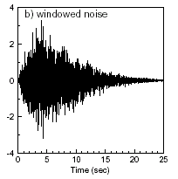
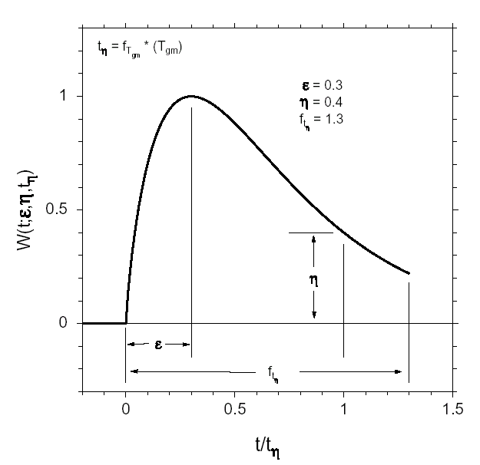
Step 2: Windowing the noise
Aim: produce time-series that look realistic
Windowing function
  Boxcar
  Cosine-tapered boxcar
  Saragoni & Hart (exponential)

Slide 20
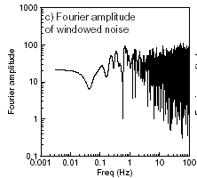
Step 3: Transformation to frequency-domain
FFT algorithm

Slide 21
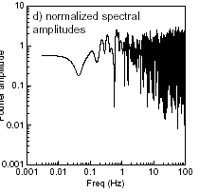
Step 4: Normalisation of noise spectrum
Divide by rms integral
Aim of random noise generation = simulate random PHASE only
Normalisation required to keep energy content dictated by deterministic amplitude spectrum

Slide 22
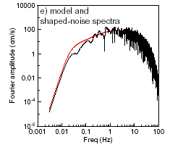
Step 5: Multiply random noise spectrum by deterministic target amplitude spectrum
Normalised amplitude spectrum of noise with random phase characteristics
Y(M₀,R,f)
=
E(M₀,f)
X
P(R,f)
X
G(f)
X
I(f)
TARGET
FOURIER
AMPLITUDE
SPECTRUM
Earthquake source
Propagation path
Site response
Instrument or ground motion

Slide 23
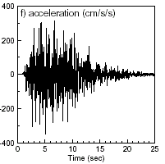
Step 6: Transformation back to time-domain
Numerical IFFT yields acceleration time series
Manipulation as with
empirical record
1 run = 1 realisation of random process
  Single time-history not necessarily realistic
  Values calculated =
  average over N simulations
  (N large enough to yield an accurate value of ground-motion intensity measure)

Slide 24
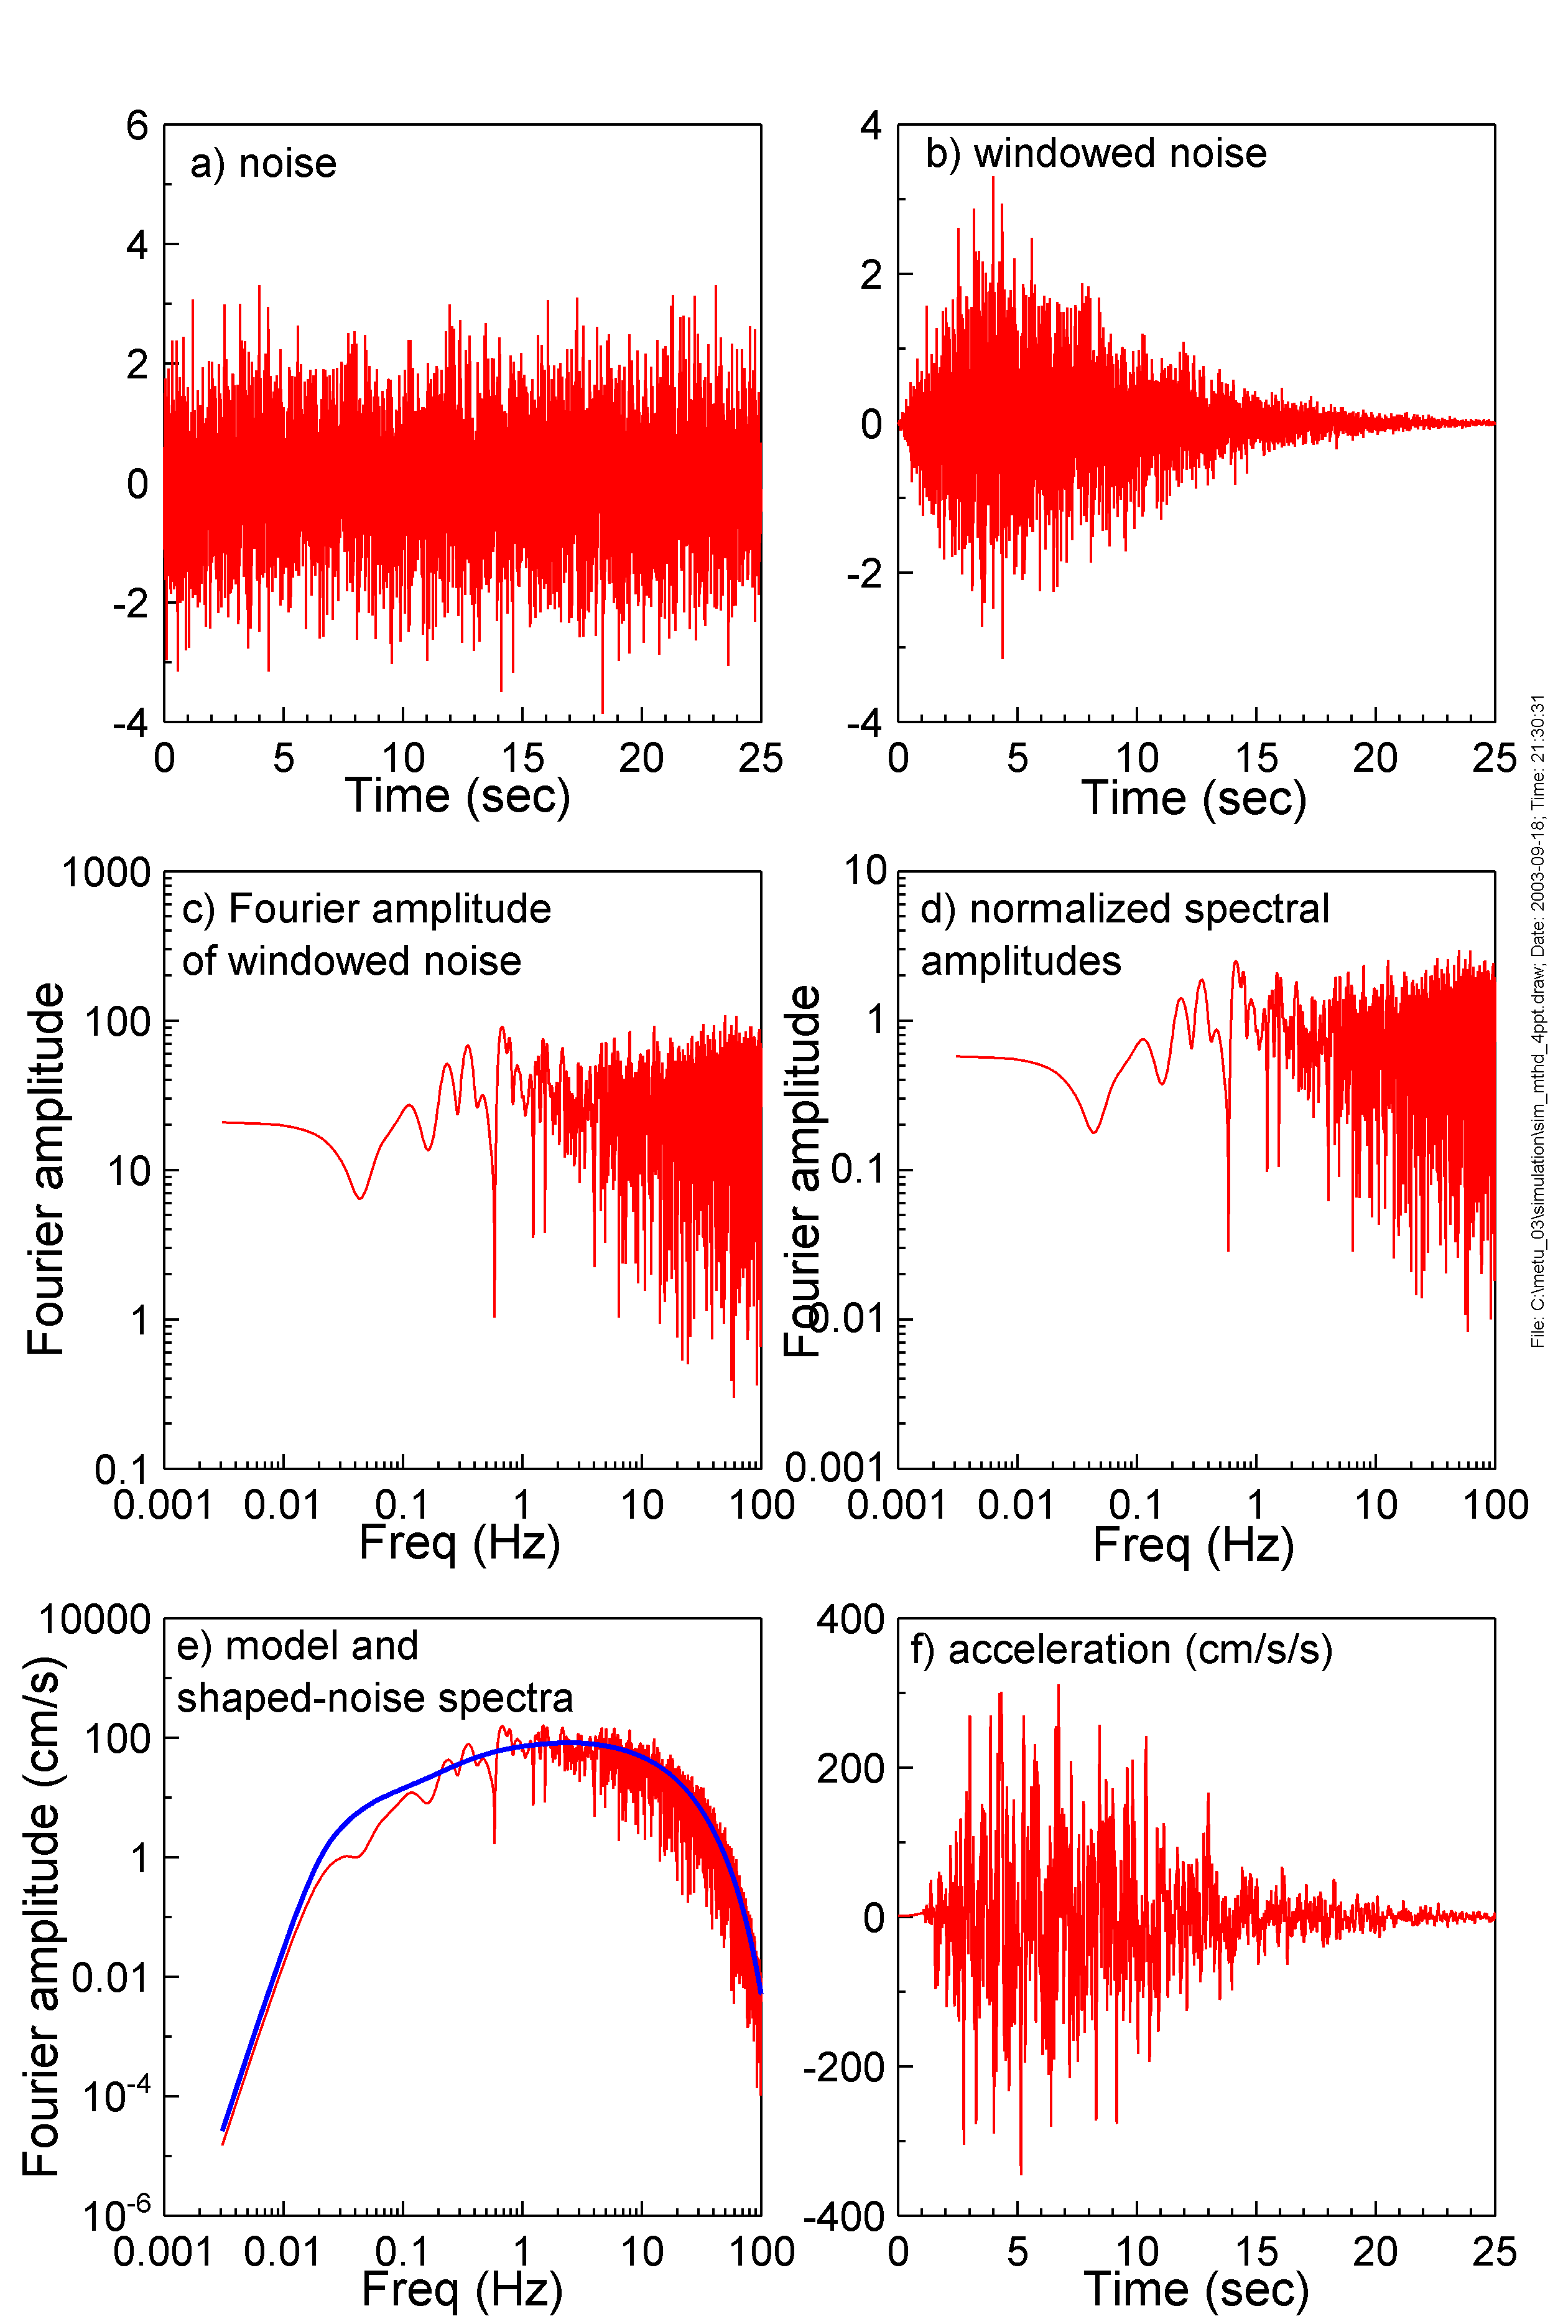
Steps in simulating time series
Generate Gaussian or uniformly distributed random white noise
Apply a shaping window in the time domain
Compute Fourier transform of the windowed time series
Normalize so that the average squared amplitude is unity
Multiply by the spectral amplitude and shape of the ground motion
Transform back to the time domain

Slide 25
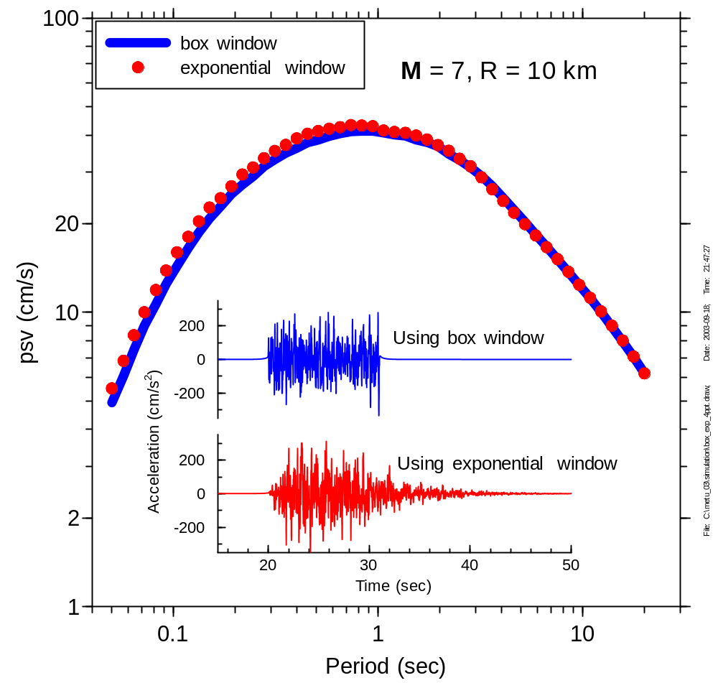
Effect of shaping window on response spectra

Slide 26
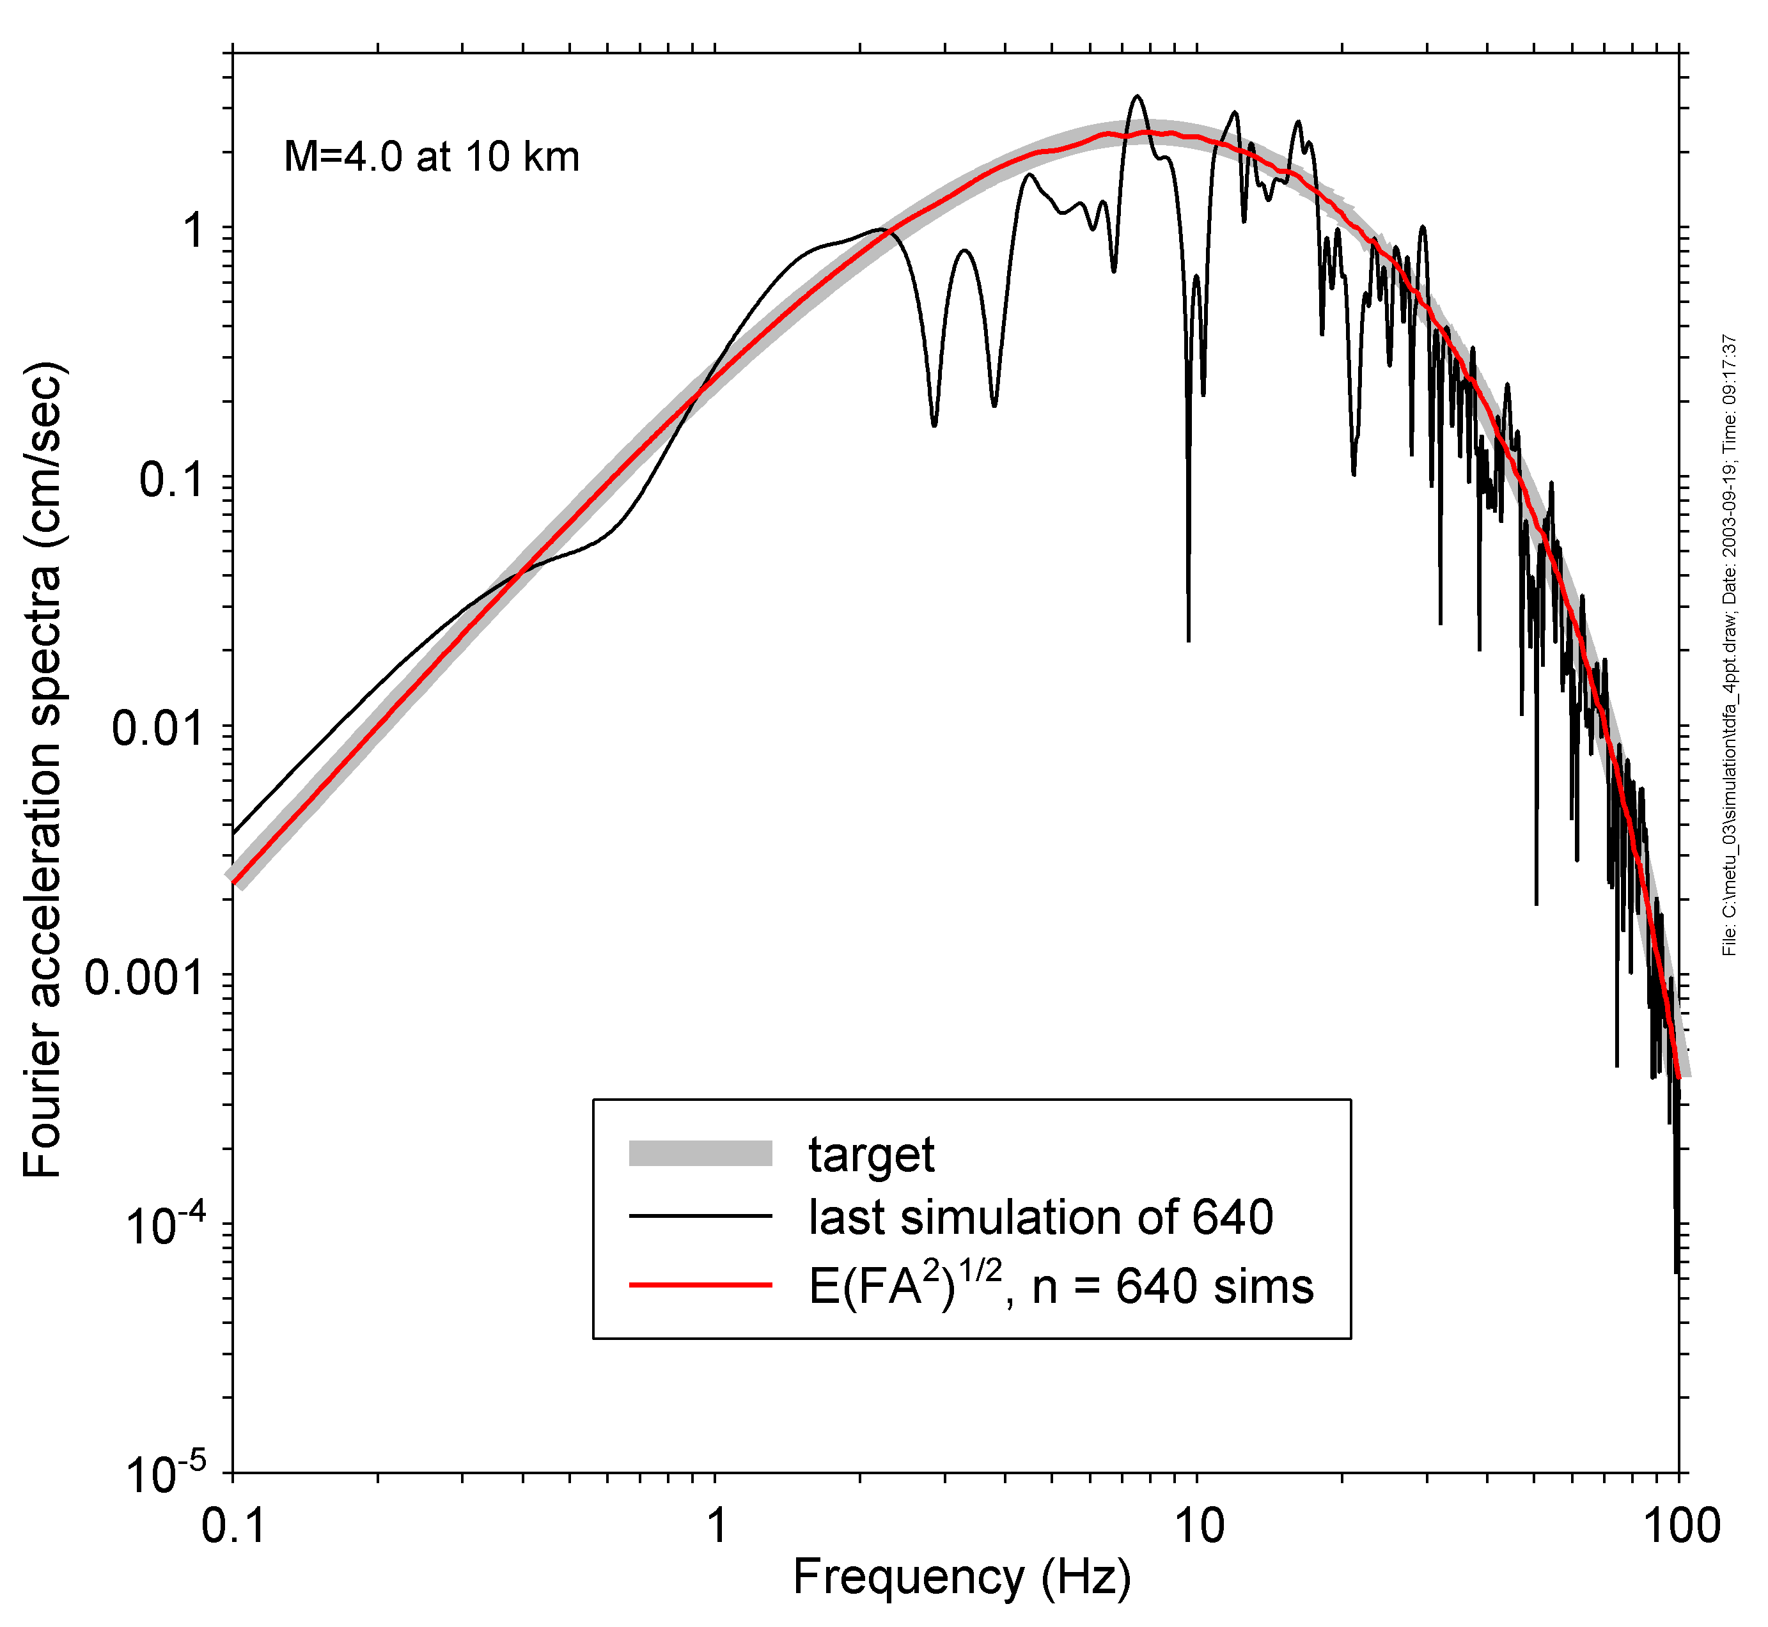
Warning: the spectrum of any one simulation may not closely match the specified spectrum. Only the average of many simulations is guaranteed to match the specified spectrum

Slide 27
Random Vibration Simulation

Slide 28
Random Vibration Simulations - General
Aim:
  Improve efficiency by using Random Vibration Theory to model random phase
Principle:
  no time-series generation
  peak measure of motion obtained directly from deterministic Fourier amplitude spectrum through rms estimate

Slide 29
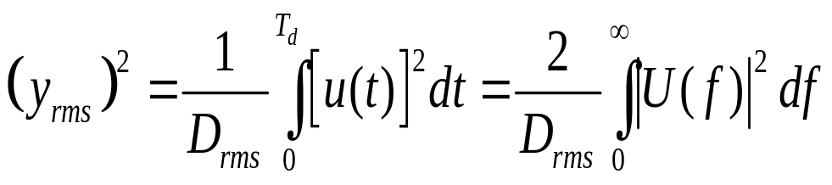
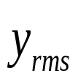

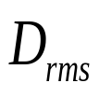
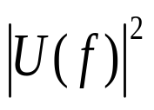
y_{rms} is easy to obtain from amplitude spectrum:
Parseval's theorem
is root-mean-square motion
Is ground-motion time series (e.g., accel. or osc. response)
is a duration measure
is Fourier amplitude spectrum of ground motion
But need extreme value statistics to relate rms acceleration to peak time-domain ground-motion intensity measure (y_{max})

Slide 30
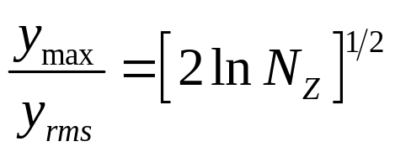

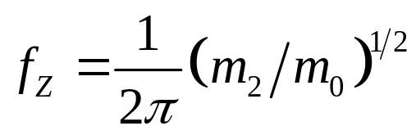
Peak parameters from random vibration theory:
For long duration (D) this equation gives the peak motion given the rms motion:
where
m₀ and m₂ are spectral moments, given by integrals over the Fourier spectra of the ground motion

Slide 31
Random Vibration Simulation – Possible Limitations
Neither stationarity nor uncorrelated peaks assumption true for real earthquake signal
Nevertheless, RV yields good results at greatly reduced computer time
Problems essentially with
  Long-period response
  Lightly damped oscillators
  Corrections developed

Slide 32
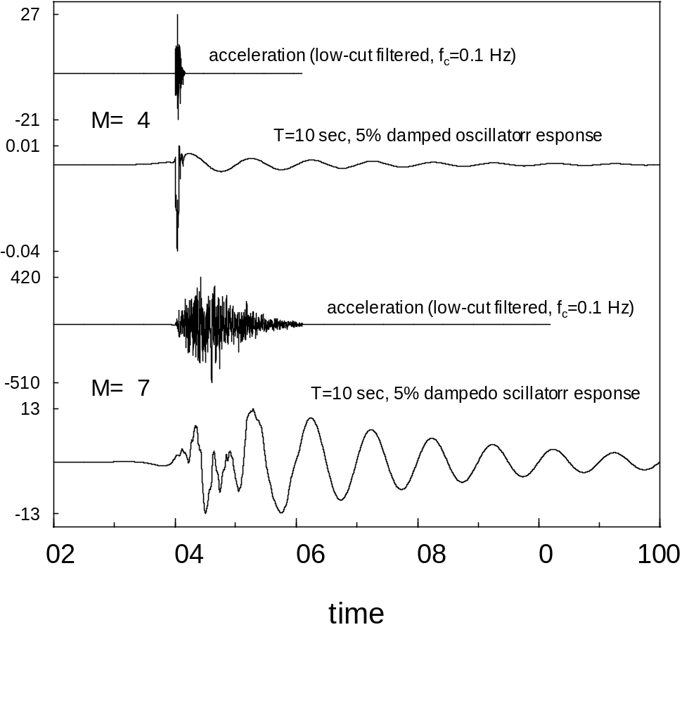
Special consideration needs to be given to choosing the proper duration T to be used in random vibration theory for computing the response spectra for small magnitudes and long oscillator periods. In this case the oscillator response is short duration, with little ringing as in the response for a larger earthquake. Several modifications to rvt have been published to deal with this.

Slide 33
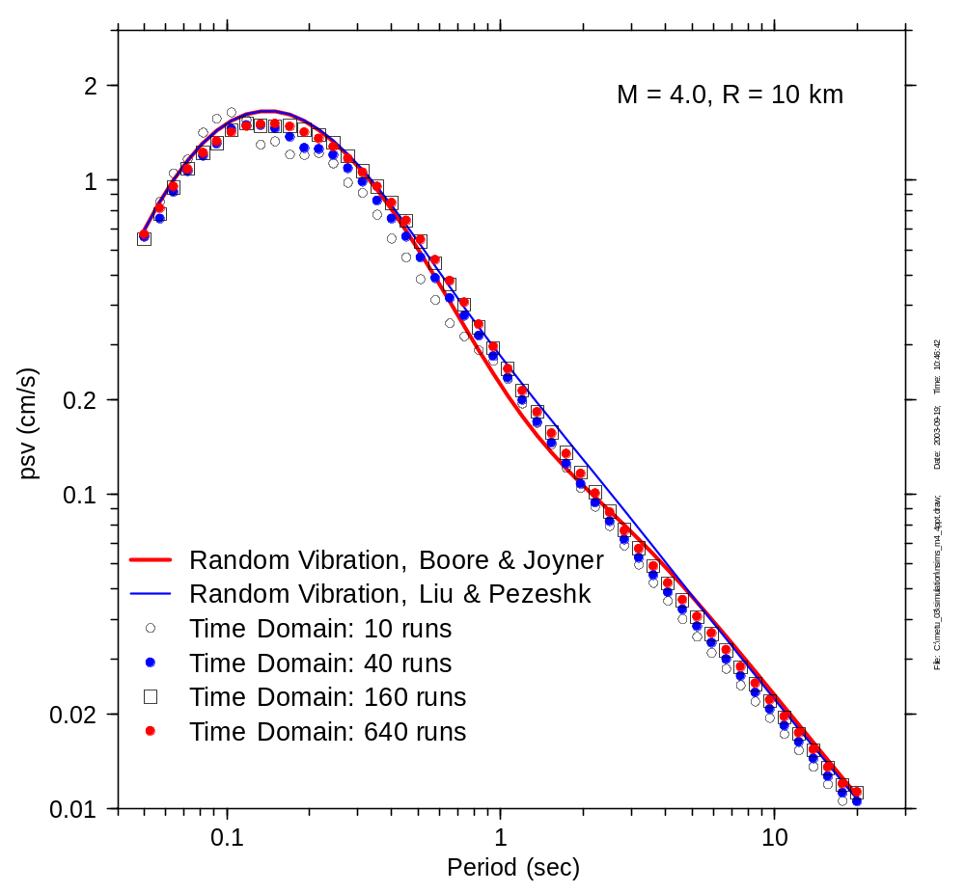
Comparison of time domain and random vibration calculations, using two methods for dealing with nonstationary oscillator response.
For M = 4, R = 10 km

Slide 34
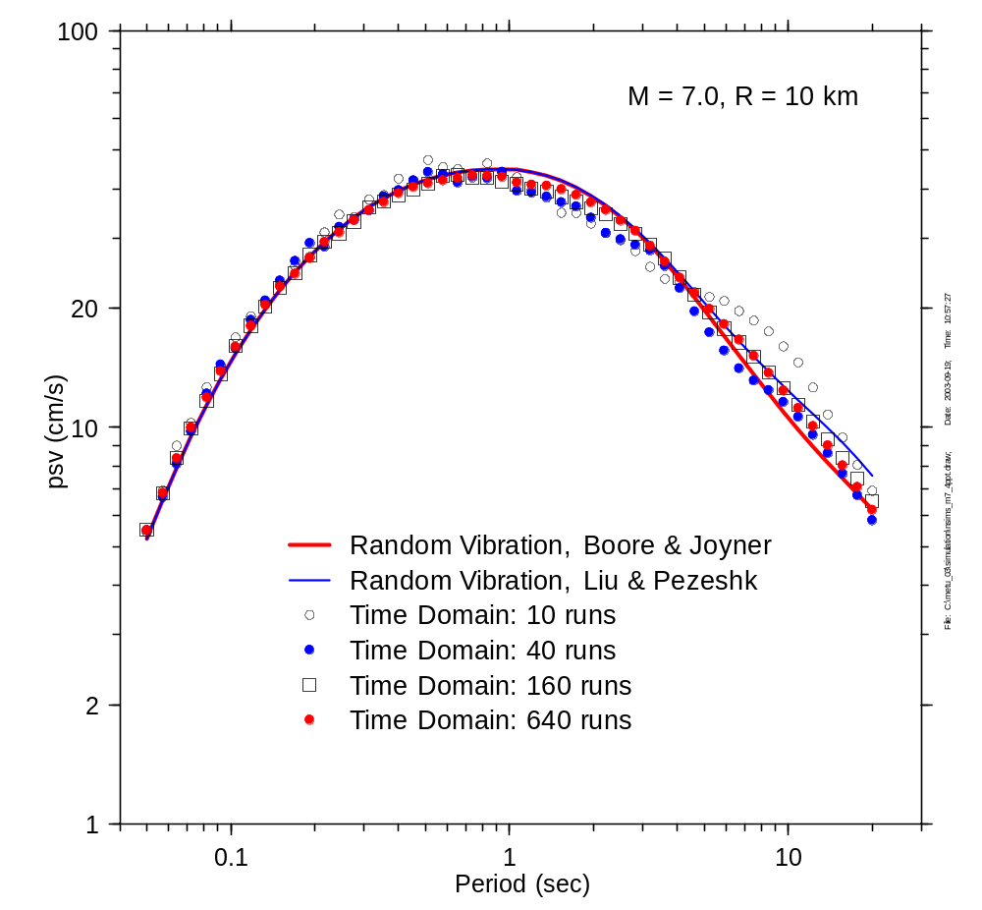
Comparison of time domain and random vibration calculations, using two methods for dealing with nonstationary oscillator response.
For M = 7, R = 10 km

Slide 35
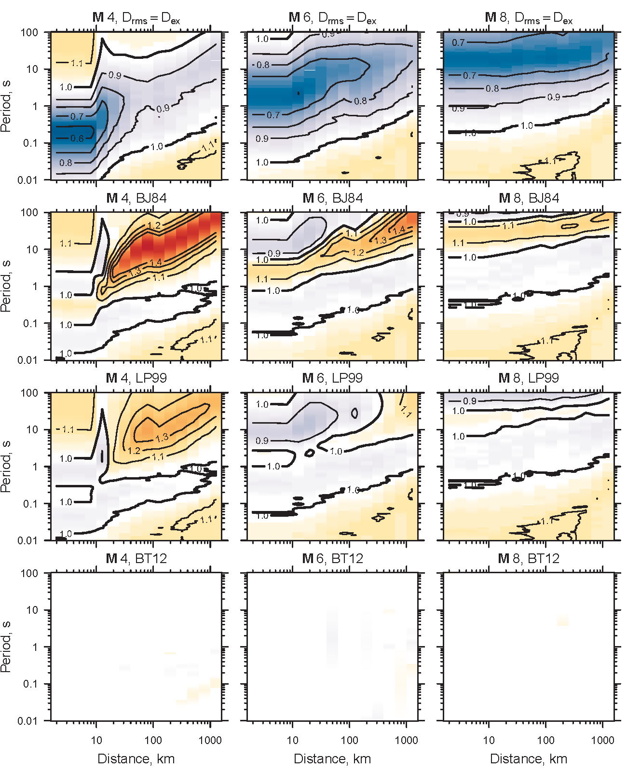
Recent improvements on determining D_{rms} (Boore and Thompson, 2012):
Contour plots of TD/RV ratios for an ENA SCF 250 bar model for 4 ways of determining D_{rms}:
D_{rms} = D_{ex}
BJ84
LP99
BT12

Slide 36
Target amplitude spectrum
Deterministic function of source, path and site characteristics represented by separate multiplicative filters
Earthquake source
Propagation path
Site response
Instrument or ground motion
THE KEY TO THE SUCCESS OF THE MODEL LIES IN BEING ABLE TO DEFINE FOURIER ACCELERATION SPECTRUM AS F(M, DIST)

Slide 37
Parameters required to specify Fourier accn as f(M,dist)
Model of earthquake source spectrum
Attenuation of spectrum with distance
Duration of motion [=f(M, d)]
Crustal constants (density, velocity)
Near-surface attenuation (fmax or kappa)

Slide 38
Stochastic method
To the extent possible the spectrum is given by seismological models
Complex physics is encapsulated into simple functional forms
Empirical findings can be easily incorporated

Slide 39
Source Function

Slide 40
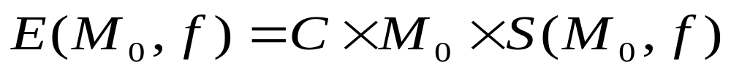
Source function E(M₀, f)
Scaling constant
near-source crustal properties
assumptions about wave-type considered (e.g. SH)
Source DISPLACEMENT
Spectrum
Scaling of amplitude spectrum with earthquake size
Seismic moment
Measure of earthquake size

Slide 41
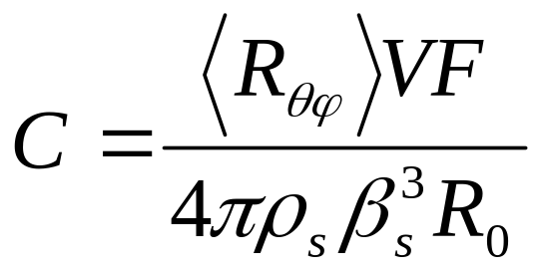
Scaling constant C (frequency independent)
β_{s} = near-source shear-wave velocity
ρ_{s} = near-source crustal density
V = partition factor
(R_{θφ}) = average radiation pattern
F = free surface factor
R₀ = reference distance (1 km).

Slide 42
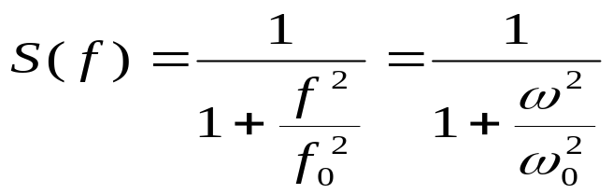
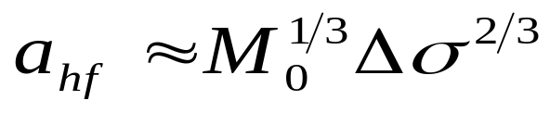
Brune source model
Brune’s point-source model
  Good description of small, simple ruptures
  "surprisingly good approximation for many large events". (Atkinson & Beresnev 1997)
Single-corner frequency model
High-frequency amplitude of acceleration scales as:

Slide 43
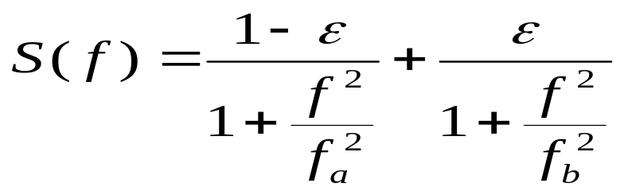
Semi-empirical two-corner-frequency models
Aim: incorporate finite-source effects by refining the source scaling
Example: AB95 & AS00 models
Keep Brune's HF amplitude scaling
  f_{a}, f_{b} and e determined empirically (visual inspection & best-fit)

Slide 44
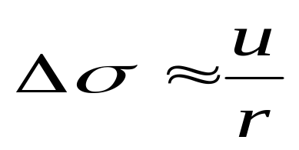
Stress parameter: definitions
"Stress drop" should be reserved for static measure of slip relative to fault dimensions
"Brune stress drop" = change in tectonic (static) stress due to the event
"SMSIM stress parameter" = “parameter controlling strength of high-frequency radiation” (Boore 1983)
u = average slip
r = characterisic fault dimension

Slide 45
Stress parameter - Values
SMSIM stress parameter
  California: 50 - 200 bar
  ENA: 150 – 1000 bar
    (greater uncertainty)

Slide 46
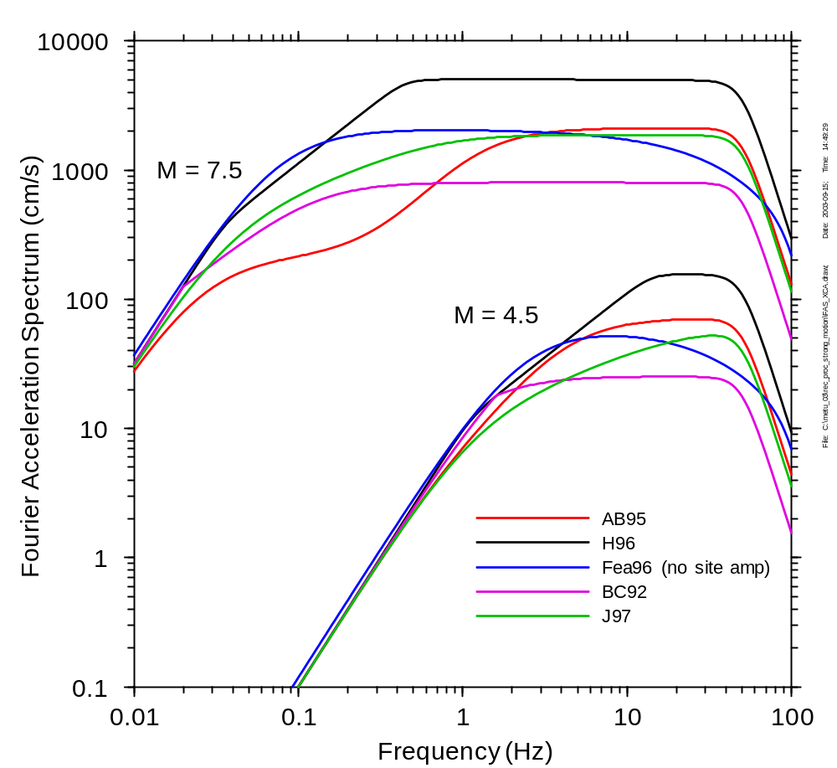
The spectra can be more complex in shape and dependence on source size. These are some of the spectra proposed and used for simulating ground motions in eastern North America. The stochastic method does not care which spectral model is used. Providing the best model parameters is essential for reliable simulation results (garbage in, garbage out).

Slide 47
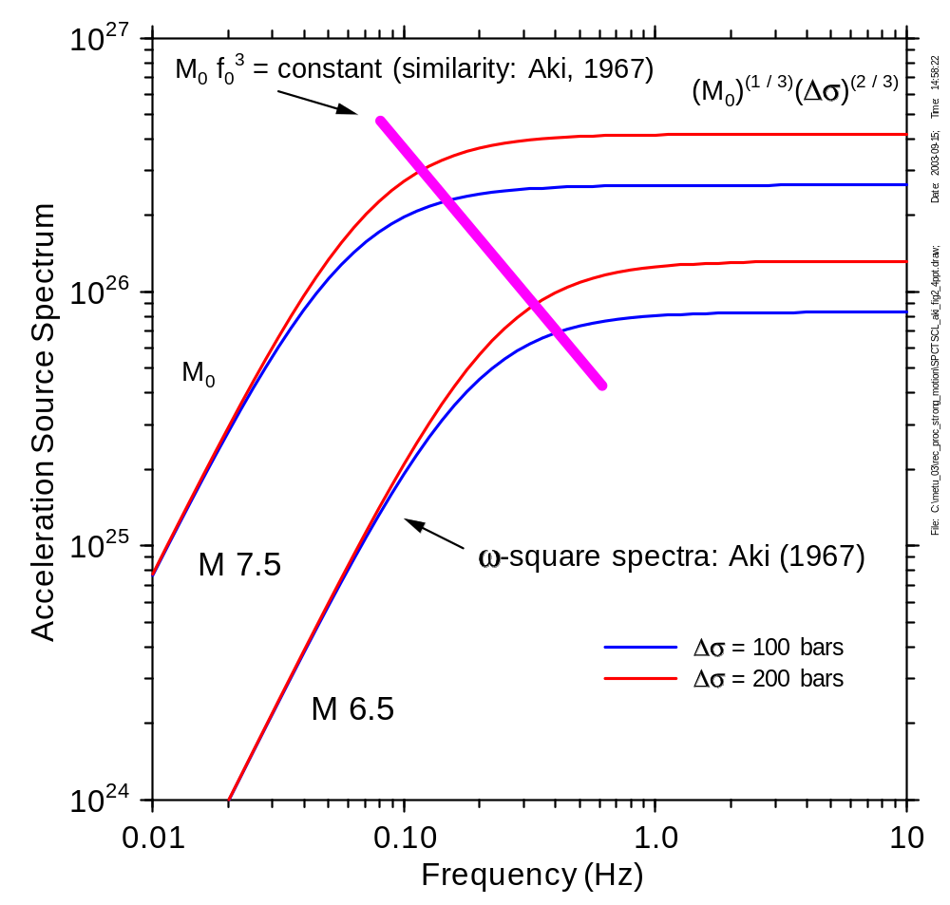
Source Scaling
Low frequency
  A≈ M₀, but log M₀ ≈ 1.5M, so A ≈ 10^{1.5M}. This is a factor of 32 for a unit increase in M
High frequency
  A ≈ M₀^{(1/3)}, but log M₀ ≈ 1.5M, so A ≈ 10^{0.5M}. This is a factor of 3 for a unit increase in M
Ground motion at frequencies of engineering interest does not increase by 10x for each unit increase in M
The key is to describe how the corner frequencies vary with M. Even for more complex sources, often try to relate the high-frequency spectral level to a single stress parameter

Slide 48
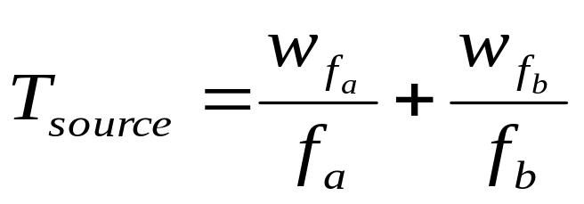
Source duration
Determined from source scaling model via:
  For single-corner model, f_{a}= f_{b} = f₀

Slide 49
Path Function

Slide 50
Path function P(R, f)
Geometrical
Spreading (R)
Anelastic Attenuation (R,f)
P(R,f)
=
Point-source => spherical wave
Propagation medium is neither perfectly elastic nor perfectly homogeneous
Loss of energy through material damping & wave scattering by heterogeneities
Loss of energy through spreading of the wavefront

Slide 51
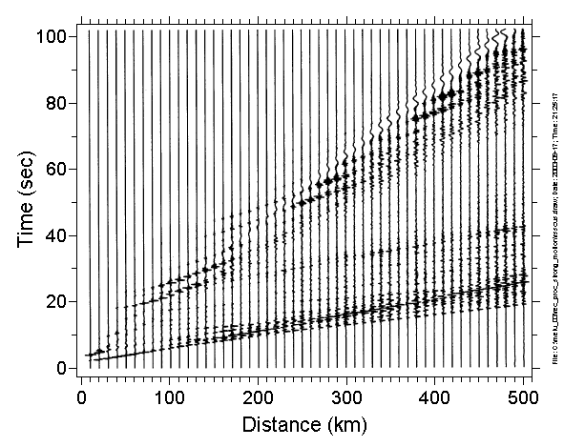
Wave propagation produces changes of amplitude (not shown here) and increased duration with distance. Not included in these simulations is the effect of scattering, which adds more increases in duration and smooths over some of the amplitude changes (as does combining propagation over various profiles with laterally changing velocity)

Slide 52
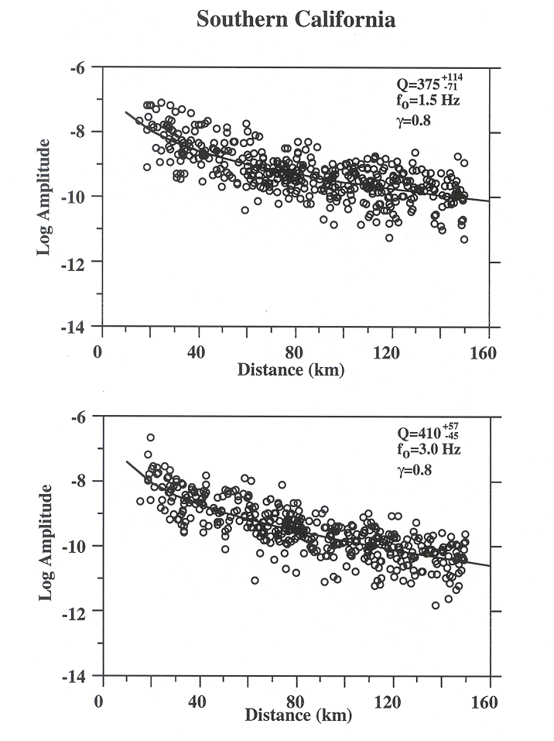
The overall behavior of complex path-related effects can be captured by simple functions, leaving aleatory scatter. In this case the observations can be fit with a simple geometrical spreading and a frequency-dependent Q operator

Slide 53
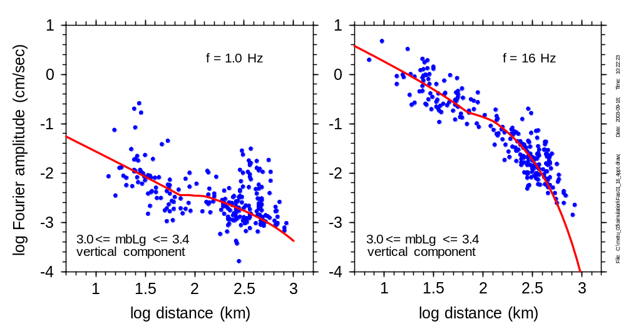
In eastern North America a more complicated geometrical spreading factor is needed (here combined with the Q operator)

Slide 54
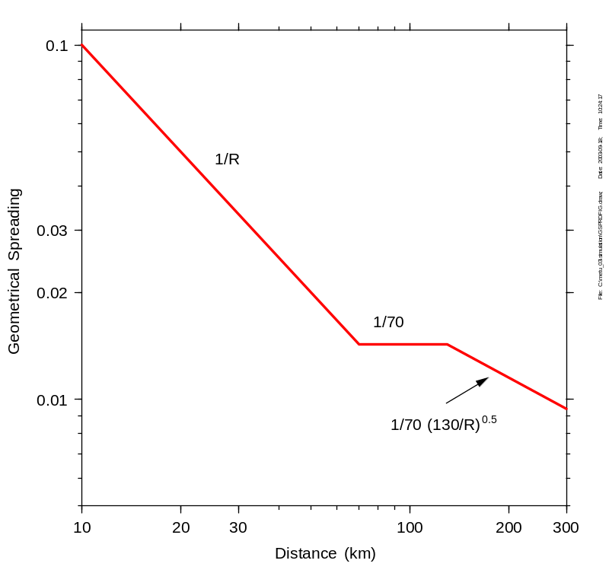
Geometrical Spreading Function
Often 1/R decay (spherical wave), at least within a few tens of km
At greater distances, the decay is better characterised by 1/R^{α} with α <1
SMSIM allows n segment piecewise linear function in log (amplitude) – log (R) space
Magnitude-dependent slopes possible : allows to capture finite-source effect (Silva 2002)
Example: Boore & Atkinson 1995 Eastern North America model

Slide 55
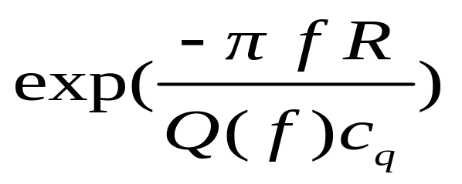
Path-dependent anelastic attenuation
Form of filter:
  Q(f) = « quality factor » of propagation medium in terms of (shear) wave transmission
  c_{q}= velocity used to derive Q; often taken equal to βs
  (not strictly true – depends on source depth)
  N.B. Distance-independent term (kappa) removed since accounted for elsewhere

Slide 56
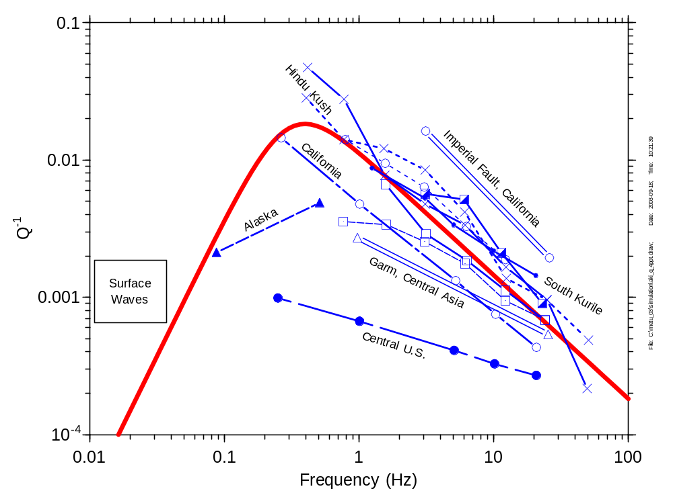
Observed Q from around the world, indicating general dependence on frequency

Slide 57
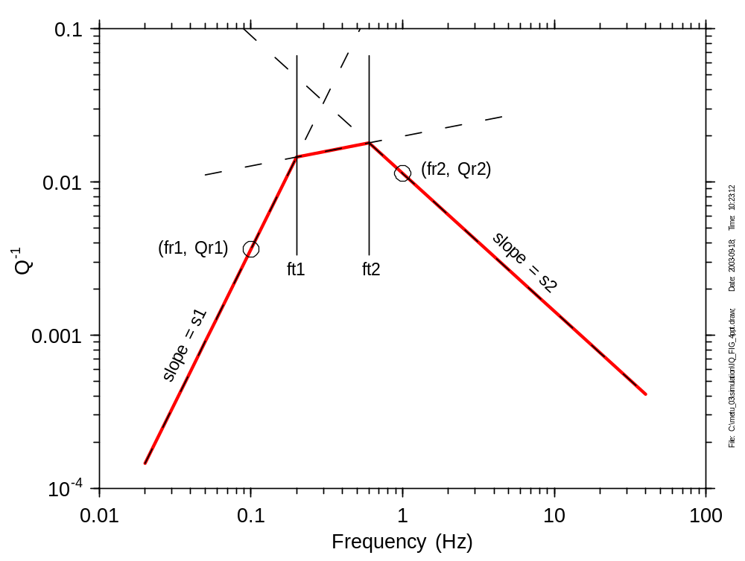
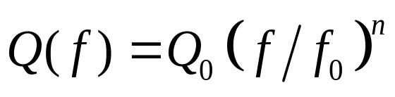
Wave-transmission quality factor Q(f)
Form usually assumed:
Study of published relations led Boore to assign 3-segment piecewise linear form (in log-log space)

Slide 58
Empirical determination of Q(f)
Assuming simple functional forms for source function and geometrical spreading function (e.g. Brune model & 1/R decay)
  Source-cancelling (for constant Q)
  Best fit for assumed functional form (Q=Q₀f^{n})
Simultaneous inversion of source, path and site effects
  One unconstrained dimension => additional assumption required (e.g. site amplification)
Trade-off problems

Slide 59
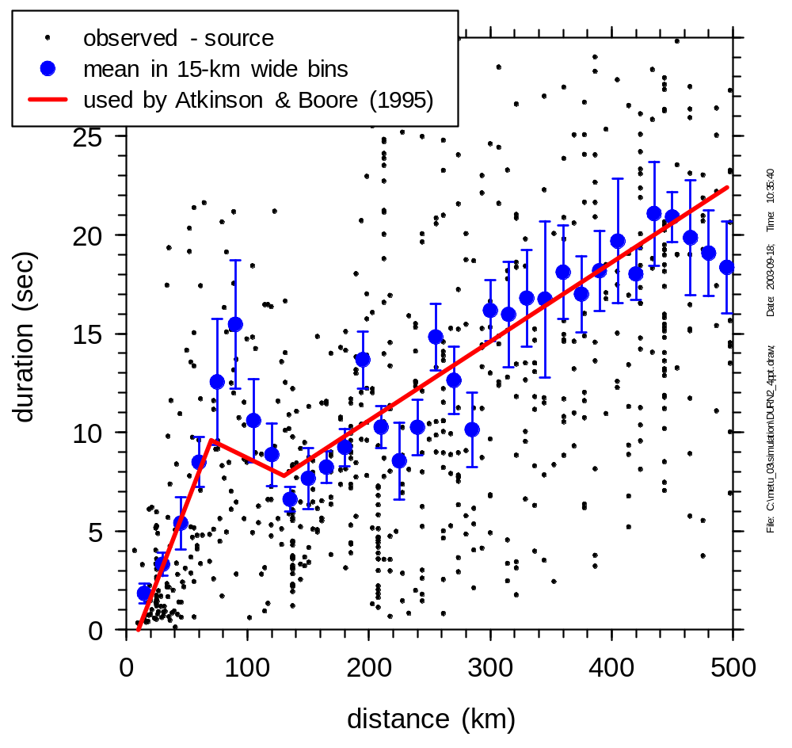
Path duration
Required for array size
Usually assumed linear with distance
SMSIM allows representation by a piecewise linear function
Regional characteristic, should be determined from empirical data
Example: AB95 for ENA

Slide 60
Site Response Function

Slide 61
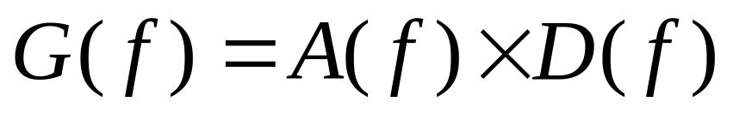
Site response
Form of filter:
Regional distance-independent attenuation (high frequency)
  Near-surface anelastic attenuation?
  Source effect?
  Combination?
Linear amplification for GENERIC site

Slide 62
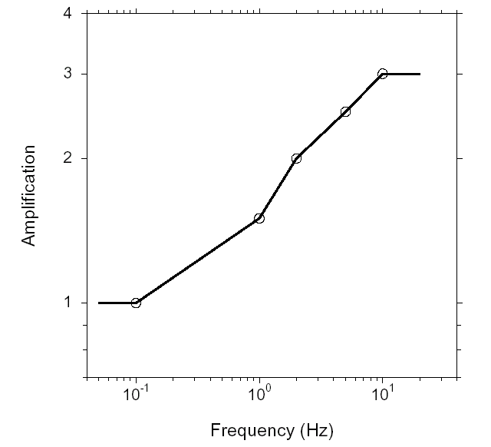
Site amplification
Attenuation function for GENERIC site
Modelled as a piecewise linear function in log-log space
Soil non-linearity effects not included
Determined from crustal velocity & density profile via SITE_AMP
  Square-root of impedance approximation
  Quarter-wave-length approximation (f – dependent)

Slide 63
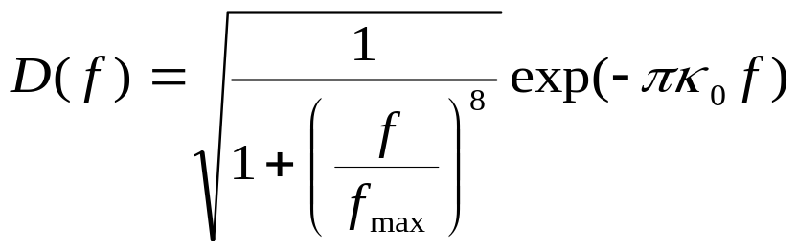
Site attenuation
Form of filter:
Reflects lack of consensus about representation
  f_{max} (Hanks, 1982) : high-frequency cut-off
  κ₀ (Anderson & Hough, 1984) : high-frequency decay
  Both factors seldom used together

Slide 64
Cut-off frequency f_{max}
Hanks (1982)
  Observed empirical spectra exhibit cut-off in log-log space
  Value of cut-off in narrow range of frequency
  Attributed to site effect
Other authors (e.g. Papageorgiou & Aki 1983) consider f_{max} to be a source effect
Boore’s position:
  Multiplicative nature of filter allows for both approaches
  Classification as site effect = « book-keeping » matter
  Often set to a high value (50 to 100 Hz) when preference is given to the kappa filter

Slide 65
Kappa factor κ₀
Anderson & Hough (1984)
  empirical spectra plotted in semi-log axes exhibit exponential HF decay
  rate of this decay = κ (varies with distance)
Treatment in SMSIM
  similar determination, but with records corrected for path effects and site amplification
  parameter used = κ₀ = zero-distance intercept
  allowed to vary with magnitude
    source effect (at least partly)
    trade-off with source strength (characteristic of regional surface geology)

Slide 66
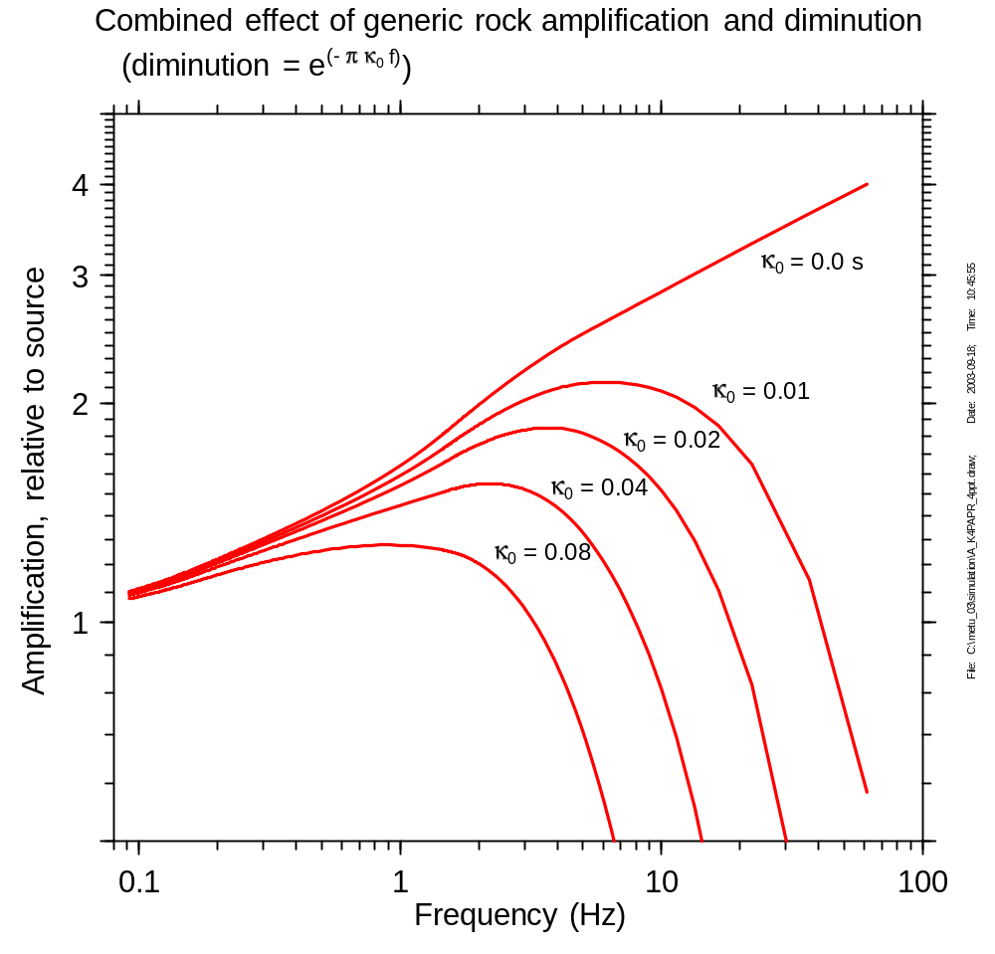
Site response is represented by a table of frequencies and amplifications. Shown here is the generic rock amplification for coastal California (k = 0.04), combined with the k diminution factor for various values of k

Slide 67
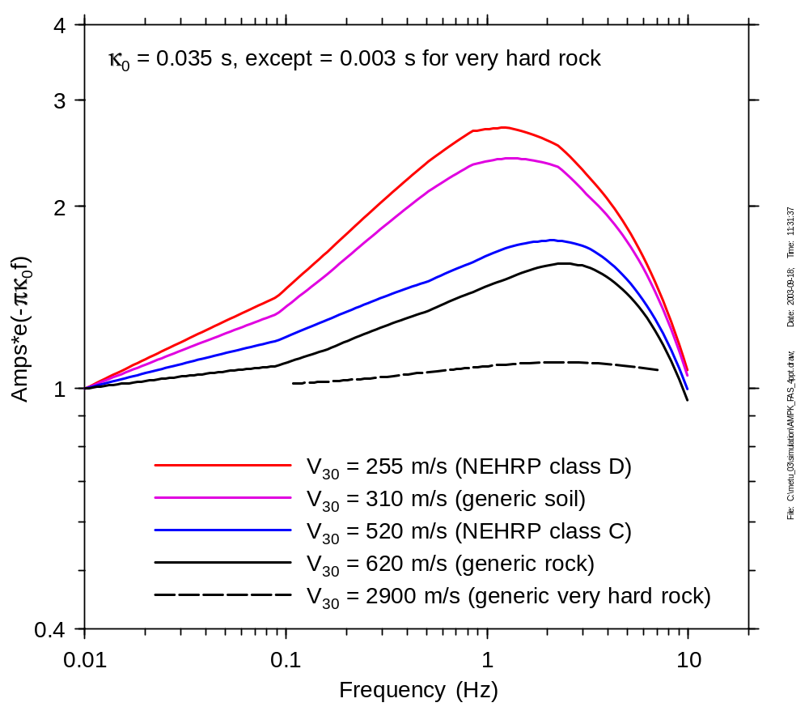
Combined amplification and diminution filter for various average site classes

Slide 68
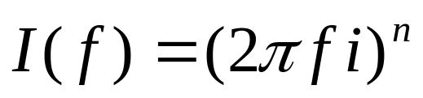
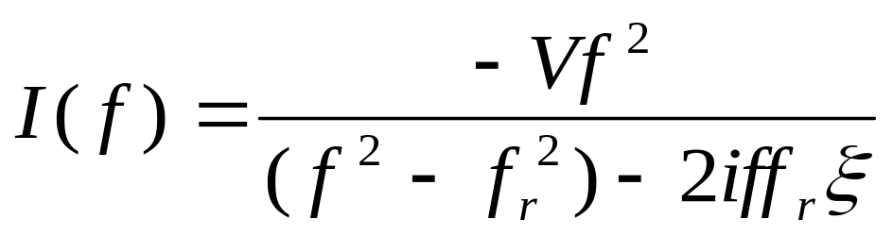
Instrument/Ground motion filter
For ground-motion simulations:
n=0 displacement
n=1 velocity
n=1 acceleration
i² = 1
For oscillator response:
f_{r} = undamped natural frequency
ξ = damping
V = gain
(for response spectra, V=1).

Slide 69
Summary of Parameters Needed for Stochastic Simulations

Slide 70

Parameters needed for Stochastic Simulations
Frequency-independent parameters
  Density near the source
  Shear-wave velocity near the source
  Average radiation pattern
  Partition factor of motion into two components (usually )
  Free surface factor (usually 2)

Slide 71
Parameters needed for Stochastic Simulations
Frequency-dependent parameters
  Source:
    Spectral shape (e.g., single corner frequency; two corner frequency)
    Scaling of shape with magnitude (controlled by the stress parameter Δσ for single-corner-frequency models)

Slide 72
Parameters needed for Stochastic Simulations
Frequency-dependent parameters
  Path (and site):
    Geometrical spreading (multi-segments?)
    Q (frequency-dependent? What shear-wave and geometrical spreading model used in Q determination?)
    Duration
    Crustal amplification (can include local site amplification)
    Site diminution (fmax? κ₀?)
correlated

Slide 73
Parameters needed for Stochastic Simulations
RV or TD parameters
  Low-cut filter
  RV
    Integration parameters
    Method for computing D_{rms}
    Equation for y_{max}/y_{rms}
  TD
    Type of window (e.g., box, shaped?)
    dt, npts, nsims, etc.

Slide 74
Parameters that might be obtained from empirical analysis of small earthquake data
Focal depth distribution
Crustal structure
  S-wave velocity profile
  Density profile
Path Effects
  Geometrical spreading
  Q(f)
  Duration
  κ₀
  Site characteristics

Slide 75
Parameters difficult to obtain from small earthquake data
Source Spectral Shape
Scaling of Source Spectra (including determination of Δσ)

Slide 76
Some points to consider
Uncertainty
  Specify parametric uncertainty when giving an estimate from empirical data
Trade-offs between parameters
  Δσ and κ₀ (or similar)
  Geometrical spreading & anelastic attenuation
  Site amplification and κ₀
  always state assumptions
Consistency more important than uniqueness

Slide 77
Applicability of Point Source Simulations near Extended Ruptures
Modify the value of R_{rup} used in point source, to account for finite fault effects
  Use R_{eff} (similar to R_{rms}) for a particular source-station geometry)
  Use a more generic modification, based on finite-fault modeling (e.g., Atkinson and Silva, 2000; Toro, 2002)

Slide 78

Use a scenario-specific modification to R_{rup}
(note: No directivity---EXSIM results are an average of motions from 100 random hypocenters)
Modified from Boore (2010)

Slide 79

Using generic modifications to R_{rup}. For the situation in the previous slide (M 7, R_{rup} = 2.5):
R_{eff} = 10.3 km for AS00
R_{eff} = 8.4 km for T02
Compared to R_{eff} = 10.3 (off tip) and 6.7 (normal) in the previous slide

Slide 80
A few applications
Scaling of ground motion with magnitude
Simulating ground motions for a specific M, R
Extrapolating observed ground motion to part of M, R space with no observations

Slide 81
Other applications of the stochastic method
Generate motions for many M, R; use regression to fit ground-motion prediction equations (used in U.S. National Seismic Hazard Maps)
Design-motion specification for critical structures
Derive parameters such as Δσ, κ, from strong-motion data

Slide 82
Other applications of the stochastic method
Studies of sensitivity of ground motions to model parameters
Relate time-domain and frequency-domain measures of ground motion
Generate time series for use in nonlinear analysis of structures and site response
Use to compute motions from subfaults in finite-fault simulations

Slide 83

Application: study magnitude scaling for a fixed distance
Note that response of long period oscillators is more sensitive to magnitude than short period oscillators, as expected from previous discussions. Also note the nonlinear magnitude dependence for the longer period oscillators.

Slide 84

Magnitude scaling
Expected scaling for simplest self-similar model. Does this imply a breakdown in self similarity? The simulations were done for a fixed close distance, and more simulations are needed at other distances to be sure that a M-dependent depth term is not contributing.

Slide 85

Applications:
extrapolating small earthquake motion to large earthquake motion (makes use of path and site effects in the small ‘quake recording)
predict response spectra for two magnitudes without use of the observed recording
Note comparison with empirical prediction equations and importance of basin waves (not in simulations)

Slide 86

Observed data adequate for regression except
close to large ‘quakes
Observed data not adequate for regression, use simulated data
This is a major application of stochastic simulations

Slide 87
Some observations about predicting ground motions
Empirical analysis:
  Adequate data in some places for M around 7
  Lacking data at close distances to large earthquakes
  Lacking data in most parts of the world
  May be possible to “export” relations from data-rich areas to tectonically similar regions
  Need more data to resolve effects such as nonlinear soil response, breakdown of similarity in scaling with magnitude, directivity, fault normal/fault parallel motions, style of faulting, etc.
Stochastic method:
  Very useful for many applications
  Source specification for one region might be used for predictions in another region
  Can use motions from more abundant smaller earthquakes to define path, site effects
  Site effects, including nonlinear response, might be exportable from data-rich regions
Hybrid method combining empirical and theoretical predictions can be very useful

Slide 88
Some Limitations to Point-Source Model (“A kindergarten model”—A. Frankel)
Faults are not points
No spatial coherence
No correlation between components
Inadequate period-to-period correlation
Etc.

Slide 89
Finite Faults
Stochastic
  Silva
  Zeng et al.
  Papageorgiou & Aki
  Beresnev & Atkinson (FINSIM)
  Motazedian & Atkinson (EXSIM)
  Pacor, Cultrera, Mendez, & Cocco (DSM)
  Irikura et al.
  Etc.
Deterministic + Stochastic
  Graves et al.
  Frankel
  Pacor et al. ? (simple Green’s function, does not include wave propagation effects)
  Etc.

Slide 90

Extension of stochastic model to finite faults (Silva; Beresnev and Atkinson; Motazedian and Atkinson, Pacor et al.)

Slide 91
Parameters needed to apply stochastic finite-fault model
All parameters needed for stochastic point source model
Geometry of source (can assume fault plane based on empirical relations such as Wells and Coppersmith on fault length and width vs. M)
Direction of rupture propagation (can assume random or bilateral)
Slip distribution on fault (can assume random)
Can also incorporate ‘self-healing’ slip behaviour

Slide 92
Summary
Stochastic models are a useful tool for interpreting ground motion records and developing ground motion relations
Model parameters need careful validation
Point-source models appropriate for small magnitudes, and work pretty well on average for large magnitudes IF an adjustment is made to the distance (and perhaps to the shape of the source spectrum
Finite-fault models preferable for large earthquakes (M>6) because they can model more realistic fault behaviour

Slide 93
Case Study
M scaling-go over each input. Don’t forget FFF, Rjb—Rrup calculation, discuss durpath, generalized source spectrum
Use figure from Erice paper showing reff
TD vs RVT computations

Slide 94


Slide 95


Slide 96


Slide 97


Slide 98

Another Case Study—PSA vs R

Slide 99
The future (is here?): Numerical simulations, deterministic plus stochastic
Continue to Rob Grave’s PPT slides

