Slide 1
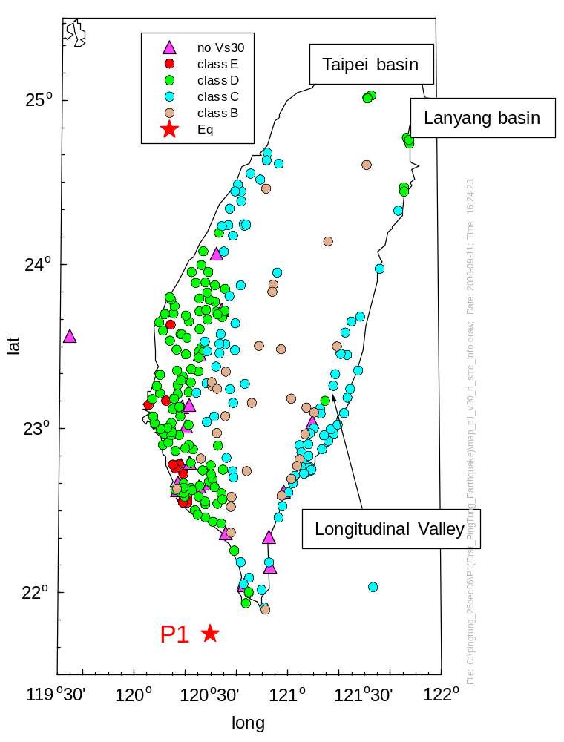
M 7.0, M_{L} 6.96

Slide 2
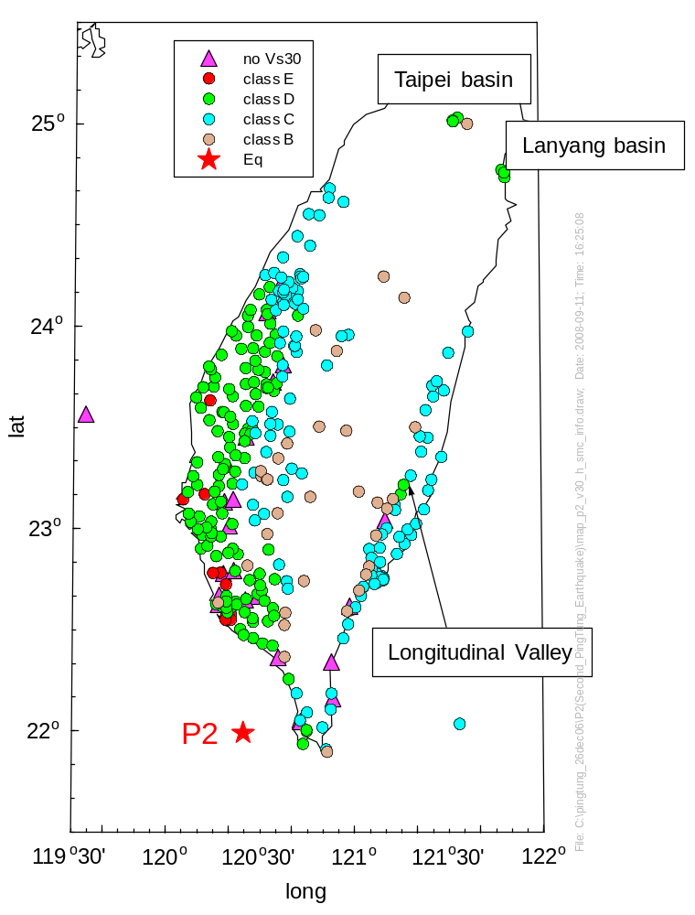
M 6.9, M_{L} 6.99

Slide 3
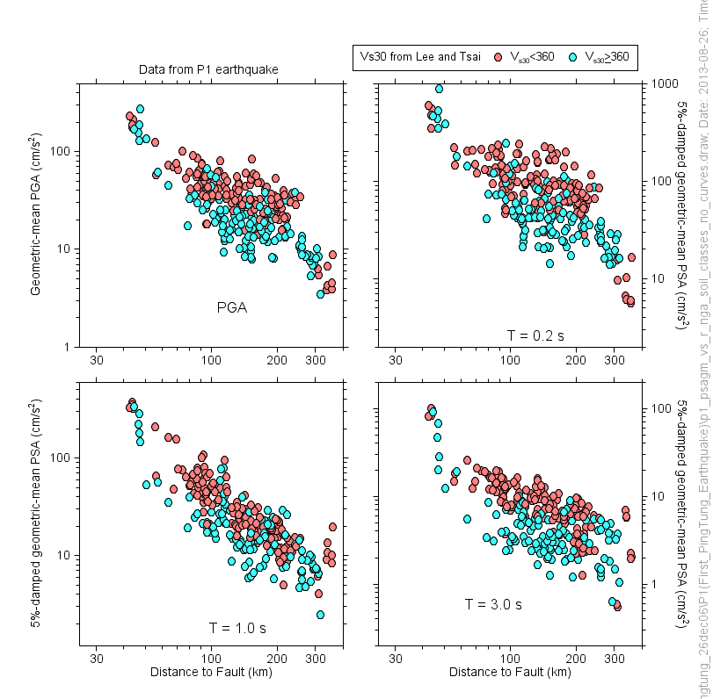

Slide 4
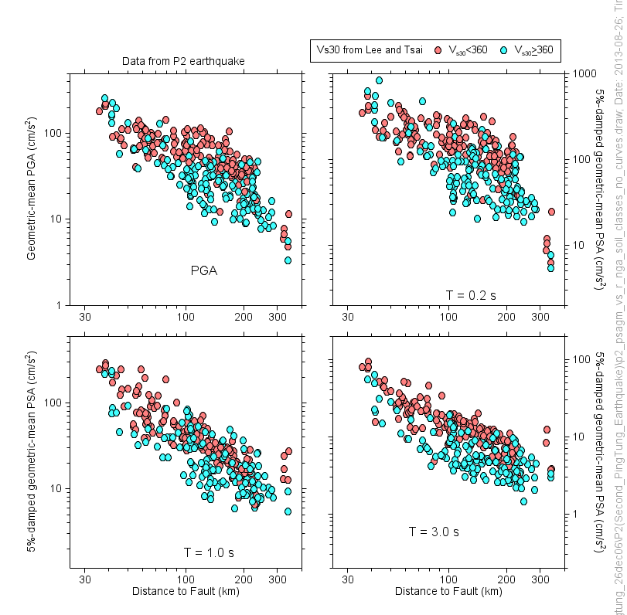

Slide 5
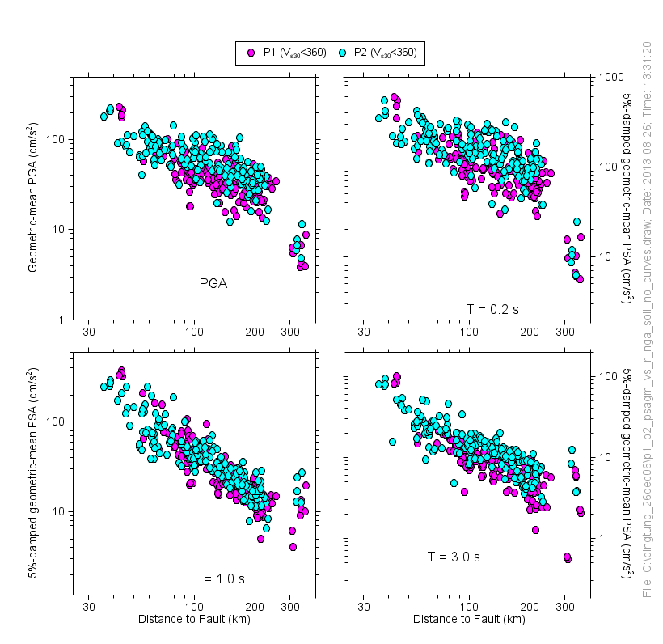

Slide 6
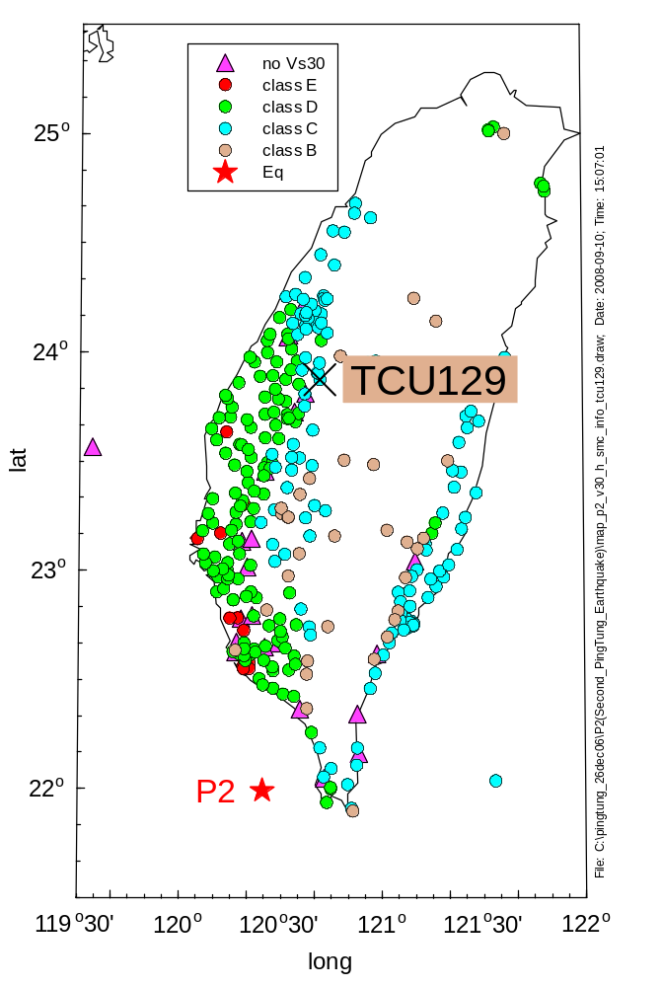

Slide 7
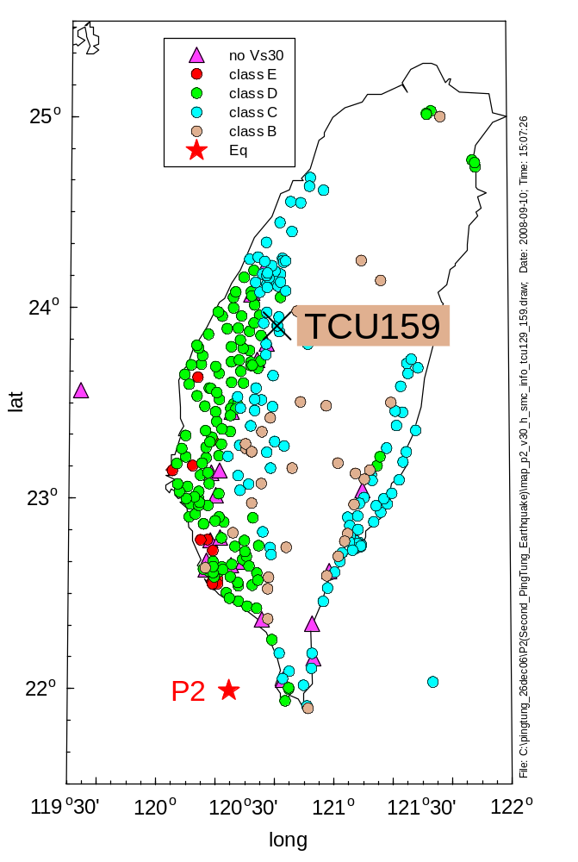

Slide 8
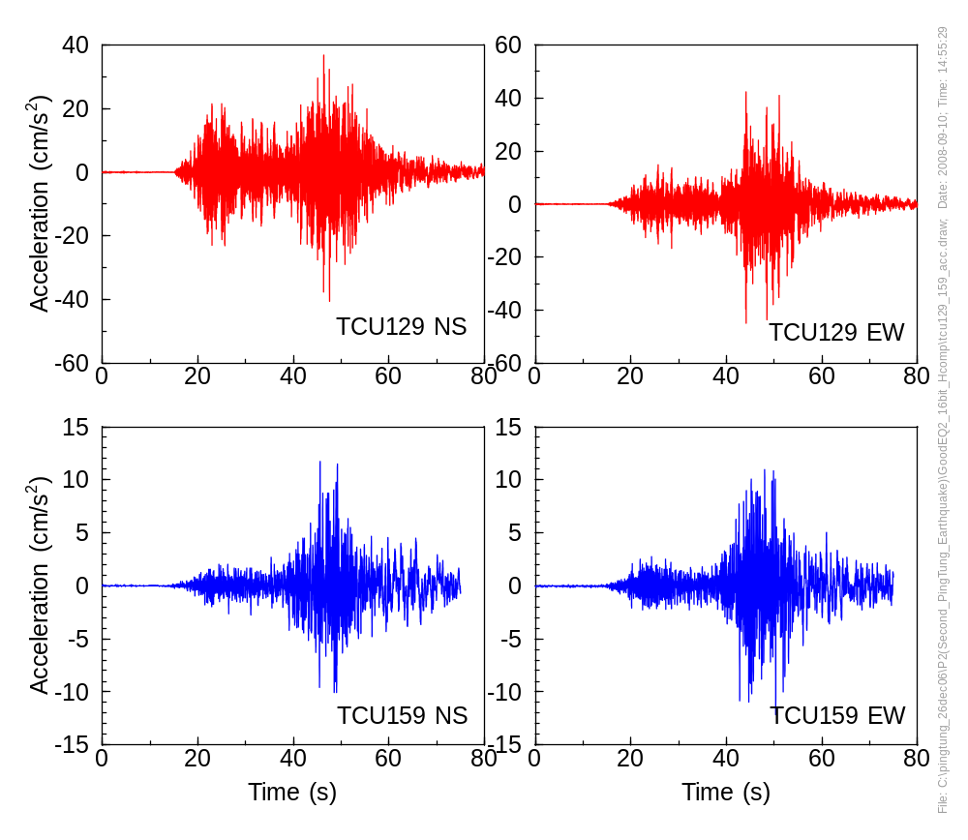

Slide 9
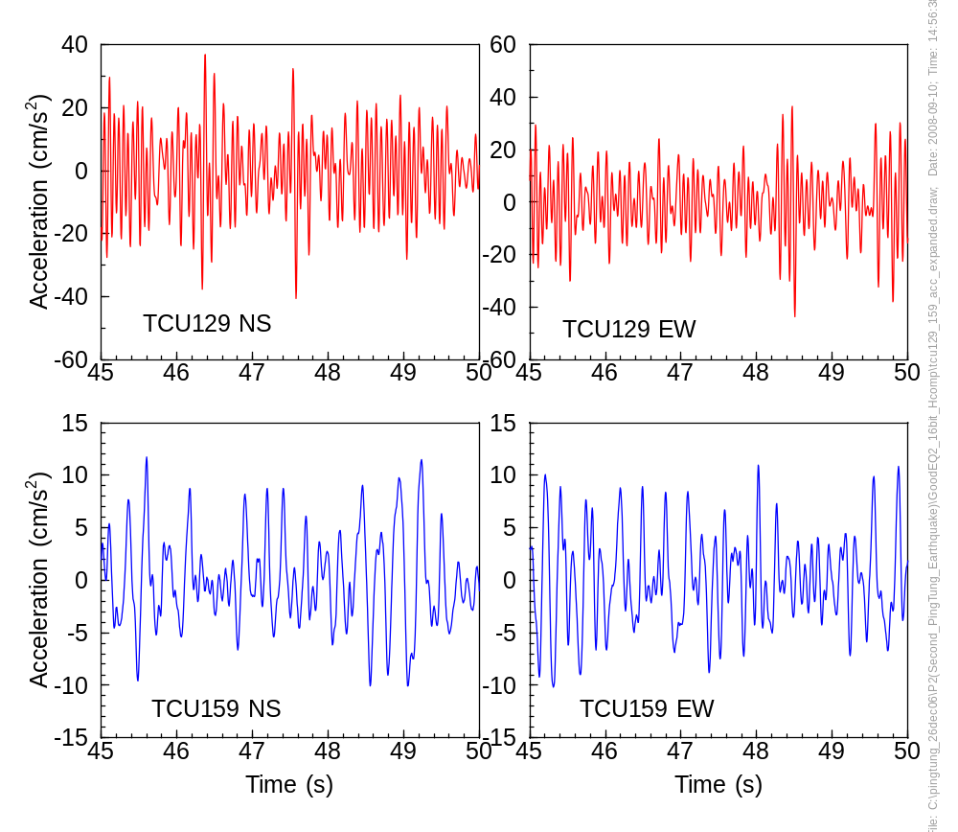

Slide 10
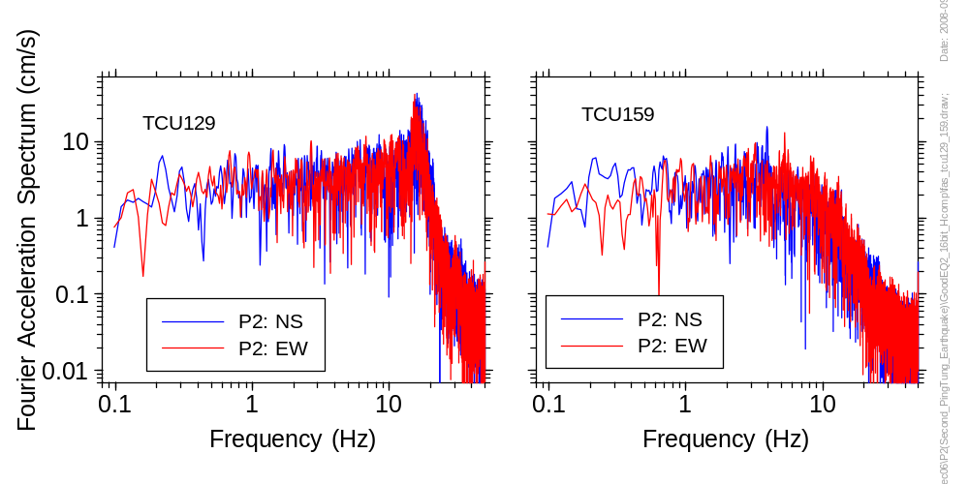

Slide 11
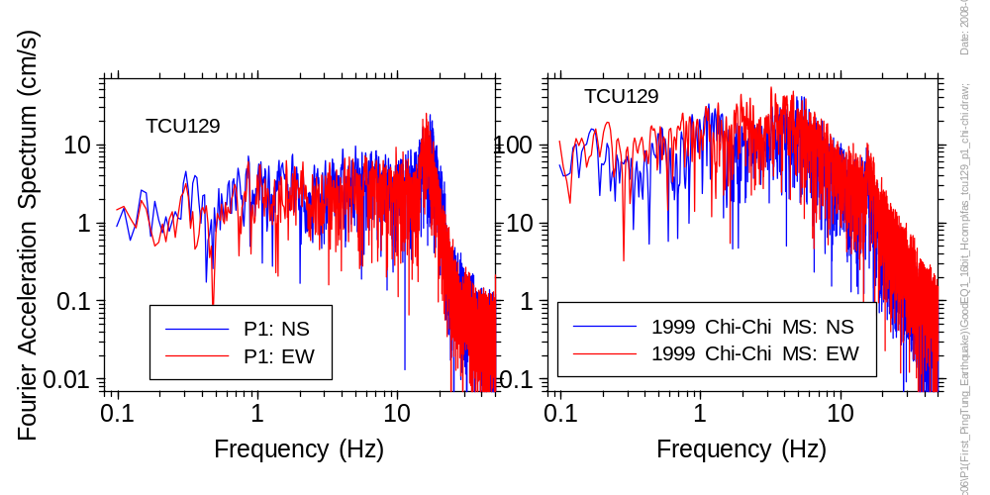

Slide 12

See Wen et al., Why 1G Was Recorded at TCU129 Site During the 1999 Chi-Chi, Taiwan, Earthquake, Bull. Seismol. Soc. Am. 91, 1255-1266.

Slide 13
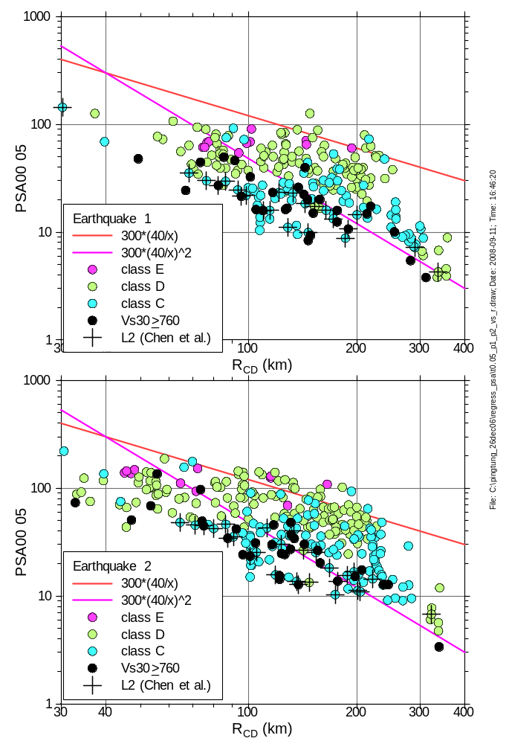
Look for these things as a function of period
The lines are the same for both events
The scale of the ordinates of each graph is the same (for both events and for all periods)
P1 vs P2 magnitude scaling
Site effects (pay particular attention to points beyond 300 km, some of them in the Taipei and Lanyang basins)
Distance function (look at variations along line L2 in the Longitudinal Valley)
Scatter

Slide 14
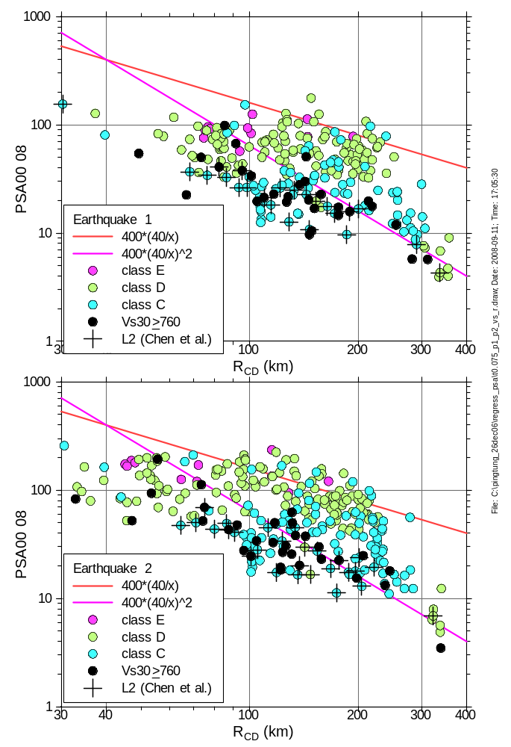

Slide 15
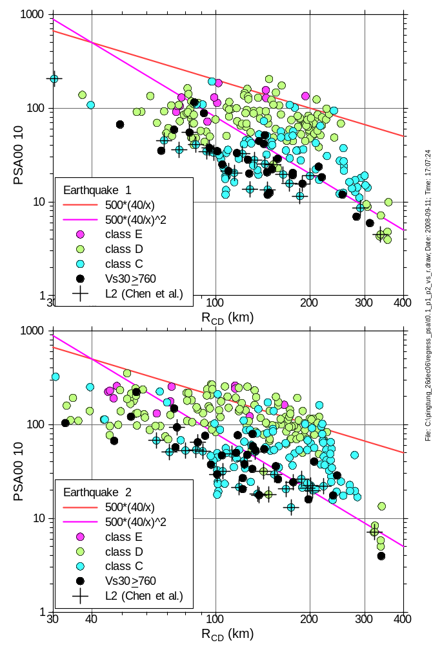

Slide 16
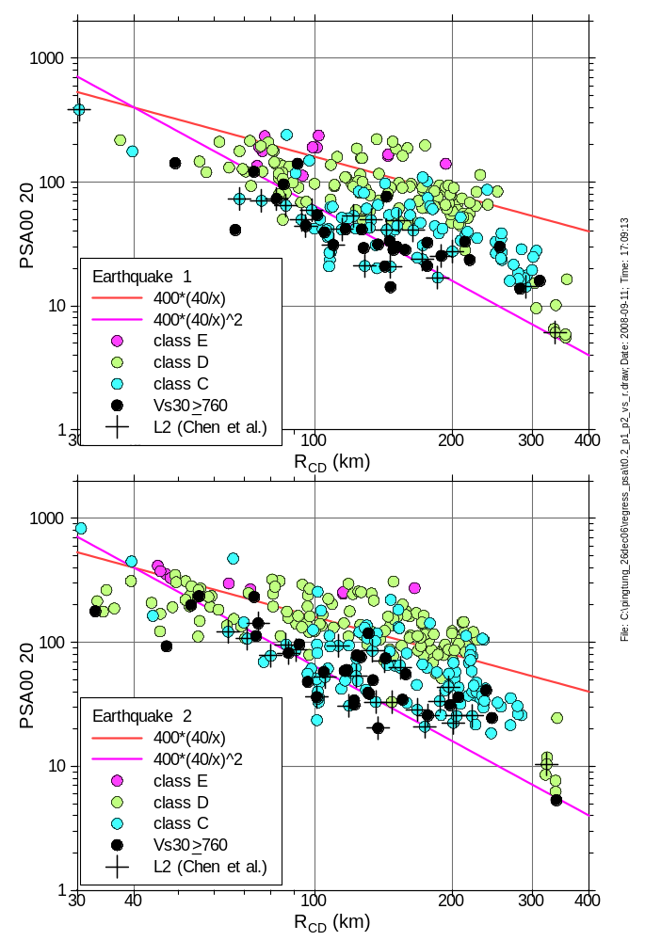

Slide 17
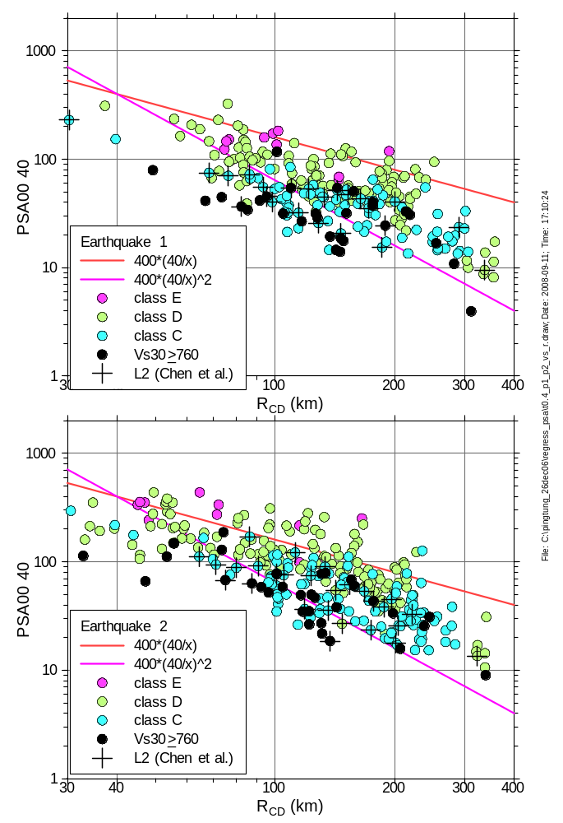

Slide 18
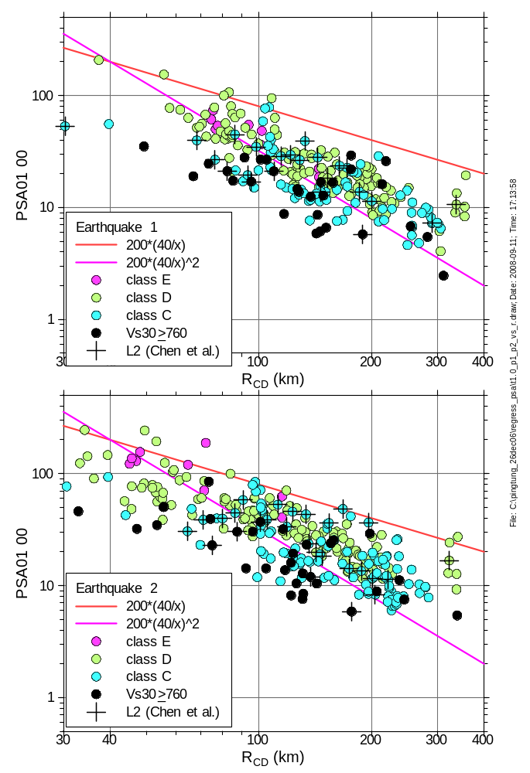

Slide 19
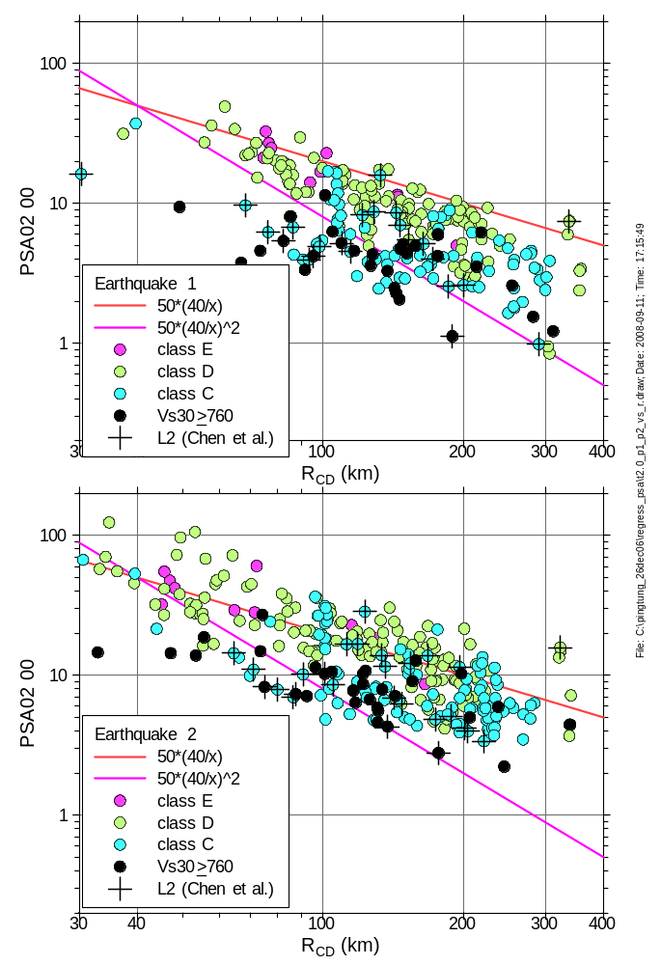

Slide 20
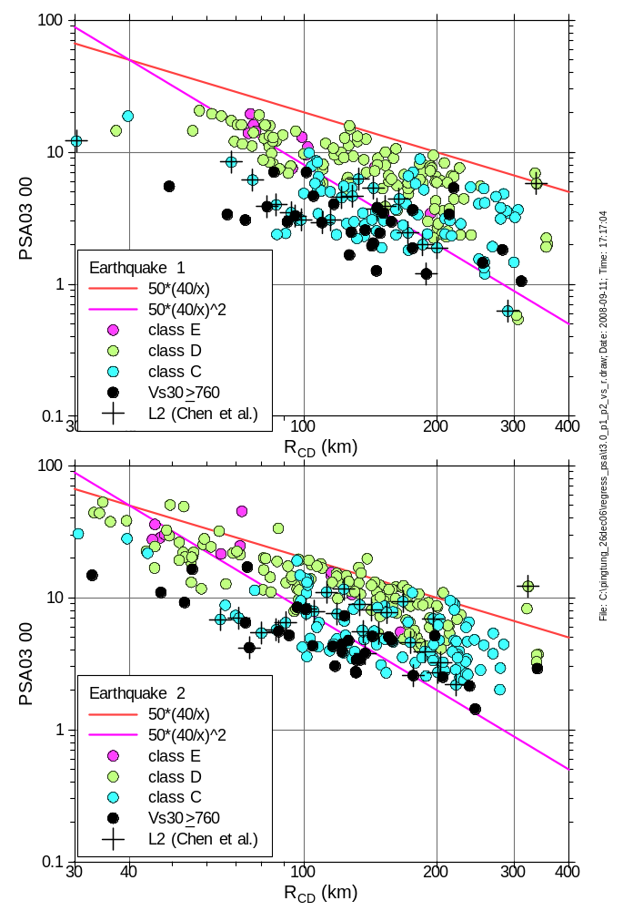

Slide 21
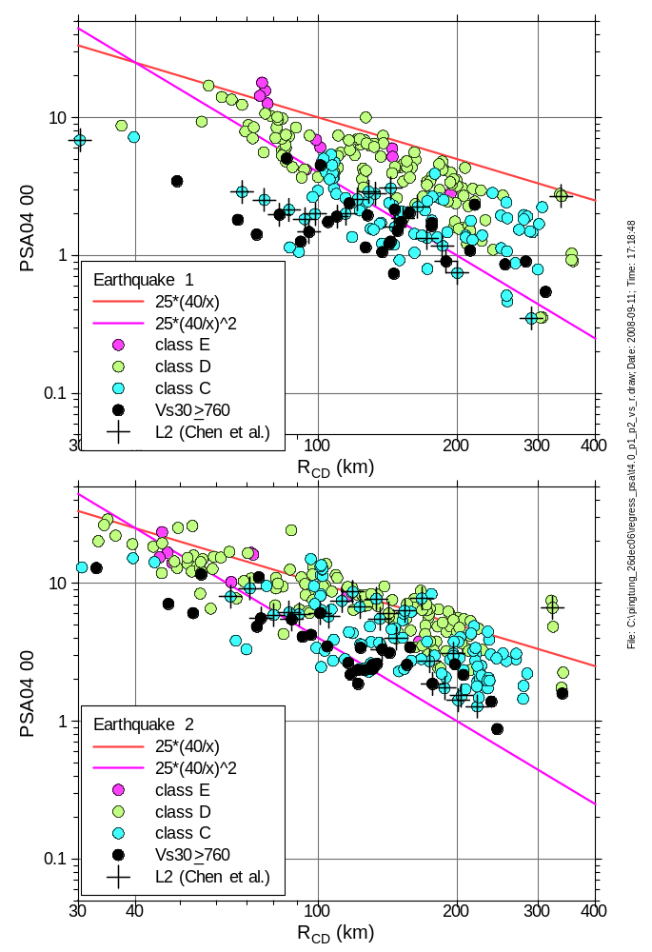

Slide 22
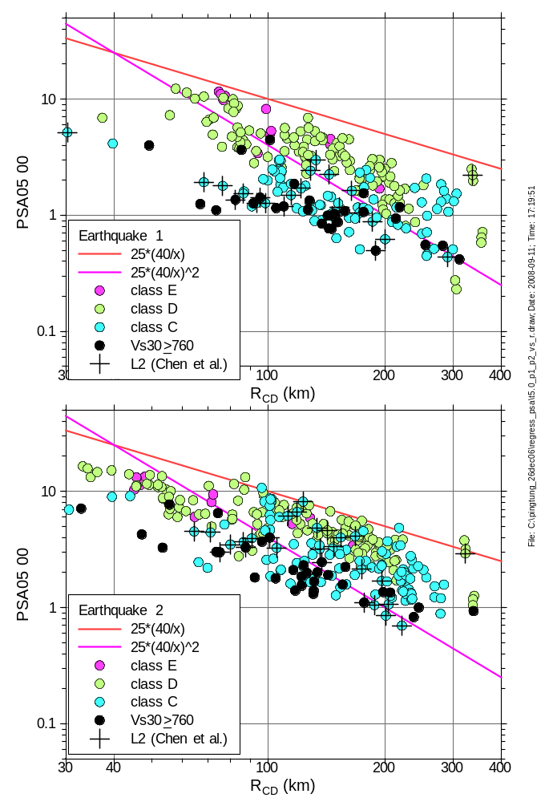

Slide 23
What can we say about
Site effects
Distance function
Scatter

