Slide 1
FUNDAMENTALS of ENGINEERING SEISMOLOGY
    SOURCE, PATH, AND SITE EFFECTS FROM OBSERVATIONS

Slide 2
Overview of lecture
Properties of Data from Observations
  Data distribution in M-D space
  Path dependence of ground motion
  Magnitude dependence of ground motion
  Site dependence of ground motion
Acknowledgment: a number of slides are from G. Cultrera and A. Herrero

Slide 3
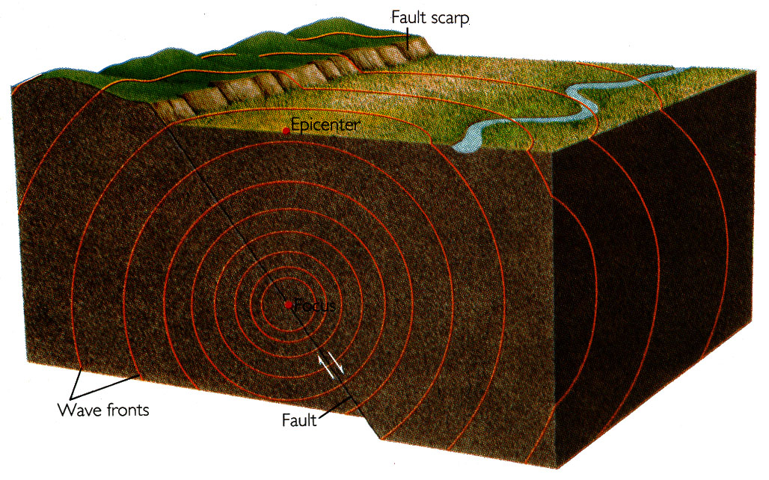
The release of the accumulated elastic strain energy by the sudden rupture of the fault is the cause of the earthquake shaking

Slide 4
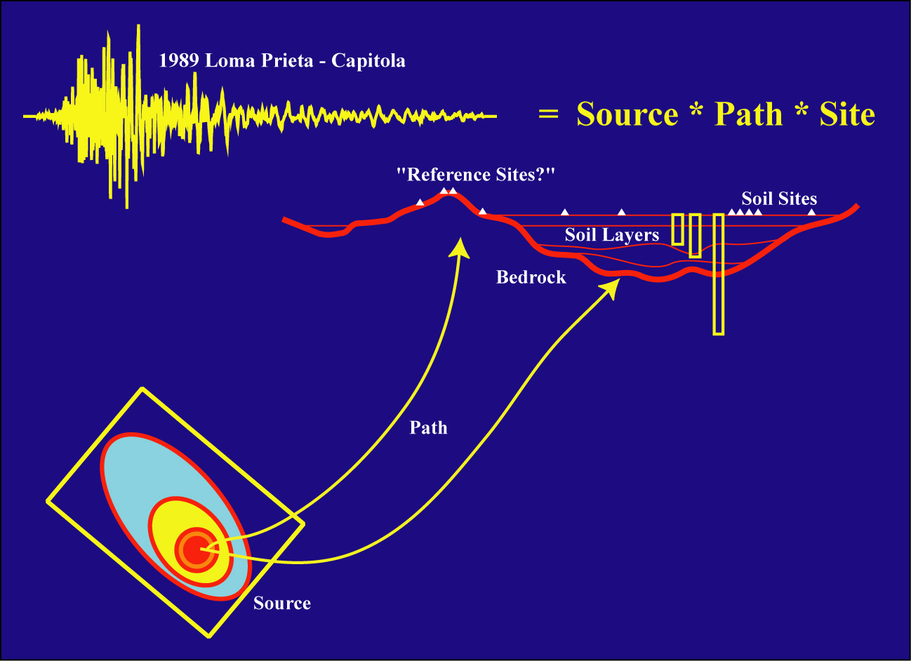
Ground Motion Deconvolution
(Steidl)

Slide 5
Horizontal S and surface waves are most important for engineering seismology:
Seismic shaking in range of resonant frequencies of structures
Shaking often strongest on horizontal component:
  Earthquakes radiate larger S waves than P waves
  Decreasing seismic velocities near Earth’s surface produce refraction of the incoming waves toward the vertical, so that the ground motion for S waves is primarily in the horizontal direction
Buildings generally are weakest for horizontal shaking

Slide 6
Frequencies of ground-motion for engineering purposes
10 Hz --- 10 sec (usually less than about 3 sec)
Resonant period of typical N story structure ~ N/10 sec
  What is the resonant period of the building in which we are located?
Corner periods for M 5, 6, and 7 ~ 1, 3, and 9 sec

Slide 7
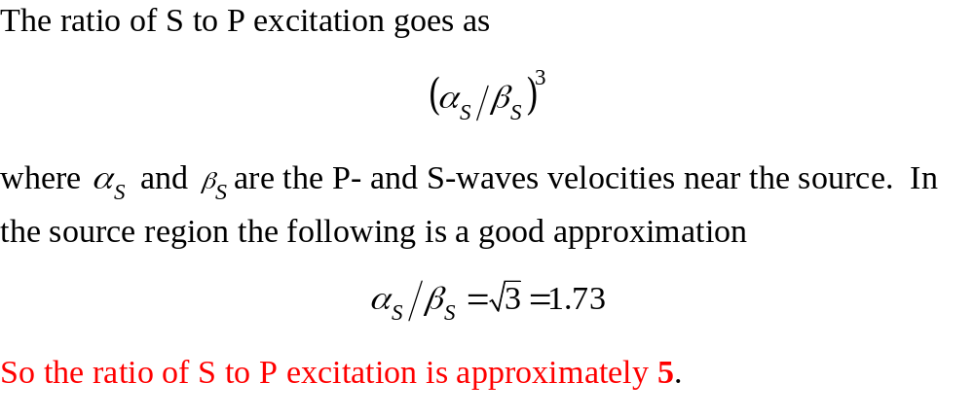

Slide 8
Reminder: Play Chuettsu and Tottori movies (again)

Slide 9
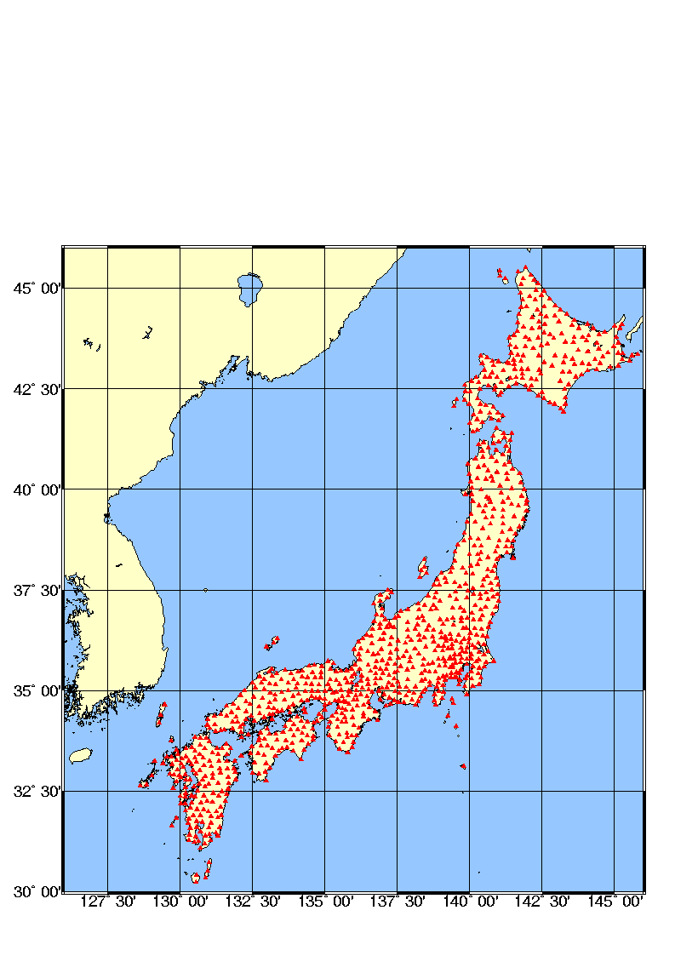
INSTRUMENTATION
Kyoshin Net: Japanese strong motion network
1000 digital instruments installed after the Kobe earthquake of 1995
free field stations with an average spacing of 25 km
velocity profile of each station up to 20 m by downhole measurement
data are transmitted to the Control Center and released on Internet in 3-4 hours after the event
http://www.k-net.bosai.go.jp

Slide 10
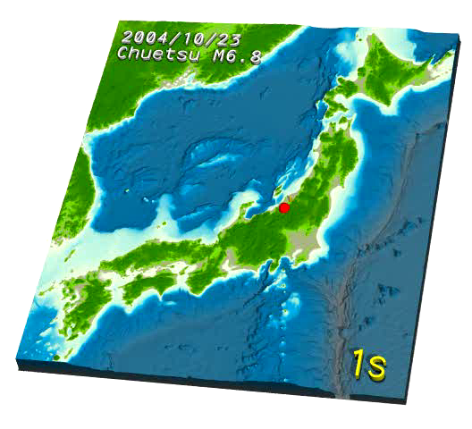
Chuetsu

Slide 11
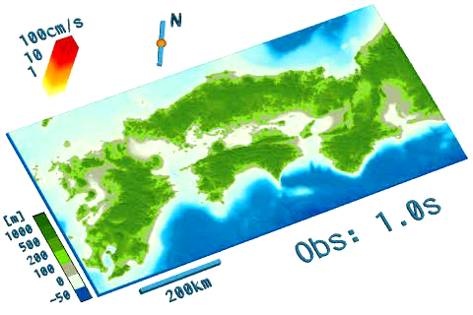
Tottori

Slide 12
Characteristics of Data
Magnitude-distance distribution depends on region
Change of amplitude with distance for fixed magnitude
Change of amplitude with magnitude after removing distance dependence
Site dependence
Scatter

Slide 13
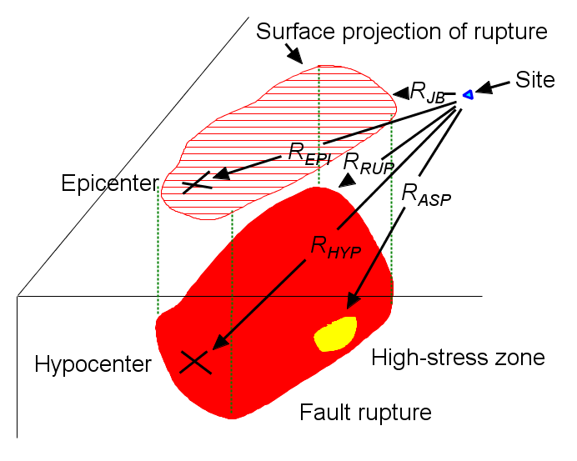
Distance Measures

Slide 14
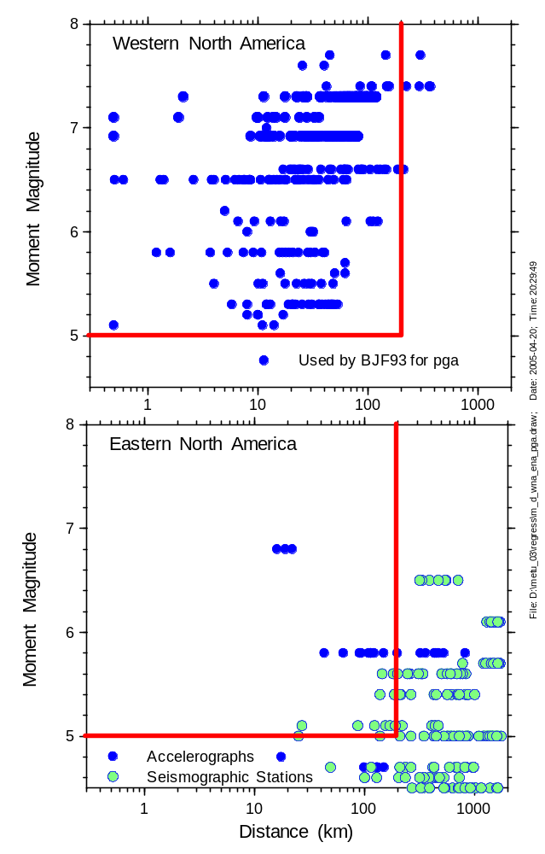
Observed data adequate for regression except
close to large ‘quakes
(the recently developed NGA database contains such records, primarily from Taiwan and Turkey)
Observed data not adequate for regression, use simulated data

Slide 15
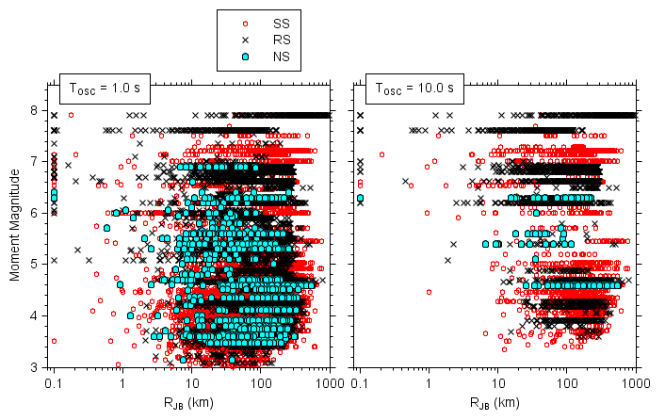
Updated M-R plots, using data from the PEER NGA-West2 2013 flatfile

Slide 16
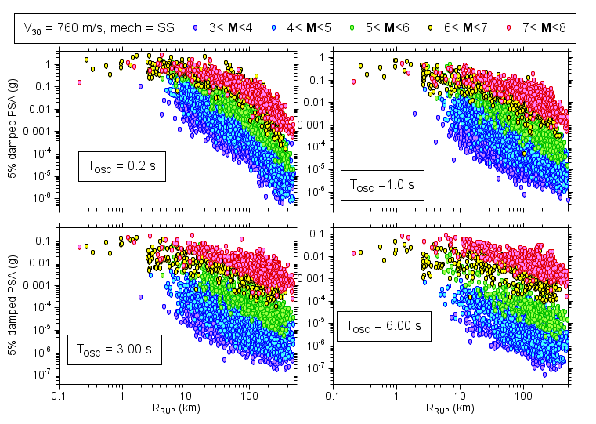
NGA-West2 PSAs (adjusted to Vs30=760 m/s) vs. R_{RUP}
Notes:
Next: site amp w BA w SM. Compare w iCB results.
Resi v vs30.
Filter, gmx SM.
Thursday, updates to ppt.
Linear term in gmpe that data sets. C term set by data in regression. Nonlin taken out.
BA c term not diff than gmpe work olmali.

Slide 17
What do the data tell us about magnitude and path scaling?
There is significant scatter in the data. The scatter is larger for small earthquakes and generally increases with distance (at least to distances of about 200 km). In spite of the scatter, however, there are systematic distance and magnitude trends in the data, as discussed in the next items.
For a single magnitude and for all periods the motions tend to saturate for large earthquakes, that is, they approach a constant value, as the distance from the fault rupture to the observation point decreases. This can only be concluded definitively for large magnitudes, for which the rupture approaches the ground surface and therefore the distance measure used in in the figure can approach 0.0. Smaller earthquakes do not reach the surface, and therefore surface observations cannot be used to infer whether or not the motions near the rupture surfaces of small earthquakes saturate.

Slide 18
What do the data tell us about magnitude and path scaling?
At any fixed distance the ground motion increases with magnitude in a nonlinear fashion, with a tendency to saturate for large magnitudes, particularly for shorter period motions. The overall magnitude scaling increases with increasing period, but it is smaller at short distances than at longer distances. For short periods and close distances there appears to be almost complete saturation for the motions from large earthquakes.
For a given period and magnitude the median ground motions decay with distance; this decay shows curvature at greater distances on the log-log plot used in the figure. This decay can be parameterized as exp(-αR_{RUP})/R_{RUP}^{β}, where the terms in the numerator and denominator are similar to the decay from a point source due to anelastic attenuation and geometrical spreading, respectively. In log-log plots, the anelastic attenuation produces the curvature at greater distances, and the geometrical spreading produces the linear decay at closer distances. Careful inspection of the figure shows that the apparent geometrical spreading decreases as magnitude increases.

Slide 19
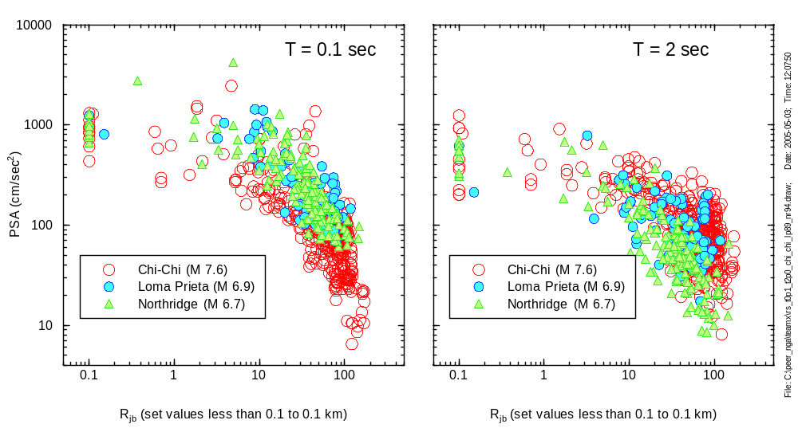
Illustrating distance and magnitude dependence
Chi-Chi data are low at short periods
(note also scatter, distance dependence)

Slide 20
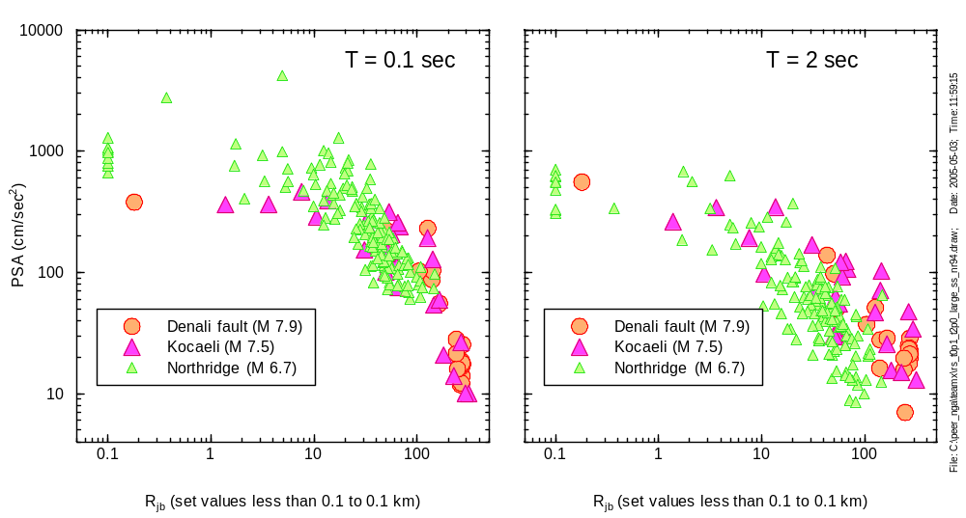
And so are Denali and Kocaeli (or is Northridge high?)

Slide 21
Scaling with magnitude

Slide 22
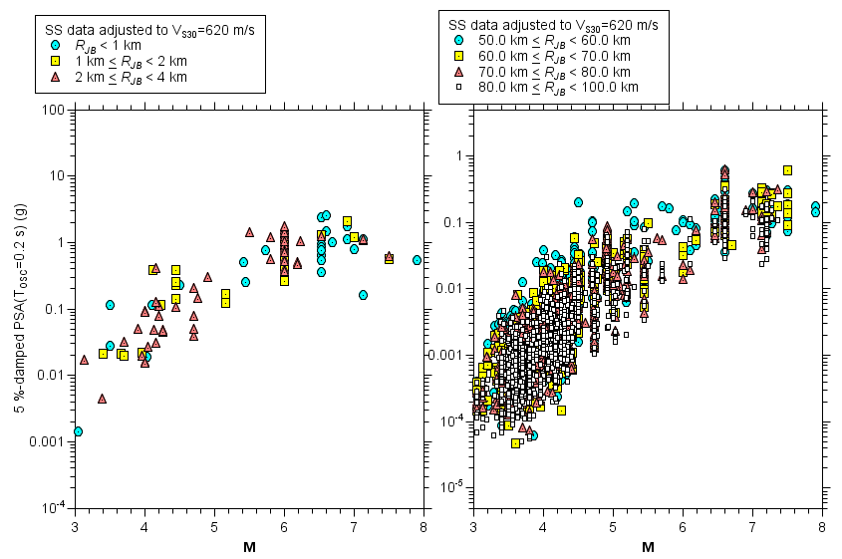

Slide 23
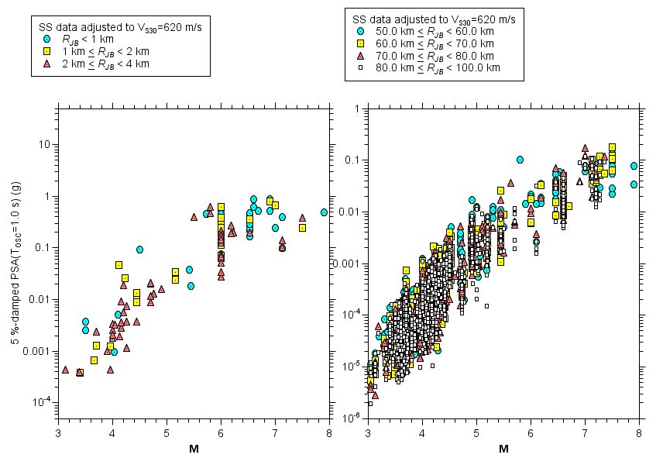

Slide 24
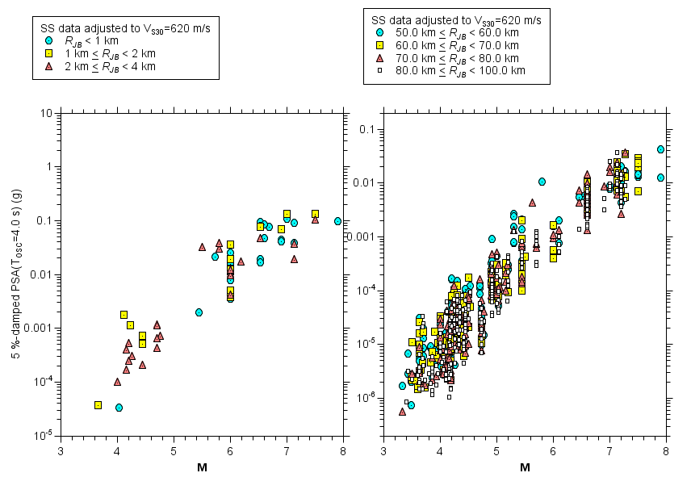

Slide 25
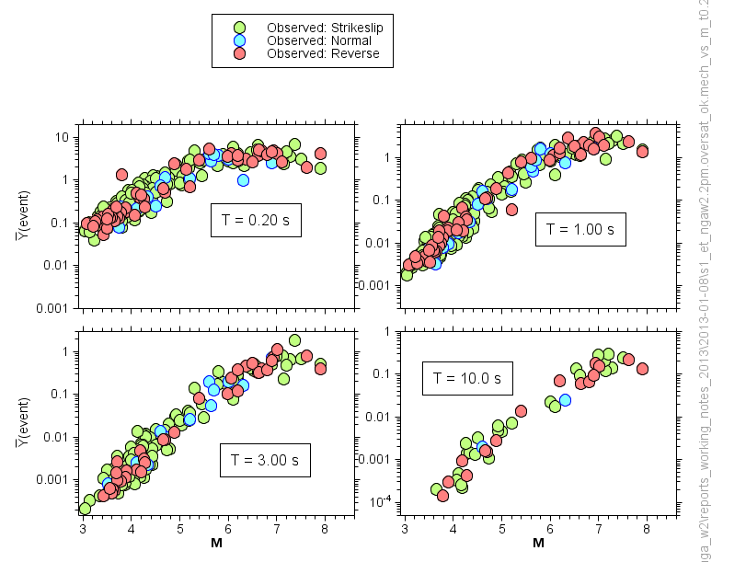
Magnitude scaling
Note that each symbol represents the average of the strong-motion recordings for a single earthquake, correcting for the distance dependence.

Slide 26
Path effects
Wave types
  Body (P, S)
  Surface (Love, Rayleigh)
Amplitude changes due to wave propagation
  Geometrical spreading (1/r in uniform media, more rapid decay for velocity increasing with depth)
  Critical angle reflections
  Waveguide effects
Amplitude changes due to intrinsic attenuation (conversion to heat) and scattering attenuation

Slide 27
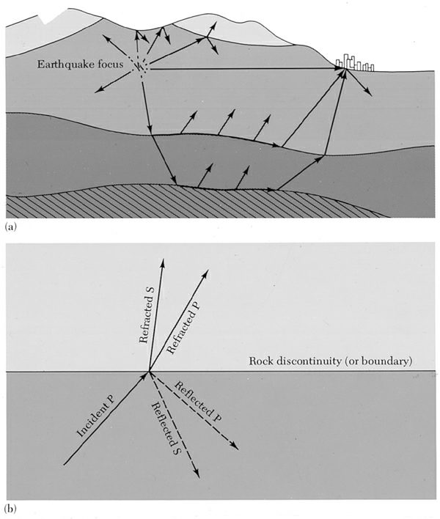
FAR SOURCE
far field, reflection and refraction
Picture of the paths of seismic P or S waves being reflected and refracted in rock structures of the Earth's crust.
Reflection and refraction of a longitudinal (P) wave in an earthquake after it hits a boundary between two types of rock. Note conversion from P to S (angles determined by Snell’s law)

Slide 28
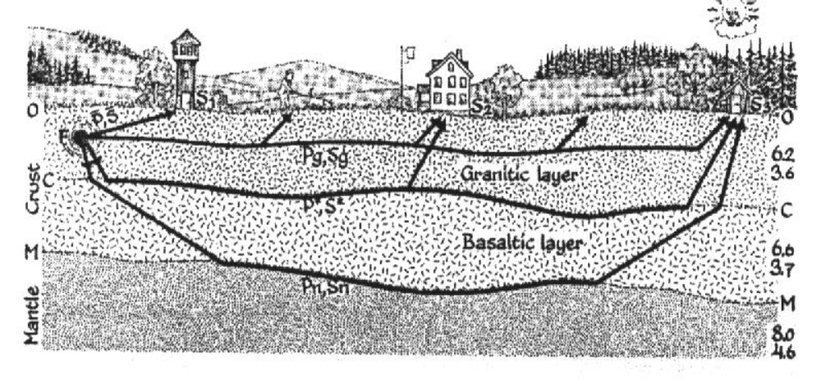
FAR SOURCE
Main crustal phases

Slide 29
How does the motion depend on distance?
Generally, it will decrease (attenuate) with distance
But wave propagation in a layered earth predicts more complicated behavior (e.g., increase at some distances due to critical angle reflections (“Moho-bounce”)
Equations assume average over various crustal structures

Slide 30
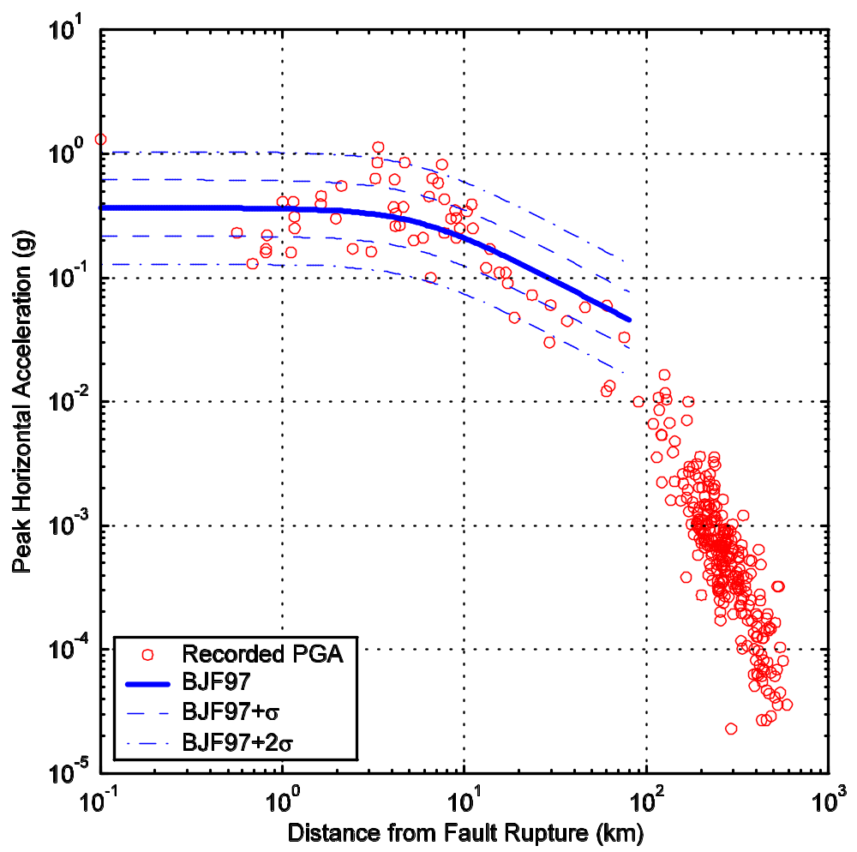
More distant data show limitations of function fit to closer data (but ground motions at greater distances are of little engineering interest)
From V. Graizer

Slide 31
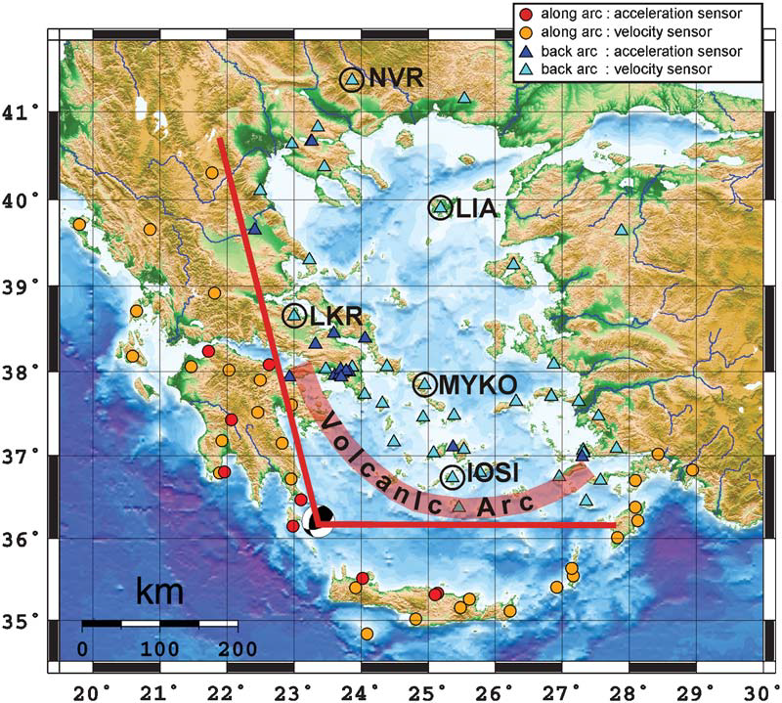

Slide 32
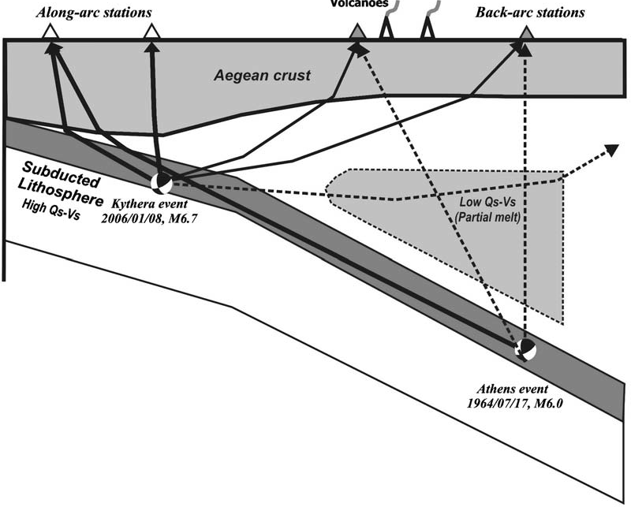

Slide 33
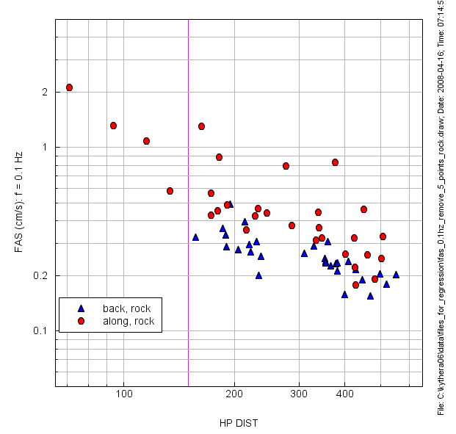

Slide 34
ATTENUATION
Definition
REFLECTION AND TRANSMISSION OF SEISMIC WAVES AT DISCRETE INTERFACES REDUCE THEIR AMPLITUDES.
FOUR OTHER PROCESSES ALSO REDUCE WAVE AMPLITUDES:
- GEOMETRICAL SPREADING
SCATTERING
MULTIPATHING
ANELASTICITY
THE FIRST THREE ARE ELASTIC PROCESSES, IN WHICH
THE ENERGY IN THE PROPAGATING WAVE FIELD IS CONSERVED.
IN CONTRAST, ANELASTICITY, SOMETIMES CALLED INTRINSIC ATTENUATION, INVOLVES CONVERSION OF SEISMIC ENERGY TO HEAT.

Slide 35
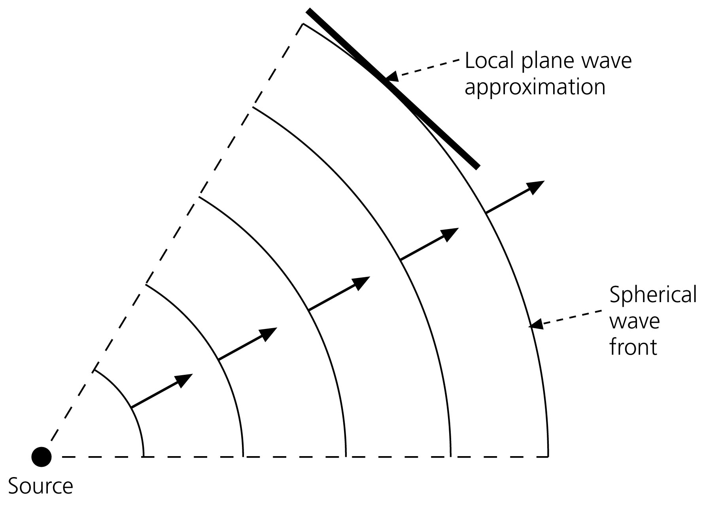
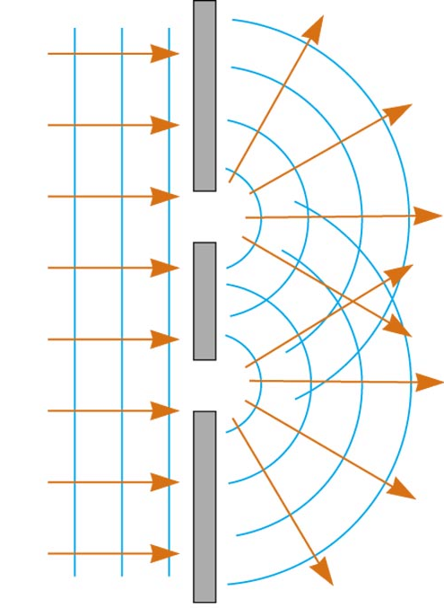
ATTENUATION
Analogous behaviors for light
1) Geometric spreading: light moves outward from lamp in expanding spherical wave fronts. By conservation of energy, the energy in a unit area of the growing wave front decreases as r⁻², where r is the radius of the sphere or distance from the lamp.
2) Scattering: light dims as it is scattered by air molecules, dust, and water in the air. Scattering results when objects acting as Huygens' sources scatter energy in all directions. This effect is dramatic on a foggy night because scattered light causes a halo around the lamp.

Slide 36
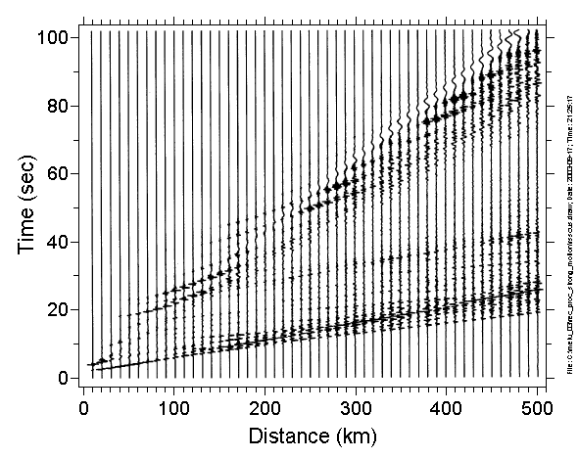
Wave propagation produces changes of amplitude (not shown here) and increased duration with distance. Not included in these simulations is the effect of scattering, which adds more increases in duration and smooths over some of the amplitude changes (as does combining propagation over various profiles with laterally changing velocity)
Amplitude of each trace normalzed independently—cannot see geometrical spreading effects

Slide 37
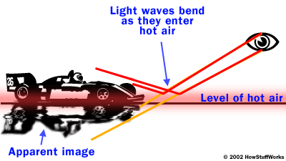
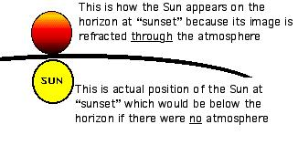
ATTENUATION
Analogous behaviors for light
3) Light is focused or defocused by changes in the refractive properties of the air. This process causes mirages, where light is refracted differently by hot air just above the ground.
Similarly the distorted appearance of the setting sun results from seeing different parts of it through different levels of the atmosphere which refract light differently because of the vertical density gradient.
This effect is termed multipathing in seismology.
4) Some light energy is absorbed by the air and converted to heat. This process differs from the other three in that light energy is actually lost, not just moved onto a different path. It is called in seismology attenuation.

Slide 38
ATTENUATION
Definition
ALL FOUR PROCESSES ARE IMPORTANT FOR SEISMIC WAVES.
The first three are described by elastic wave theory, and can increase or decrease an arrival's amplitude by shifting energy within the wave field.
In contrast, anelasticity only reduces wave amplitudes because energy is lost from the elastic waves.
So much of seismology is built upon the approximation that the earth responds elastically during seismic propagation that it is easy to forget that the earth is not
perfectly elastic.
However, without anelasticity seismic waves from every earthquake that ever occurred would still be reverberating until the accumulating reverberations shattered the earth.
Elasticity is a good approximation for the earth's response to seismic waves, but there are many important implications and applications of anelasticity.

Slide 39


GEOMETRICAL SPREADING
Body waves
For body waves, consider a spherical wavefront moving away from a deep earthquake. Energy is conserved on the expanding spherical wavefront whose area is 4 π r ², where r is the radius of the wavefront.
Thus the energy per unit wave front decays as 1 / r², and the amplitude decreases as 1 / r
Energy proportionnal to
Planar wave: Constant
Cylindrical wave :
Spherical wave:

Slide 40


GEOMETRICAL SPREADING
Surface waves
Conical waves decay in

Slide 41
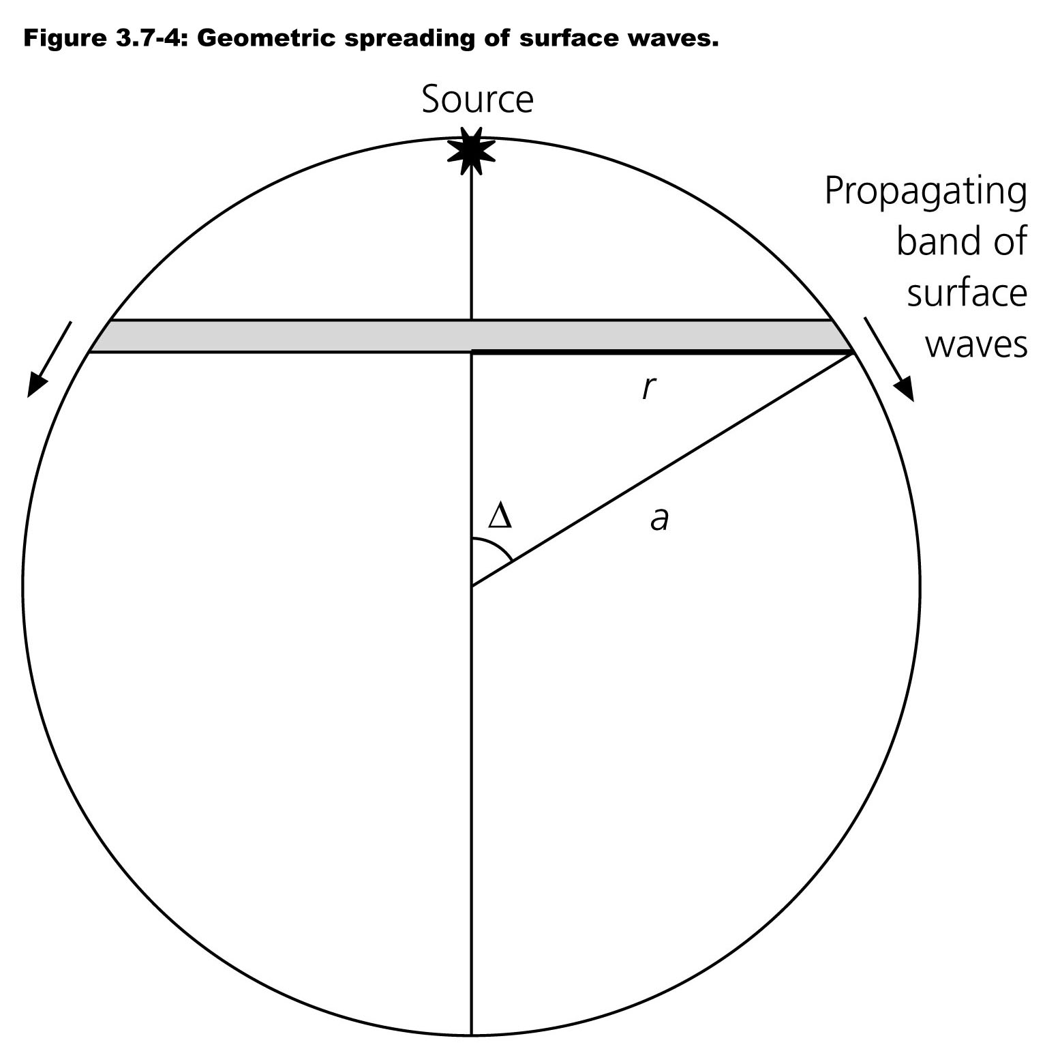
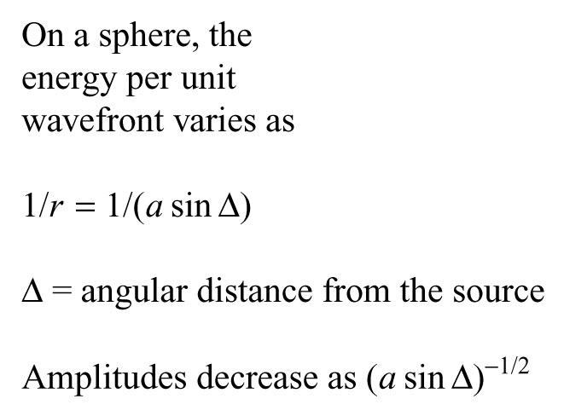
GEOMETRICAL SPREADING
Surface waves
Expect minimum at Δ=90º, and maxima at 0º and 180º

Slide 42
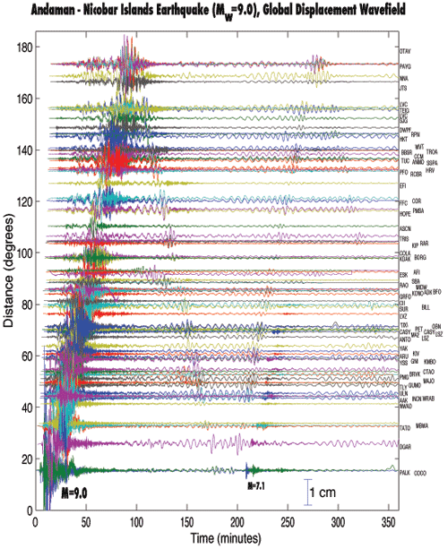
GEOMETRICAL SPREADING
Surface waves
From geometric spreading alone, expect minimum at Δ=90º, and maxima at 0º and 180º
Also have effects of anelasticity

Slide 43
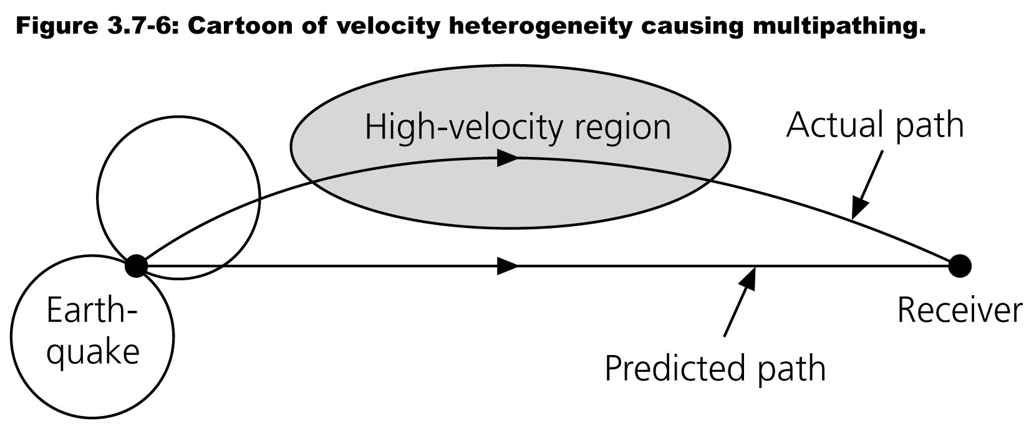
ATTENUATION
Multipathing
Seismic waves are focused and defocused by lateral variations in velocity.
Although physically this process is the same as the effects of vertical variations, it is often distinguished by the term multipathing.
The distinction reflects our view of the earth as an essentially layered planet with secondary lateral variations.

Slide 44
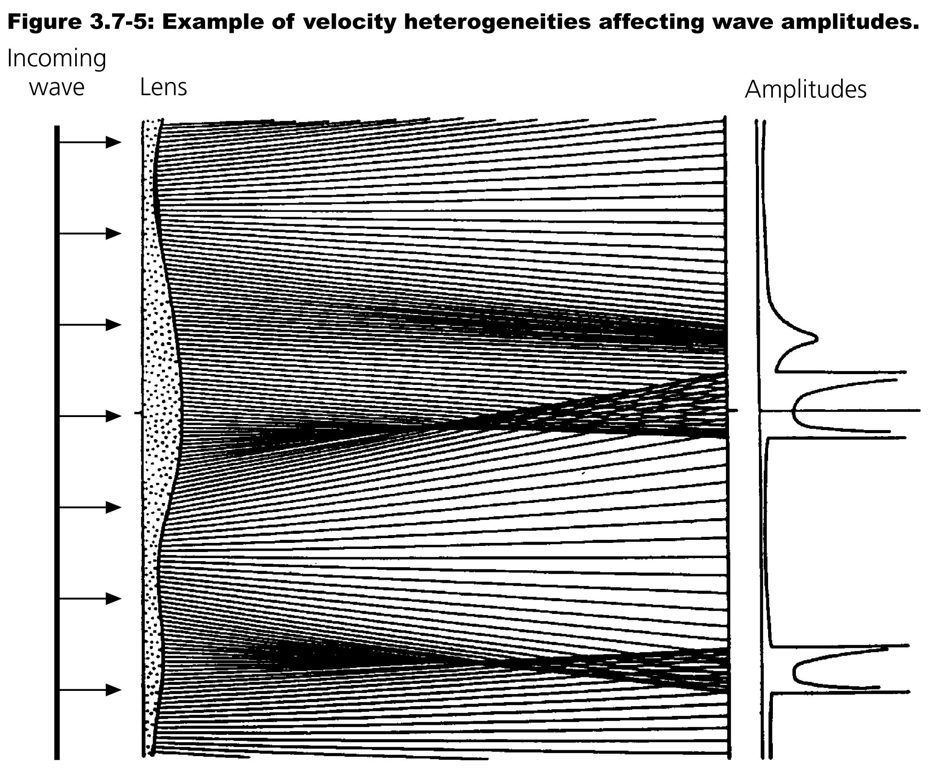
MULTIPATHING
Focusing and defocusing

Slide 45
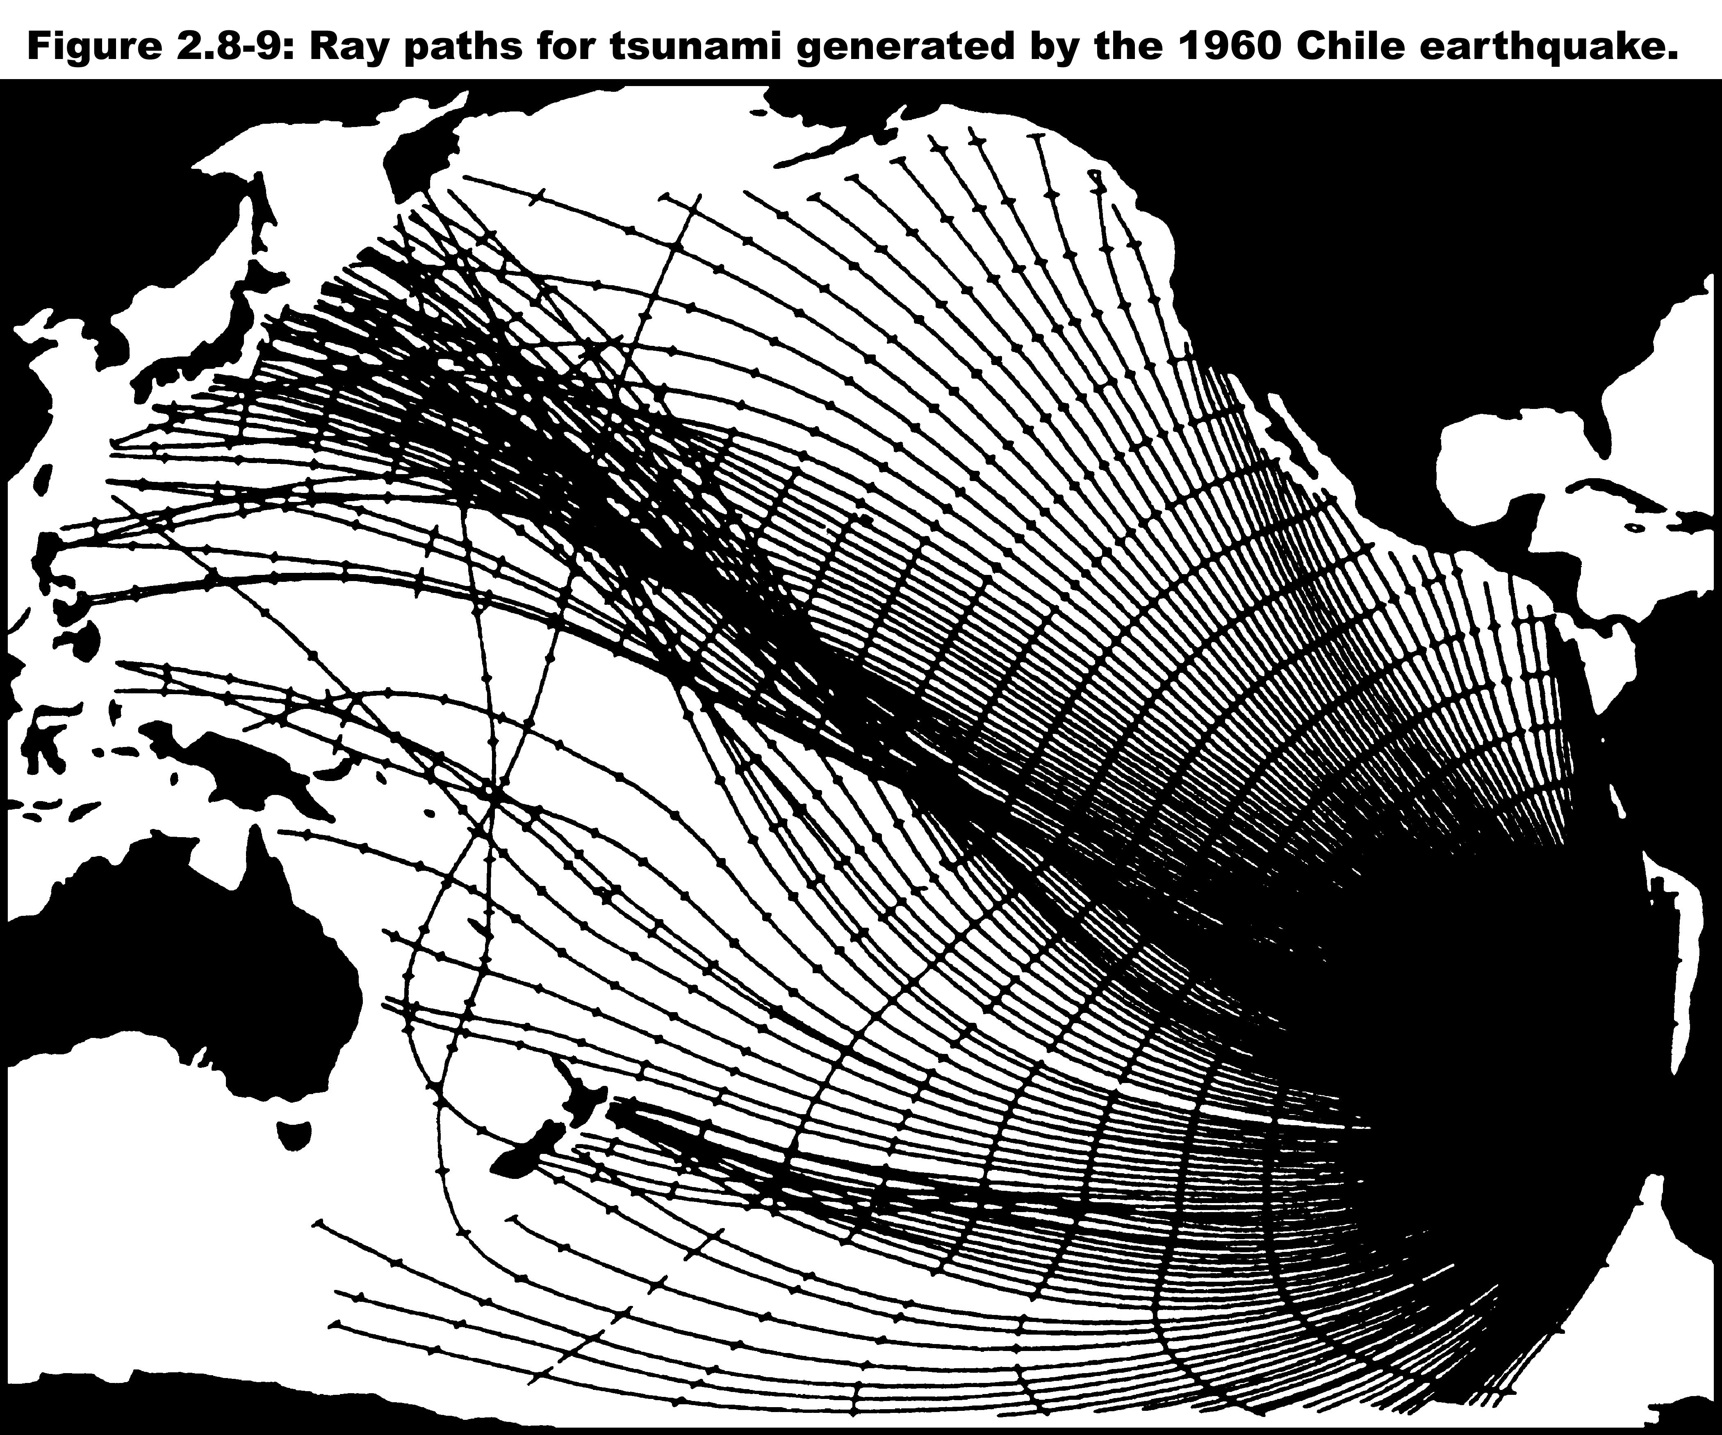
MULTIPATHING
Focusing and defocusing
TRACE RAY PATHS USING SNELL’S LAW
RAYS BEND AS WATER DEPTH CHANGES
FIND WHEN WAVES ARRIVE AT DIFFERENT PLACES
DENSITY OF WAVES SHOWS FOCUSING & DEFOCUSING

Slide 46
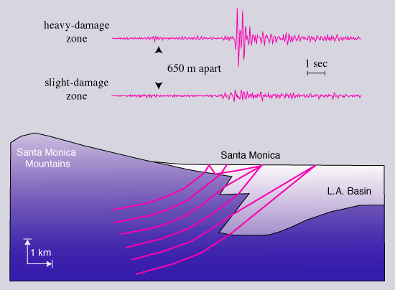

Slide 47
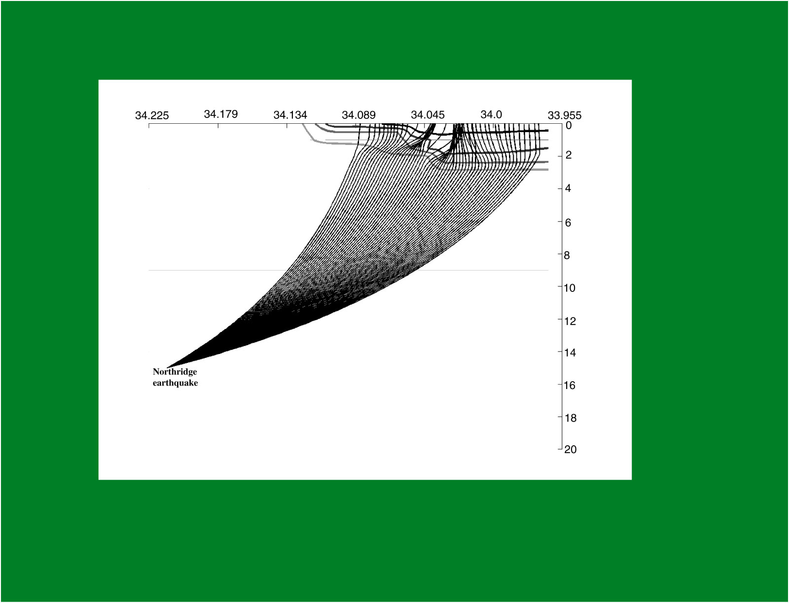

Slide 48
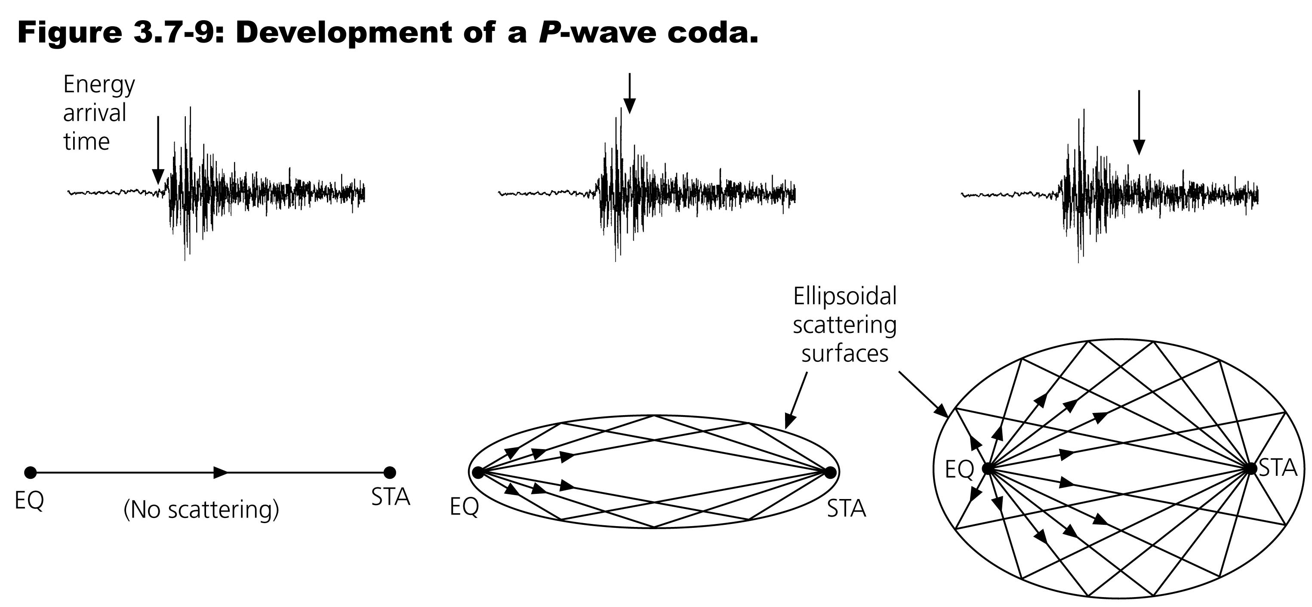
SCATTERING
Seismic waves
The unscattered wave travels the shortest distance and gives the initial arrival. Scattered energy lost from this arrival arrives later & could have been scattered from an infinite number of locations that yield the observed travel time. In a constant-velocity medium, the locus of possible scatterers is an ellipsoid with the source and receiver as foci. Larger ellipsoids define the possible scatterers for energy that arrives later.

Slide 49
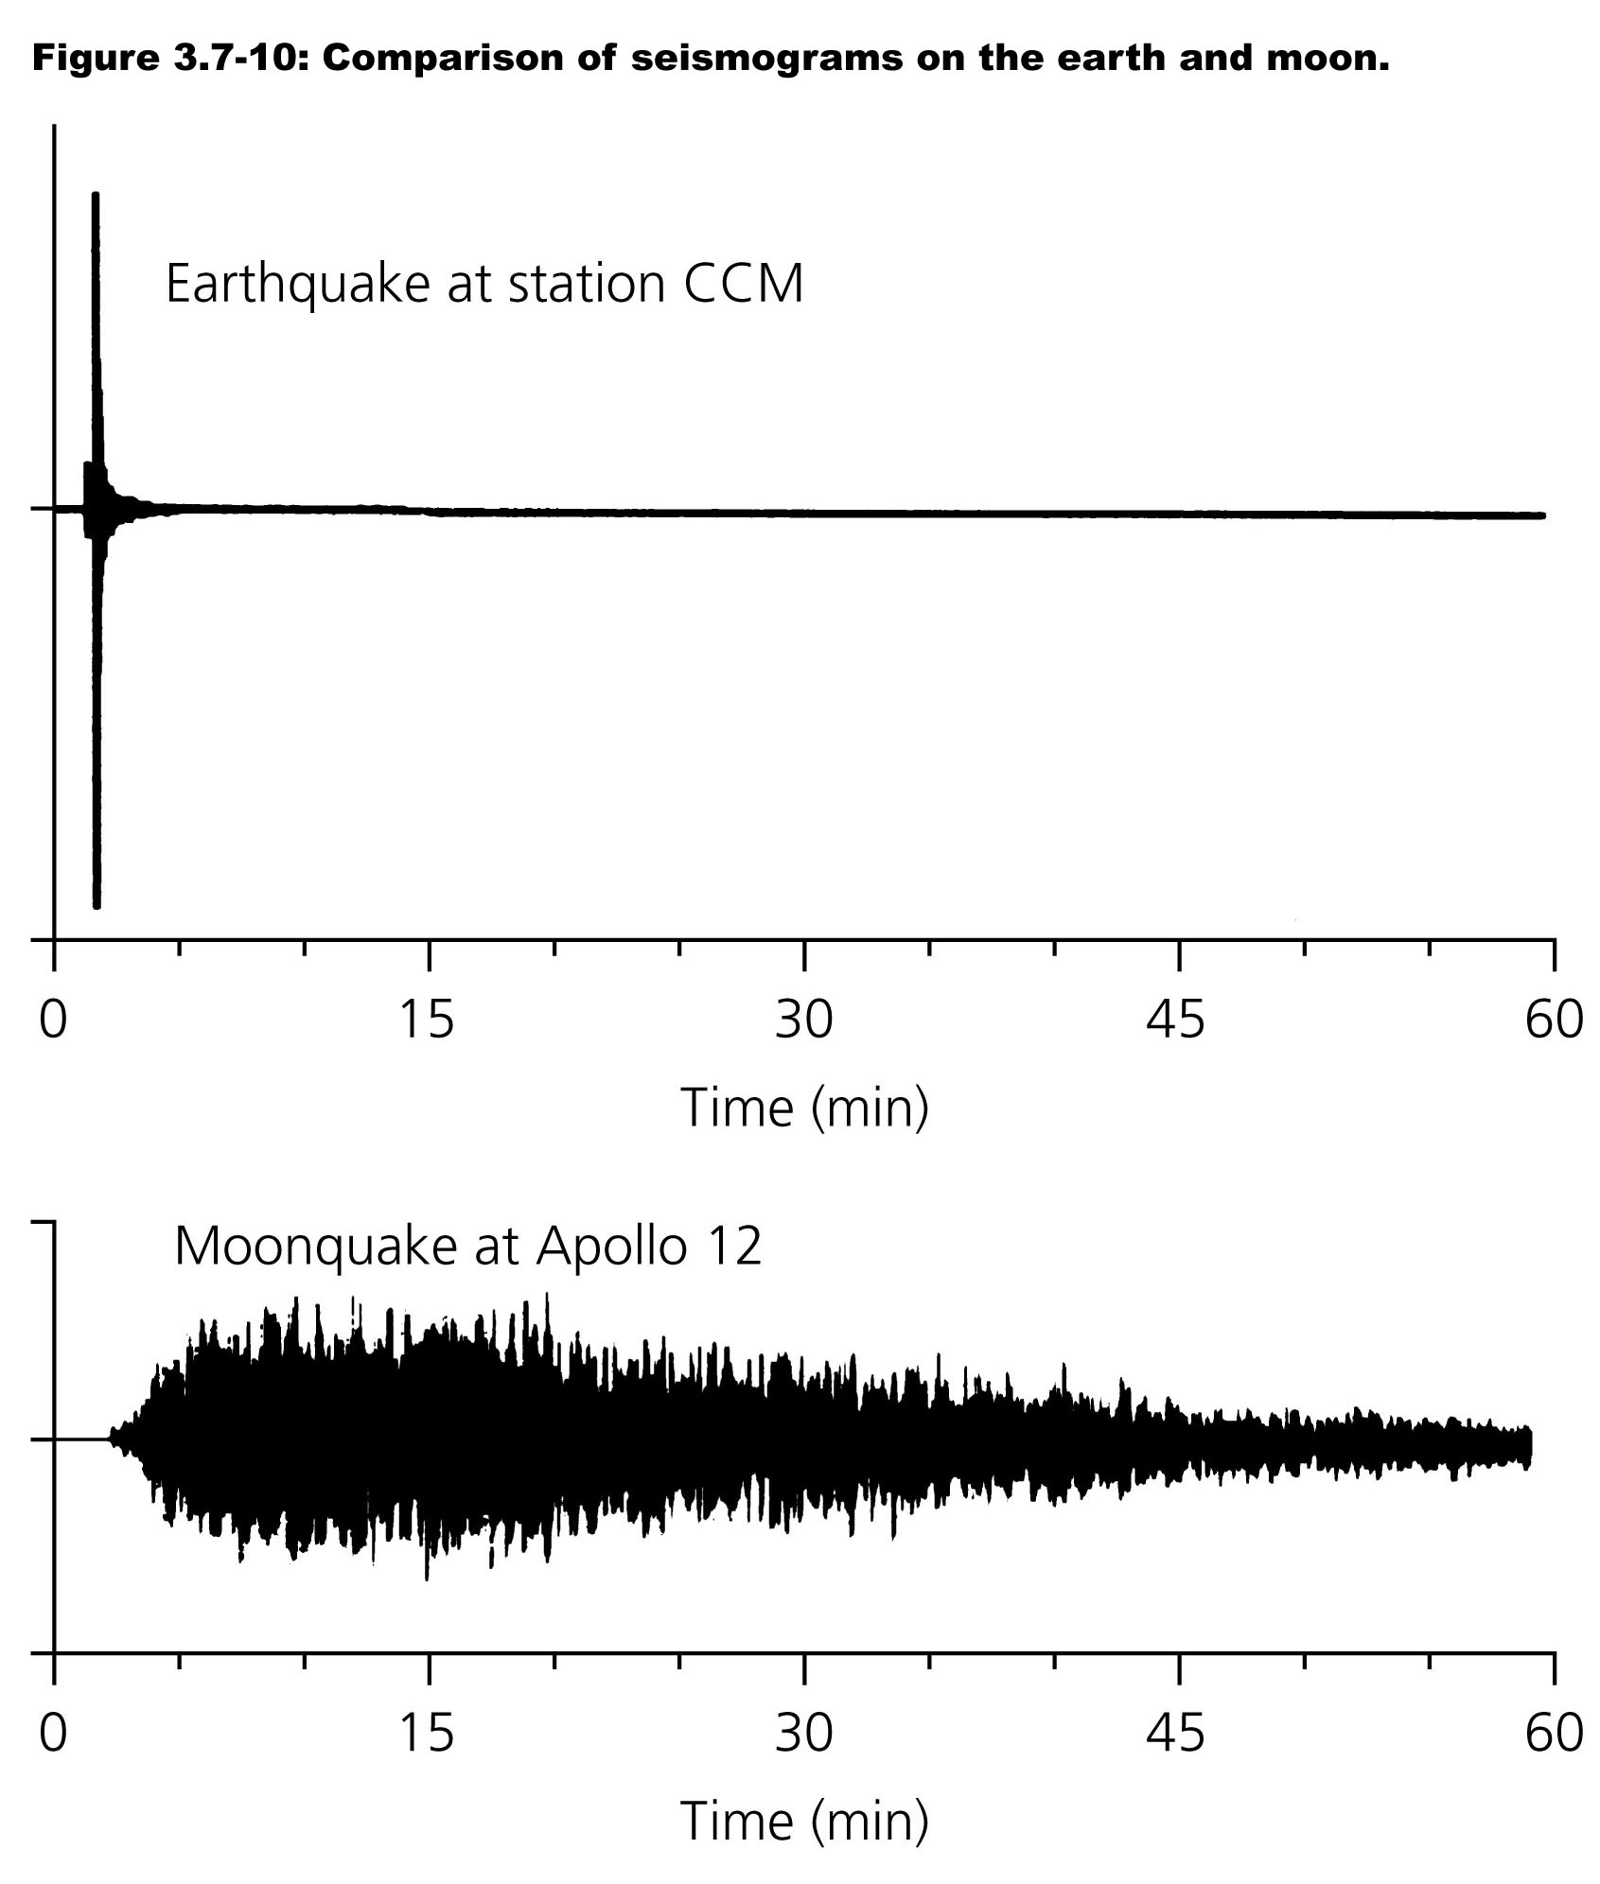
SCATTERING
Earth versus Moon

Slide 50
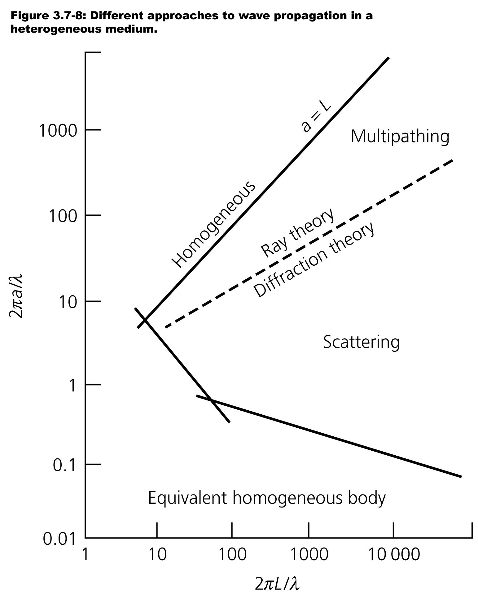
ATTENUATION
Multipathing or scattering ?
When the heterogeneity is large compared to the wavelength, we regard the wave as following a distinct ray path possibly distorted by multipathing.
When velocity heterogeneities are close in size to the wavelength, we think of scattered energy rather than distinct ray paths.
When heterogeneities are << than the wavelength, they simply change the medium's overall properties. The further the wave travels in the heterogeneous region, the more useful the scattering description becomes. Hence for longer distances, the wavelength range viewed as scattering increases.
a = size of heterogeneity; L = distance wave travels; λ = wavelength

Slide 51
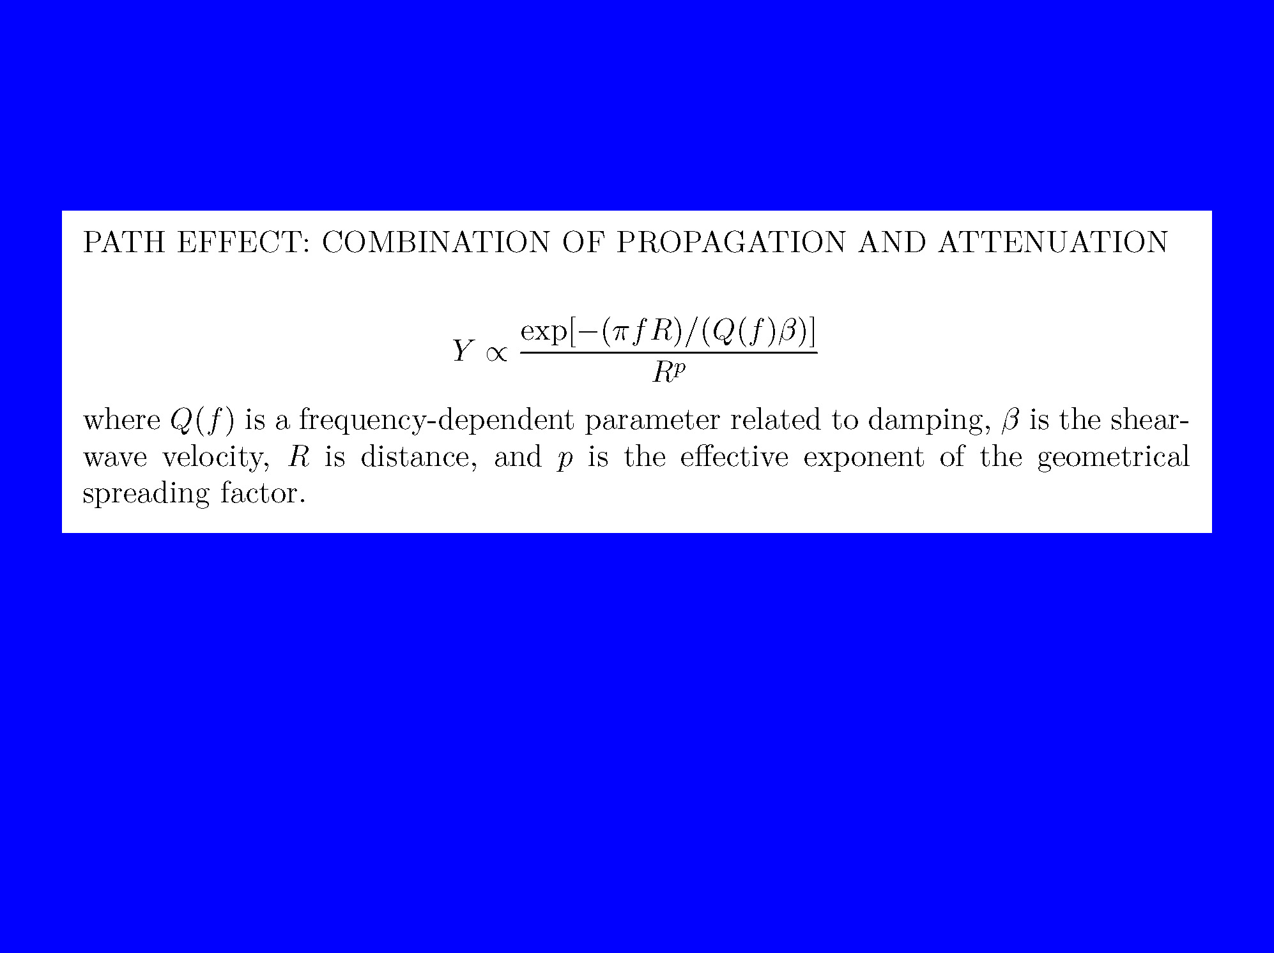

Slide 52
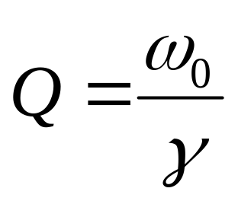
ANELASTICITY
Analogy with a damped oscillator

Slide 53
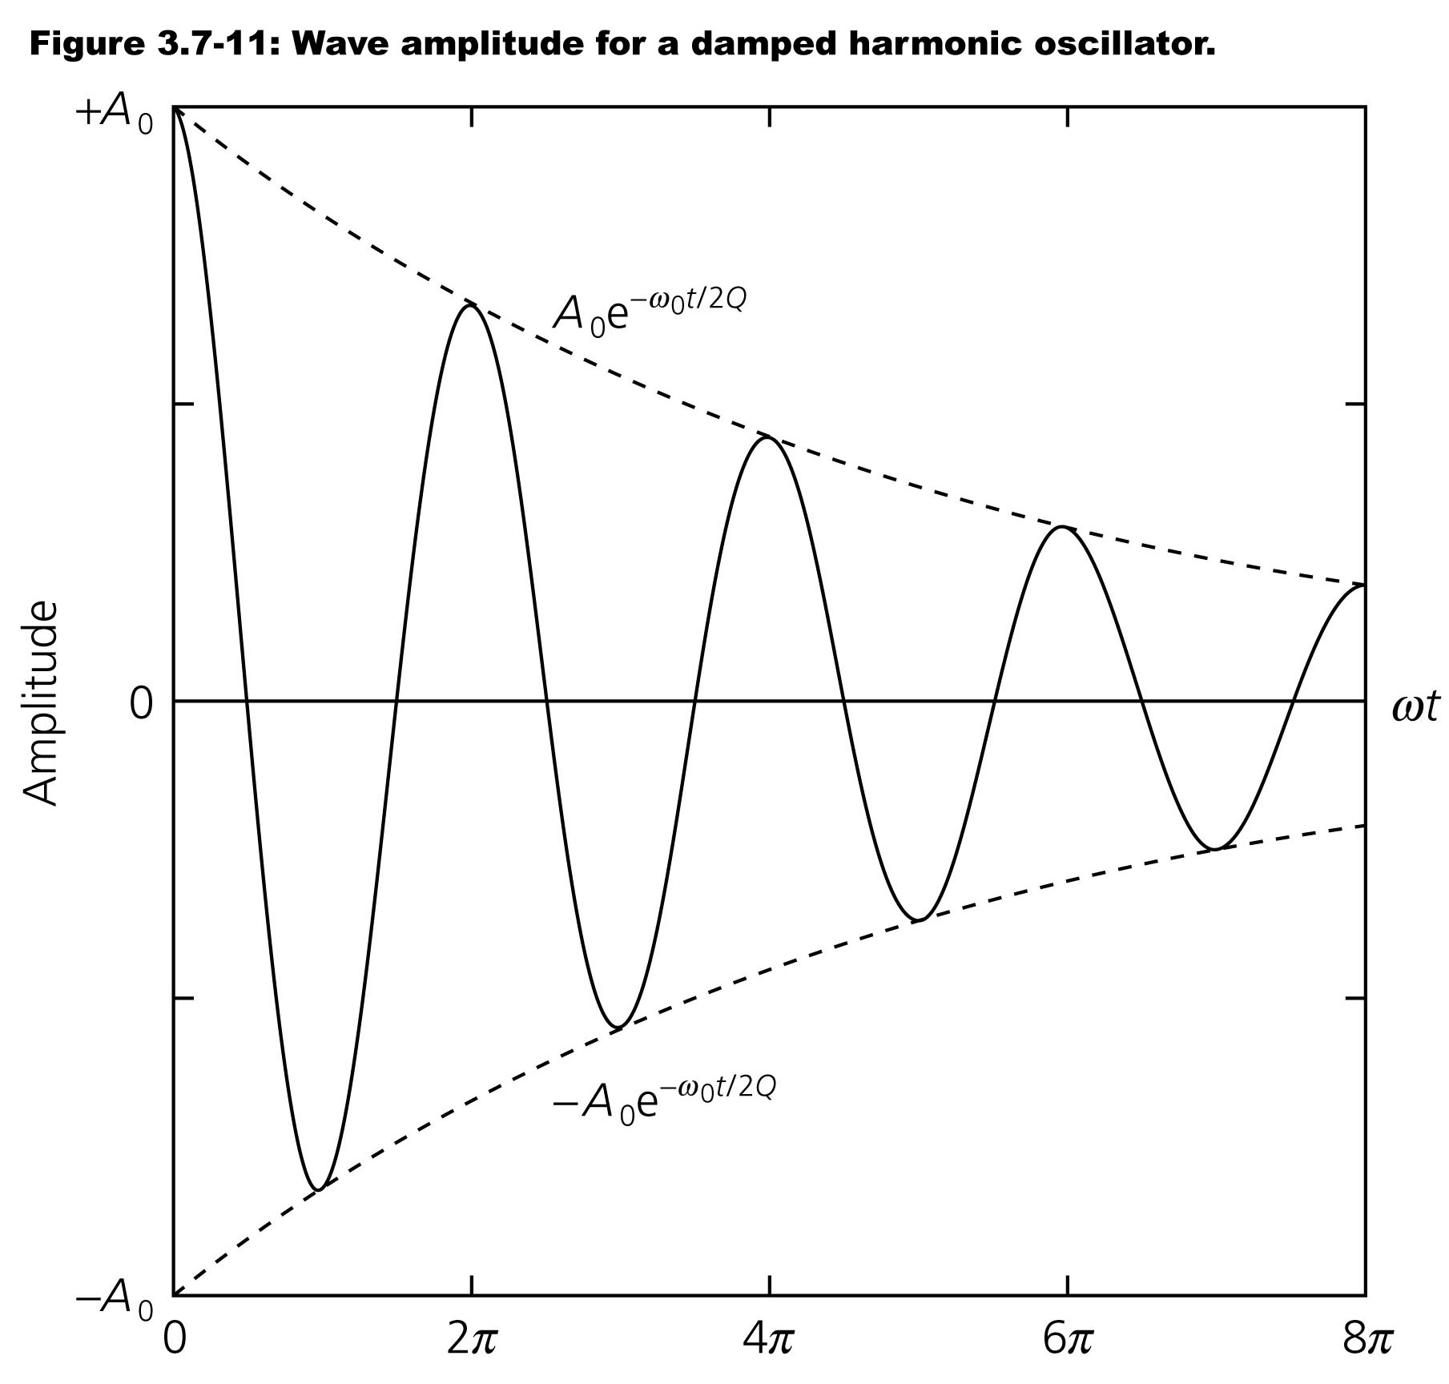
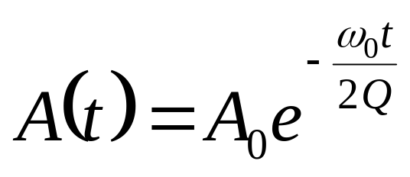
ANELASTICITY
Wave amplitude with time

Slide 54
ANELASTICITY
Effect in the frequency domain
Q and Q⁻¹
The solution for the damped harmonic oscillator incorporated the damping through the quality factor Q.
Attenuation for seismic waves and a variety of other physical phenomena are often discussed in terms of Q or Q ⁻¹.
Q ⁻¹ has the advantage that is directly rather than inversely proportional to the damping.
No attenuation -> Q = ∞ 1/Q =0
High attenuation -> Q low 1/Q high

Slide 55
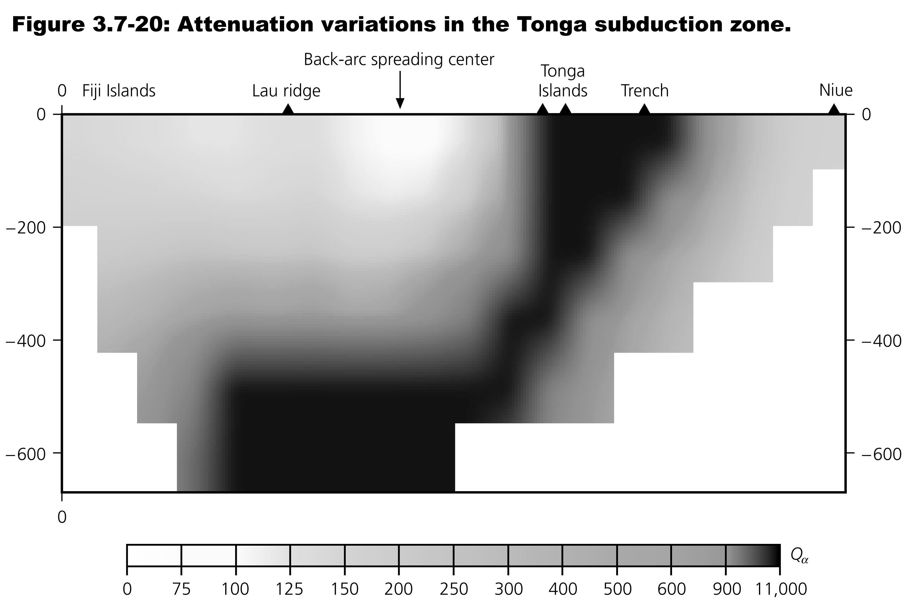
ANELASTICITY
Variations of Q
Q > 10,000 in the cold and rigid subducting slab but is less than 75 beneath the hot back-arc basin.

Slide 56
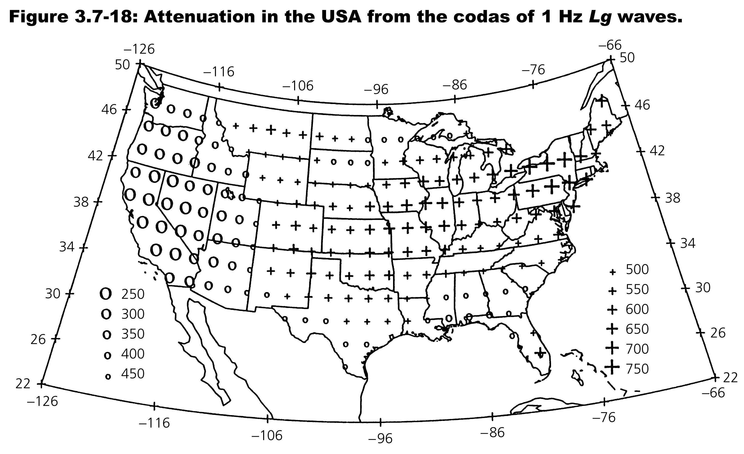
ANELASTICITY
Variations of Q

Slide 57
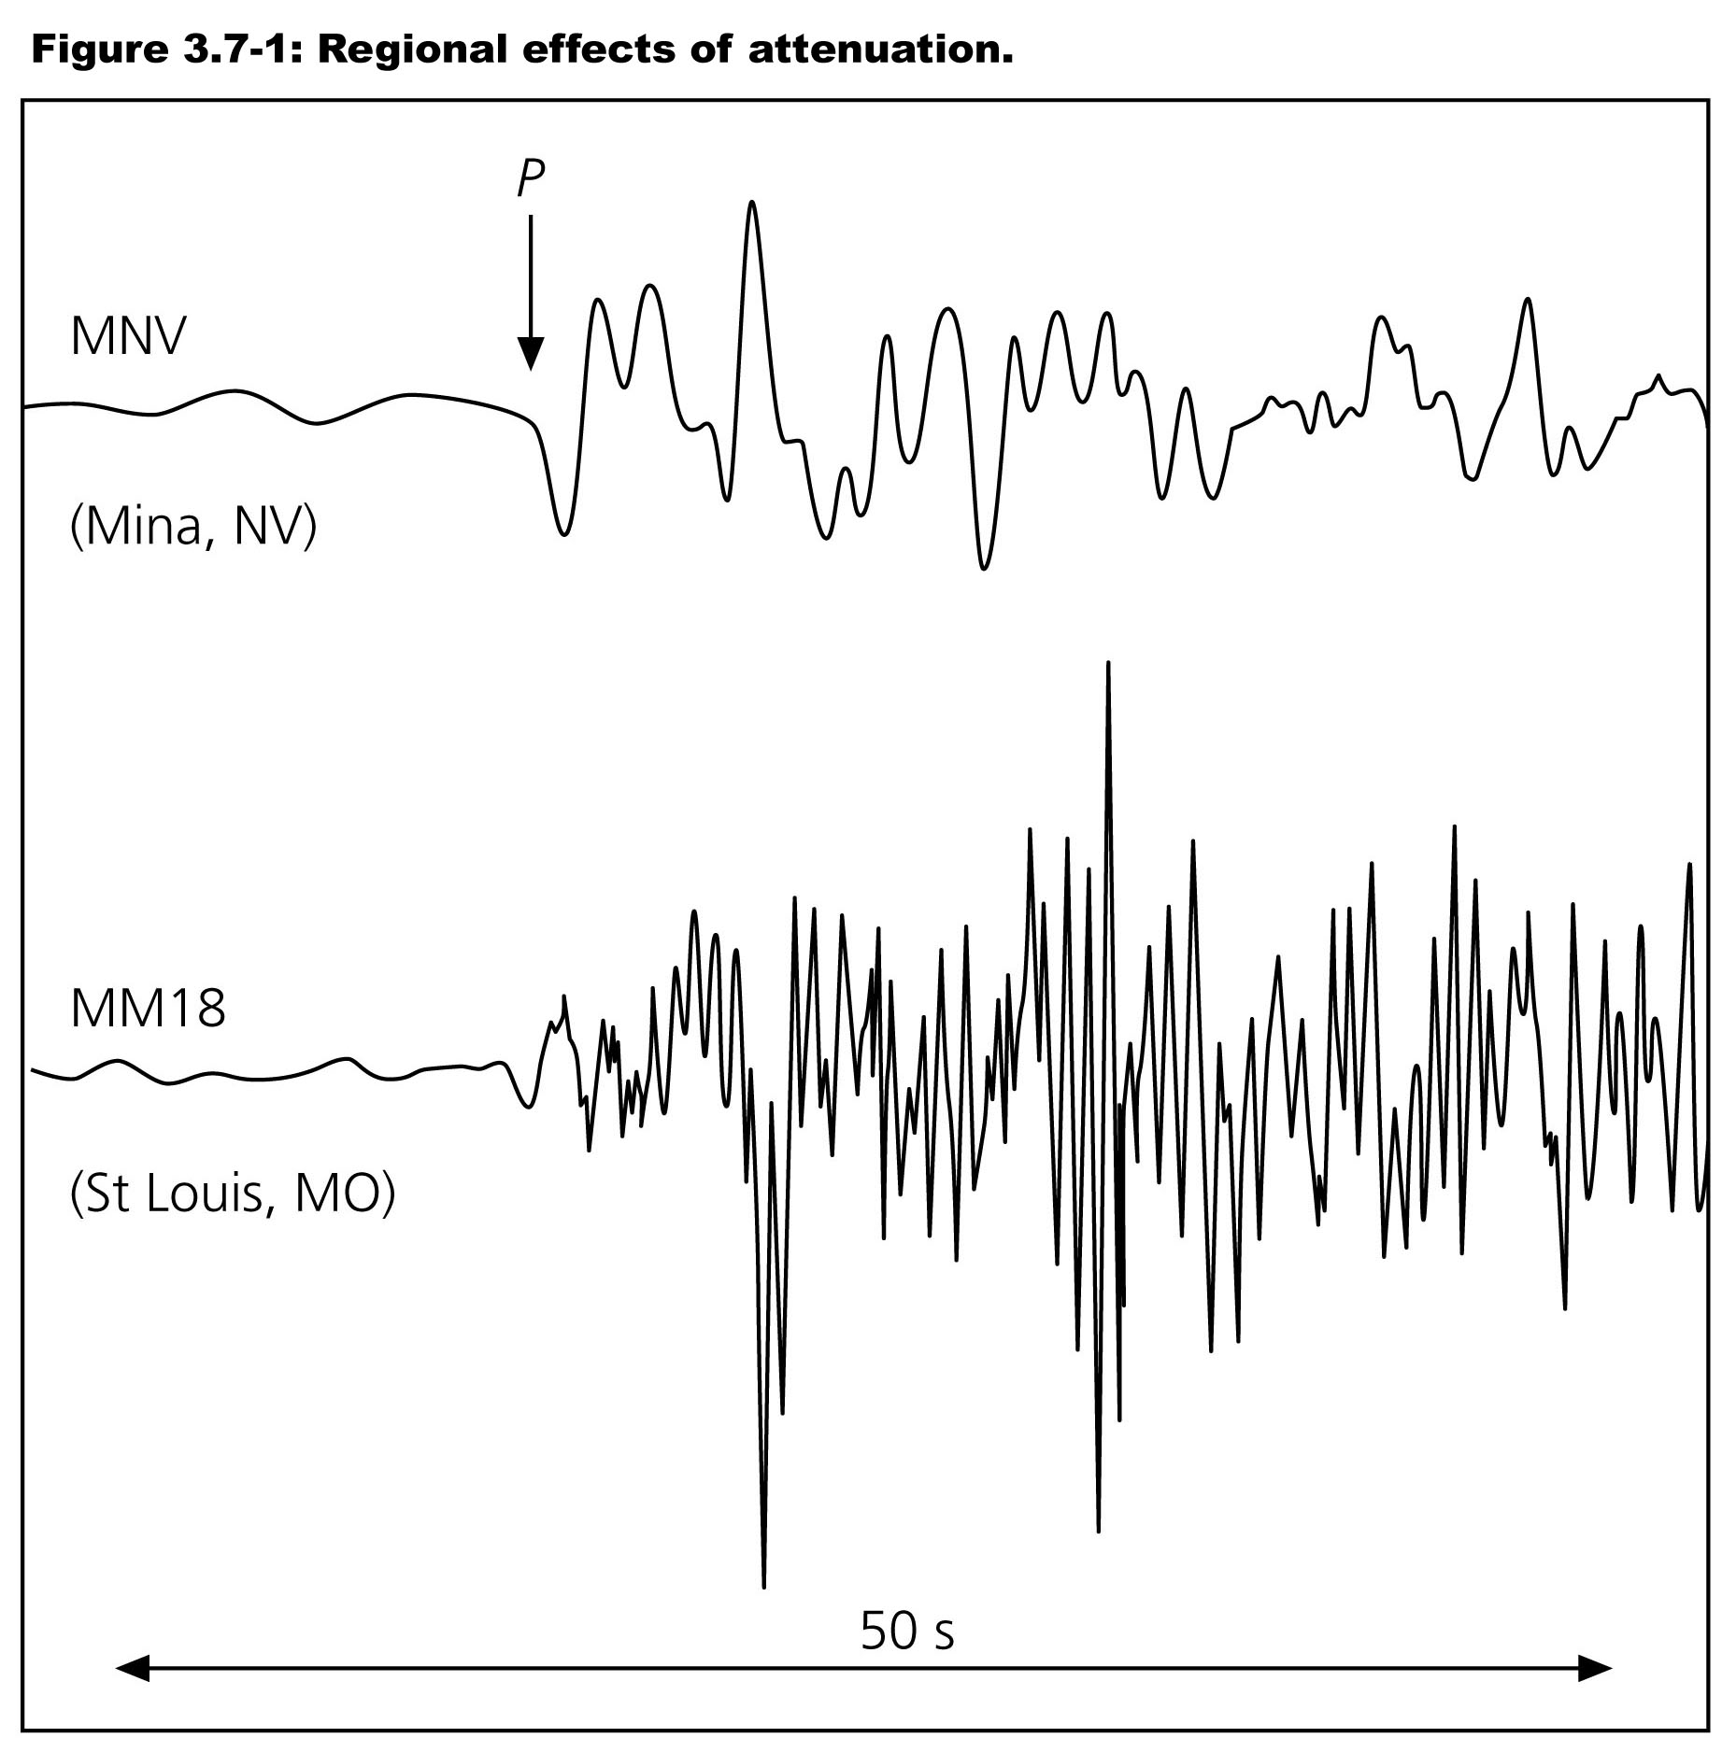
ANELASTICITY
Effect on waveform at regional scale
Seismograms from an earthquake in Texas
recorded in Nevada and Missouri.
The MNV record has less high frequency energy
because the tectonically-active western U.S.
is more attenuating than the stable mid-continent.

Slide 58
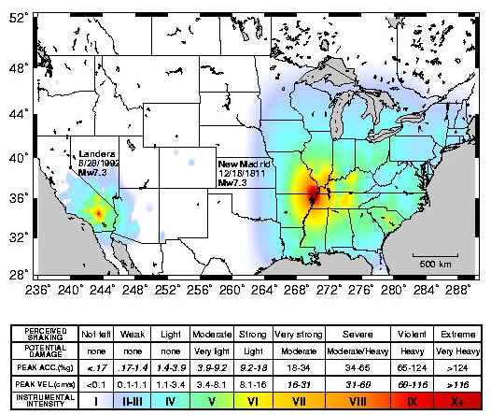
ANELASTICITY
Effect on waveform at regional scale

Slide 59
Path-independent filtering of high frequencies
Fmax? (Hanks)
Kappa? (Anderson & Hough)
Site or source effect? Does it matter (perhaps, if the parameter controlling the high frequency filtering is magnitude dependent, as it might be if a source effect)

Slide 60
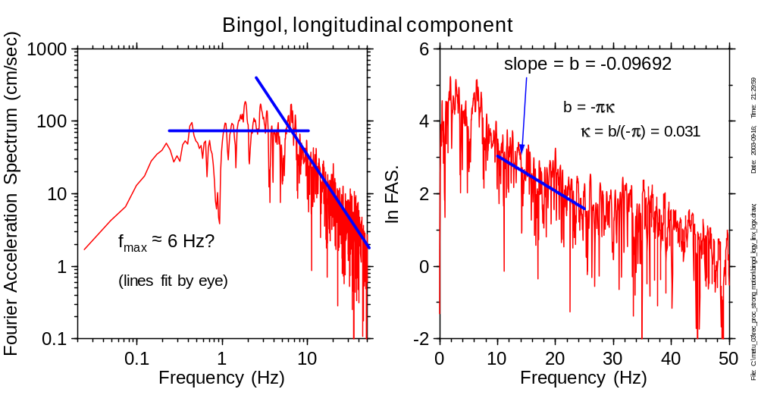
Two alternate parameters to control the reduction of high frequencies are f_{max} and κ (these parameters appear in functions that have the effect of filtering out the high frequencies)

Slide 61
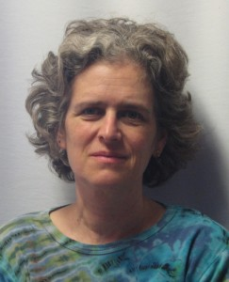

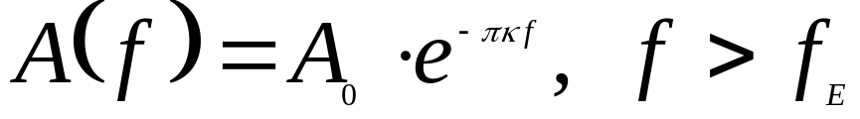
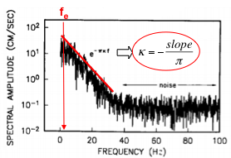
But the most-used factor to describe this ‘extra’ attenuation was given by Anderson & Hough (1984):
the spectral decay parameter… κ:
(holds for frequency-independent Q_{ef})
^{lin}
(From O. Ktenidou)

Slide 62

Plot κ against distance (each point corresponding either to a separate record at the same station, or separate recordings for the same earthquake), fit a line to the points. The zero-distance intercept is known as κ₀. The part that depends on distance is accounted for by the Q parameter discussed in the path effects section.

Slide 63

The attenuation controlled by both parameters is independent of the source-to-site distance. Here is a cartoon suggesting how this can be true:

Slide 64
FMAX or κ
Origin
Aki’s school
surface
OR
It exists a minimum size for the asperities of the fault
Anderson & Hough (1984)

Slide 65

ANELASTICITY
Effect in the frequency domain
Source convolved with high-frequency diminution
f

Slide 66
Site Effects, Basin Waves,Spatial Variability, Azimuthal Dependence

Slide 67
Basin Waves:
Path effect or site effect?

Slide 68


Slide 69


Slide 70


Slide 71
People have known for a long time that
motions on soil are greater than on rock
e.g., Daniel Drake (1815) on the 1811-1812 New Madrid sequence:
  "The convulsion was greater along the Mississippi, as well as along the Ohio, than in the uplands. The strata in both valleys are loose. The more tenacious layers of clay and loam spread over the adjoining hills … suffered but little derangement."

Slide 72

Steidl

Slide 73

Steidl

Slide 74

Site Classifications for Use With
Ground-Motion Prediction Equations
1. Rock/Soil
Rock = less than 5m soil over “granite”, “limestone”, etc.
Soil= everything else
2. NEHRP Site Classes (based on V_{S30})
620 m/s = typical rock
310 m/s = typical soil
3. Continuous Variable (V_{S30})

Slide 75


Time-averaged shear-wave velocity to depth z:
Average shear-wave slowness to depth z:

Slide 76


Slide 77
Why V_{S30}?
Most data available when the idea of using average Vs was developed were from 30 m holes, the average depth that could be drilled in one day
Better would be V_{sz}, where z corresponds to a quarter-wavelength for the period of interest, but
Few observations of V_{s} are available for greater depths
V_{sz} correlates quite well with V_{s30} for a wide range of z greater than 30 m (see previous slide, from Boore et al., BSSA, 2011, pp. 3046—3059)

Slide 78

V_{S30} as continuous variable
Note period dependence of site response

Slide 79

Simplest: Rock vs Soil
(E. Field)
Notes:
1994 was about the time the SCEC Phase III effort began
Also the year of the Northridge earthquake, which was part of the impetus for the phase III study.

Slide 80

2002 M 7.9 Denali Fault

Slide 81

Site Classes are based on the average shear-wave velocity in the upper 30 m (discussed later).

Slide 82


Slide 83

pulses 1 & 2: subevent 1
pulse 3: subevent 2
pulse 4: subevent 3
Remove high frequency by filtering to emphasize similarity of longer-period waveforms

Slide 84


Slide 85


Slide 86

Site Amplification from global database (NGA-West2):

Slide 87



Observations from global database (NGA-West2) can be modeled as:
or
with the results:

Slide 88
Spatial Variability
"It is an easy matter to select two stations within 1,000 feet of each other where the average range of horizontal motion at the one station shall be five times, and even ten times, greater than it is at the other”
John Milne, (1898, Seismology)

Slide 89


Slide 90


Comparing the 1966 and 2004 Aftershocks
Both Earthquakes Ruptured the Same Segment

Slide 91
But with Some Important Differences

Slide 92

Most Extensively Observed Earthquake to Date in the Near-Fault
Region

Slide 93


Slide 94

Potential Contributing Factors to the Observed Ground Motion
Site conditions
Rupture propagation
Stopping phases
Prestress (“Asperities”)
Fault geometry

Slide 95


Slide 96


Slide 97


Slide 98


Slide 99

A key concept in this course is the relation of frequency content of ground motion to such things as scaling with magnitude, attenuation with distance, and the effect of local site geology. In general things become more complex as frequency increases, leading to differences in deterministic and stochastic predictions of ground shaking.

Slide 100


Slide 101
Azimuth-dependent amplification of weak and
strong ground motions within a fault zone
(Nocera Umbra, central Italy)
G. Cultrera, A. Rovelli, G. Mele, R. Azzara,
A. Caserta, and F. Marra (2003)

Slide 102


Slide 103


Slide 104


Slide 105
CONTINUE WITH PINGTUNG

Slide 106
ATTENUATION
Definition
REFLECTION AND TRANSMISSION OF SEISMIC WAVES AT DISCRETE INTERFACES REDUCE THEIR AMPLITUDES.
FOUR OTHER PROCESSES ALSO REDUCE WAVE AMPLITUDES:
- GEOMETRICAL SPREADING
SCATTERING
MULTIPATHING
ANELASTICITY
THE FIRST THREE ARE ELASTIC PROCESSES, IN WHICH
THE ENERGY IN THE PROPAGATING WAVE FIELD IS CONSERVED.
IN CONTRAST, ANELASTICITY, SOMETIMES CALLED INTRINSIC ATTENUATION, INVOLVES CONVERSION OF SEISMIC ENERGY TO HEAT.

