Slide 1
Rose School Lecture – 2013
S. Akkar and D. M. Boore
Fundamentals of Seismology & Seismic Hazard Assessment
MEASURES OF STRONG MOTION and PROCESSING OF DATA

Slide 2
Ground-motion intensity measures (GMIMs) for engineering purposes
PGA, PGV
Response spectra (elastic, inelastic)
Others (Arias intensity (avg. spectra over freq.), power spectra, Fourier amplitude spectra, duration)
Time series

Slide 3
Ground-Motion Intensity Measures (GMIMs) can be grouped into three categories:
Amplitude parameters
Frequency content parameters
Strong ground motion duration parameters
Some of these parameters can describe only one characteristic feature of a ground motion. While others may reflect two or three features at the same time.
Strong Ground Motion Parameters – Data Processing
Dr. Sinan Akkar

Slide 4
Amplitude parameters
Strong Ground Motion Parameters – Data Processing
Dr. Sinan Akkar

Slide 5
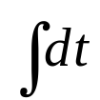

Time series is the most common way of describing a ground motion. The time series of a ground motion can be
a
Acceleration: shows a significant proportion of relatively high frequencies.
t
v
Velocity: shows substantially less high frequency motion than the acceleration.
t
d
t
Displacement: dominated by relatively low frequency motion.
Strong Ground Motion Parameters – Data Processing
Dr. Sinan Akkar

Slide 6
Peak ground acceleration (PGA)
Largest absolute value of acceleration obtained from an accelerogram.
t
easy to measure because the response of most instruments is proportional to ground acceleration
liked by many engineers because it can be related to the force on a short-period building
convenient single number to enable rough evaluation of importance of records

Slide 7
Peak ground acceleration (PGA)
BUT it is not a measure of the force on most buildings
and it is controlled by the high frequency content in the ground motion (i.e., it is not associated with a narrow range of frequencies); records can show isolated short-duration, high-amplitude spikes with little engineering significance
It is not associated with a specific frequency of ground shaking

Slide 8
Peak ground velocity (PGV)
(obtained from single integration of acceleration time series)
Many think it is better correlated with damage than other measures
It is sensitive to longer periods than PGA (making it potentially more predictable using deterministic models)
BUT it requires digital processing (no longer an important issue)

Slide 9
Peak ground displacement (PGD)
(obtained from double integration of acceleration time series)
The best parameter for displacement-based design?
BUT highly sensitive to the low-cut (high-pass) filter that needs to be applied to most records (in which case the derived PGD might not represent the true PGD, unlike PGA, for which the Earth imposes a natural limit to the frequency content). For this reason I recommend against the use of PGD.

Slide 10
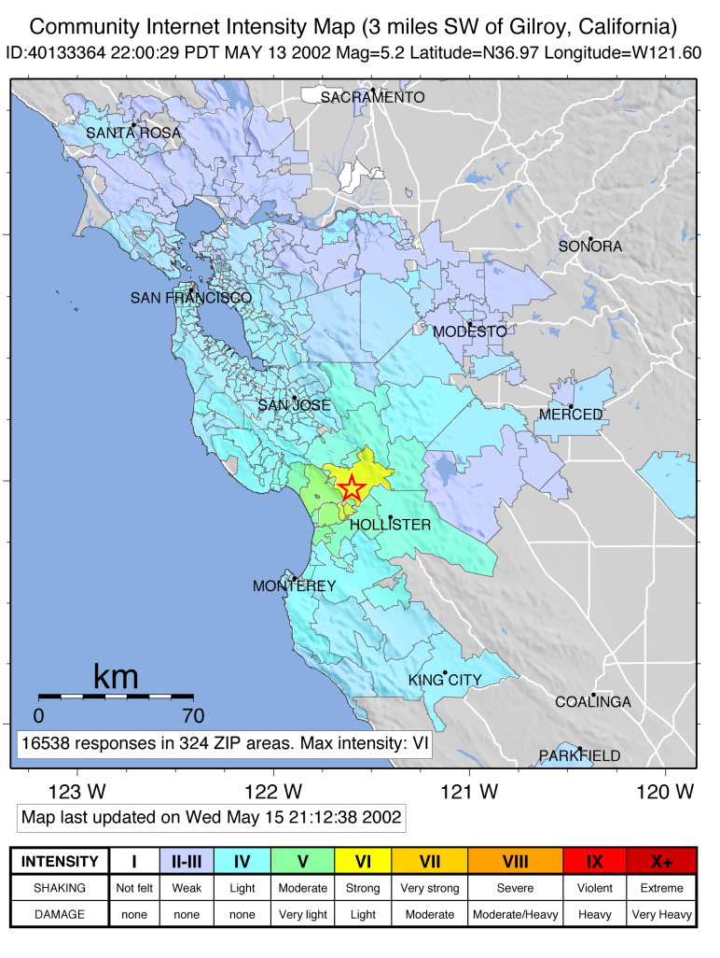
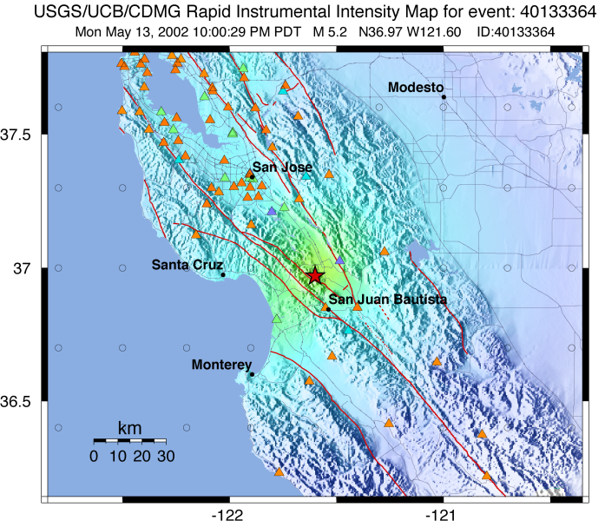
PGA and PGV can be used for a rapid response to picture the extent and variation of ground shaking throughout a well-instrumented, seismic-prone region.
Read PGAs and PGVs from the strong motion instruments
Use the relevant relations and derive intensities.
Draw these maps (ShakeMap) to portray the event
Courtsey of Dave Wald
Strong Ground Motion Parameters – Data Processing
Dr. Sinan Akkar

Slide 11
Note that
  The maps should only serve for a rapid (preliminary) detection of the earthquake extent.
  One shortcoming of ShakeMaps is that they need a dense array for the computation of peak ground motion amplitudes. For regions where the instrumentation is scarce, the shake map is produced through ground-motion prediction equations (GMPEs) that should be chosen very carefully to reflect the seismicity of the region.
  These maps should be used with caution because of the large dispersion on the computed regression equations.
  For more information: http://www.shakemap.org
Strong Ground Motion Parameters – Data Processing
Dr. Sinan Akkar

Slide 12
Frequency content parameters
Strong Ground Motion Parameters – Data Processing
Dr. Sinan Akkar

Slide 13
The dynamic response of structural systems, facilities and soil is very sensitive to the frequency content of the ground motions.
The frequency content describes how the amplitude of a ground motion is distributed among different frequencies.
The frequency content strongly influences the effects of the motion. Thus, the characterization of the ground motion cannot be complete without considering its frequency content.
Strong Ground Motion Parameters – Data Processing
Dr. Sinan Akkar

Slide 14
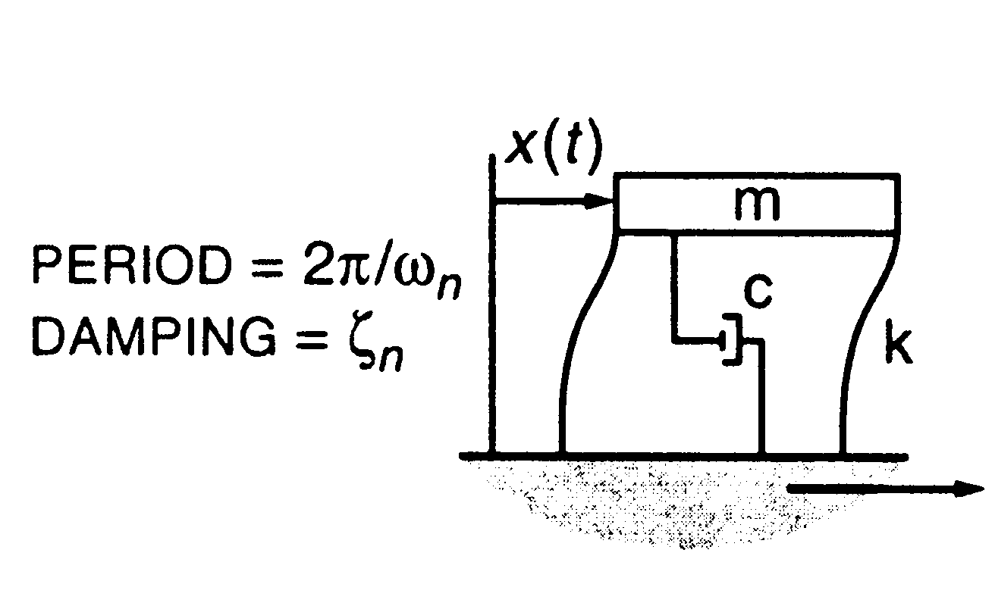

Elastic response spectra (many structures can be idealized as SDOF oscillators)

Slide 15
Single Degree of Freedom (SDOF) Harmonic Oscillator
Total displacement
u^{t} = u_{g} + u
represents the mass of the system
m
m
k
represents the mechanical properties of the system (stiffness).
Relative displacement
k, c
c
represents the energy dissipation mostly due to friction, opening and closing of microcracks, friction between structural and nonstructural components etc (viscous damping coefficient).
u_{g}
Ground displacement
Strong Ground Motion Parameters – Data Processing
Dr. Sinan Akkar

Slide 16
F_{I}
Dynamic Equilibrium
m
F_{D}
F_{S}
F_{S} + F_{D} + F_{I} = 0
F_{S} = ku
internal force due to relative displacement u.
.
F_{D} = cu
internal force due to elative velocity acting on the viscous damping c.
..
F_{I} = mu_{t}
inertia force due to total acceleration acting on the mass m.
Strong Ground Motion Parameters – Data Processing
Dr. Sinan Akkar

Slide 17
F
F_{S} = ku
k
For elastic systems:
u
Equation of motion
..
.
..
mu + cu + ku = -mu_{g}
F
.
Depends prior deformation history and whether deformation is currently increasing (u > 0) or decreasing (u < 0)
F_{S} = f(u,u)
For inelastic systems:
u
.
.
Equation of motion
..
.
.
..
mu + cu + F_{S}(u,u) = -mu_{g}
Strong Ground Motion Parameters – Data Processing
Dr. Sinan Akkar

Slide 18
The equation of motion for an elastic system can be solved either analytically or numerically. However, there are very few cases in which the equation of an inelastic system can be solved analytically. The solutions for the inelastic case is usually numerical.
Nonlinear oscillator response is out of scope of this lecture
Strong Ground Motion Parameters – Data Processing
Dr. Sinan Akkar

Slide 19
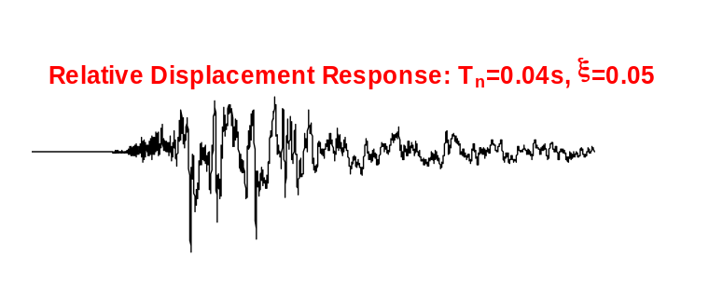
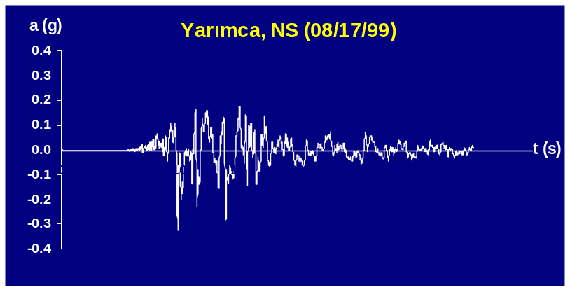
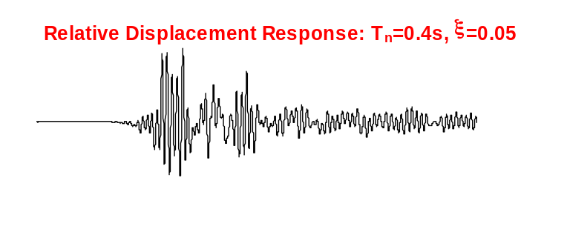
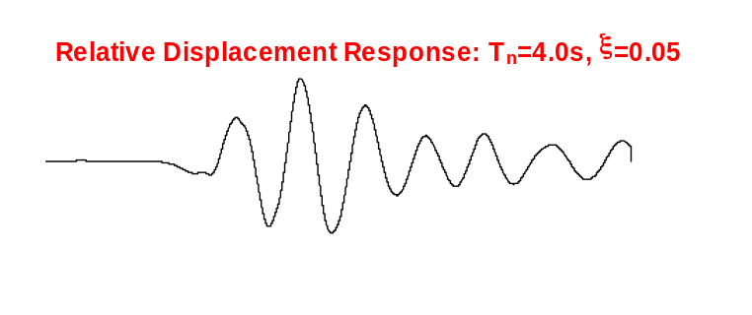
Critical damping, ξ and natural frequency ω_{n} are the primary factors that effect the SDOF elastic response:
For a constant damping:
As the period of vibration grows, the oscillator response is dominated by the long period components of the ground motion.
Strong Ground Motion Parameters – Data Processing
Dr. Sinan Akkar

Slide 20
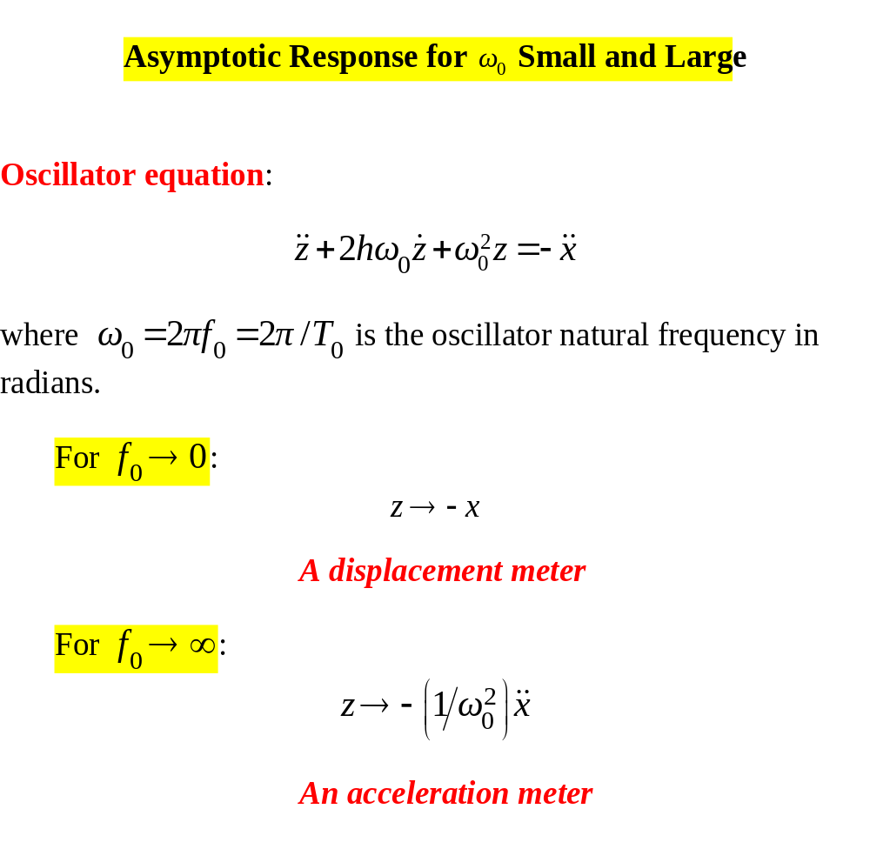
Important Asymptotic Cases (for which it is easy to solve the oscillator equation)

Slide 21
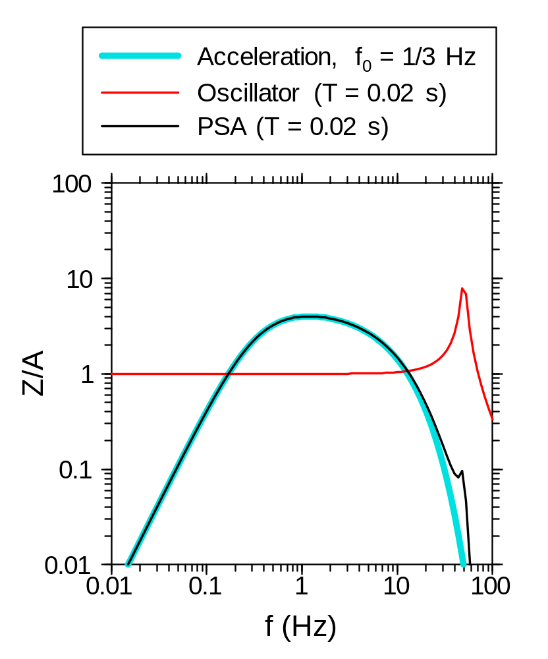
Short-period oscillator response = PGA

Slide 22
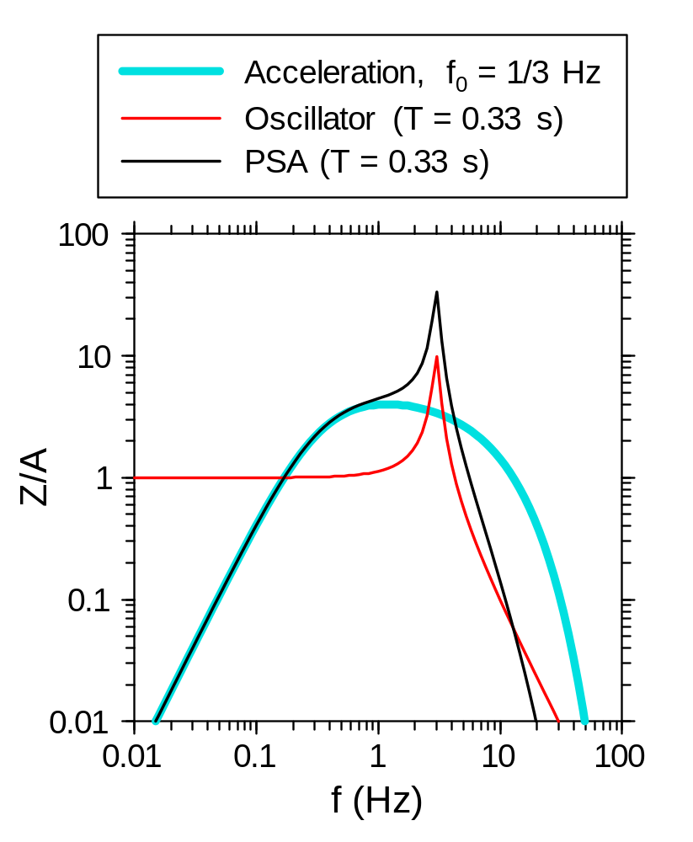
intermediate-period oscillator response not a relatively broadband motion PGA or PGD, but it is more oscillatory

Slide 23
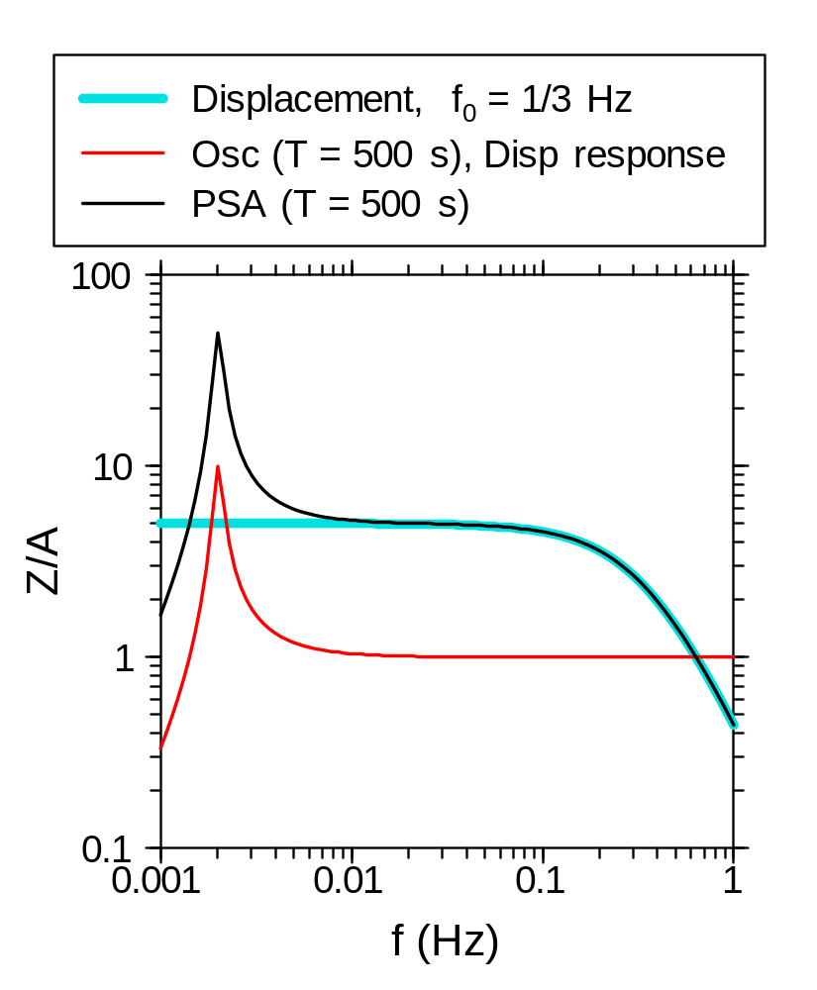
Long-period oscillator response = PGD (best seen by looking at the displacement response of the oscillator to the spectrum of ground displacement)

Slide 24
Elastic Response Spectrum
ω_{n}(T_{n})
ω₁(T₁)
ω₂(T₂)
ω₃(T₃)
. . . .
A plot of the absolute peak values of an elastic response quantity as a function of vibration period T_{n} of an SDOF system, or a related parameter such as circular frequency ω_{n} or cyclic frequency f_{n}. Each such plot is for a fixed damping ratio, ξ.

Slide 25
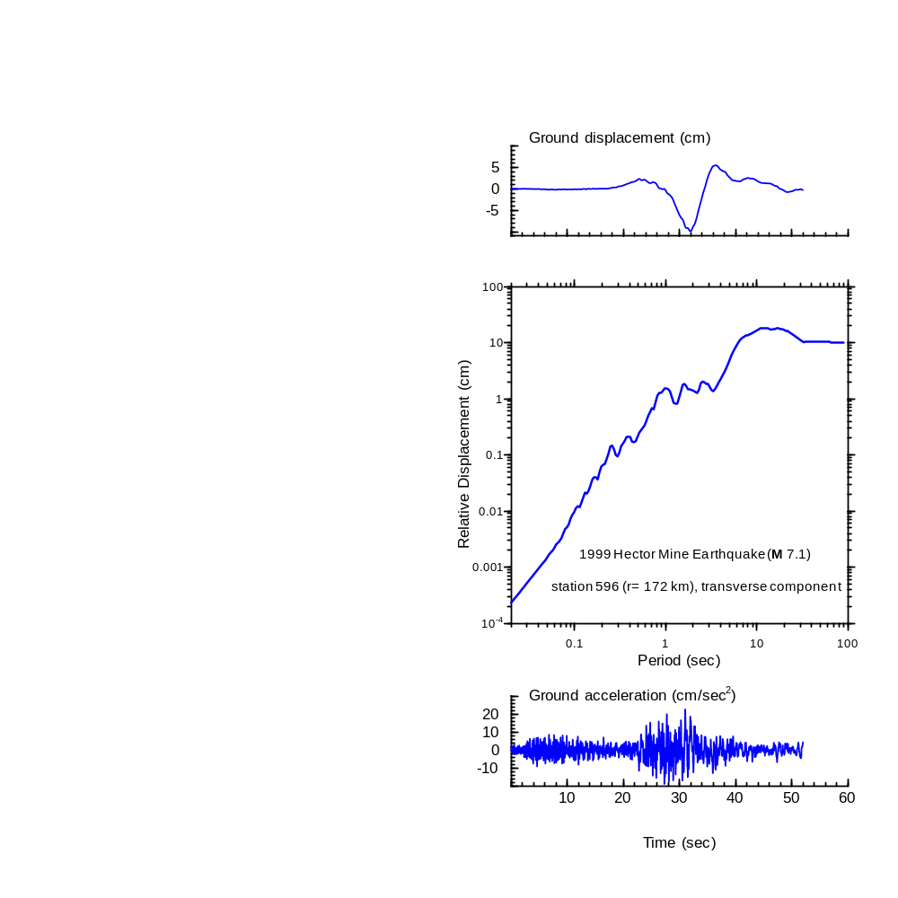

Slide 26
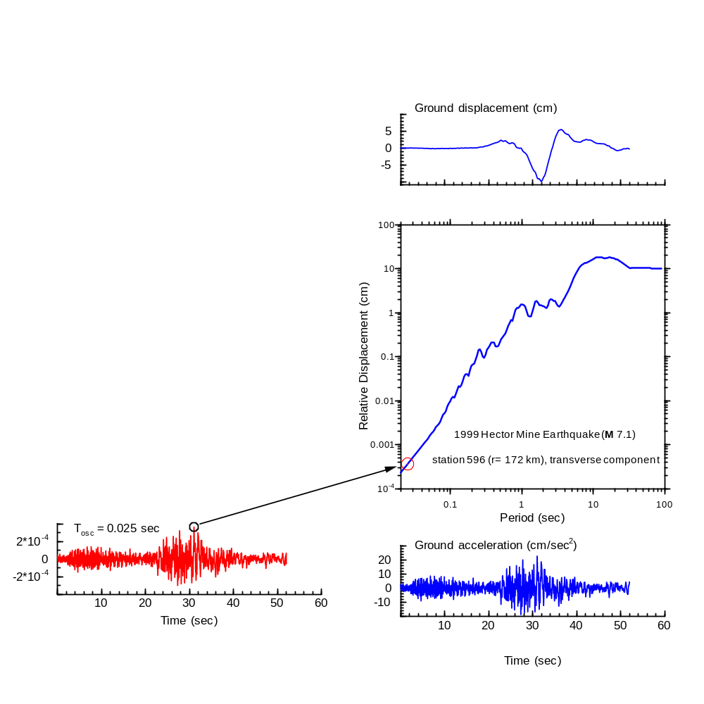
At short periods, oscillator response proportional to base acceleration

Slide 27
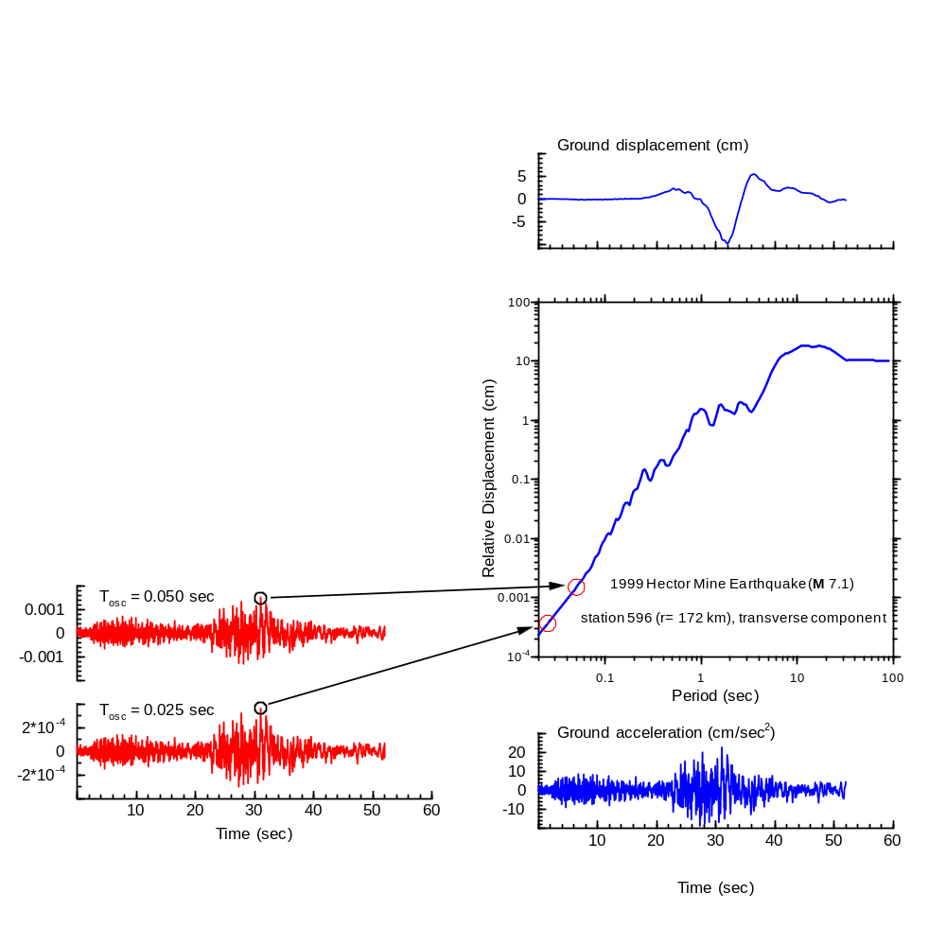

Slide 28
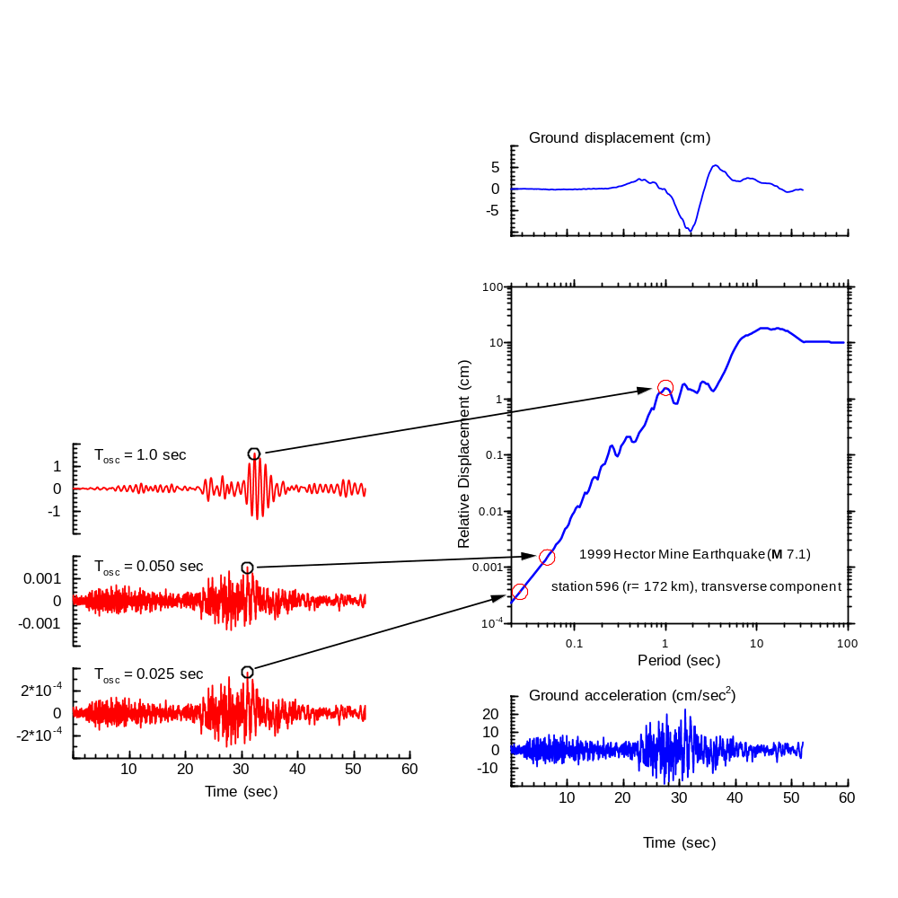

Slide 29
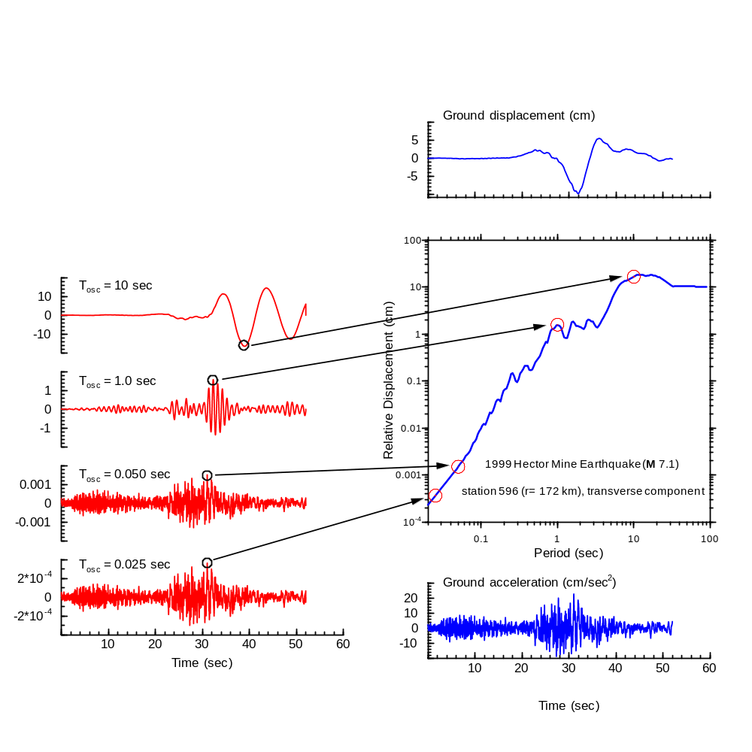

Slide 30
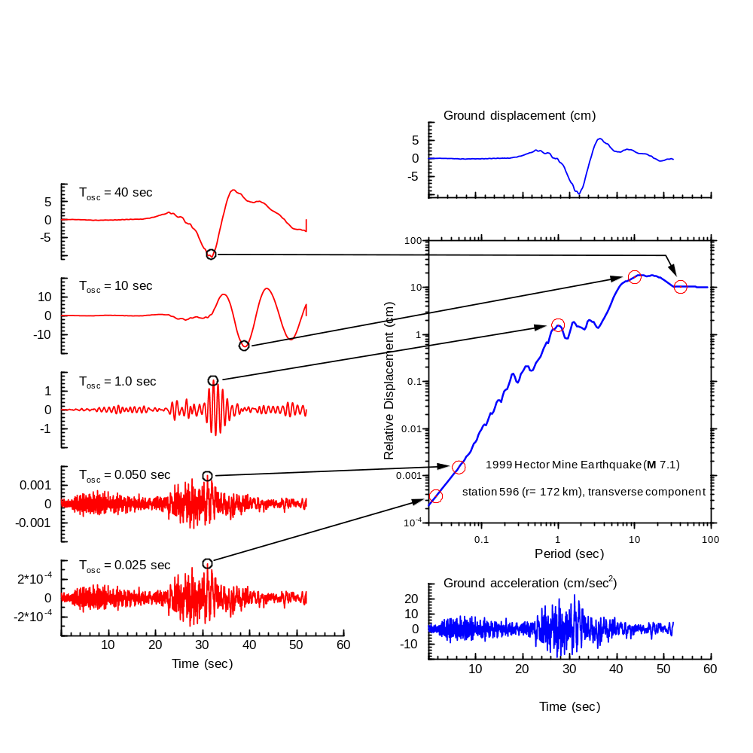

Slide 31
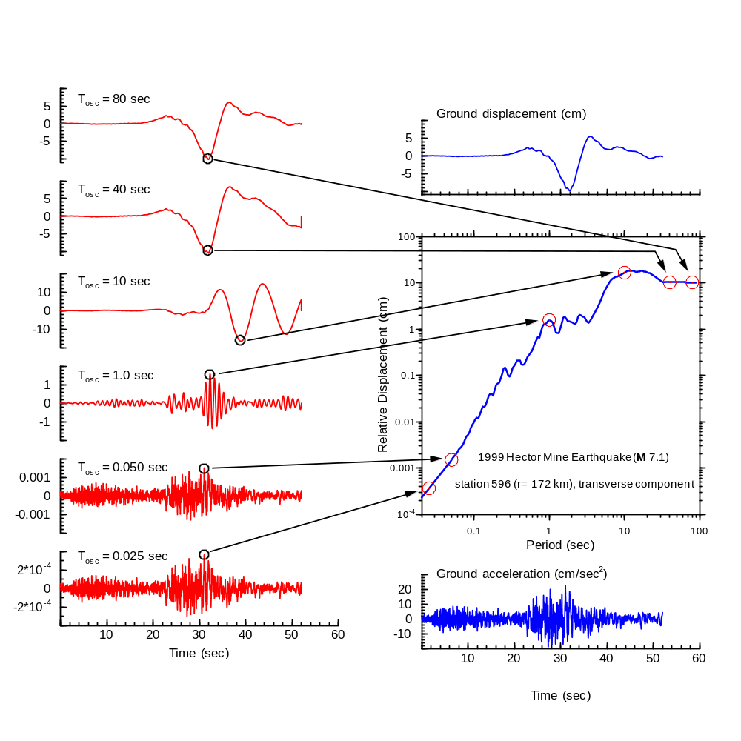
At long periods, oscillator response proportional to base displacement

Slide 32
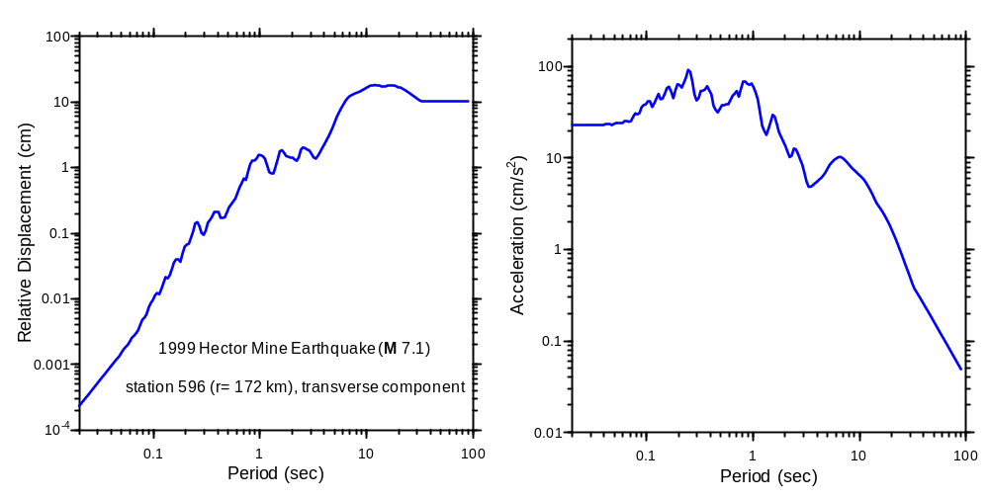
convert displacement spectrum into acceleration spectrum (multiply by (2π/T)²)--
Acceleration spectrum usually used in engineering

Slide 33
Types of Response Spectra
SD: relative displacement response
PSA: pseudo-absolute response spectral acceleration
SA: absolute response spectral acceleration
PSV: pseudo-relative response spectral velocity
RV: relative response spectral velocity
Prefer PSA (simply related to SD, same ground-motion prediction equations can be used for SD and PSA)
See aa_pa_rv_pv_2.pdf on the Dave’s Notes page of my web site (www.daveboore.com) for details (but somewhat different notation)

Slide 34
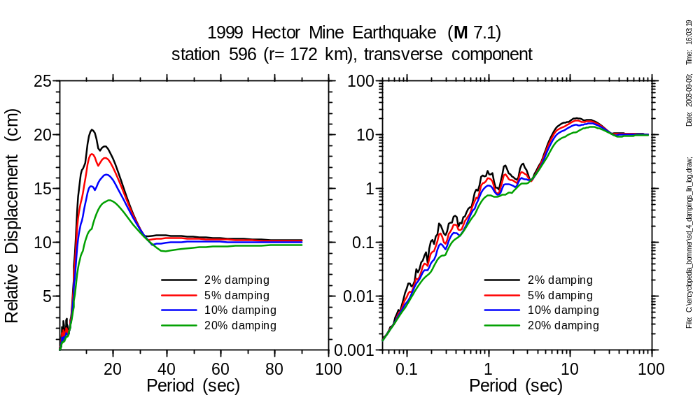
At short and very long periods, damping not significant (lin-lin and log-log plots to emphasize different periods of motion):

Slide 35
Why is a RS Useful?
Buildings can be thought of as single-degree of freedom harmonic oscillators with a damping (nominally 5%) and free period (about 0.1 s per story)
A RS for a given record then gives the response of a building for the buildings resonant period and damping

Slide 36
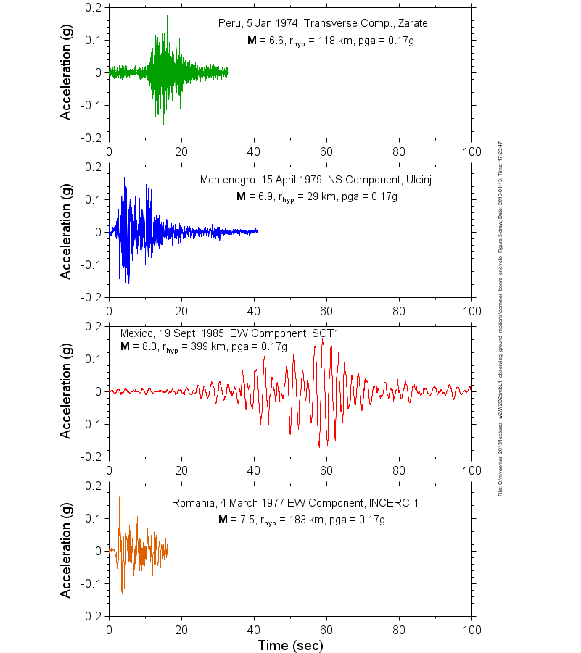
PGA generally a poor measure of ground-motion intensity. All of these time series have the same PGA:
(Could not show this before because the next slide, which is associated with this slide, uses response spectra, so I had to discuss that first)

Slide 37
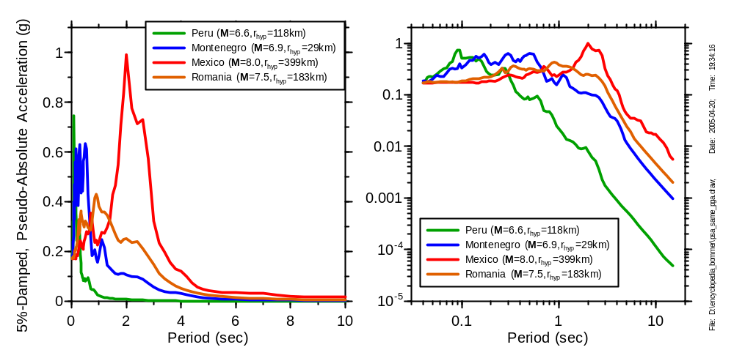
But the response spectra (and consequences for structures) are quite different (lin-lin and log-log plots to emphasize different periods of motion):

Slide 38
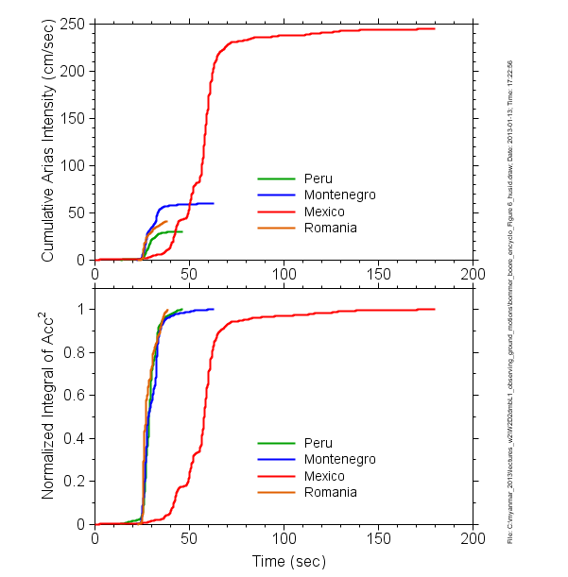
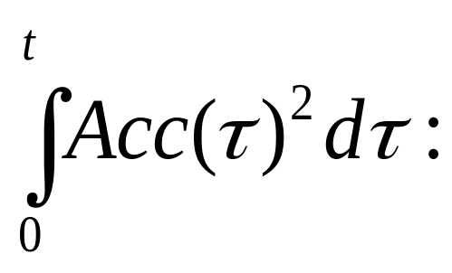
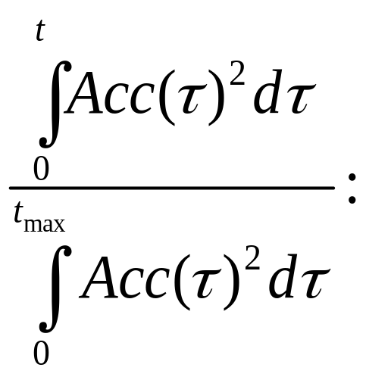

Slide 39
Dealing with Two Horizontal Components
Treat each independently
Choose a random component
Compute vector sum of RS for each period
Compute geometric mean for each period
Compute GMRotI50
Compute RotD50 (and RotD00, RotD100)

Slide 40
How RotDnn is Computed
Project the two as-recorded horizontal time series into azimuth Az
For each period, compute PSA, store Az, PSA pairs in an array
Increment Az by δα and repeat first two steps until Az=180
Sort array over PSA values
RotD50 is the median value
RotD00, RotD100 are the minimum and maximum values
NO geometric means are used

Slide 41
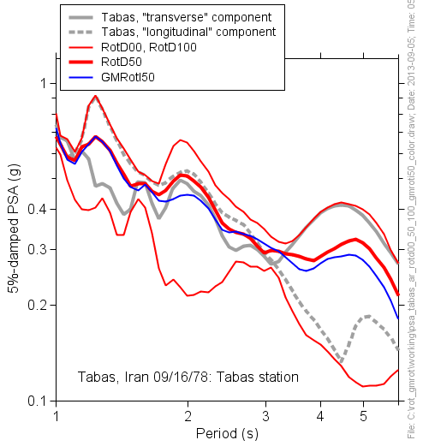

Slide 42
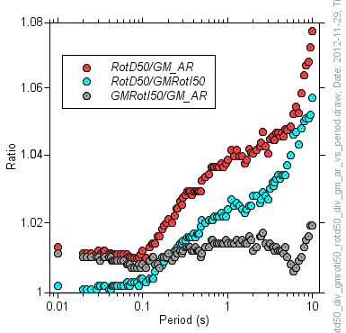
To convert GMPEs using random component as the IM (essentially, the as-recorded geometric mean), multiply by RotD50/GM_AR
To convert GMPEs using GMRotI50 as the IM (e.g., 2008 NGA GMPEs), multiply by RotD50/GMRotI50

Slide 43
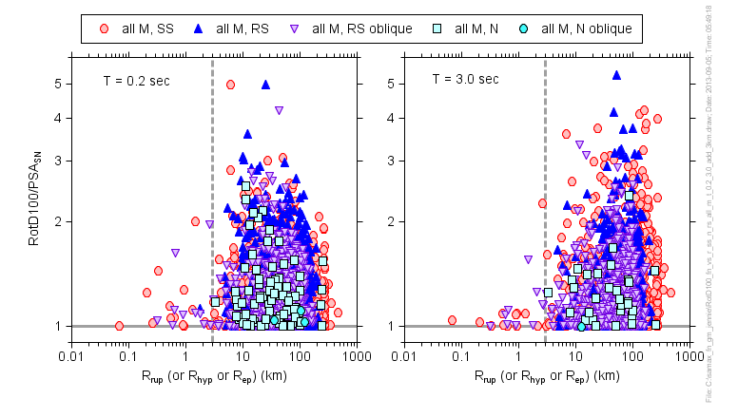

Slide 44
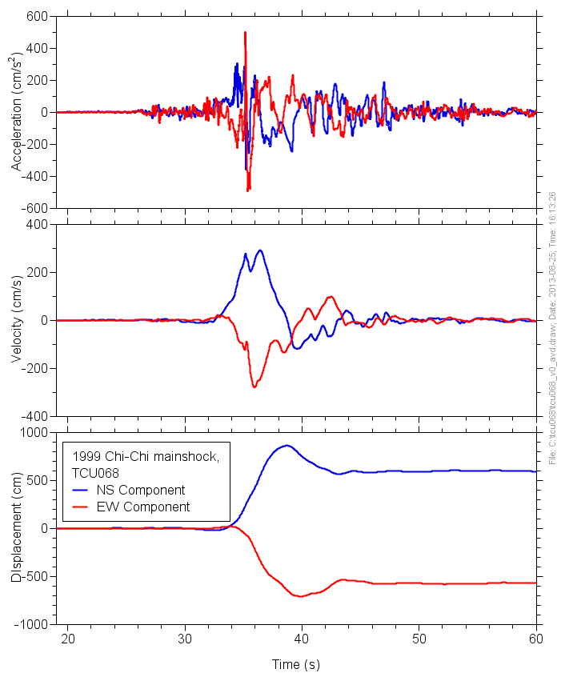
Long-period motions are usually more coherent (linearly polarized) than short-period motions

Slide 45
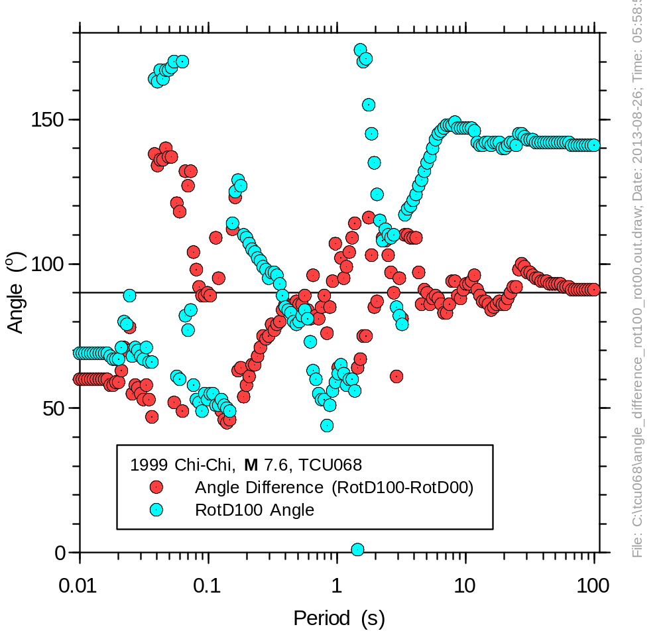
The RotD100 angle approaches a value of about 140° for periods longer than about 10 s, and because the motions are then close to being linearly polarized, the difference in angles for RotD100 and RotD00 is then about 90 °

Slide 46
References
Boore, D. M., J. Watson-Lamprey, and N. A. Abrahamson (2006). Orientation-independent measures of ground motion, Bull. Seismol. Soc. Am. 96, 1502-1511.
Boore, D. M. (2010). Orientation-independent, non geometric-mean measures of seismic intensity from two horizontal components of motion, Bull. Seismol. Soc. Am. 100, 1830-1835.

Slide 47
Duration parameters
Strong Ground Motion Parameters – Data Processing
Dr. Sinan Akkar

Slide 48
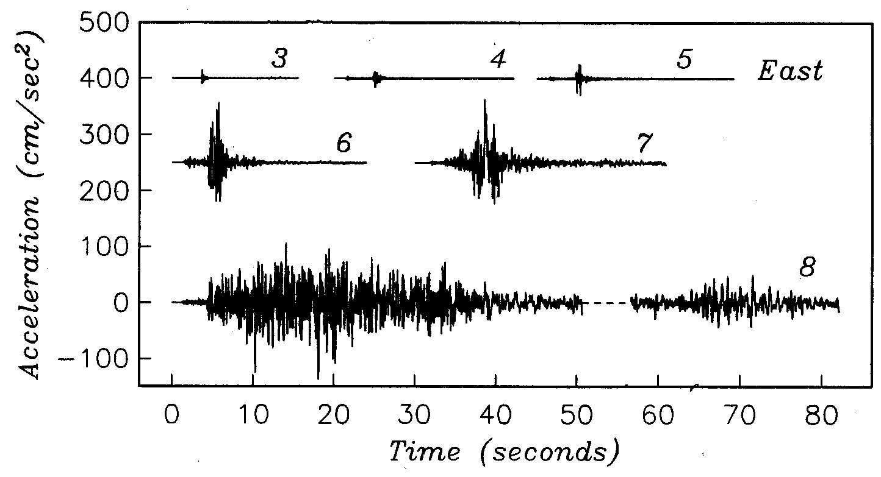
Strong ground motion duration is related to the earthquake magnitude
Data from Guerrero, Mexico (Anderson and Quaas, 1988)
Courtesy of Prof. John Anderson, University of Nevada at Reno
Strong Ground Motion Parameters – Data Processing
Dr. Sinan Akkar

Slide 49
Duration of strong ground motion plays an important role as amplitude and frequency content parameters in seismic hazard assessment
is important for the response of foundation materials as the build up of pore water pressure and essentially the liquefaction is strongly dependent on duration
Ground motion duration
is important for relatively weak and short period structures as their inelastic deformations are strongly dependent on duration (Mahin, 1980)
is important for any structure with stiffness and strength degrading characteristics
Strong Ground Motion Parameters – Data Processing
Dr. Sinan Akkar

Slide 50
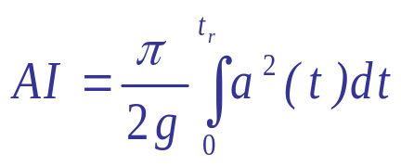
Bracketed durations (D_{b}): Total time elapsed between the first and last excursions of a specified level of acceleration, a_{o}.
Definitions for strong motion duration
Uniform durations (D_{u}): Defined by a threshold level of acceleration, a_{o} but not as an interval between the first and final peaks that exceed this level. It is the sum of the time intervals during which the acceleration is greater than the threshold.
Significant durations (D_{s}): based on the accumulation of energy in the accelerogram represented by the integral of the ground acceleration, velocity, or displacement. If integral is of ground acceleration then the quantity is related to Arias Intensity.
Strong Ground Motion Parameters – Data Processing
Dr. Sinan Akkar

Slide 51
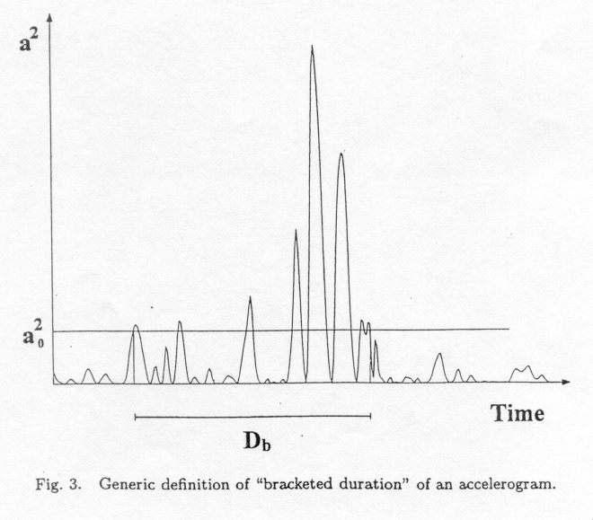
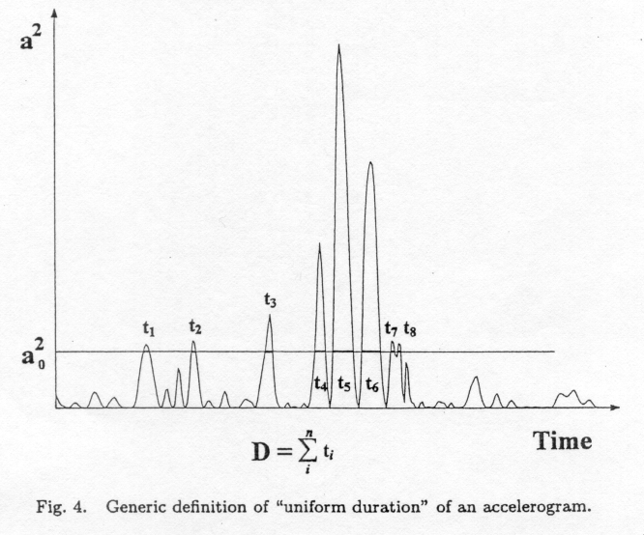
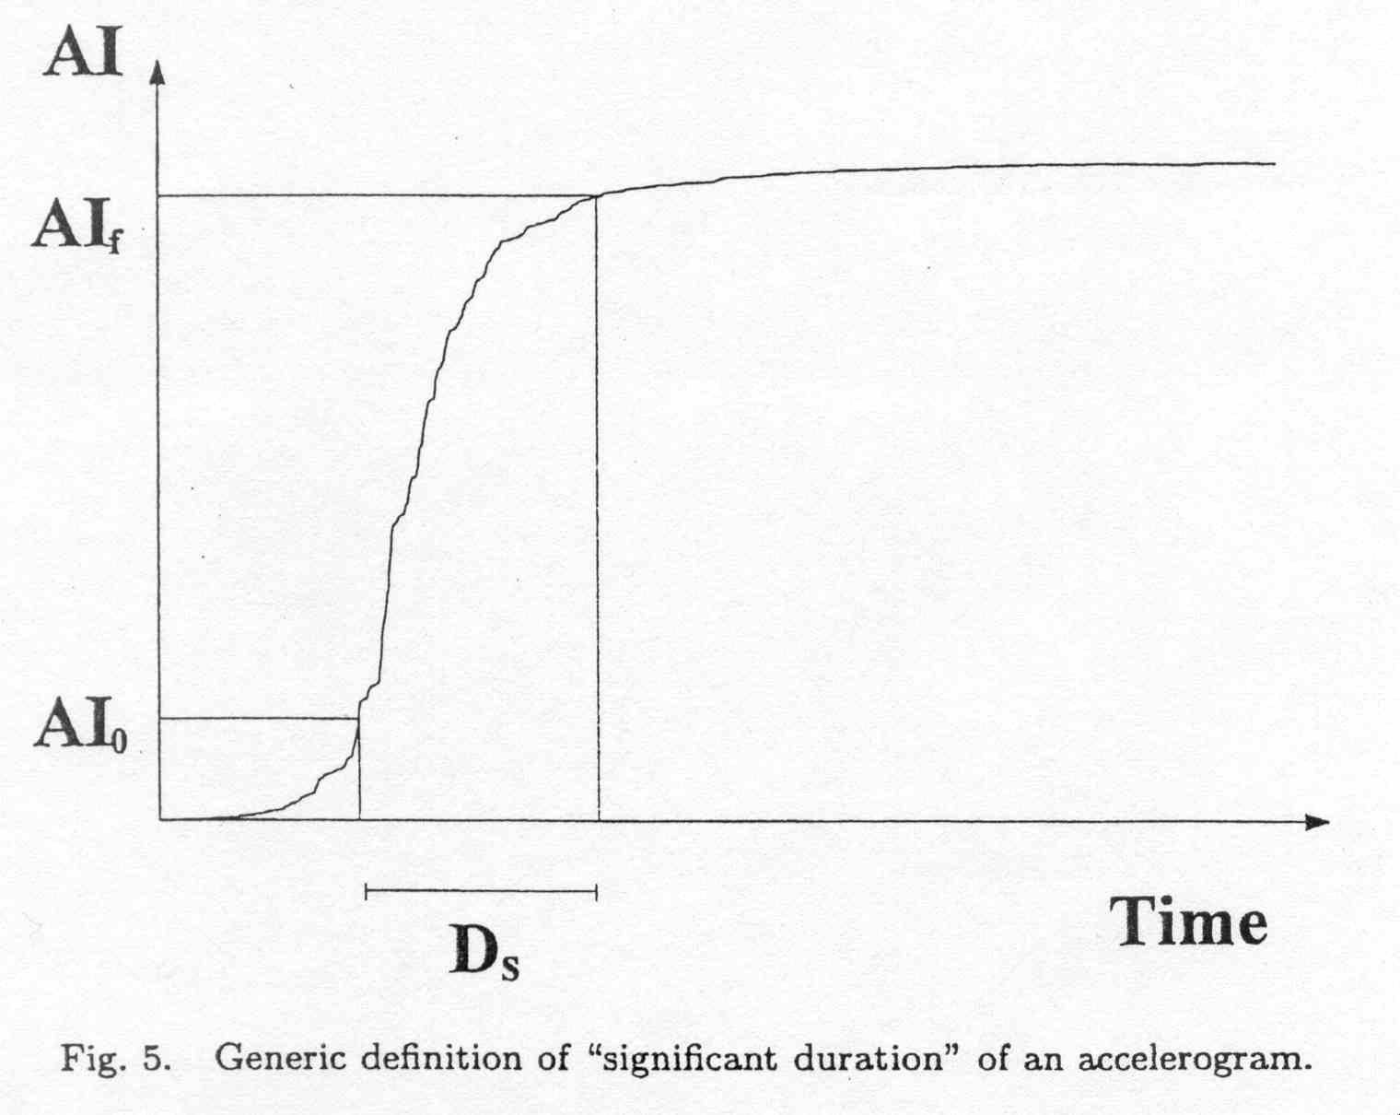
Bracketed duration
Uniform duration
Significant duration
Strong Ground Motion Parameters – Data Processing
Dr. Sinan Akkar

Slide 52
A well-known significant duration definition:
The interval between the times at which 5% and 95% of the total integral is attained (Trifunac and Brady, 1975) (currently, the 5%--75% duration seems to be used often).
AI
95%AI
5%AI
Bommer and Martinez-Pereíra, 1999
Strong Ground Motion Parameters – Data Processing
Dr. Sinan Akkar

Slide 53
The bracketed, uniform and significant durations are based on the characteristics of the record. There are a few other durations that are based on the response of a specified structure (Structural response based).
However
Durations definitions that are based on ground motion characteristics are more relevant to seismic hazard assessment.
Strong Ground Motion Parameters – Data Processing
Dr. Sinan Akkar

Slide 54
For EQUAL ACCELERATIONS, greater duration is generally more damaging.
For EQUAL ENERGY, shorter duration represents more hazard.
Thus
One should be very careful when defining the strong motion duration.
Strong Ground Motion Parameters – Data Processing
Dr. Sinan Akkar

Slide 55
Other strong ground-motion parameters
Strong Ground Motion Parameters – Data Processing
Dr. Sinan Akkar

Slide 56
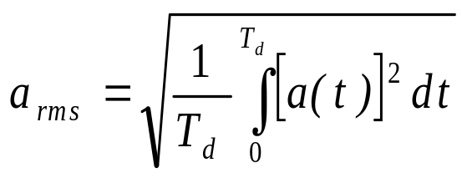
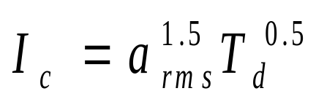
Root mean square (RMS) acceleration
Duration of the motion
reflects the effects of the amplitude and the frequency content of a strong motion record.
Ang (1990) described a “characteristic intensity” that is related linearly to structural damage due to maximum deformations and absorbed hysteretic energy.
Strong Ground Motion Parameters – Data Processing
Dr. Sinan Akkar

Slide 57
Arias Intensity: based on the integral of squared acceleration over time (“Husid” plots, shown in previous slides).

Slide 58
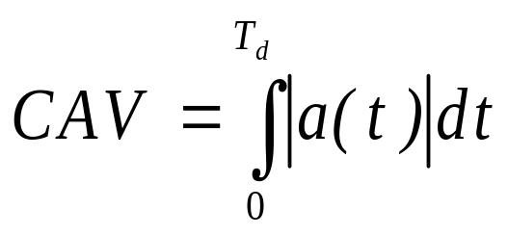
Cumulative absolute velocity
(Kramer, 1996)
The cumulative absolute velocity has been found to correlate well with the structural damage potential.
Definition of CAV according to Reed and Kennedy (1985):
Average value of the absolute value of acceleration during 1 sec time windows that include an acceleration of 0.025g or larger, multiplied by the total duration of the 1-sec time windows. Reed and Kennedy (1985) recommended that if CAV < 0.016g-sec, the ground motion will not be potentially damaging to engineered structures.
Strong Ground Motion Parameters – Data Processing
Dr. Sinan Akkar

Slide 59
STRONG MOTION DATA PROCESSING
Characterization of ground motions as well as seismic demand have been developed primarily from recordings obtained from strong-motion accelerographs.
Primary Processing Operations:
Baseline Correction
High-pass filtering
Strong Ground Motion Parameters – Data Processing
Dr. Sinan Akkar

Slide 60
The global databank of strong-motion accelerographs that has been accumulated since the first records were obtained in Long Beach, California, has been of prime importance to the development of earthquake engineering. (As of the end of 1980 there were about 1700 accelerographs in the US - 1350 of those in California-, and by January of 1982 over 1400 accelerographs in Japan).
Strong Ground Motion Parameters – Data Processing
Dr. Sinan Akkar

Slide 61
For a variety of reasons digitized strong-motion data contain noise (extraneous motions). For engineering uses of strong-motion data it is important to be able to estimate the level of noise present in each accelerogram and the degree to which this may affect different parameters that are derived from the records.
Main parameters of interest for engineering applications are
  ordinates of response spectra both for acceleration and displacement
  peak ground motion values (i.e. peak ground acceleration, velocity and displacement)
Strong Ground Motion Parameters – Data Processing
Dr. Sinan Akkar

Slide 62
Analog accelerographs
These instruments produce traces of the ground acceleration against time on film or paper. Most widely used analog instrument is the Kinemeterics SMA-1
Three important disadvantages of analog accelerographs:
Always triggered by a specified threshold of acceleration which means the first motions are often not recorded
The limitation of natural frequency of analog instruments. They are generally limited to about 25 Hz.
It is necessary to digitize the traces of analog instruments as they record on film or paper (most important disadvantage as it is the prime source of noise)
Strong Ground Motion Parameters – Data Processing
Dr. Sinan Akkar

Slide 63
Digital accelerographs
Digital accelerographs came into operation almost 50 years after the first analog strong motion recorders. Digital instruments provide a solution to the three disadvantages associated with the earlier accelerographs:
1. They operate continuously and by use of pre-event memory are able to retain the first wave arrivals.
2. Their dynamic range is much wider, the transducers having natural frequencies of 50 to 100 Hz or even higher
3. Analog-to-digital conversion is performed within the instrument, thus obviating the need to digitize the records.
Strong Ground Motion Parameters – Data Processing
Dr. Sinan Akkar

Slide 64
Noise characteristics of strong-motion data
Strong Ground Motion Parameters – Data Processing
Dr. Sinan Akkar

Slide 65
It is important for strong-ground motion users to appreciate that digitized accelerograms are never pure.
The purpose of processing accelerograms is to optimize the balance between acceptable signal-to-noise ratios and the information required for a particular application both of which depend on period or frequency.
Strong Ground Motion Parameters – Data Processing
Dr. Sinan Akkar

Slide 66
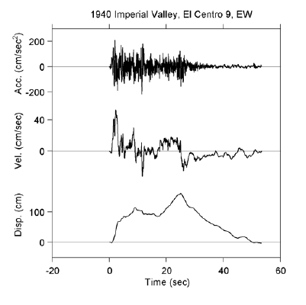
Analog accelerograms
The problems of noise in the analog record are generally not apparent from acceleration time-history. The most important effects of noise in the record only become apparent when the acceleration trace is integrated to obtain velocity and displacement time series
The velocity and displacements obtained from integration of accelerogram will generally appear unphysical: the ground motion appears as a single asymmetrical elastic displacement pulse of more than 2 m amplitude.
Strong Ground Motion Parameters – Data Processing
Dr. Sinan Akkar

Slide 67
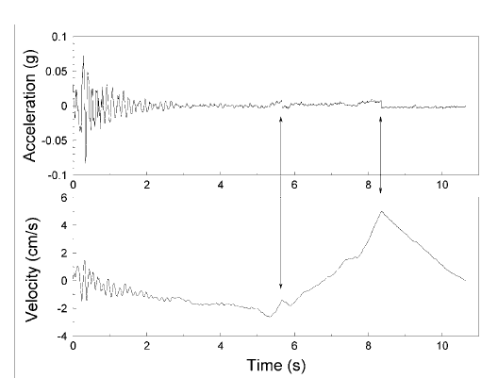
A problem encountered with some digitized analogue records is shifts in the baseline. (Result of the record being digitized in sections and not being correctly spliced)
The procedure to compensate for their effect is essentially the same for both analog and digital recordings; these are described in the succeeding slides
Strong Ground Motion Parameters – Data Processing
Dr. Sinan Akkar

Slide 68
The unphysical nature of the velocities and displacements obtained from integration are mostly the unknown baseline and long-period noise coming from variety of sources but predominantly from the imperfection of tracking in digitizers (Trifunac et al., 1973; Hudson, 1979; Trifunac and Todorovska, 2001). Long period error can also be introduced by lateral movements of the film during recording and warping of the analog record prior to digitization.
Strong Ground Motion Parameters – Data Processing
Dr. Sinan Akkar

Slide 69
It is not possible to identify, separate and remove the noise in order to recover the actual seismic signal.
The best that can be achieved is
  Identify those portions of the frequency content of the record where the signal-to-noise ratio is unacceptably low .
  Remove the contaminated frequencies from the record through processing.
Thus, we are not “correcting” the raw data but we are retrieving the most useful information through a suitable processing.
Strong Ground Motion Parameters – Data Processing
Dr. Sinan Akkar

Slide 70
Most analog accelerographs produce fixed traces
on the film together with the actual traces of motion. These fixed traces can (if digitized) can model the noise.
Unfortunately, the fixed traces are very often not digitized or else the digitized fixed traces are not kept. Hence it is rare that a model of the noise can be obtained from this information.
Shakal et al. (1984), Lee and Trifunac (1984) and Skarlatoudis et al. (2003) have examined the noise from fixed traces. Although they provide useful information these studies correspond to a particular combination of accelerograph and digitizer.
Strong Ground Motion Parameters – Data Processing
Dr. Sinan Akkar

Slide 71
Digital accelerograms
Digital accelerographs are superior then the analog accelerographs. They have improved dynamic range, higher sampling rate and there is no need of digitization process. However, the need to apply processing to the records is not entirely eliminated, as can be seen in the next figure.
The nature of baseline errors in digital recordings is distinct from those in digitized analog recordings. One advantage of digital recordings is that presence of the pre-event memory portion of the recordings. It provides a direct model for the noise in the record. However, in digital records the noise is actually associated with the signal itself, hence the pre-event memory is not a incomplete model for the noise.
Strong Ground Motion Parameters – Data Processing
Dr. Sinan Akkar

Slide 72
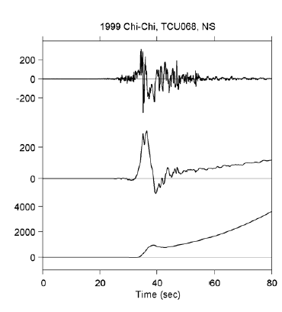
the true baseline of the digital record is still unknown and this manifests in the velocity and displacement time-histories obtained by double integration.
Strong Ground Motion Parameters – Data Processing
Dr. Sinan Akkar

Slide 73
High-frequency noise and instrument effects
Strong Ground Motion Parameters – Data Processing
Dr. Sinan Akkar

Slide 74
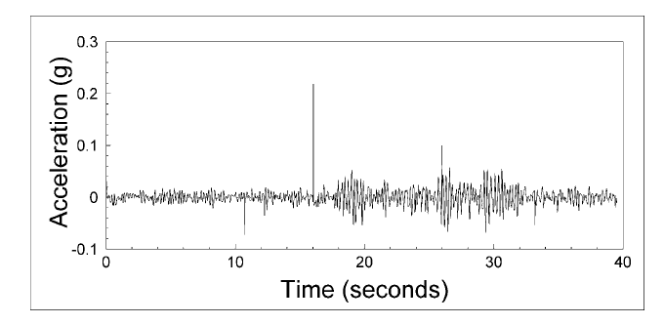
Standard vs. non-standard noise
In many records, errors are found that are not from the characteristics of the instrument . These are non-standard errors and should be removed prior to routine processing.
An example of non-standard error: spurious “spikes” in the digitized record can be identified at about 10.5, 16 and 26 seconds
Fix by: replacing the acceleration ordinate of the spike with the mean of the accelerations of the data points either side.
Strong Ground Motion Parameters – Data Processing
Dr. Sinan Akkar

Slide 75
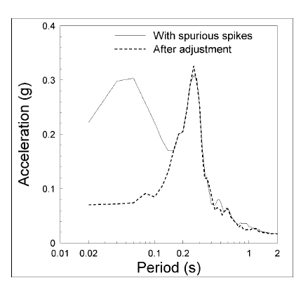
Spectral acceleration of the record shown in slide 14 before and after removing the spikes.
Spikes clearly constituted a serious noise contamination at short periods but it is also noted that their elimination appears to have led to the removal of a small part of the signal at longer periods.
Strong Ground Motion Parameters – Data Processing
Dr. Sinan Akkar

Slide 76
Limited transducer frequency and digitization process itself introduce high frequency noise in analog instruments
Strong Ground Motion Parameters – Data Processing
Dr. Sinan Akkar

Slide 77
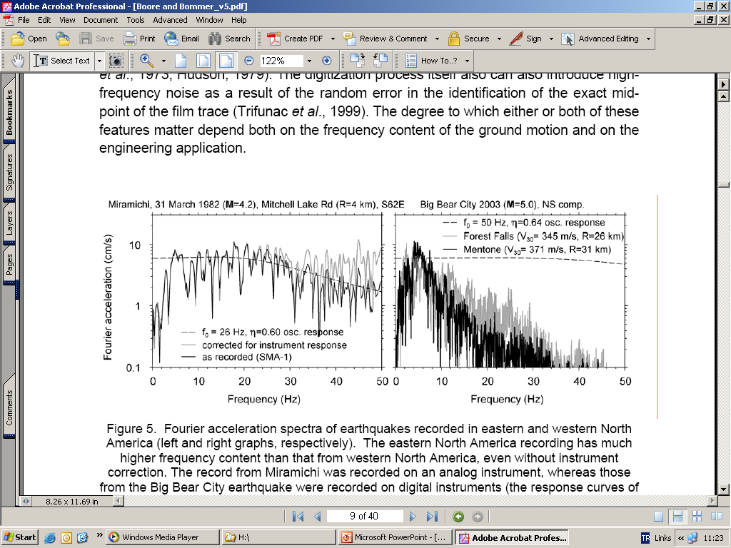
Theoretical instrument response
Same record corrected for instrument response
Hard rock recording at a distance of 4km from the source (as is)
The effect of applying a correction for the instrument characteristics results in a slight increase in the amplitudes at frequencies greater than 30 Hz. This will affect the demands on very stiff structures that are of little relevance in daily design practice
Strong Ground Motion Parameters – Data Processing
Dr. Sinan Akkar

Slide 78
Two records from the same event recorded at different stations. Gray one is recorded at a distance of 26 km. The black solid curve is recorded at a distance of 31 km.
High frequency records attenuate very fast as the site gets softer and distance to source increases. This fact decreases the importance of high frequency motions in many cases.
Strong Ground Motion Parameters – Data Processing
Dr. Sinan Akkar

Slide 79
Corrections for transducer characteristics
For digital recordings, instrument corrections should not be necessary. For analog recordings, if the engineering application is concerned with motions at frequencies above 20 Hz and the site characteristics are sufficiently stiff for appreciable amplitudes at such frequencies to be expected, a correction should be considered.
Instrument corrections amplify the high-frequency motions. Therefore they should be done carefully in order not to amplify the high frequency noise
Strong Ground Motion Parameters – Data Processing
Dr. Sinan Akkar

Slide 80
Correction procedures for transducer characteristics
Techniques more widely used in current practice generally perform the correction by using either higher-order approximations to the derivatives or using frequency-domain corrections (e.g., Shyam Sunder and Connor, 1982; Converse and Brady, 1992).
If it is judged that there is significant high-frequency noise in the record this can be removed by the application of high-cut (low-pass) filters.
Strong Ground Motion Parameters – Data Processing
Dr. Sinan Akkar

Slide 81
Baseline adjustments
Strong Ground Motion Parameters – Data Processing
Dr. Sinan Akkar

Slide 82
A major problem encountered with both analog and digital accelerograms are distortions and shifts of the baseline, which result in unphysical velocities, displacements, and long-period response spectra.
One approach to compensating for these problems is to use baseline adjustments, whereby one or more baselines, which may be straight lines or low-order polynomials, are subtracted from the acceleration trace.
Strong Ground Motion Parameters – Data Processing
Dr. Sinan Akkar

Slide 83
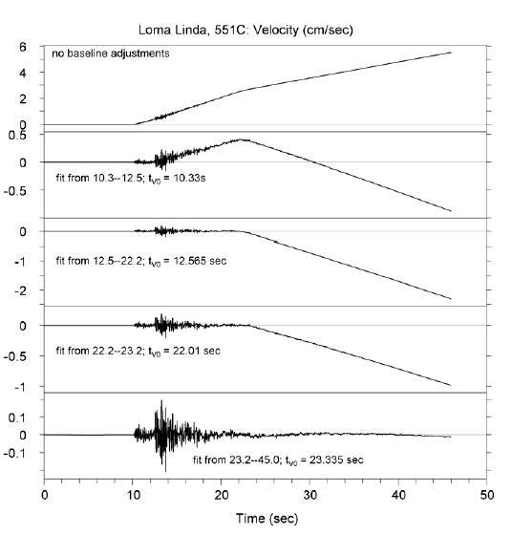
Multi-segment baselines
Application of a piece-wise sequential fitting of baselines to the velocity trace. There are clearly identifiable offsets in the baseline. A similar procedure could be applied directly to the acceleration time-history (the derivative of the baseline fits to velocity is simultaneously subtracted from the acceleration time series).
Strong Ground Motion Parameters – Data Processing
Dr. Sinan Akkar

Slide 84
Baselines to remove long-period noise
The distortion of the baseline encountered in digitized analog accelerograms is generally interpreted as being the result of long-period noise combined with the signal.
Baselines can be used as a tool to remove at least part of this noise – and probably some of the signal with it – as a means of recovering less unphysical velocities and displacements.
There are many procedures that can be applied to fit the baselines, including polynomials of different orders.
A point that is worth making clearly is that in effect baseline adjustments are low-cut filters of unknown frequency characteristics.
Strong Ground Motion Parameters – Data Processing
Dr. Sinan Akkar

Slide 85
Physical rationale for baseline correction procedures
The ground velocity must return to zero the end of the ground shaking. This is indeed a criterion by which to judge the efficacy of the record processing. The final displacement, however, need not be zero since the ground can undergo permanent deformation either through the plastic response of near-surface materials or through the co-seismic slip on the fault (fling step). Fling step is observed at stations close to the fault rupture (when M ~ 6.5 and above). This displacement can be on the order of tens or hundreds of centimeters.
Strong Ground Motion Parameters – Data Processing
Dr. Sinan Akkar

Slide 86
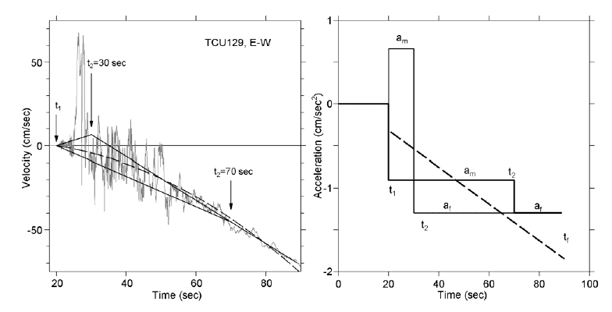
Corresponding straight line for acceleration time series
Quadratic fit to velocity
Two approaches to fitting baselines to the velocity trace, and the changes that they impose on the acceleration trace.
One scheme is a simple quadratic fit to the velocity, a simplification of the more complex scheme proposed by Graizer (1979) in which a series of progressively higher-order polynomials are fit to the velocity trace.
Strong Ground Motion Parameters – Data Processing
Dr. Sinan Akkar

Slide 87
Two alternative choices for t₂
The other approach approximates the complex set of baseline shifts with two shifts, one between times of t₁ and t₂, and one after time t₂. The adjustment scheme can be applied to any record, with the advantage that the velocity will oscillate around zero (a physical constraint), but the scheme requires selection of the times t₁ and t₂.
Strong Ground Motion Parameters – Data Processing
Dr. Sinan Akkar

Slide 88
Determination of t₁ and t₂:
Iwan et al. (1985), the original proponents of the method, suggeted t₁ and t₂ as the times that correspond to the first and last exceedance of 50 m/s². Alternatively, Iwan et al. (1985) proposed that t₂ be chosen so as to minimize the final ground displacement.
Boore (2001) proposed t₁ and t₂ be any value provided that t₁ > t₂ and t₂ is less than the total length of the record.
Strong Ground Motion Parameters – Data Processing
Dr. Sinan Akkar

Slide 89
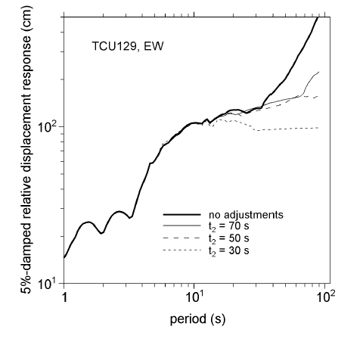
Without a physical reason for choosing these times, the choices of t₁ and t₂ become arbitrary, and as illustrated in the figure, the long-period response spectrum ordinates are sensitive to the choice of t₂ (t₁ was not varied in this illustration). However, the sensitivity of spectral displacements starts for T > 10s.
Strong Ground Motion Parameters – Data Processing
Dr. Sinan Akkar

Slide 90
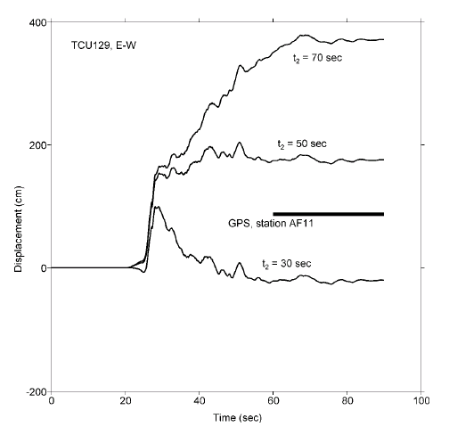
Residual displacements
Different t₂ values result in significant variation in residual displacements
Strong Ground Motion Parameters – Data Processing
Dr. Sinan Akkar

Slide 91
Boore proposed a further simplification to the baseline correction procedure originally proposed by Iwan et al. (1985).
He assumed that t₁ = t₂; there was only one baseline offset and that it occurred at a single time. The time is computed by the zero intercept of a line fit to the final part of the velocity trace.
This method is called as “v₀” correction by the proponent of the procedure (Boore, 2001).
Strong Ground Motion Parameters – Data Processing
Dr. Sinan Akkar

Slide 92
Filters to reduce low-frequency noise
Strong Ground Motion Parameters – Data Processing
Dr. Sinan Akkar

Slide 93
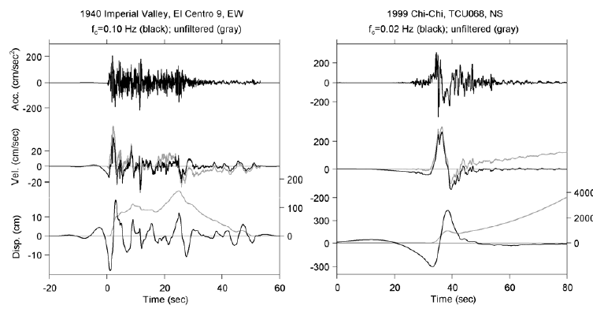
Most widely used tool for reducing the long-period noise in accelerograms is the low-cut filter (Trifunac, 1971). Figure shows the raw and filtered accelerograms of an analog and digital recording. (Note different y-axis scales for displacement)
Strong Ground Motion Parameters – Data Processing
Dr. Sinan Akkar

Slide 94
Choice of filtering technique
A wide range of filters to choose from: including Ormsby, elliptical, Butterworth, Chebychev and Bessel.
The correct application of the chosen filter is much more important than the choice of a particular filter.
Strong Ground Motion Parameters – Data Processing
Dr. Sinan Akkar

Slide 95
Terminology:
Low-cut filtering: removes the low-frequency (long-period) components of ground motion (also known as high-pass filtering)
High-cut filtering: removes the high-frequency (short-period) components of ground motion (also known as low-pass filtering)
Strong Ground Motion Parameters – Data Processing
Dr. Sinan Akkar

Slide 96

roll-off
Low-cut Butterworth filter with different filter orders for a cut off frequency of 0.05 Hz (20 seconds).
The filters are defined by a filter frequency and an order: the higher the order of the filter, the more rapid the roll-off.
Strong Ground Motion Parameters – Data Processing
Dr. Sinan Akkar

Slide 97
The fundamental choice of filtering is between causal and acausal filters.
Acausal filters: They do not produce phase distortion in the signal.
Causal filters: They result in phase shifts in the record.
The zero-phase shift of acausal filters is achieved in the time domain by passing the transform of the filter along the record from start to finish and then reversing the order and passing the filter from the end of the record to the beginning. To achieve the zero phase shift, acausal filters have to start acting prior to the beginning of the record. For this, they need zero pads before and after the record.
Strong Ground Motion Parameters – Data Processing
Dr. Sinan Akkar

Slide 98

The length of the pads depends on the filter frequency and the filter order. (pads are needed regardless of whether the filtering is done in the time- or frequency-domain)
Even if there are pre- and post-event memory on digital recordings, you have to pad them with additional zeros if the required length of the filter pads are longer than the pre- and post-event portions of the record.
Strong Ground Motion Parameters – Data Processing
Dr. Sinan Akkar

Slide 99

Application of causal and acausal filters, even with very similar filter parameters produce very different results in terms of the integrated displacements (shown above) and the elastic spectral response ordinates (shown in the next slide).
Strong Ground Motion Parameters – Data Processing
Dr. Sinan Akkar

Slide 100

causal
Ratio of 5%-damped pseudo absolute acceleration spectra (in cm/s²) for causal (top) and acausal (bottom) filtering, using the results for a filter corner of 100 s as reference.
acausal
In case of causally filtered data: both elastic and inelastic response spectra can be sensitive to the choice of filter corner periods even for oscillator periods much shorter than the filter corner periods.
Strong Ground Motion Parameters – Data Processing
Dr. Sinan Akkar

Slide 101
An important remark regarding consistency of acceleration time series and ground-motion measures obtained from the acceleration time series
When acausal filters are applied, the pads are a tool of convenience but their retention as part of the processed record is important. If pads of acausally filtered data are not retained, the filtering effects will not be completely captured, as a portion of the filter transient will be removed.
Strong Ground Motion Parameters – Data Processing
Dr. Sinan Akkar

Slide 102

Data from analog strong-motion accelerograph at station Dinar-Meteorology Station (R_{HYP}=5 km,V_{S30}=198 m/s) from the 01 October 1995 Dinar, Turkey, earthquake (M 6.4)
Note very small filter transients

Slide 103

Computing ground-motion intensity measure from pad-stripped data can lead to inconsistencies between ground-motion intensity measures (GMIMs) computed from the padded and filtered acceleration time series and from that time series after removing the seemingly unimportant padded portions

Slide 104

Computing ground-motion intensity measure from pad-stripped data can lead to errors, particularly at long periods
See Boore, D. M., A. Azari Sisi, and S. Akkar (2012). Using pad-stripped acausally filtered strong-motion data,
Bull. Seismol. Soc. Am. 102, 751-760, for more information and other references.

Slide 105
Choosing Filter Corners
Choosing filter corners often guided by
  Shape of Fourier acceleration spectrum (look for f² slope)
  Appearance of displacement waveforms (do they “look reasonable”?)

Slide 106

This is an example of how filter corners might be chosen on the appearance of the displacement time series

Slide 107


Slide 108


Slide 109

Discuss highest usable period (important for GMPE development)
In spite of large differences in waveforms, the response spectra at periods of engineering interest are similar. Two general conclusions to be made here:
  Filtering alone is often all that is needed
  Response spectra at periods of engineering interest are often insensitive to filter cutoff periods for modern digital records

Slide 110
A Case Study
TCU068 Recording, 1999 Chi-Chi (M 7.6) Earthquake

Slide 111


Slide 112

TCU068

Slide 113


Slide 114


Slide 115


Slide 116


Slide 117


Slide 118

gps vector similar to that from residual displacements obtained from the v0 baseline correction

Slide 119


Slide 120


Slide 121


Slide 122


Slide 123


Slide 124


Slide 125


Slide 126


Slide 127


Slide 128


Slide 129


Slide 130

It’s time to forget work and go have some fun!
Tifosi may recognize
my maglia rosa as
that of the 1984
Giro d’Italia
winner Francesco
Moser

Slide 131
END

