Slide 1
FUNDAMENTALS of ENGINEERING SEISMOLOGY
    SEISMIC SOURCES: POINT VS. EXTENDED SOURCE; SOURCE SCALING

Slide 2
SOURCE REPRESENTATION
Kinematic point source

Slide 3
Point sources
Complete wave solution
  near-, intermediate-, far-field terms
  Radiation patterns
  P vs. S wave amplitudes
S wave spectra

Slide 4
Basic properties of seismic sources
Focal mechanisms
Double couple force system
Brune source model
Self-similarity principle
Haskell source model
directivity

Slide 5
Point Source
Much can be learned from the equation giving the motion in an infinite medium resulting from a small (mathematically, a point) seismic source.
This is a specialized case of the Representation Theorem, using a point source and the infinite space Green’s function.

Slide 6
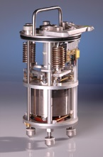

KINEMATICS POINT SOURCE
Validity range
M₀ (seismic moment)
Point source approximation is allowed when the receiver is at a distance from the source larger than a few lengths of the fault.
r >> L
r

Slide 7
KINEMATICS POINT SOURCE
Moment release
Fault perimeter at different times in the rupture process.
1 s
2 s
3 s
4 s
5 s
Imagine an earthquake source which is growing with time.
At each instant in time, one could define the moment that has been accumulated so far.
That would involve the area A(t) and the average slip D(t) at each point in time.

Slide 8
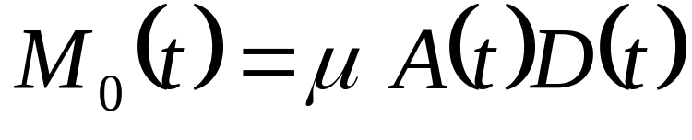
KINEMATICS POINT SOURCE
Seismic moment
M₀(t)=0 before the earthquake begins.
M₀(t)= M₀, the final seismic moment, after slip has finished everyplace on the fault.
M₀(t) treats this process as if it occurs at a point, and ignores the fault finiteness.

Slide 9



KINEMATICS POINT SOURCE
Source time function
Source time function
rise
time
t
t

Slide 10
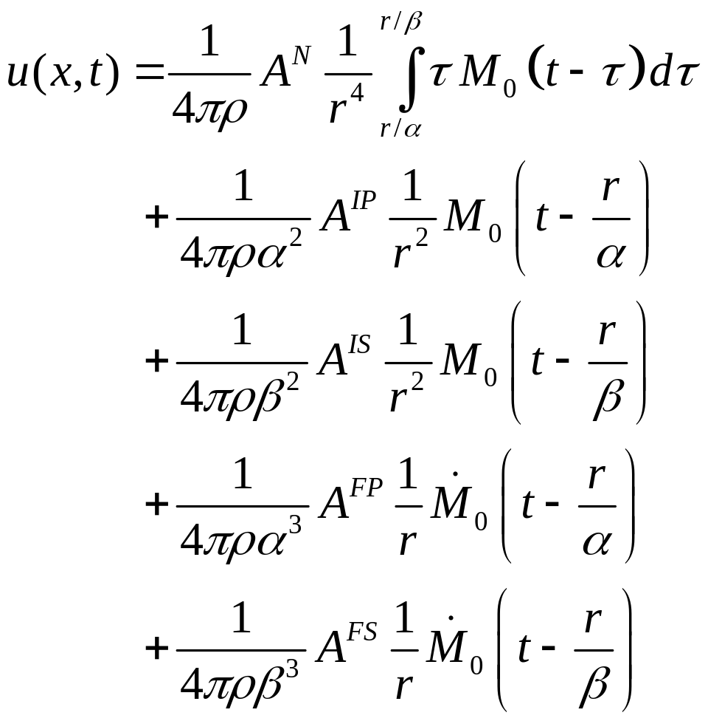
KINEMATICS POINT SOURCE
Simplest solution
true only if the medium is :
Infinite
Homogeneous
Isotropic
3D

Slide 11
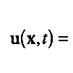
Point Source: Discussion
Both u and x are vectors.
u gives the three components of displacement at the location x.
The time scale t is arbitrary, but it is most convenient to assume that the radiation from the earthquake source begins at time t=0.
This assumes the source is at location x=0. The equations use r to represent the distance from the source to x.

Slide 12

KINEMATICS POINT SOURCE
Equation terms
Near-field term
Intermediate-field P-wave
Intermediate-field S-wave
Far-field P-wave
Far-field S-wave

Slide 13
KINEMATICS POINT SOURCE
Radiation pattern
A* is a radiation pattern.
A* is a vector.
A* is named after the term it is in.
For example, A^{FS} is the “far-field S-wave radiation pattern”

Slide 14
KINEMATICS POINT SOURCE
Other constants
ρ is material density
α is the P-wave velocity
β is the S-wave velocity.
r is the source-station distance.

Slide 15
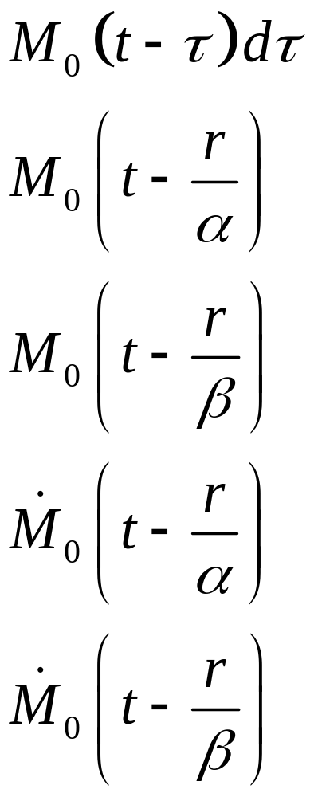
KINEMATICS POINT SOURCE
Temporal waveform
M₀(t), or it’s first derivative, controls the shape of the radiated pulse for all of the terms.
M₀(t) is introduced here for the first time.
Closely related to the seismic moment, M₀.
Represents the cumulative deformation on the fault in the course of the earthquake.

Slide 16
KINEMATICS POINT SOURCE
Geometrical spreading
1/r⁴
1/r²
1/r²
1/r
1/r

Slide 17
KINEMATICS POINT SOURCE
Geometrical spreading
The far field terms decrease as r⁻¹. Thus, they have the geometrical spreading that carries energy into the far field.
The intermediate-field terms decrease as r⁻². Thus, they decrease in amplitude rapidly, and do not carry energy to the far field. However, being proportional to M₀(t) , these terms carry a static offset into the region near the fault.
The near-field term decreases as r⁻⁴. Except for the faster decrease in amplitude, it is like the intermediate-field terms in carrying static offset into the region near the fault.

Slide 18
KINEMATICS POINT SOURCE
Temporal delays
Signal between the P and the S waves.
Signal for duration of faulting, delayed by P-wave speed.
Signal for duration of faulting, delayed by S-wave speed.

Slide 19


KINEMATICS POINT SOURCE
Solution for a Heaviside source time function
M₀
Rise time = 0
r
t

Slide 20
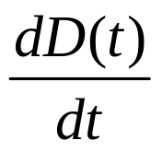
KINEMATICS POINT SOURCE
Solution for a Heaviside source time function
M₀
Rise time = 0
r
t
t

Slide 21


KINEMATICS POINT SOURCE
Solution for a Heaviside source time function
M₀
Rise time = 0
r
t
t
0

Slide 22
KINEMATICS POINT SOURCE
Solution for a Heaviside source time function
M₀
Rise time = 0
r
t
Far field P wave
t
0

Slide 23
KINEMATICS POINT SOURCE
Solution for a Heaviside source time function
M₀
Rise time = 0
r
t
+ Int. field P wave
t
0

Slide 24
KINEMATICS POINT SOURCE
Solution for a Heaviside source time function
M₀
Rise time = 0
r
t
+ far field S wave
t
0

Slide 25
KINEMATICS POINT SOURCE
Solution for a Heaviside source time function
M₀
Rise time = 0
r
t
+ int. field S wave
t
0

Slide 26
KINEMATICS POINT SOURCE
Solution for a Heaviside source time function
M₀
Rise time = 0
r
t
+ near field wave
t
0

Slide 27
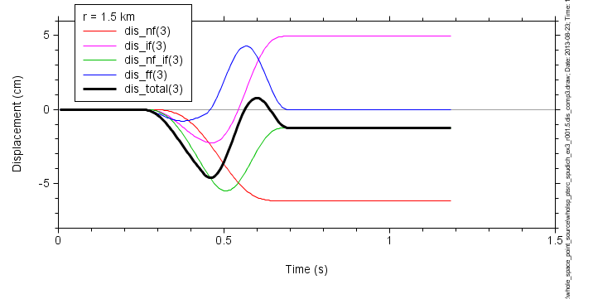

Slide 28
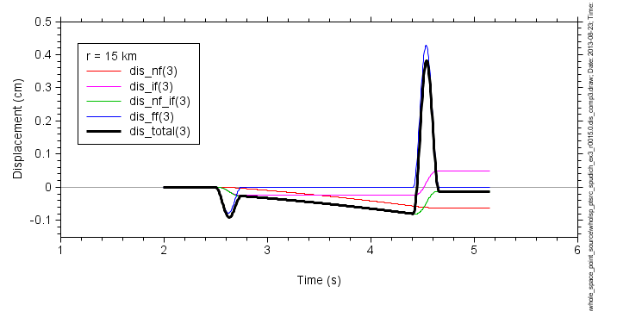

Slide 29
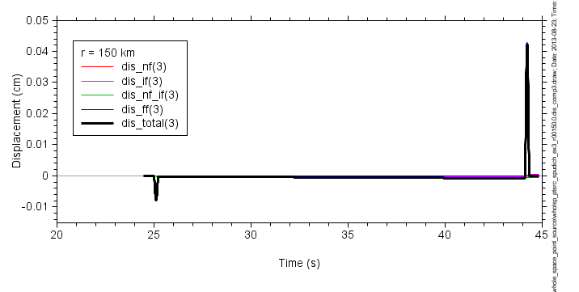

Slide 30
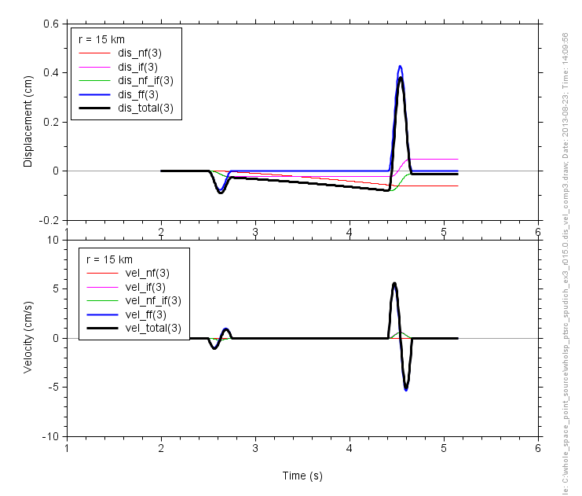

Slide 31
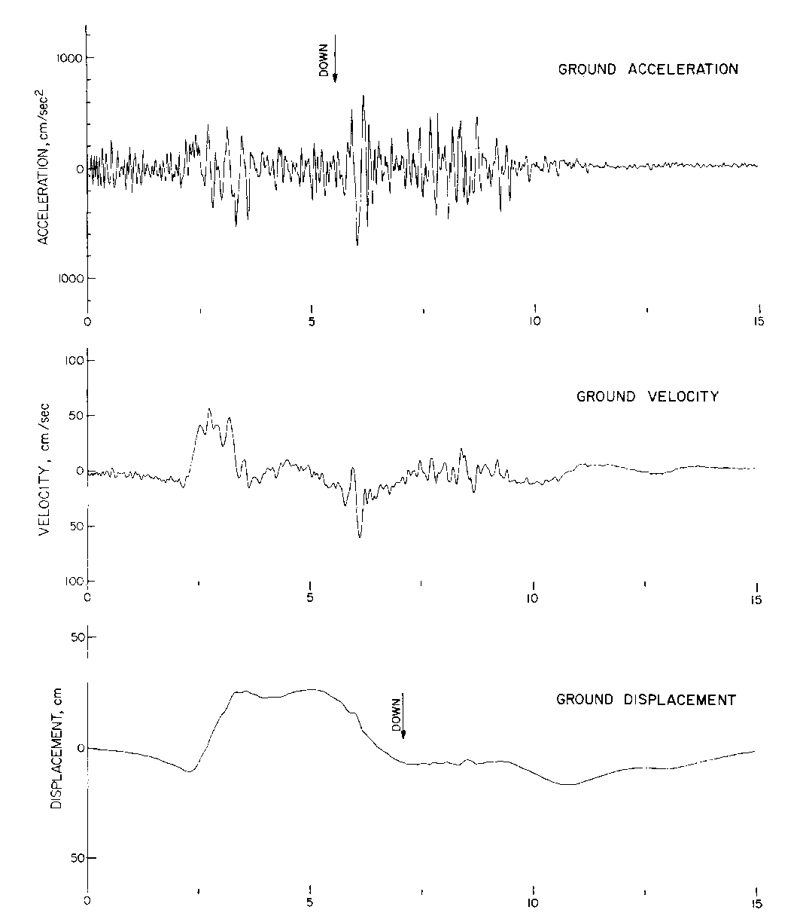
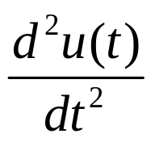
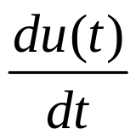

INFLUENCE OF SOURCE PARAMETERS
Displacement versus acceleration (for the S-wave, showing starting and stopping arrivals)
t
t
t

Slide 32
SOURCE REPRESENTATION
Kinematic point source: FAR FIELD

Slide 33
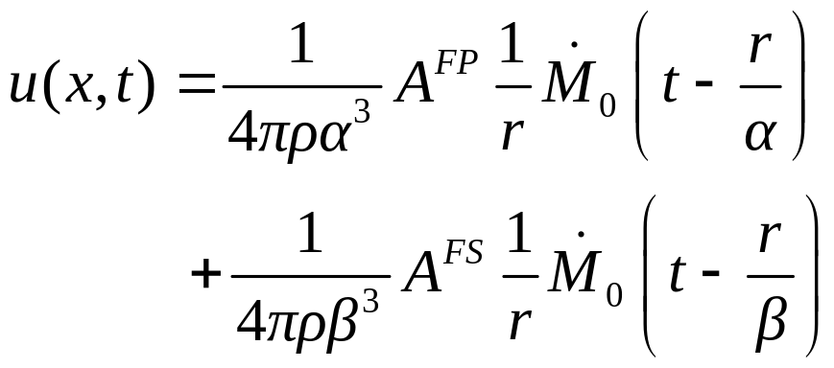
KINEMATICS POINT SOURCE
Far Field
1/r geometrical spreading
Signal for duration of faulting, delayed by P-wave speed.
Signal for duration of faulting, delayed by S-wave speed.

Slide 34
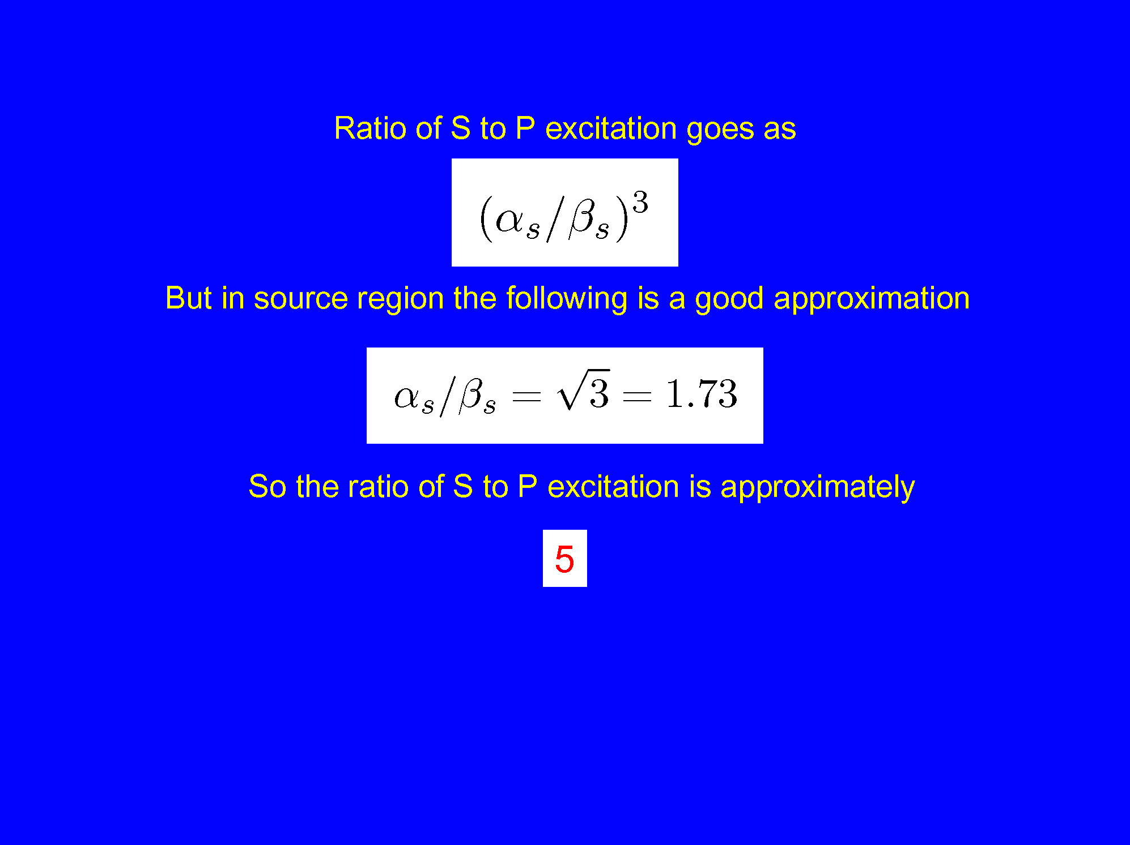

Slide 35
Frequencies of ground-motion for engineering purposes
10 Hz --- 10 sec (usually less than about 3 sec)
Resonant period of typical N story structure ~ N/10 sec
Corner periods for M 5, 6, and 7 ~ 1, 3, and 9 sec

Slide 36
Horizontal motions are of most importance for earthquake engineering
Seismic shaking in range of resonant frequencies of structures
Shaking often strongest on horizontal component:
  Earthquakes radiate larger S waves than P waves
  Decreasing seismic velocities near Earth’s surface produce refraction of the incoming waves toward the vertical, so that the ground motion for S waves is primarily in the horizontal direction
Buildings generally are weakest for horizontal shaking
=> An unfortunate coincidence of various factors

Slide 37
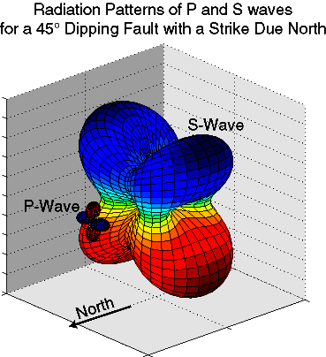
Radiation Patterns & Relative Amplitudes in 3D
no nodal surfaces for S waves

Slide 38
Source spectra of radiated waves
(far-field, point source)

Slide 39
Source spectra of radiated waves
(far-field, point source)
A description of the amplitude and frequency content of waves radiated from the earthquake source is the foundation on which theoretical predictions of ground shaking are built. The specification of the source most commonly used in engineering seismology is based on the motions from a simple point source.

Slide 40
Point Source: Discussion
Fault perimeter at different times in the rupture process.
1 s
2 s
3 s
4 s
5 s
Imagine an earthquake source which is growing with time.
At each instant in time, one could define the moment that has been accumulated so far.
That would involve the area A(t) and the average slip D(t) at each point in time.

Slide 41
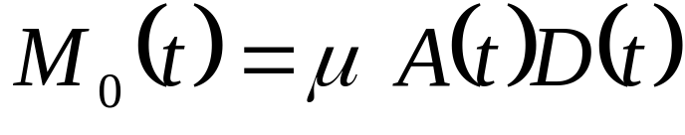
Point Source: Discussion
M₀(t)=0 before the earthquake begins.
M₀(t)= M₀, the final seismic moment, after slip has finished everyplace on the fault.
M₀(t) treats this process as if it occurs at a point, and ignores the fault finiteness.

Slide 42
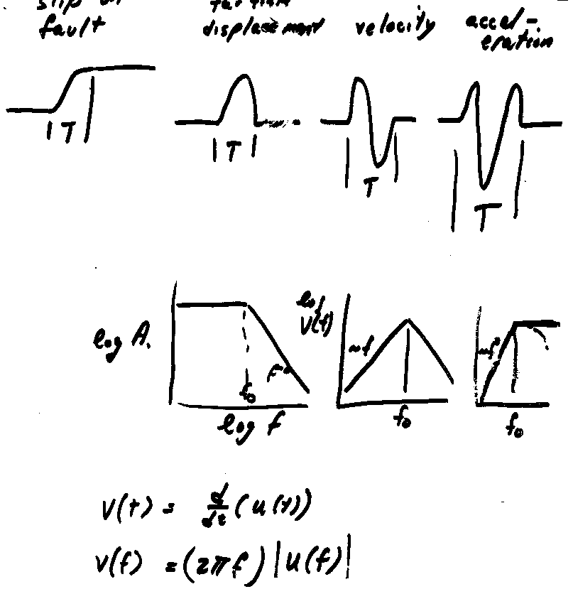
Consider:
M₀(t)
M₀
0
t
This is the shape of M₀(t). It is zero before the earthquake starts, and reaches a value of M₀ at the end of the earthquake.
This figure presents a “rise time” for the source time function, here labeled T. (Do not confuse this symbol with the period of a harmonic wave--- should have used T_{r} )

Slide 43
Consider these relations:
dM₀(t)/dt
the far-field shape is proportional to the moment rate function
M₀(t)
From M₀(t), this suggests that the simplest possible shape of the far-field displacement pulse is a one-sided pulse.
The simplest possible shape of M₀(t) is a very smooth ramp.

Slide 44
Consider these relations:
M₀(t)
dM₀(t)/dt
d²M₀(t)/dt²
d³M₀(t)/dt³
Differentiating again, the simplest possible shape of the far-field velocity pulse is a two-sided pulse.
Likewise, the simplest possible shape of the far-field acceleration pulse is a three-sided pulse.

Slide 45
Consider these relations:
M₀(t)
dM₀(t)/dt
d²M₀(t)/dt²
d³M₀(t)/dt³
Far-field:
displacement
velocity
acceleration
If the simplest possible far-field displacement pulse is a one-sided pulse, the simplest velocity pulse is two-sided, and the simplest acceleration pulse is three sided (with zero area, implying velocity = 0.0 at end of record).

Slide 46
Point Source: Discussion
These results for the shape of the seismic pulses will always apply at “low” frequencies, for which the corresponding wavelengths are much longer than the fault dimensions--- the fault “looks” like a point. They will tend to break down at higher frequencies.
They have important consequences for the shape of the Fourier transform of the seismic pulse.

Slide 47
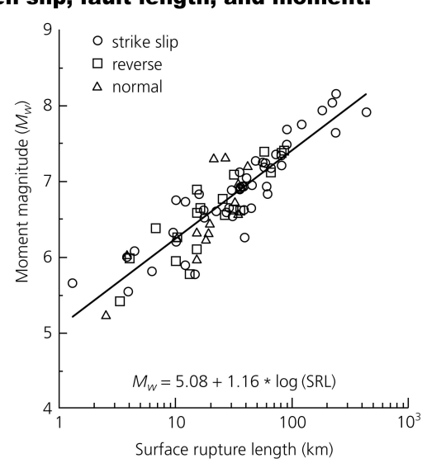


Calculate the period for which the wavelength equals a given value. Assume β_{s} = 3.5 km/s.
M | λ | T
5.7 | 3.5
6.9 | 35
8.0 | 350

Slide 48
Calculate the period for which the wavelength equals a given value. Assume β_{s} = 3.5 km/s.
M | λ | T
5.7 | 3.5 | 1 s
6.9 | 35 | 10 s
8.0 | 350 | 100 s

Slide 49
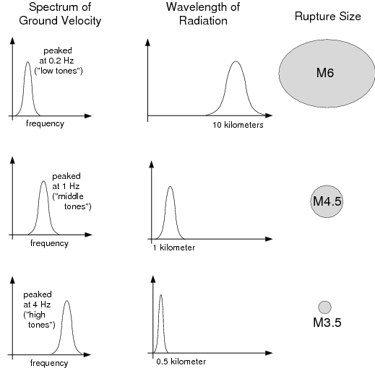
Source Time Function
The “Source time function” describes the moment release rate of an earthquake in time
For large earthquakes, source time function can be complicated
For illustration, consider a simple pulse

Slide 50
Source Spectrum
To explore source properties in more detail, consider the source spectrum

Slide 51
Source Spectrum
To explore source properties in more detail, consider the source spectrum

Slide 52
Source Spectrum
To explore source properties in more detail, consider the source spectrum

Slide 54
Source Spectrum
Radiated energy as function of frequency
Small earthquake: high frequencies (short λ)
Large earthquake: lower frequencies (long λ)
Energy release proportional to velocity spectrum
Corner frequency = peak of velocity spectrum
peak frequency of energy release
Displacement spectrum: flat below corner

Slide 55
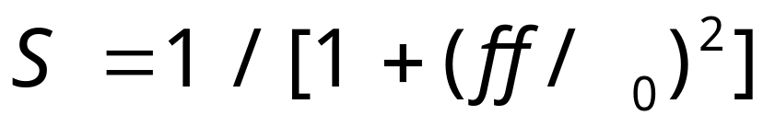
Point Source: Discussion
The Fourier transform of a one-sided pulse is always flat at low frequencies, and falls off at high frequencies.
The corner frequency is related to the pulse width.
Commonly used equation:
f_{c}

Slide 56
Motivation for commonly used equation

Slide 57

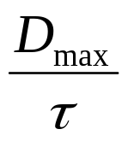

KINEMATICS EXTENDED SOURCE
Source radiation: convolution of two box functions
t
t
t
This motivates the need to look at the frequency-domain representation of a box function

Slide 58
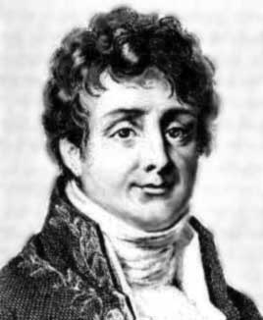
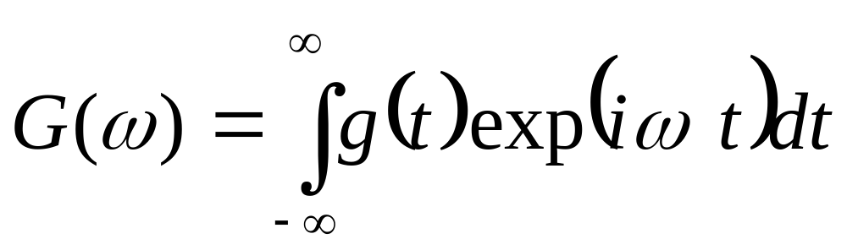
Fourier spectrum of a box function:
The frequency domain representation of the point source
For any time series g(t), the Fourier spectrum is:

Slide 59
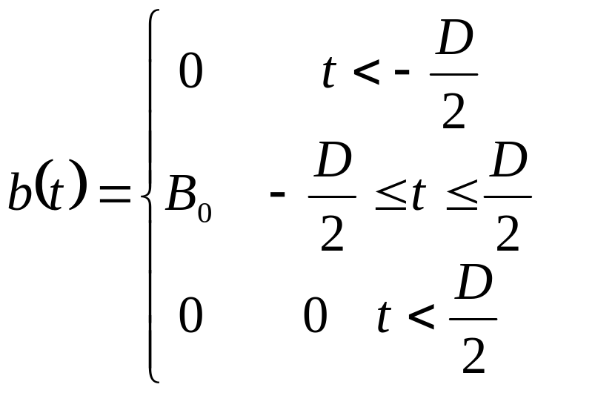
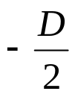

Example
Calculate the Fourier transform of a “boxcar” function.
B₀
0

Slide 60
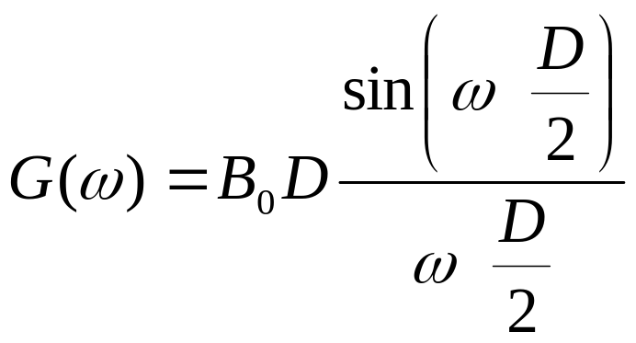
The answer…
With the following behavior for low and high frequencies:
G(ω) → area of pulse = B₀D, ω→0
G(ω) → 1/ω, ω→∞

Slide 61
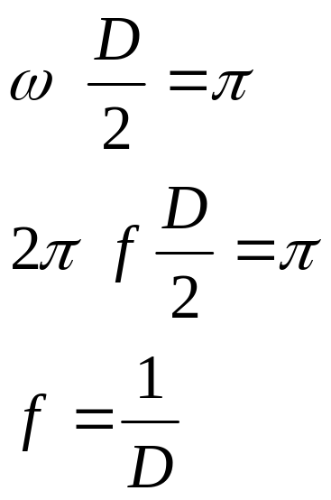
Properties:
The asymptotic limit for frequency -->0 is B₀D.
The first zero is at:

Slide 62
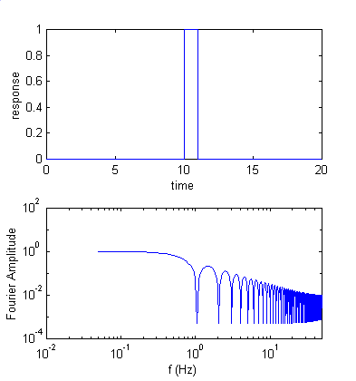
Note can approximate the spectral shape with two lines, ignoring the scalloping. The intersection of the two lines is the corner frequency, an important concept.
Corner
frequency
First
zero

Slide 63
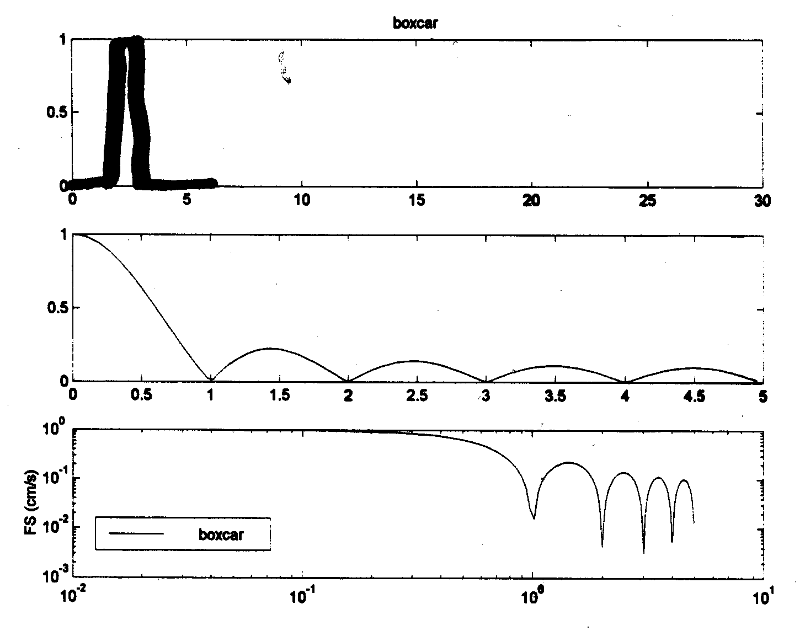
Examples of spectra for two pulses with the same area but different durations
linear-linear axes
log-log axes

Slide 64
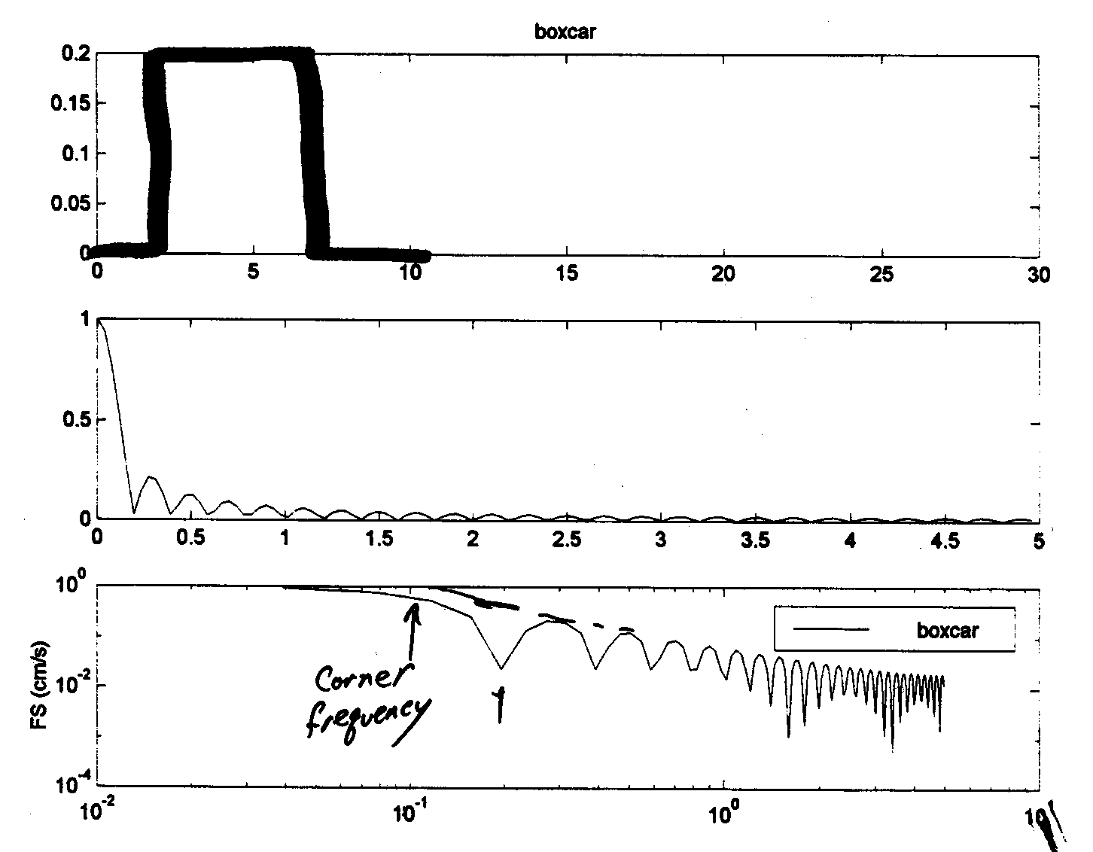
Examples of spectra for two pulses with the same area but different durations. Note that the low frequency limit is the same for both pulses, but the corner frequency shifts
linear-linear axes
log-log axes

Slide 65
KINEMATICS EXTENDED SOURCE
Source radiation: convolution of two box functions
t
t
t

Slide 66




KINEMATICS EXTENDED SOURCE
Omega square model
Spectrum of single box function goes as 1/f at high frequencies; spectrum of convolution of two box functions goes as 1/f²
t
d
f
corner frequency

Slide 67
KINEMATICS POINT SOURCE
Far Field
1/r geometrical spreading
Signal for duration of faulting, delayed by P-wave speed.
Signal for duration of faulting, delayed by S-wave speed.

Slide 68

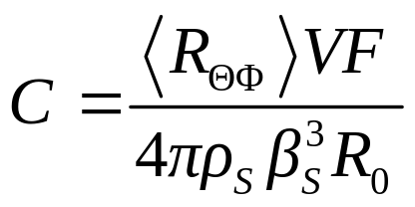
Static scaling before, now consider frequency-dependent source excitation
Changing notation, the Fourier transform of u(t) can be written:
Spectrum of displacement = Source X Path X SIte

Slide 69
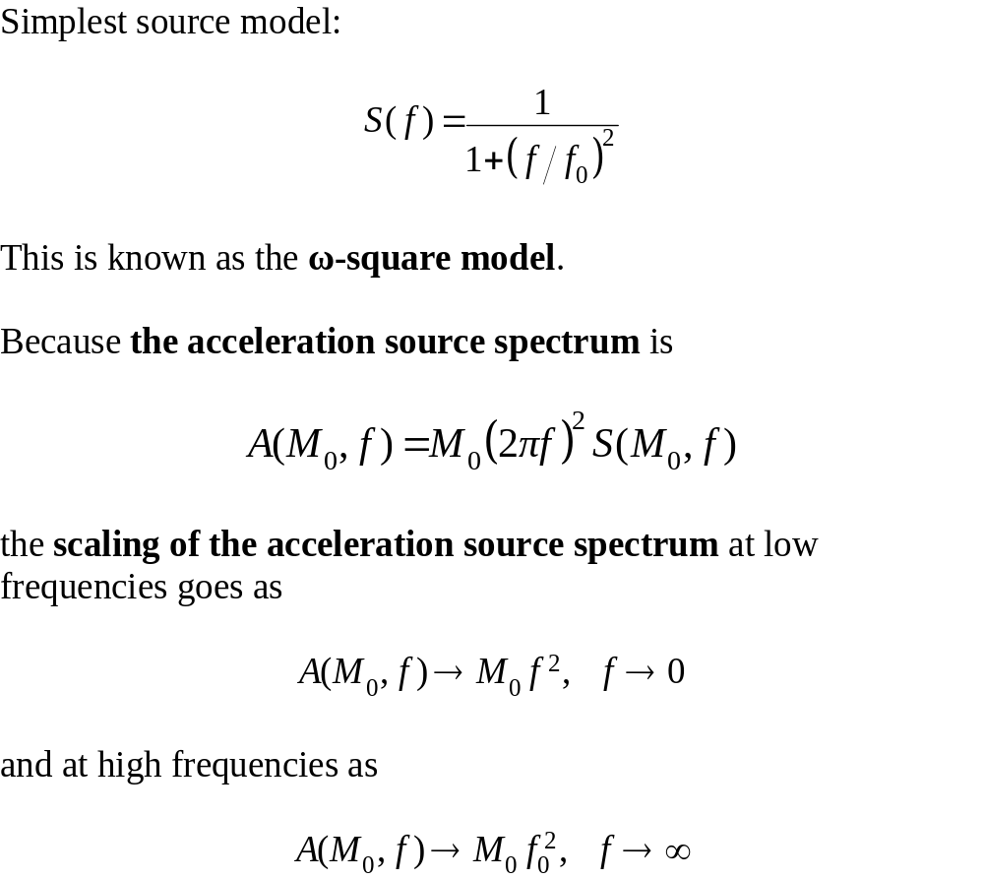

Slide 70
Discussion
The displacement spectrum is flat at low frequencies, then starts to decrease at a corner frequency.
Above the corner frequency, the spectrum falls off as f⁻² (for two box functions), with some fine structure superimposed.
The corner frequency is inversely related to the (apparent) duration of slip on the fault.

Slide 71
Point Source: Discussion
The duration of the pulse gives information about the size of the source.
Expect that rupture will cross the source with a speed (v_{r}) that does not depend much, if at all, on magnitude.
Thus, the duration of rupture is ~L/v_{r}. We thus expect the pulse width (D before, but T now) is T~L/v_{r} with some modification for direction.
If we measure T, we can estimate the fault dimension. The uncertainty may be a factor of 2 or so.

Slide 72
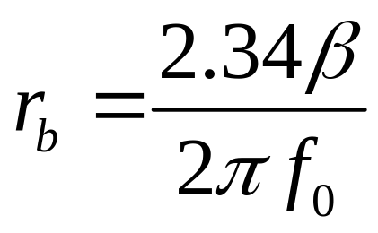
Point Source: Discussion
For a circular fault with radius r_{b}, Brune (1970, 1971) proposed the relationship (β is shear-wave velocity, f₀ is corner frequency):
This is widely used in studies of small earthquakes.
Uncertainties in r_{b} due to the approximate nature of Brune’s model are probably a factor of two or so.

Slide 73
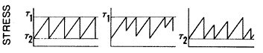
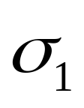
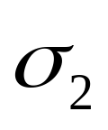
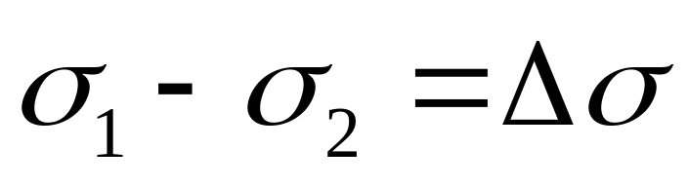
Introducing the stress drop Δσ (also known as the stress parameter)

Slide 74
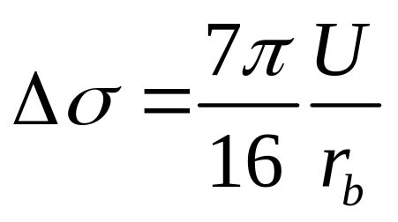
For a circular crack:
There is a theoretical relation between the static stress drop (Δσ), the average slip over the crack surface (U), and the radius of the crack (r_{b}):
Note that for a constant radius, an increasing slip gives increasing stress drop

Slide 75
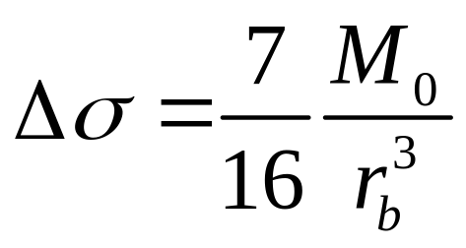
For a circular crack:
This can be converted into an equation in terms of seismic moment:
Although developed for a simple source (a circular crack), this equation is the basis for the simulation of ground motions of engineering interest, as improbable as that seems.

Slide 76
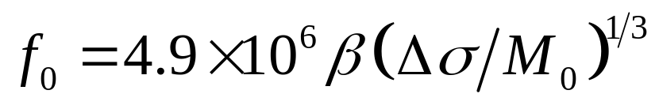
Using the relation between source radius, corner frequency and
stress drop leads to this important equation
where f₀ is in Hz, β in km/s, Δσ in bars, and M_{o} in dyne-cm

Slide 77
Stress Drop
“Static” versus “dynamic stress”
Variability over rupture area
Estimation = difficult

Slide 78
Typical Stress Drop Values
Typical values: 0.1 bars – 500 bars
0.01 MPa – 50 MPa
Units: force/area (bars = cgs)
Atmospheric pressure ~ 1 bar
Absolute stress in earth = high, very difficult to measure

Slide 79
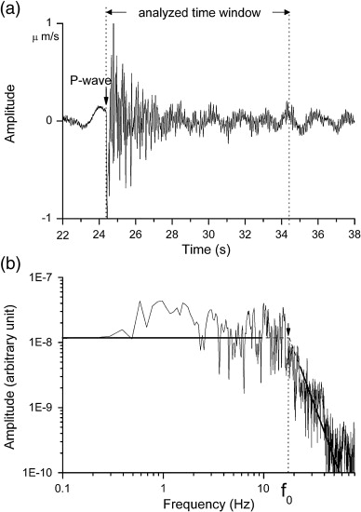
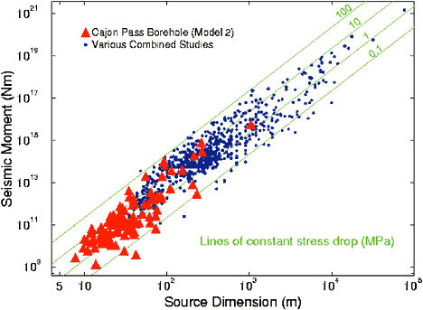
Example
f₀ = _____
r = 2.34 β/(2πf₀)
= ? meters
If Mo =

Slide 80
Example
R = 50 m
If M_{o} = 10¹²Nm, stress drop = ____
If M_{o} = 10¹⁰Nm, stress drop = ____

Slide 81
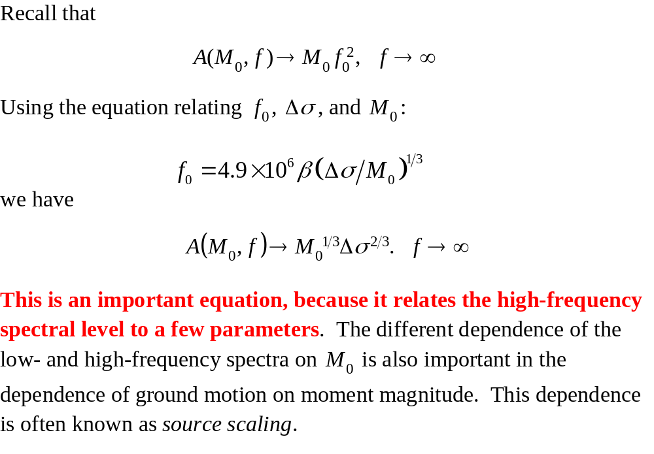
Source Scaling

Slide 82
Self Similarity and Scaling at High Frequencies
Δσ ∼ U/r_{b} = constant for self similarity
A_{HF} ∼ Μ₀^{(1/3)}Δσ ^{(2/3)} ∼ Μ₀ ^{(1/3)}
constant stress parameter (drop) scaling (a common assumption)

Slide 83
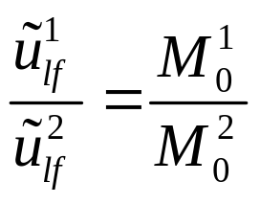
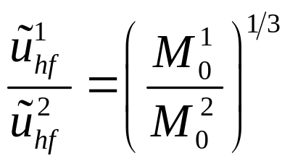


INFLUENCE OF SOURCE PARAMETERS
Magnitude
Scaling if Δσ is constant
This is an important figure, as it indicates that the magnitude scaling of ground motion will be a function of frequency, with stronger scaling for low frequencies than high frequencies. One consequence is that the spectral shape of ground motion will be magnitude dependent, with large earthquakes having relatively more low-frequency energy than small earthquakes
f

Slide 84
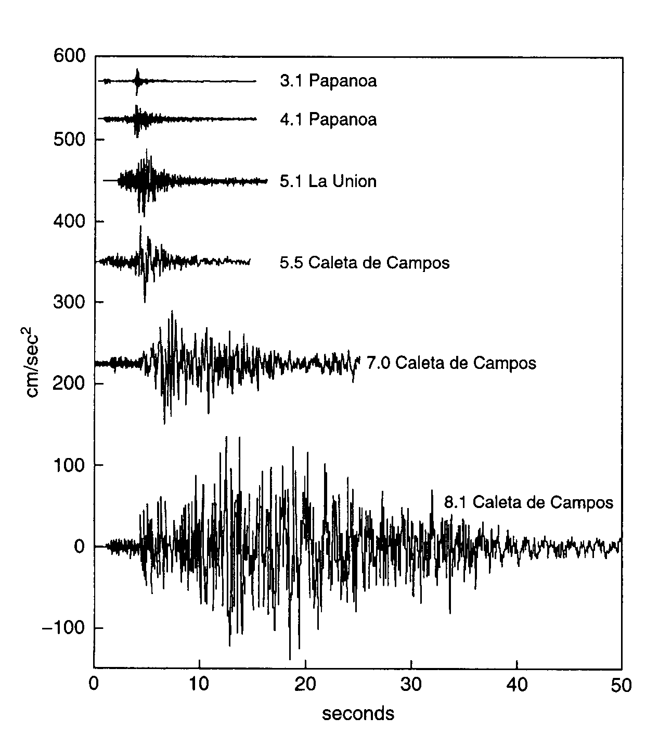
(From J. Anderson)

Slide 85
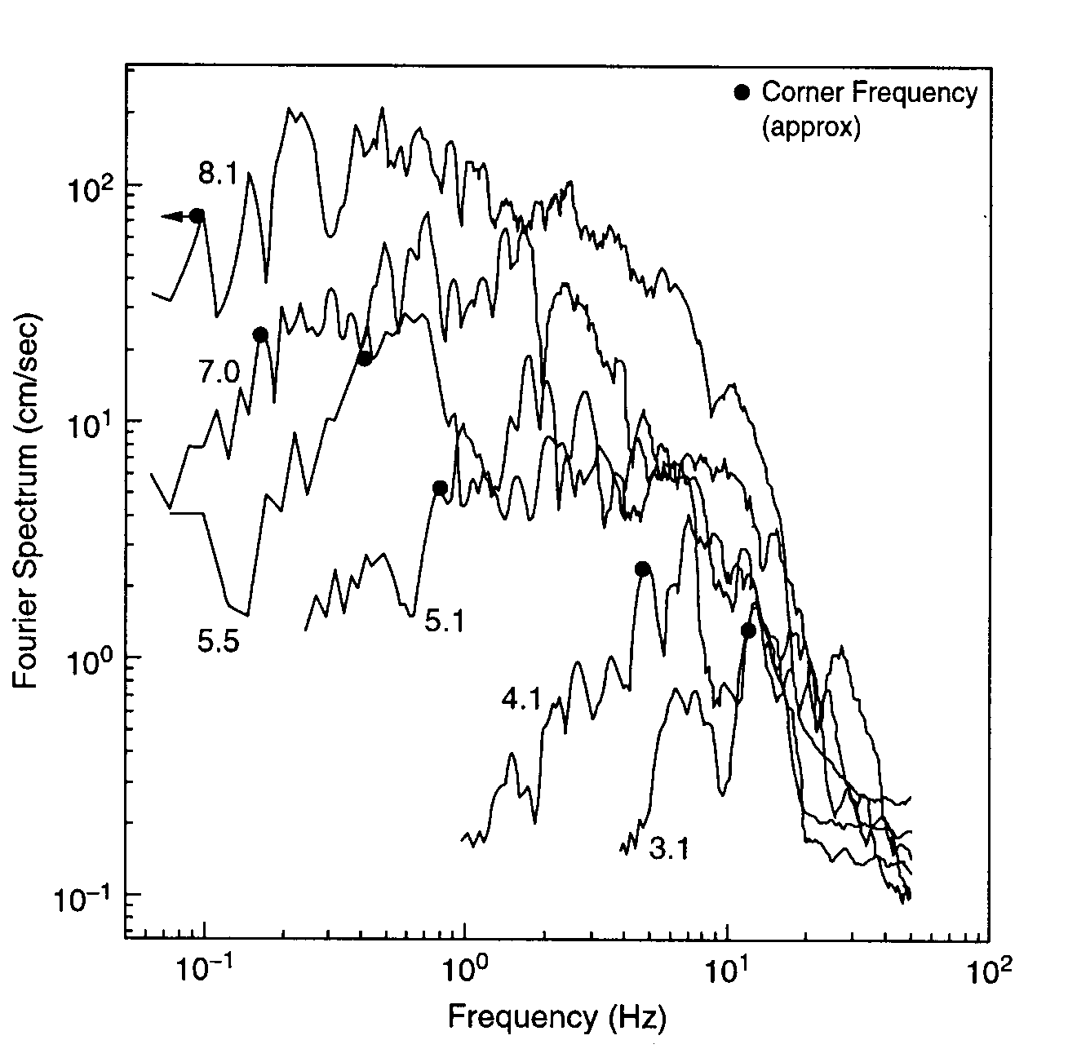
(From J. Anderson)

Slide 86
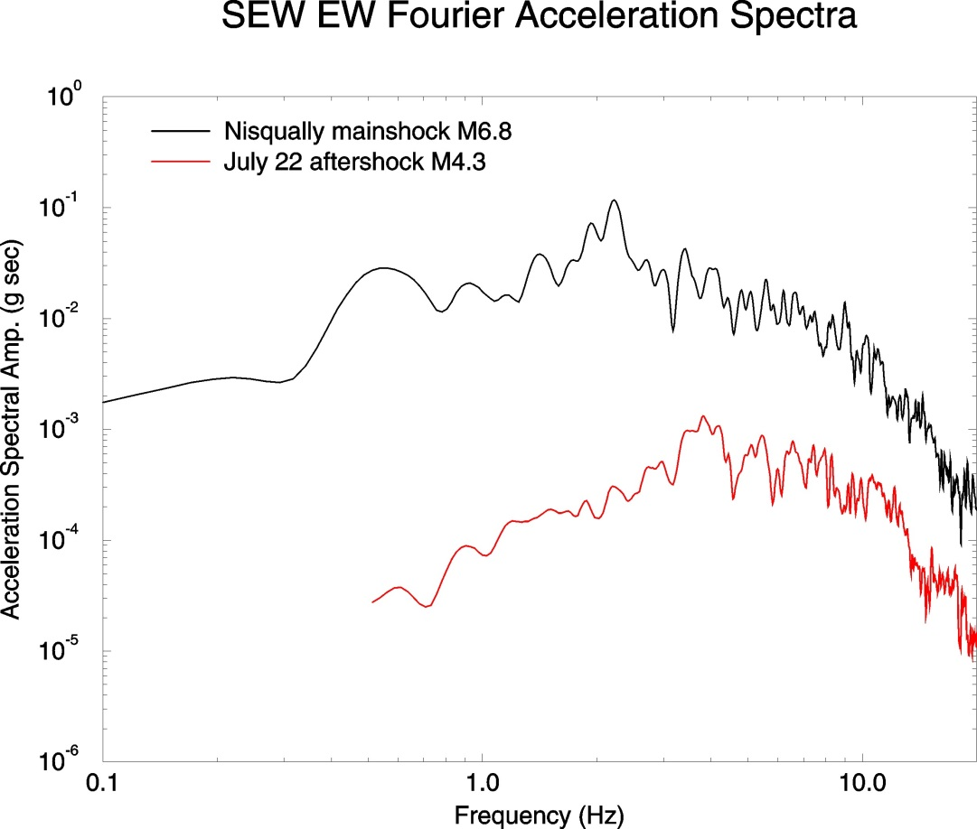
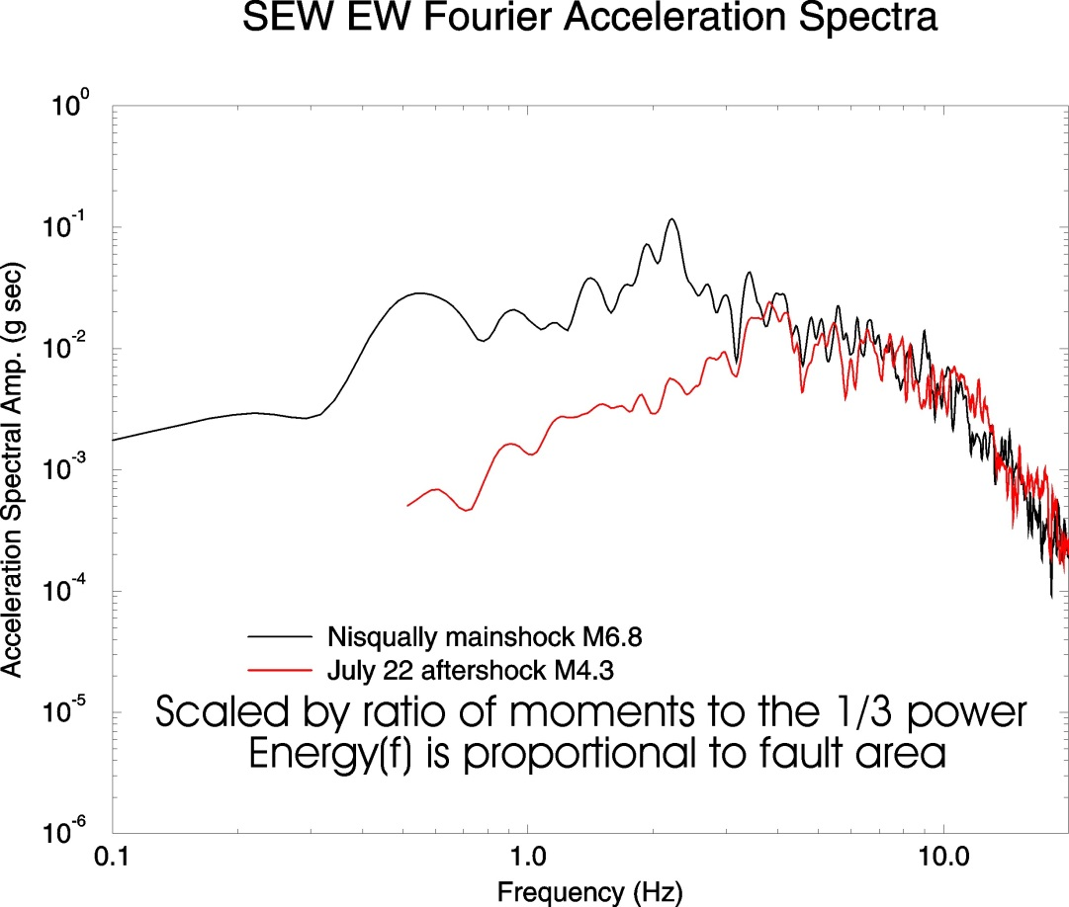



Scaling of high-frequency ground motions:
Typical scaling of spectra observed for earthquakes with M<7 :
ω⁻² displacement spectral falloff and constant stress drop with
respect to seismic moment

Slide 87


INFLUENCE OF SOURCE PARAMETERS
Stress drop
If the moment is fixed, an increase of stress drop means an increase of the corner frequency value
f

Slide 88

Scaling difference:
Low frequency
  A≈ M₀, but log M₀ ≈ 1.5M, so A ≈ 10^{1.5M}. This is a factor of 32 for a unit increase in M
High frequency
  A ≈ M₀^{(1/3)}, but log M₀ ≈ 1.5M, so A ≈ 10^{0.5M}. This is a factor of 3 for a unit increase in M
Ground motion at frequencies of engineering interest does not increase by 10x for each unit increase in M

Slide 89

Equal M implies the same spectra at low frequencies
decay at high f due to source or site (I prefer the latter)

Slide 90
Δσ is a KEY parameter for ground-motion at frequencies of engineering interest
Units: bars, MPa, where 1 MPa= 10 bars
Also, M0 in dyne-cm or N-m, where 1 N-m=10^7 dyne-cm (log M0=1.5M+16.05 for M0 in dyne-cm).

Slide 91
Why Stress Drop Matters
Increase stress drop → more high frequency motion
Structural response depends on amplitude of shaking and frequency content
Frequencies of Engineering concern
10 Hz --- 10 sec (usually less than about 3 sec)
Resonant period of typical N story structure ~ N/10 sec
Resonance period of 20 storey structure?

Slide 92
Why Stress Drop Matters
Ground motion prediction methods:
stress drop = input parameter
Intraplate earthquakes (longer recurrence)
→ higher stress drop

Slide 93

Use of mb/Mw in the Search for High Stress-Parameter Earthquakes in Regions of Tectonic Extension
Jim Dewey and Dave Boore

Slide 94

We have 21,179 events, h(PDE) or h(GCMT) < 50 km, 1976 – Sept 2007, for which mb(PDE) and Mw(GCMT) are both available
Conventional wisdom: high mb with respect to Mw implies high stress parameter
Assumptions for theoretical curves
random-vibration source with ω-squared source-spectrum
mb measured on WWSSN SP seismograph
same raypath attenuation for all source-station pairs

Slide 95
SOURCE EFFECTS
Complex source phenomena

Slide 96
SOURCE EFFECTS ON STRONG GROUND MOTION
Influence of source phenomena
  Directivity and rupture velocity
  Super shear velocity
  Rupture in surface
  Hanging wall/foot wall
  Stopping phases
  Concept of asperities and barriers
  Self similar slip distribution
60 min

Slide 97

Haskell source model: Simple description of a moving source.

Slide 98

Directivity: Ground motion pulse duration will be shortened in duration in the direction in which wave front is advancing, as waves radiating from near-end of fault pile up on top of waves radiating from the far end. This directivity effect increases wave amplitudes in the rupture propagation direction.

Slide 99

Example of observed directivity effects in the Landers earthquake ground motions near the fault.
Directivity was a key factor in causing large ground motions in Kobe, Japan, and a major damage factor. It probably also played a role in the recent San Simeon, CA, earthquake

Slide 100





COMPLEX SOURCE PHENOMENA
Directivity formulation

Slide 101




COMPLEX SOURCE PHENOMENA
Directivity coefficient
For an unilateral fault :
.8 | 5 | 0.9
.9 | 10 | 0.83

Slide 102

COMPLEX SOURCE PHENOMENA
Directivity effect on radiation
Hirasawa (1965)

Slide 103




COMPLEX SOURCE PHENOMENA
Directivity effect on acceleration spectrum
f
For very low frequencies, the wavelengths are much longer than the fault length, and directivity has no impact on the motion, which is controlled by the seismic moment; this is why the two spectra are the same at low frequencies in this cartoon.

Slide 104
COMPLEX SOURCE PHENOMENA
Directivity effect on displacement spectrum
Haskell (1964)
Frankell (1991)
Non directive
Cd
f

Slide 105
Directivity
Directivity is a consequence of a moving source
Waves from far-end of fault will pile up with waves arriving from near-end of fault, if you are forward of the rupture
This causes increased amplitudes in direction of rupture propagation, and decreased duration.
Directivity is useful in distinguishing earthquake fault plane from its auxiliary plane because it destroys the symmetry of the radiation pattern.

Slide 106
SOURCE REPRESENTATION
Kinematics extended source

Slide 107
Fault kinematics
Distribution of fault slip as a function of space and time
Often parameterized by velocity of rupture front, and rise time and total slip at each point of the fault

Slide 108
KINEMATICS EXTENDED SOURCE
An extended source is a sum of point sources
surface

Slide 109

Slip on an earthquake fault
START
Surface of the earth
Depth
Into the
earth

100 km (60 miles)
Distance along the fault plane
Notes:
Snapshots every 2 seconds during the rupture
Starts in southern part of fault

Slide 110
Slip on an earthquake fault
Second 2.0

Slide 111
Slip on an earthquake fault
Second 4.0

Slide 112
Slip on an earthquake fault
Second 6.0

Slide 113
Slip on an earthquake fault
Second 8.0

Slide 114
Slip on an earthquake fault
Second 10.0

Slide 115
Slip on an earthquake fault
Second 12.0

Slide 116
Slip on an earthquake fault
Second 14.0

Slide 117
Slip on an earthquake fault
Second 16.0

Slide 118
Slip on an earthquake fault
Second 18.0

Slide 119
Slip on an earthquake fault
Second 20.0

Slide 120
Slip on an earthquake fault
Second 22.0

Slide 121
Slip on an earthquake fault
Second 24.0

Slide 122

Total Slip in the M7.3 Landers Earthquake
Rupture on a Fault
Notes:
Total distribution of slip after earthquake happened.
Red is a lot of slip, blue is no slip
You can see that the whole surface did not slip the same amount
Nor did it slip all at the same time, as you will see in this movie

Slide 123
End

