Slide 1
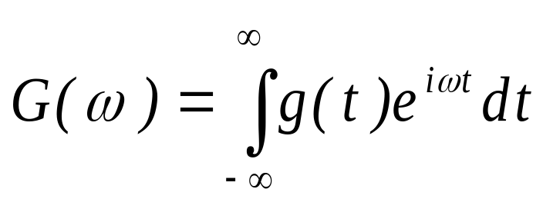
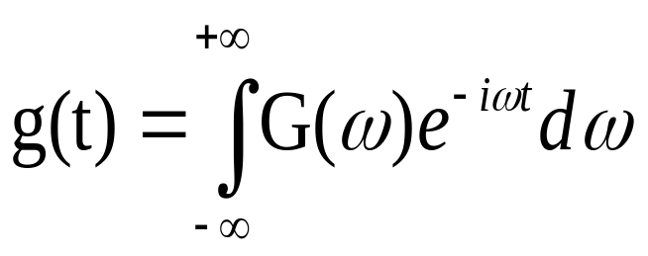
FOURIER SPECTRUM: Time Domain (TD)-Frequency-Domain (FD) and vice-versa
For any given time series, g(t), the Fourier spectrum is:
The inverse transform gives the time domain signal given the complex Fourier spectrum:
Strong Ground Motion Parameters – Data Processing
Dr. Sinan Akkar

Slide 2
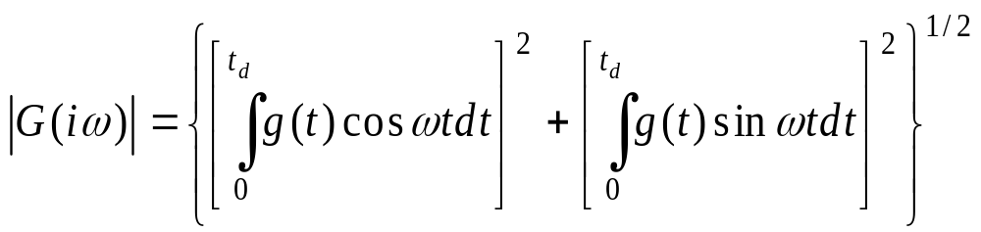
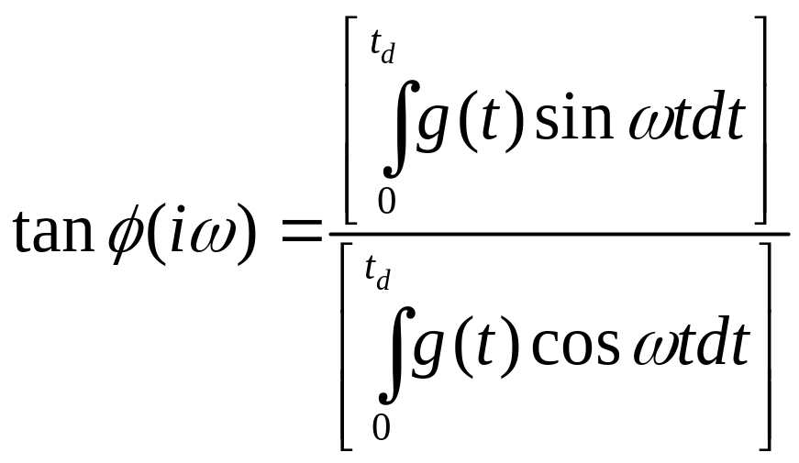
The Fourier amplitude is
The Fourier phase angle is
Strong Ground Motion Parameters – Data Processing
Dr. Sinan Akkar

Slide 3
The plot of Fourier amplitude versus frequency is known as a Fourier amplitude spectrum. A plot of Fourier phase angle versus frequency gives the Fourier phase spectrum.
Fourier amplitude spectrum of a strong ground motion expresses the frequency content of a motion very clearly.
Strong Ground Motion Parameters – Data Processing
Dr. Sinan Akkar

Slide 4
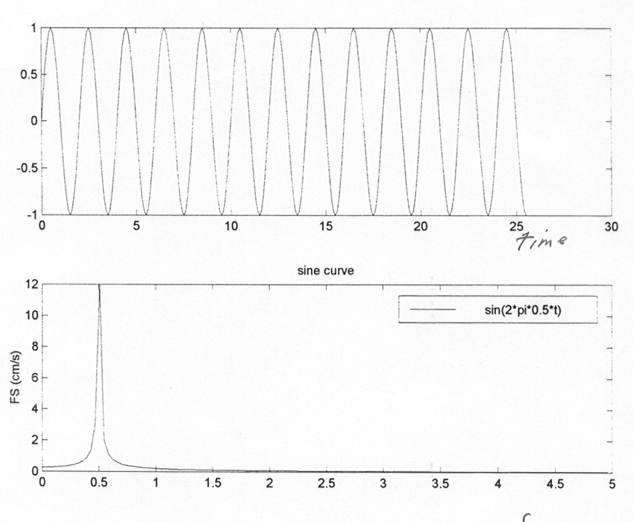
sin(2π*0.5*t)
a (cm/s²)
time (s)
FS (cm/s)
frequency (Hz)
(Modified from the class notes of Prof. John Anderson at Nevada University)
Strong Ground Motion Parameters – Data Processing
Dr. Sinan Akkar

Slide 5
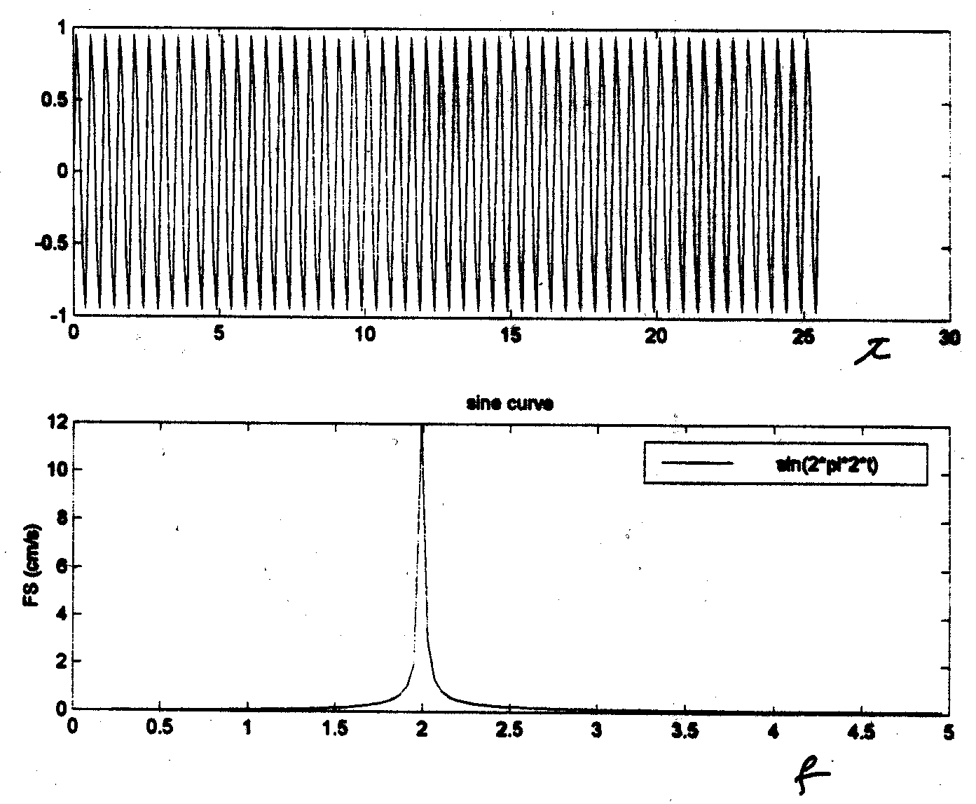
sin(2π*2t)
a (cm/s²)
time, (s)
FS (cm/s)
frequency, (Hz)
(Modified from the class notes of Prof. John Anderson at Nevada University)
Strong Ground Motion Parameters – Data Processing
Dr. Sinan Akkar

Slide 6
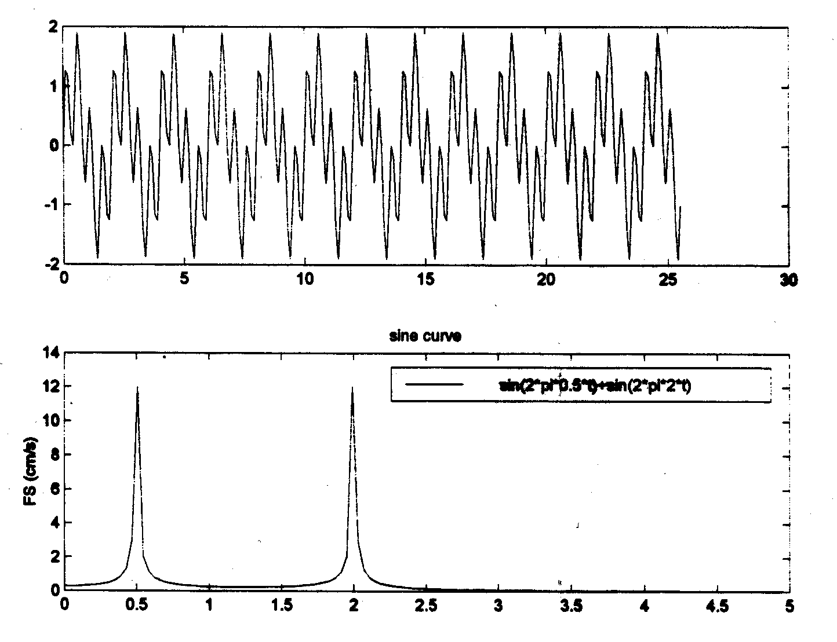
sin(2π*0.5t)+sin(2π*2t)
a (cm/s²)
time, (s)
FS (cm/s)
frequency, (Hz)
(Modified from the class notes of Prof. John Anderson at Nevada University)
Strong Ground Motion Parameters – Data Processing
Dr. Sinan Akkar

Slide 7
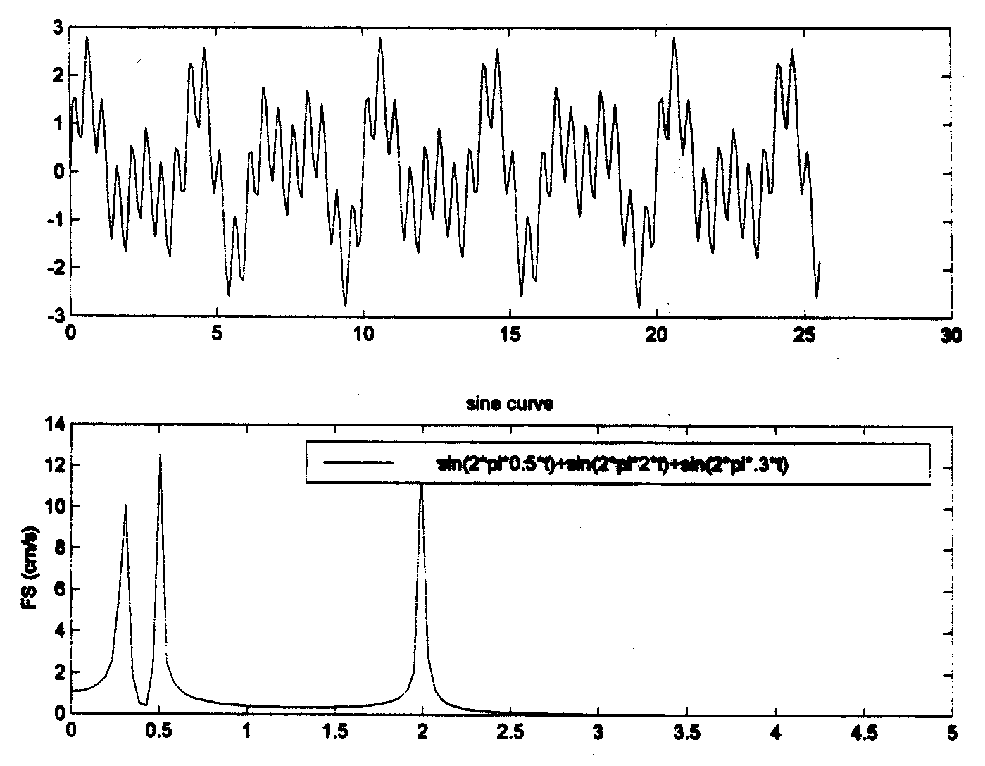
sin(2π*0.5t)+sin(2π*2t) )+sin(2π*0.3t)
a (cm/s²)
time, (s)
FS (cm/s)
frequency, (Hz)
(Modified from the class notes of Prof. John Anderson at Nevada University)
Strong Ground Motion Parameters – Data Processing
Dr. Sinan Akkar

Slide 8
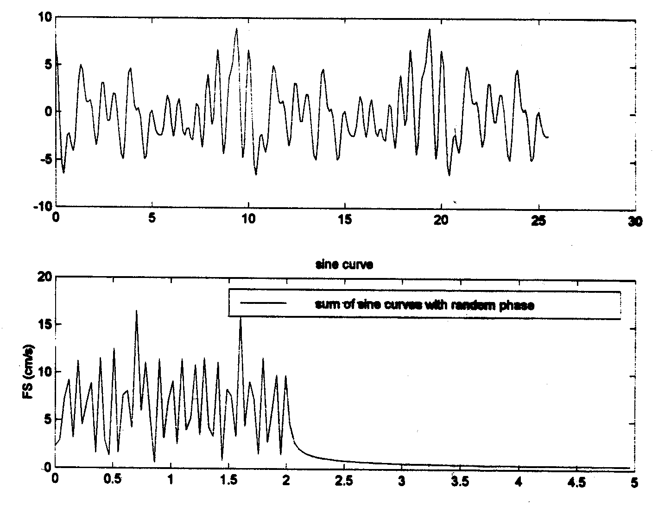
Sum of sine curves with random phase
a (cm/s²)
time, (s)
FS (cm/s)
frequency, (Hz)
(Modified from the class notes of Prof. John Anderson at Nevada University)
Strong Ground Motion Parameters – Data Processing
Dr. Sinan Akkar

Slide 9
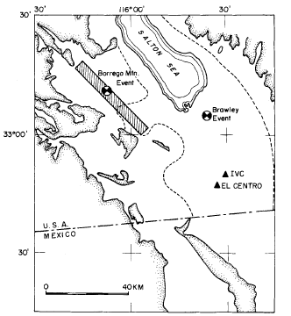
Example: summing quasi-monochromatic waves to simulate body-wave arrivals
Swanger, H. J. and D. M. Boore (1978). Simulation of strong-motion displacements using surface-wave modal superposition, Bull. Seismol. Soc. Am. 68, 907-922.

Slide 10
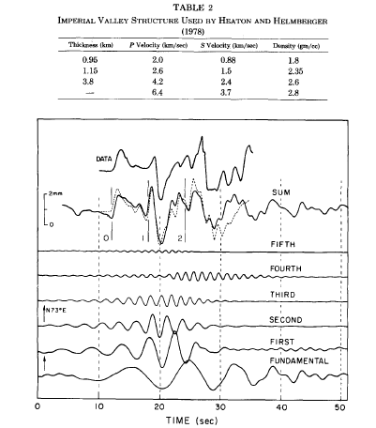

Slide 11
These sketches indicate that the ground motions can be expressed as a sum of harmonic (sinosoidal) waves with different frequencies and arrivals (phases). The Fourier amplitude spectrum (FAS) is capable of displaying these frequencies (i.e. the frequency content of the ground motion).
FAS
If g(t) is cm/s²
|G(ω)| is cm/s
Strong Ground Motion Parameters – Data Processing
Dr. Sinan Akkar

Slide 12
Fourier amplitude spectrum (FAS)
Narrow or Broadband
implies that the motion has a dominant frequency (period) that can produce a smooth, almost sinusoidal time history.
Corresponds to a motion that contains a of frequencies that produce a more jagged irregular time history.
Strong Ground Motion Parameters – Data Processing
Dr. Sinan Akkar

Slide 13
A smoothed and loglog scale FAS tends to be largest over an intermediate range of frequencies bounded by the corner frequency “f_{c}” and the cutoff frequency “f_{max}”.
FAS (log scale)
ω²
f_{c}
f_{max}
Frequency (log scale)
Brune, 1970
f_{c} ∝ M_{o}^{-1/3}
Large earthquakes produce greater low frequency motions
Strong Ground Motion Parameters – Data Processing
Dr. Sinan Akkar

Slide 14
..
U(ω)
U(ω)
ω⁰
ω⁻²
ω²
ω_{c}
ω
ω_{c}
ω_{max}
ω
Simplified source model of Haskell (with only one corner frequency) for a displacement pulse due to a dislocation in the source
Reflection, if our concern is accelerograms
Acceleration source spectrum is proportional to displacement source spectrum by ω²
Strong Ground Motion Parameters – Data Processing
Dr. Sinan Akkar

Slide 15
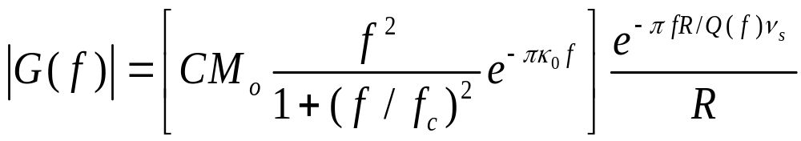
Based on Brune’s solution, the Fourier amplitudes for a far-field event at distance R can be expressed as (McGuire and Hanks, 1980; Boore, 1983)
Source spectrum
Path attenuation
Q(f)
Frequency dependent quality factor
C
A constant that accounts for the radiation pattern, free surface effect, energy partitioning into two horizontal components.
Strong Ground Motion Parameters – Data Processing
Dr. Sinan Akkar

Slide 16
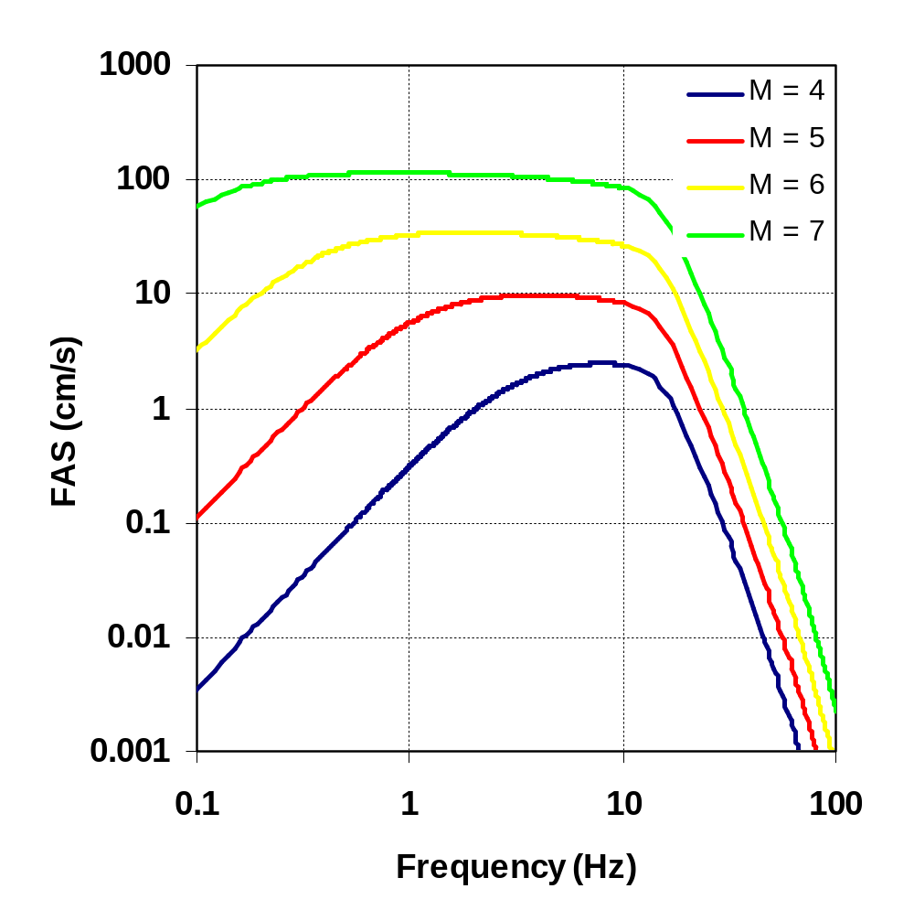
R=10km, Δσ=100 bars and f_{max}=15 Hz
The displayed Fourier expression is based on the mechanics of source rupture and wave propagation. Thus, it offers a significant advantage over purely empirical methods for magnitudes and distances for which few or no data are available
Larger the magnitude, richer the lower frequencies
(Boore, 1983)
Strong Ground Motion Parameters – Data Processing
Dr. Sinan Akkar

Slide 17
END

