Slide 1
FUNDAMENTALS of ENGINEERING SEISMOLOGY
EARTHQUAKE MAGNITUDES

Slide 2
Earthquake source characterization
Magnitude
Fault dimensions (covered before)
Slip distribution (kinematics)
Fourier transform refresher
Point source representation
  Spectral shape
  Corner frequency
  Stress parameter

Slide 3
Earthquake Magnitude
Earthquake magnitude scales originated because of
  the desire for an objective measure of earthquake size
  Technological advances -> seismometers

Slide 4
Earthquake Magnitudes
In the 1930’s, Wadati in Japan and Richter in California noticed that although the peak amplitudes on seismograms from different events differed, the peak amplitudes decreased with distance in a similar manner for different quakes.

Slide 5
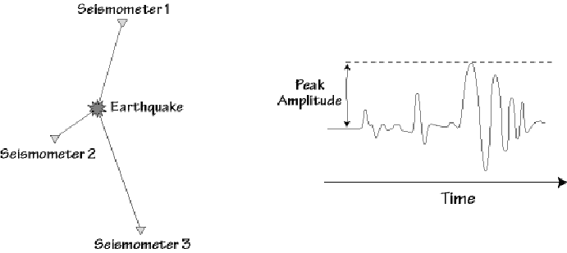
Seismogram Peak Amplitude
The peak amplitude is the size of the largest deflection from the zero line.

Slide 6
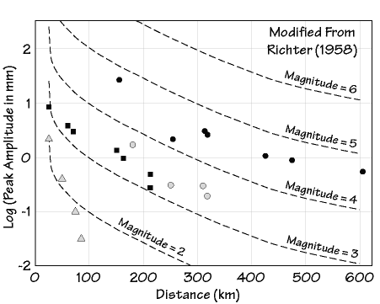
Richter’s Observations

Slide 7
Richter’s Local Magnitude
Richter used these observations to construct the first magnitude scale, M_{L} (Richter’s Local Magnitude for Southern California).
He based his formula for calculating the magnitude on the astronomical brightness scale - which was logarithmic.

Slide 8
Logarithmic Scales
In a logarithmic scale such as magnitude
  A change in one magnitude unit means a change of a factor of 10 in the amplitude of ground shaking (wait! This is an often used statement, but it is too simplistic, and I hope you will know why by the end of the course).

Slide 9
The proper statement
In a logarithmic scale such as magnitude:
  A change in one magnitude unit means a change of a factor of 10 in the amplitude of motion that defines the magnitude. This could be the response of a particular type of instrument, or it could be ground motions at very long periods or ground motions at periods near 1 sec, etc.
  For peak ground motions and response spectra, the scaling is usually less than 10^{M/2} where M is the moment magnitude, defined shortly, rather than 10^{M}.

Slide 10
Richter’s Magnitude Scale
Defined for specific attenuation conditions valid for southern California
Only valid for one specific type of seismometer
Can be used elsewhere if local attenuation correction is used and simulated Wood-Anderson response is computed
Not often used now, although it IS a measure of ground shaking at frequencies of engineering interest

Slide 11
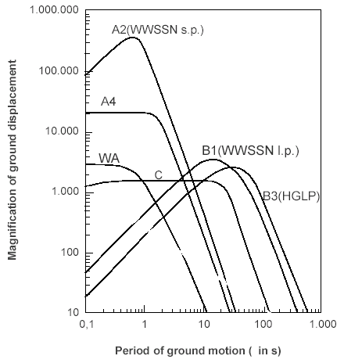
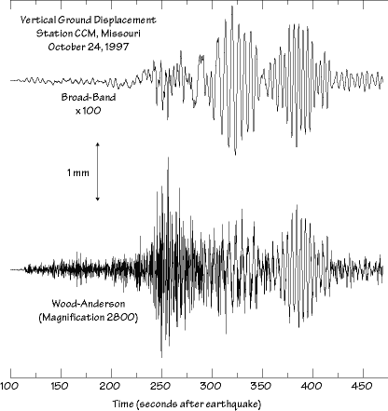
Richter tied his formula to a specific instrument, the Wood-Anderson
torsion seismograph
He assumed a reference motion at a reference distance. To compute the
magnitude at different distances, he calibrated the attenuation function

Slide 12
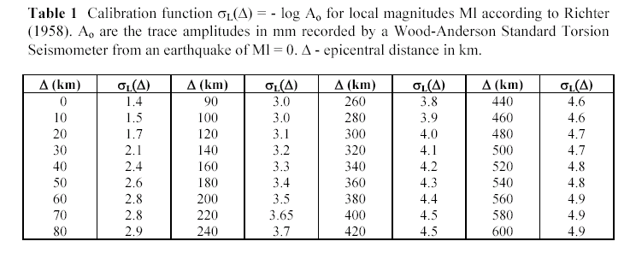
Richter fixed the scale assuming that a M_{L}=3 earthquake produces 1mm of maximum amplitude on a Wood-Anderson seismometer at 100 km
Ml=Log A_{max} -Log A₀
-logA₀ changes from region to region. The calibration of a local magnitude scale for a given region implies the determination of the empirical attenuation correction for that region (and the magnitude station corrections)
The W-A seismometers are not still used. The W-A recording is computed numerically (by convolving the ground displacement with the W-A transfer function)

Slide 13
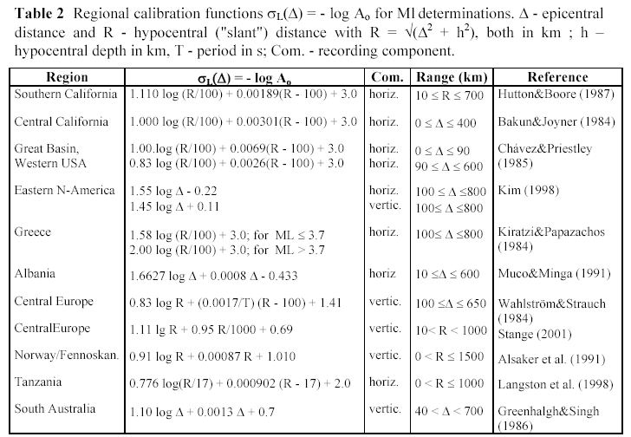
In many studies, the attenuation function is determined by a parametric
approach
where the reference distance and the reference magnitude are fixed
In agreement with the Richter scale.

Slide 14
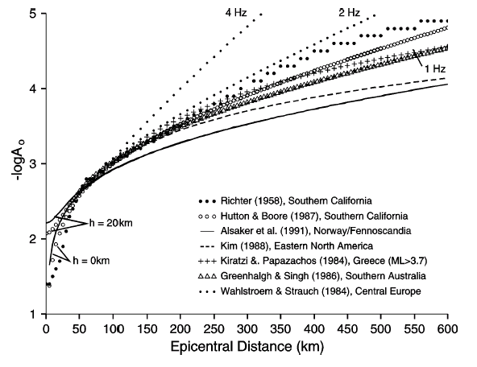

Slide 15
In contrast to the general magnitude formula, M_{L} considers only the maximum displacement amplitudes but not their periods. Reason: WA instruments are short-period and their traditional analog recorders had a limited paper speed. Proper reading of the period of high-frequency waves from local events was rather difficult. It was assumed, therefore, that the maximum amplitude phase (which in the case of local events generally corresponds to Sg, Lg or Rg) always had roughly the same dominant period.
The smallest events recorded in local microearthquake studies have negative values of M_{L} while the largest M_{L} is about 7 , i.e., the M_{L} scale also suffers saturation (see later). Despite these limitations, M_{L} estimates of earthquake size are relevant for earthquake engineers and risk assessment since they are closely related to earthquake damage. The main reason is that many structures have natural periods close to that of the WA seismometer (0.8s) or are within the range of its pass-band (about 0.1 - 1 s).
A review of the development and use of the Richter scale for determining earthquake source parameters is given by Boore (1989).
From the IASPEI New Manual Seismological Observatory Practice

Slide 16
Modern Seismic Magnitudes
Today seismologists use different seismic waves to compute magnitudes
These waves generally have lower frequencies than those used by Richter
These waves are generally recorded at distances of 1000s of kilometers instead of the 100s of kilometers for the Richter scale (this is important because most earthquakes occur in remote places, such as under the oceans, without instruments within 100s of kilometers)

Slide 17
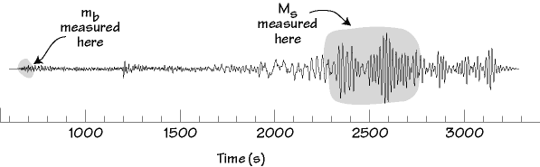
Teleseismic M_{S} and m_{b}
Two commonly used modern magnitude scales are:
    M_{S}, Surface-wave magnitude (Rayleigh Wave)
    m_{b}, Body-wave magnitude (P-wave)

Slide 18
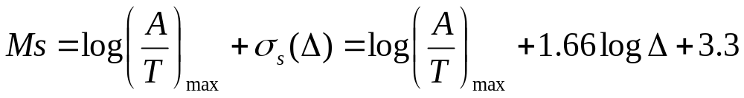
Surface wave magnitude
Work started by Gutenberg developed a magnitude scale based on surface wave recordings at teleseismic distances. The measure of amplitude is the maximum velocity (A/T)max. This allowed not only to link the scale to the energy, but also to account for the large variability of periods T corresponding to the maximum amplitude of surface waves, depending on distance and crustal structure.
Collaboration between research teams in Prague, Moscow and Sofia resulted in the proposal of a new Ms scale and calibration function, termed Moscow-Prague formula, by Karnik et al. (1962):
for epicentral distances 2° < Δ < 160° and source depth h < 50 km. The IASPEI Committee on Magnitudes recommended at its Zürich meeting in 1967 the use of this formula as standard for Ms determination for shallow seismic events (h ≤ 50 km)
Note: also Ms suffers of saturation (see later…)

Slide 19
Body wave magnitude
Gutenberg (1945b and c) developed a magnitude relationship for teleseismic body waves such as P, PP and S in the period range 0.5 s to 12 s. It is based on theoretical amplitude calculations corrected for geometric spreading and (only distance-dependent!) attenuation and then adjusted to empirical observations from shallow and deep-focus earthquakes, mostly in intermediate-period records:
  mB = log (A/T)_{max} + Q(Δ, h)
Gutenberg and Richter (1956a) published a table with Q(Δ) values for P-, PP- and S-wave observations in vertical (V=Z) and horizontal (H) components for shallow shocks, complemented by diagrams Q(Δ, h) for PV, PPV and SH which enable also magnitude determinations for intermediate and deep earthquakes. These calibration functions are correct when ground displacement amplitudes are measured in intermediate-period records and given in micrometers (1 μm = 10⁻⁶ m).

Slide 20
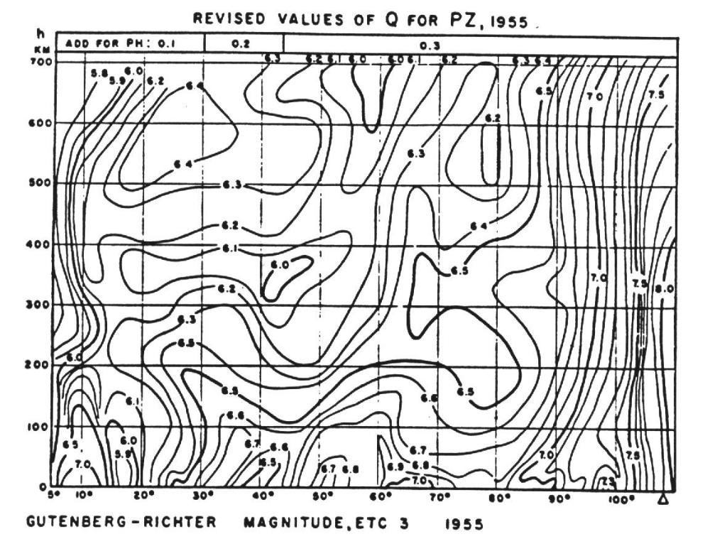

Slide 21
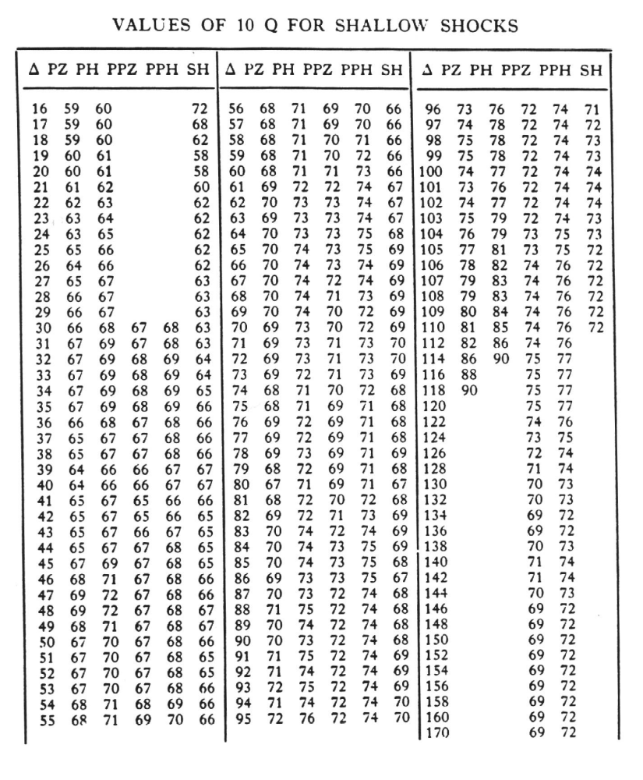

Slide 22
  Later, with the introduction of the WWSSN short-period 1s-seismometers (see Fig. 3.11, type A2) it became common practice at the NEIC to use the calibration function Q(Δ, h) for short-period PV only. In addition, it was recommended that the largest amplitude be taken within the first few cycles (see Willmore, 1979) instead of measuring the maximum amplitude in the whole P-wave train. One should be aware that this practice was due to the focused interest on discriminating between earthquakes and underground nuclear explosions. The resulting short-period mb values strongly underestimated the body-wave magnitudes for mB > 5 and, as a consequence, overestimated the annual frequency of small earthquakes in the magnitude range of kt-explosions. Also, mb saturated much earlier than the original Gutenberg-Richter mB for intermediate-period body waves or Ms for long-period surface waves Therefore, the IASPEI Commission on Practice issued a revised recommendation in 1978 according to which the maximum P-wave amplitude for earthquakes of small to medium size should be measured within 20 s from the time of the first onset and for very large earthquakes even up to 60 s (see Willmore, 1979, p. 85). This somewhat reduced the discrepancy between mB and mb but in any event both are differently scaled to Ms and the short-period mb necessarily saturates earlier than medium-period mB.

Slide 23
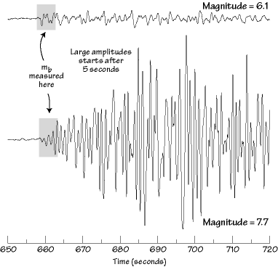
  However, some of the national and international agencies have only much later or not even now changed their practice of measuring (A/T)max for mb determination in a very limited time-window, e.g., the International Data Centre for the monitoring of the CTBTO still uses a time window of only 6 s (5.5s after the P onset), regardless of the event size.

Slide 24
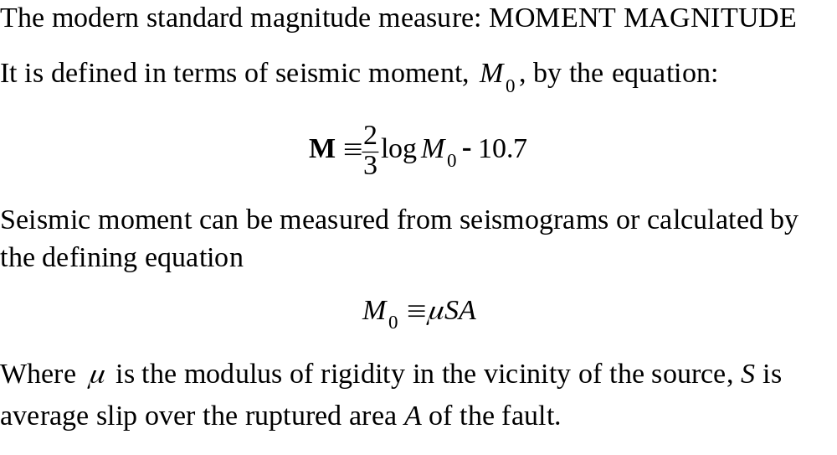

Slide 25
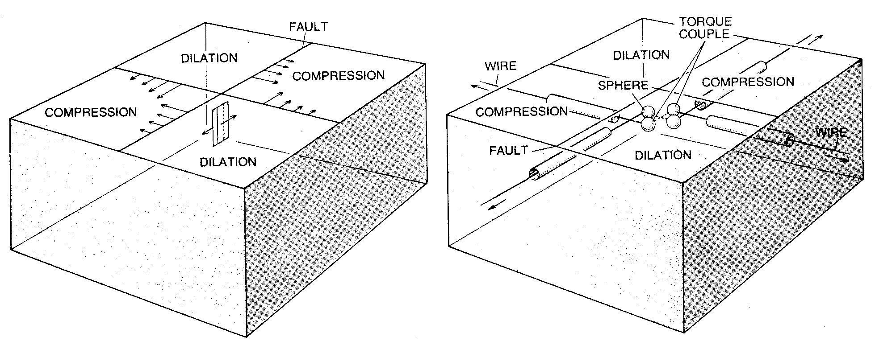
Why is it called “moment”?
Radiation from a shear dislocation with slip S over area A in material with rigidity μ is identical to that from a double couple with strength μ UA (units stress*displacement*area, but stress = force/area, so units = force*displacement = a couple = work = energy)

Slide 26
Nomenclature
M_{w}
  Defined by Kanamori as an energy magnitude (includes a parameter in addition to moment), but he clearly had in mind the present mapping of moment and magnitude but setting the additional parameter to a constant value
M
  The first explicit mapping of moment (M₀) and moment magnitude (M)
  Today people by-and-large use M_{w} (can write it in email); only purists such as DMB use M.

Slide 27
What is the proper equation?
M = 2/3 log M₀ – 10.7?
M = 2/3 log M₀ – 10.73 ?
The former is correct, it corresponds to
Log M₀ = 1.5M + 16.05 (not 16.0 or 16.1)
Hanks (personal commun.) chose 16.05 to average relations with constant terms of 16.0 and 16.1

Slide 28
Why use moment magnitude?
It is the best single measure of overall earthquake size
It does not saturate (discussed later)
It can be estimated from geological observations
It can be estimated from paleoseismology studies
It can be tied to plate motions and recurrence relations

Slide 29
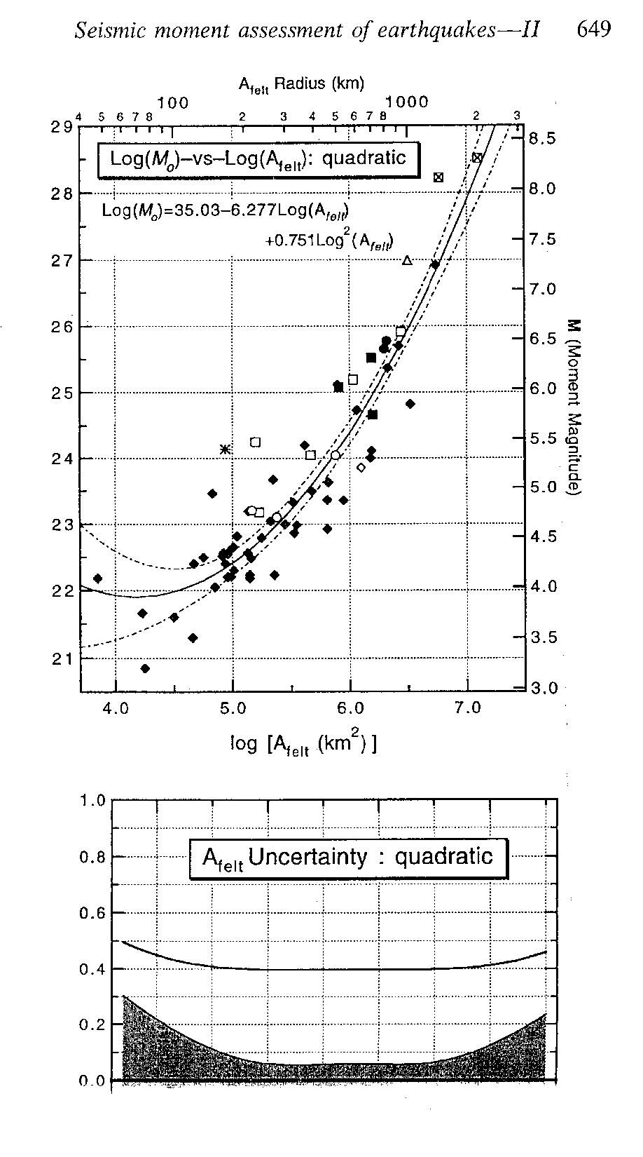
Empirical relations can be used to estimate moment magnitude based on size of felt area – eg. Johnston et al., 1996 relations for mid-plate areas

Slide 30
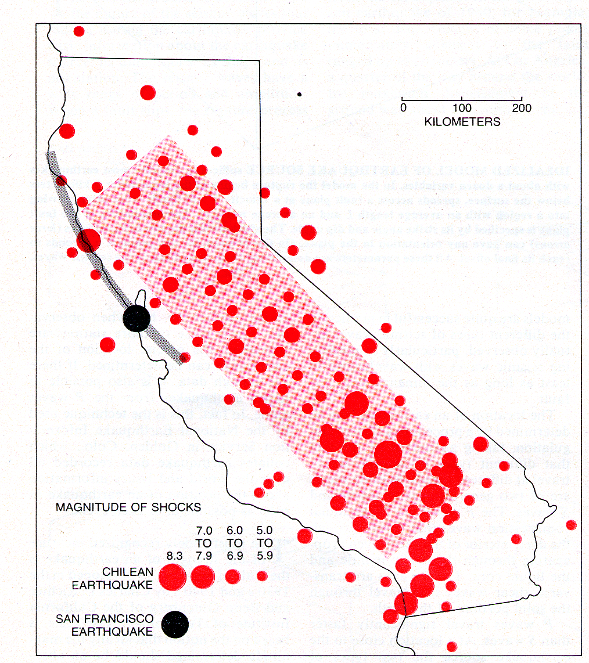
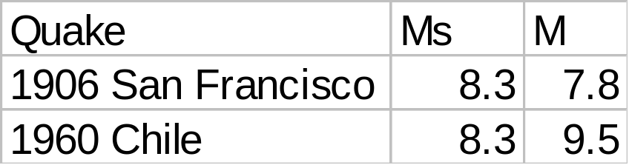
Moment Magnitude is the Best Measure of Earthquake Size

Slide 31
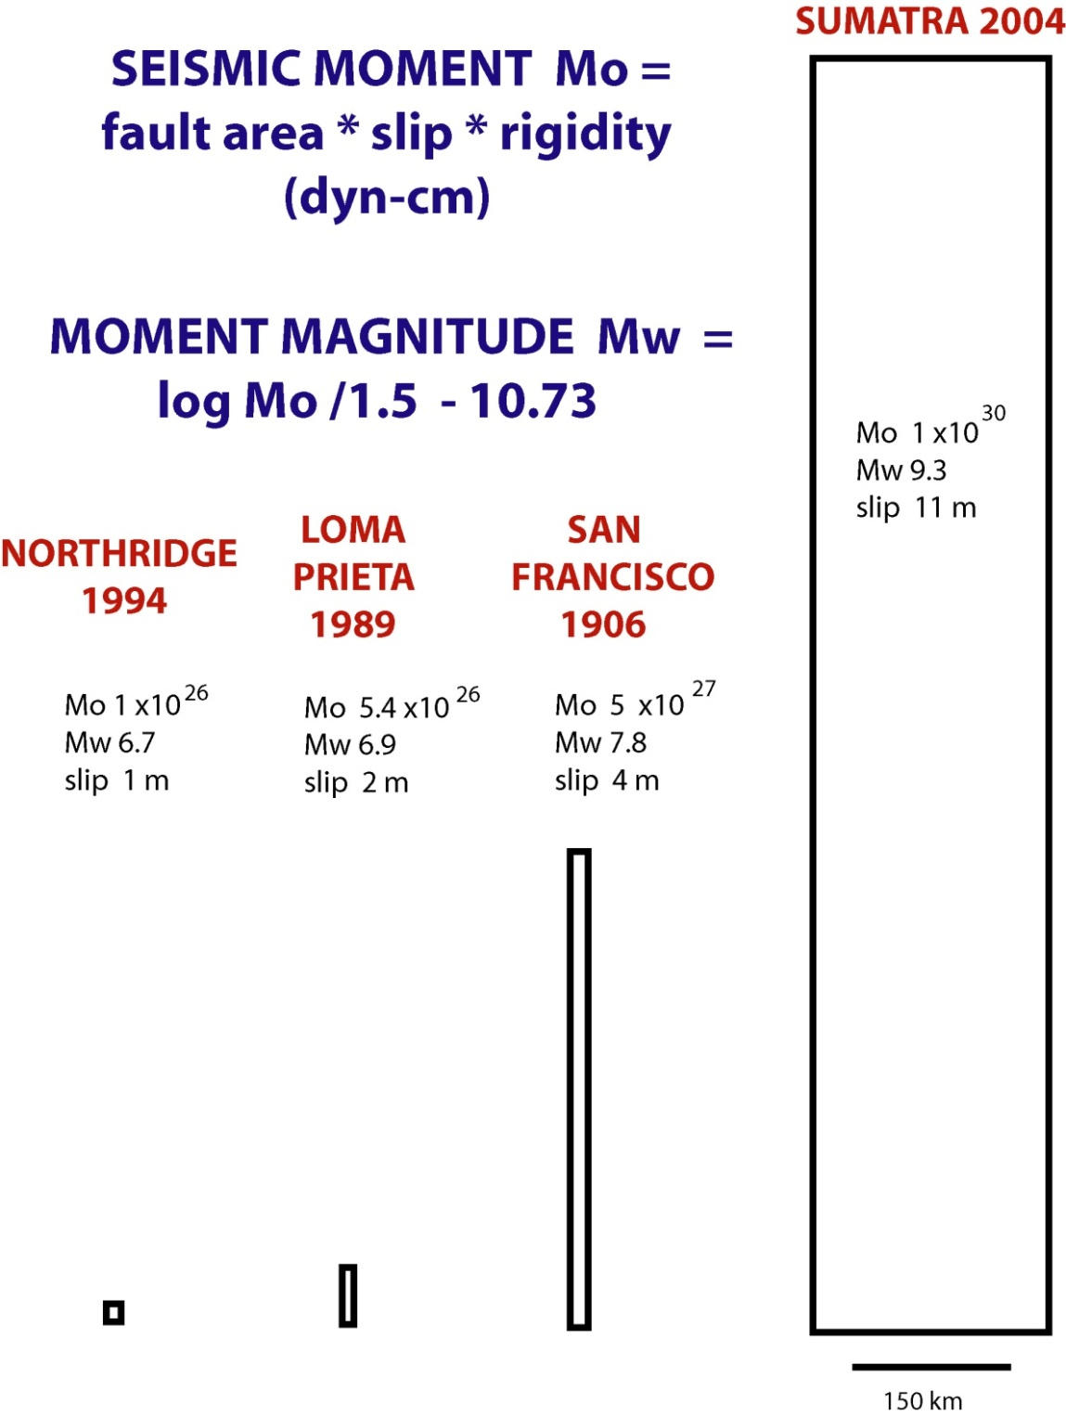
Moment
Physical units (dyne-cm)
10²⁶: Northridge, 1994
10³⁰: Sumatra, 2004
Big range!
No saturation:
bigger rupture →
bigger moment
“the big one”

Slide 32
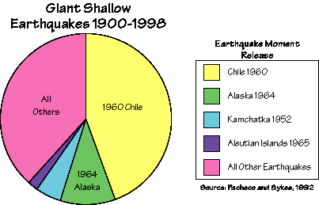
The Largest Earthquakes
M is the appropriate choice for comparing the largest events, it does not saturate.
1960 Chile 9.5
2004 Sumatra 9.3
1964 Alaska 9.2
1952 Kamchatka 9.1
1965 Aleutians 9.0
(This pie chart needs to be revised to include the 2004 Sumatra earthquake, but the chart serves to emphasize that 0.1 M units corresponds to a factor of 1.4 increase in moment.)

Slide 33
ORDERS OF MAGNITUDE
Fault width
Why are the largest earthquakes along subduction zones?
For crustal earthquakes the width is limited by the thickness of the superficial crust brittle layer (~20 km). The thickness of the brittle layer is controlled by temperature, which increases with depth
Width is often considered smaller than the length even for small earthquake

Slide 34
ORDERS OF MAGNITUDE
Fault width
surface
brittle
20 km
plastic

Slide 35
ORDERS OF MAGNITUDE
Fault width
surface
faults
brittle
20 km
plastic

Slide 36
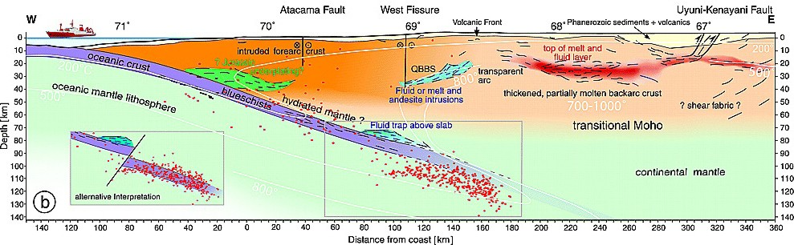
ORDERS OF MAGNITUDE
Fault width
surface
faults
brittle
20 km
plastic

Slide 37
Converting between magnitude scales:
Empirical relations (or sometimes theoretical relations) can be used to convert between magnitude scales. This is important in deriving magnitude recurrence statistics for a region or source zone, as all magnitudes should be first reported on the same scale before characterizing their statistics

Slide 38
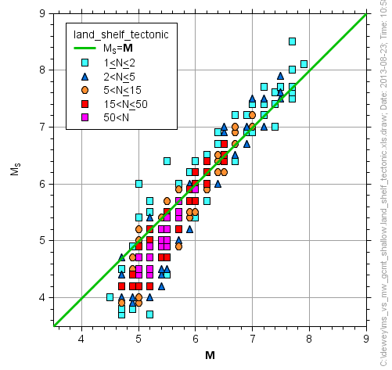
Surface wave magnitude is a close approximation to Moment M for Ms 6 to 8 events

Slide 39
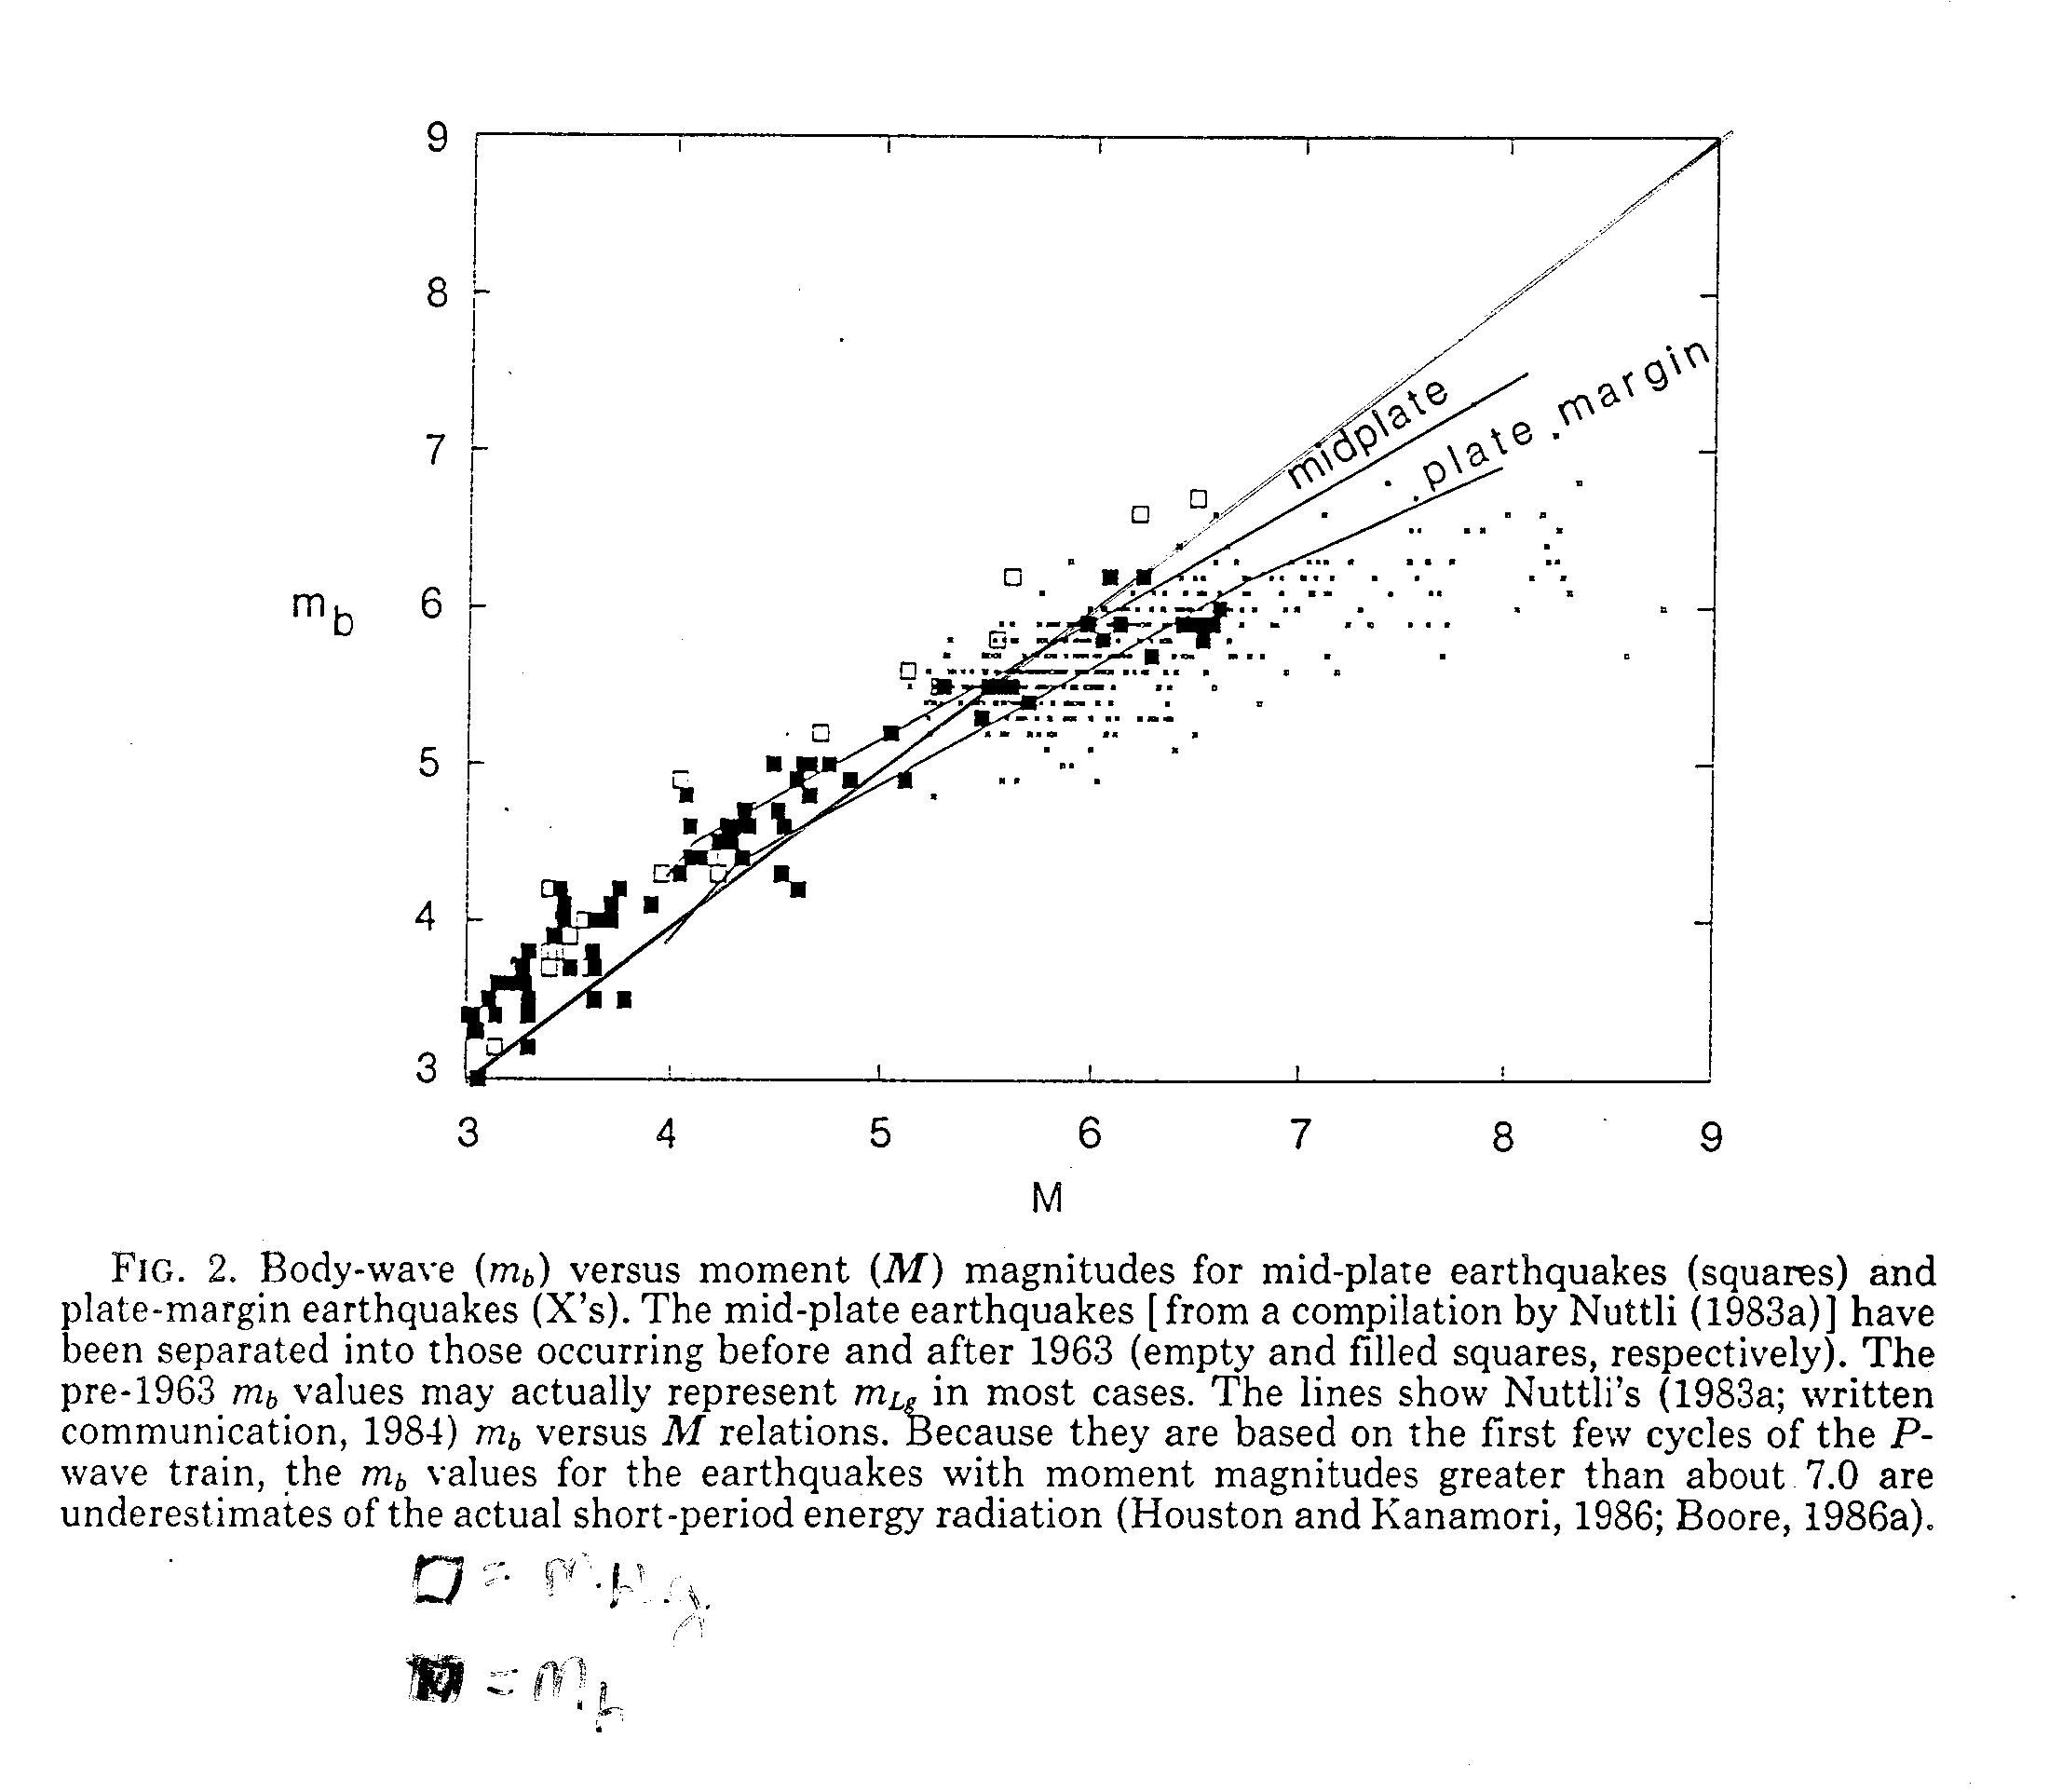
Body-wave magnitude is not a good measure of moment M, especially for large events

Slide 40
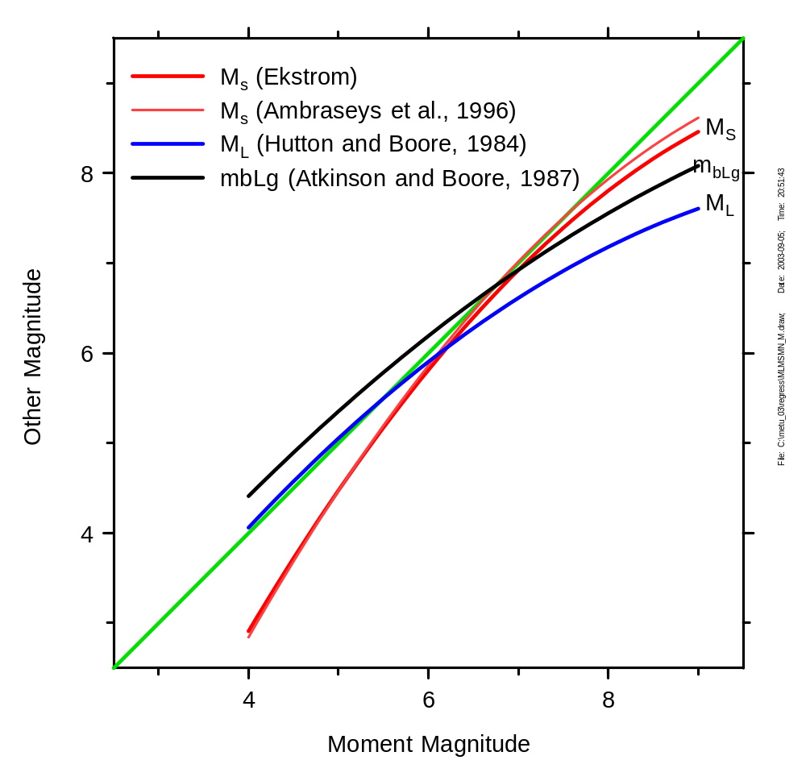
Relations between magnitude scales

Slide 41
Magnitude Discrepancies
Ideally, you want the same value of magnitude for any one earthquake from each scale you develop, i.e.
    M_{S} = m_{b} = M_{L} = M
But this does not always happen:
  San Francisco 1906: M_{S} = 8.3, M = 7.8
  Chile 1960: M_{S} = 8.3, M = 9.6

Slide 42
Why Don’t Magnitude Scales Agree?
Simplest Answer:
  Earthquakes are complicated physical phenomena that are not well described by a single number.
  Can a thunderstorm be well described by one number ? (No. It takes wind speed, rainfall, lightning strikes, spatial area, etc.)

Slide 43
Why Don’t Magnitude Scales Agree?
More Complicated Answers:
    The distance correction for amplitudes depends on geology.
    Deep earthquakes do not generate large surface waves - M_{S} is biased low for deep earthquakes.
    Some earthquakes last longer than others, even though the peak amplitude is the same.
    Variations in stress release along fault, for same moment.
    Not all earthquakes are self similar (that is, the relative radiation at different frequencies can differ--- examples: 1999 Chi-Chi compared to “standard” California earthquake).

Slide 44
Why Don’t Magnitude Scales Agree?
Most complicated reason:
  Magnitude scales saturate
  This means there is an upper limit to magnitude no matter how “large” the earthquake is
  For instance M_{s} (surface wave magnitude) seldom gets above 8.2-8.3

Slide 45
Example: m_{b} “Saturation”
m_{b} seldom gives values above 6.7 - it “saturates”.
m_{b} must be measured in the first 5 seconds - that’s the (old) rule.

Slide 46
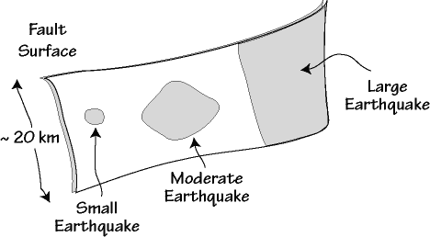
What Causes Saturation?
The rupture process.
  Small earthquakes rupture small areas and are relatively depleted in long-period signals.
  Large earthquakes rupture large areas and are rich in long-period motions (we’ll study this later, when we discuss source scaling)

Slide 47
What Causes Saturation?
The relative size of the fault and the wavelength of the motion used to determine the magnitude is a key part of the explanation.
Small fault compared to the wavelength: the magnitude will be a good measure of overall earthquake size.
Large fault compared to the wavelength: the magnitude will be determined by radiation from only a portion of the fault, and the magnitude will not be a good measure of overall fault size

Slide 48
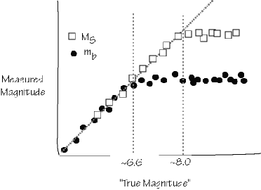
Saturation (cartoon)

Slide 49
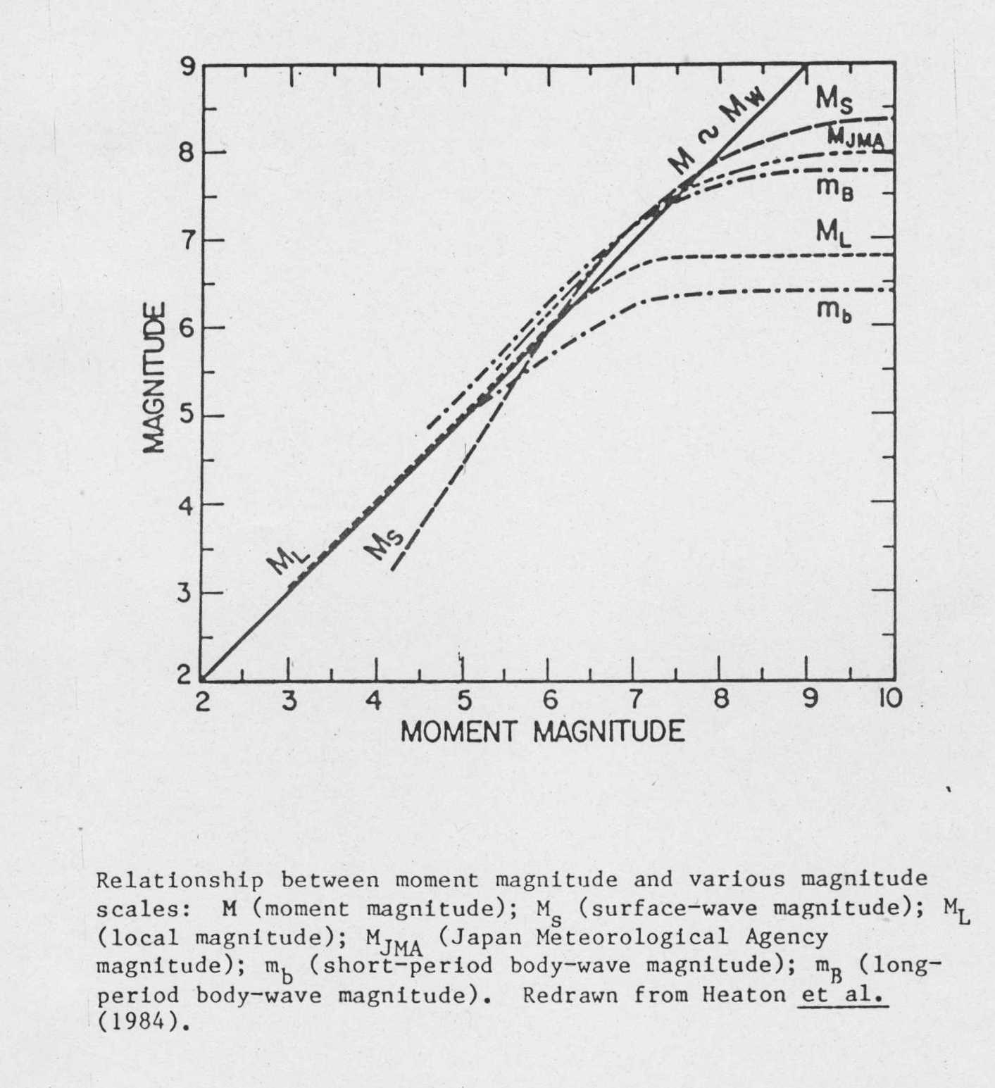
Relations between Magnitude Scales
Note saturation

Slide 50
Are m_{b} and M_{s} still useful?
YES!
  Many (most) earthquakes are small enough that saturation does not occur
  Empirical relations between energy release and m_{b} and M_{s} exist
  The ratio of m_{b} to M_{s} can indicate whether a given seismogram is from an earthquake or a nuclear explosion (verification seismology)

Slide 51
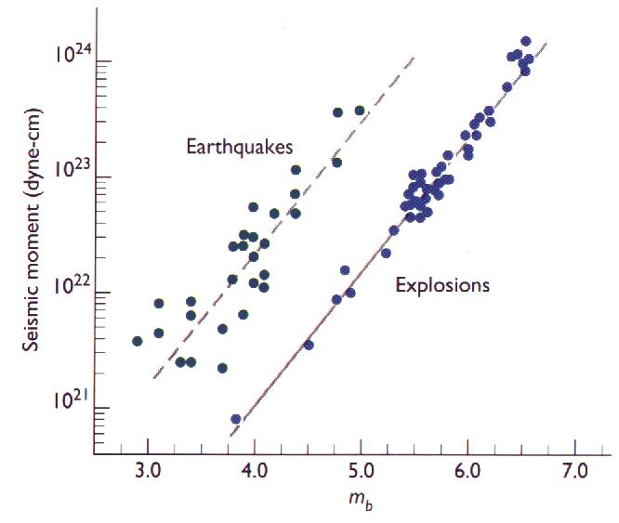
(Whoops, this uses moment. Oh well, a plot of M_{s} vs. m_{b} is similar)

Slide 52
Magnitude Summary
Magnitude is a measure of ground shaking amplitude.
More than one magnitude scale is used to study earthquakes.
All magnitude scales have the same logarithmic form.
Since different scales use different waves and different period vibrations, they do not always give the same value.
Magnitude Symbol Wave Period
Local (Richter) M_{L} S or Surface Wave* 0.8 s
Body-Wave m_{b} P 1 s
Surface-Wave M_{s} Rayleigh 20 s
Moment M_{w}, M Rupture Area, Slip 100’s-1000’s

Slide 53
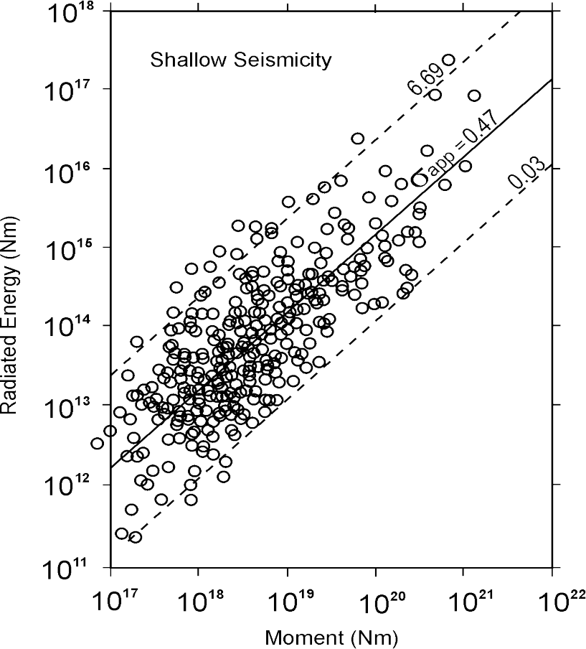

Energy magnitude Me
Me = 2/3 (log Es – 4.4)
Boatwright & Choy (1985)
Choy & Boatwright (1995)
with Me = Mw + 0.27
for Kanamori´s average condition:
E_{s}/M₀ = 5 X 10⁻⁵.
However, this ratio depends on the stress drop Δσ which varies by about three orders of magnitude
For some deep EQ´s Δσ up to about
100 MPa has been determined !
For shallow EQs Choy and Boatwright (1995) found
P. Bormann

Slide 54
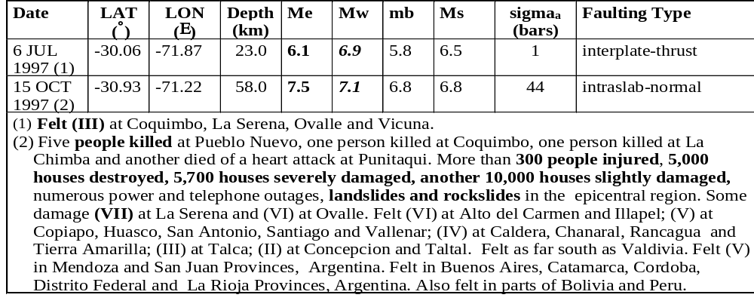
Mw and Me may differ significantly !
Reprinted from Choy et al., 2001
• Mw is related to average displacement and rupture area and thus to
=> tectonic effects of EQ
• Me is more closely related to the exitation of higher frequencies and thus to
=> damage potential of EQ
P. Bormann

Slide 55
Conclusions
• Mw and Me are the only physically well-defined and non-saturating
magnitudes, however, they mean different things.
• Determination of Mw and Me has to be based on (V)BB, digital
records (bandwidth: 2 to 4 decades or 6 to 13 octaves).
• All classical band-limited magnitudes (typically 1 to 3 octaves),
saturate (e.g.; Ml, mb, mB and Ms).
• Band-limited magnitudes still form the largest magnitude data
set. They have merits on their own (e.g., Ml-I₀, mb-Ms ratio, etc.).
P. Bormann

Slide 56
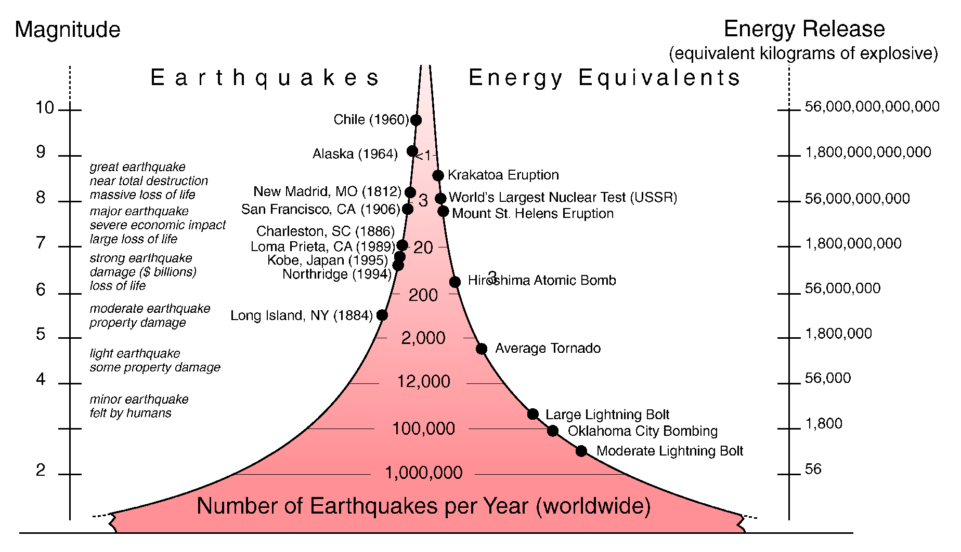
ORDERS OF MAGNITUDE
Seismic magnitude

Slide 57
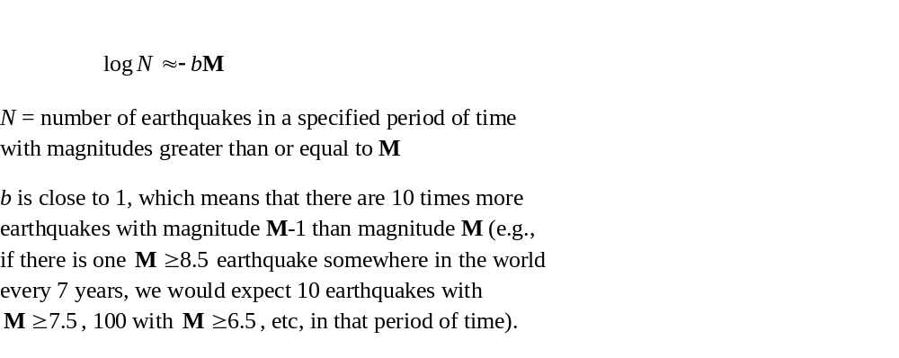
Magnitude-frequency distribution

Slide 58
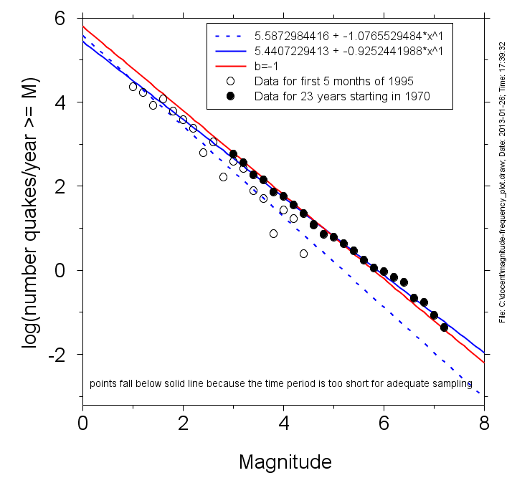

Slide 59
Recurrence Rate

Slide 60
Slip Rate → Recurrence Rate
Slip rate = N mm/year
M_{max} event = X meters (average) slip
Characteristic model: T_{r} = X/N
e.g
Sagaing fault: ? mm/yr

Slide 61
Slip Rate → Recurrence Rate
Slip rate = N mm/year
M_{max} event = X meters (average) slip
Characteristic model: T_{r} = X/N
e.g
Sagaing fault: 20 mm/year
M_{max} = ?

Slide 62
Slip Rate → Recurrence Rate
Slip rate = N mm/year
M_{max} event = X meters (average) slip
Characteristic model: T_{r} = X/N
e.g
Sagaing fault: 20 mm/year
M_{max} = 8, X = ?

Slide 63
Slip Rate → Recurrence Rate
Slip rate = N mm/year
M_{max} event = X meters (average) slip
Characteristic model: T_{r} = X/N
e.g
Sagaing fault: 20 mm/year
M_{max} = 8, X = 6 m → T_{r} = ?

Slide 64
Slip Rate → Recurrence Rate
Slip rate = N mm/year
M_{max} event = X meters (average) slip
Characteristic model: T_{r} = X/N
e.g
Sagaing fault: 20 mm/year
M_{max} = 8, X = 6 m → T_{r} = 6/(.02) = 300 yrs

Slide 65
Slip Rate → Recurrence Rate
Slip rate = N mm/year
M_{max} event = X meters (average) slip
Characteristic model: T_{r} = X/N
e.g
Sagaing fault: 20 mm/year
M_{max} = 7.5, X = ?

Slide 66
Slip Rate → Recurrence Rate
Slip rate = N mm/year
M_{max} event = X meters (average) slip
Characteristic model: T_{r} = X/N
e.g
Sagaing fault: 20 mm/year
M_{max} = 7.5, X = 3 m → T_{r} = ?

Slide 67
Slip Rate → Recurrence Rate
Gutenberg-Richter distribution:
~10% of moment released in M<M_{max} events
e.g
Sagaing fault: 20 mm/year
M_{max} = 8, X = 6 m → T_{r} = 6/(.018) = 333 yrs
M_{max} = 7.5, X = 3 m → T_{r} = 3/(.018) = 167 yrs

Slide 68
If time remains, proceed to
ROSE_2013_W1D4L1_Fourier_spectra.pptx

Slide 69
End

