Slide 1
FUNDAMENTALS of ENGINEERING SEISMOLOGY
LOCATING EARTHQUAKES

Slide 2
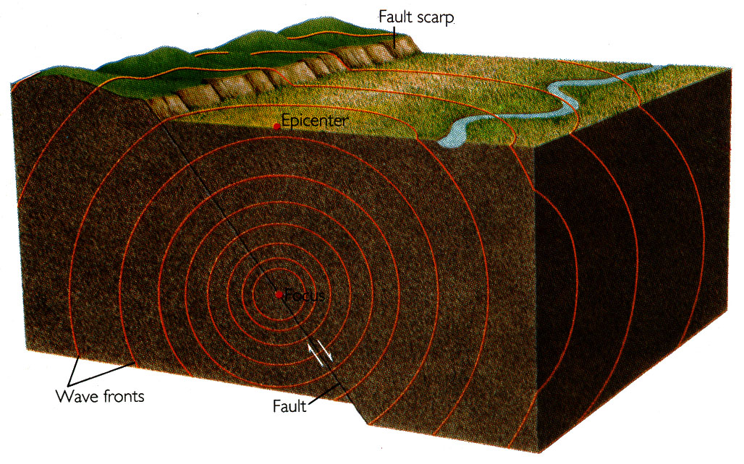
The release of the accumulated elastic strain energy by the sudden rupture of the fault is the cause of the earthquake shaking

Slide 3
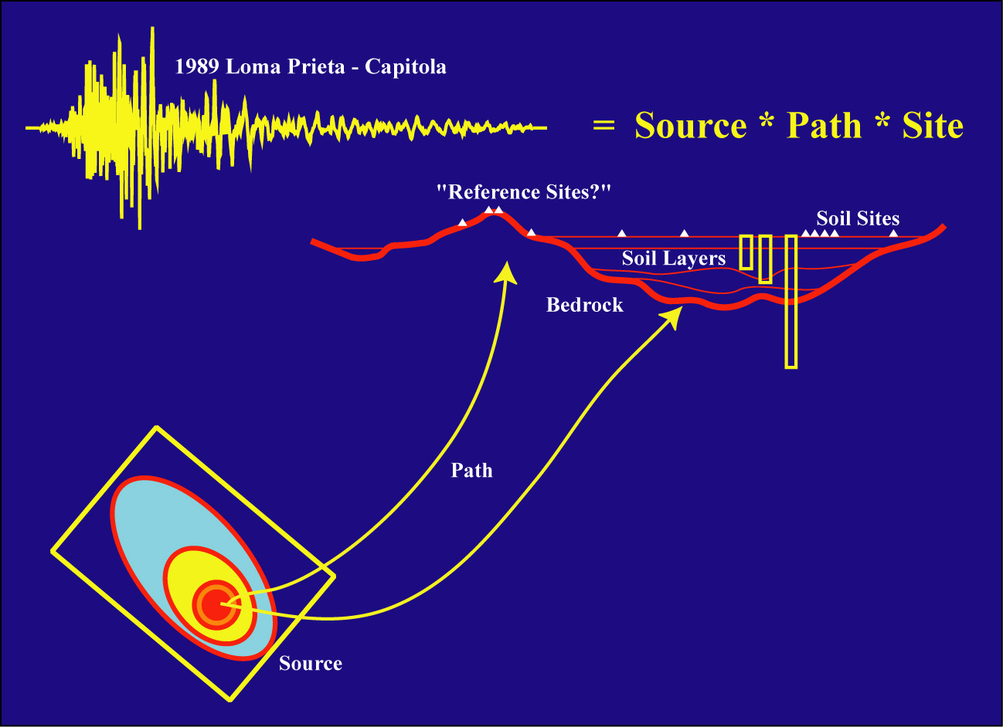
Ground Motion Deconvolution
(Steidl)

Slide 4
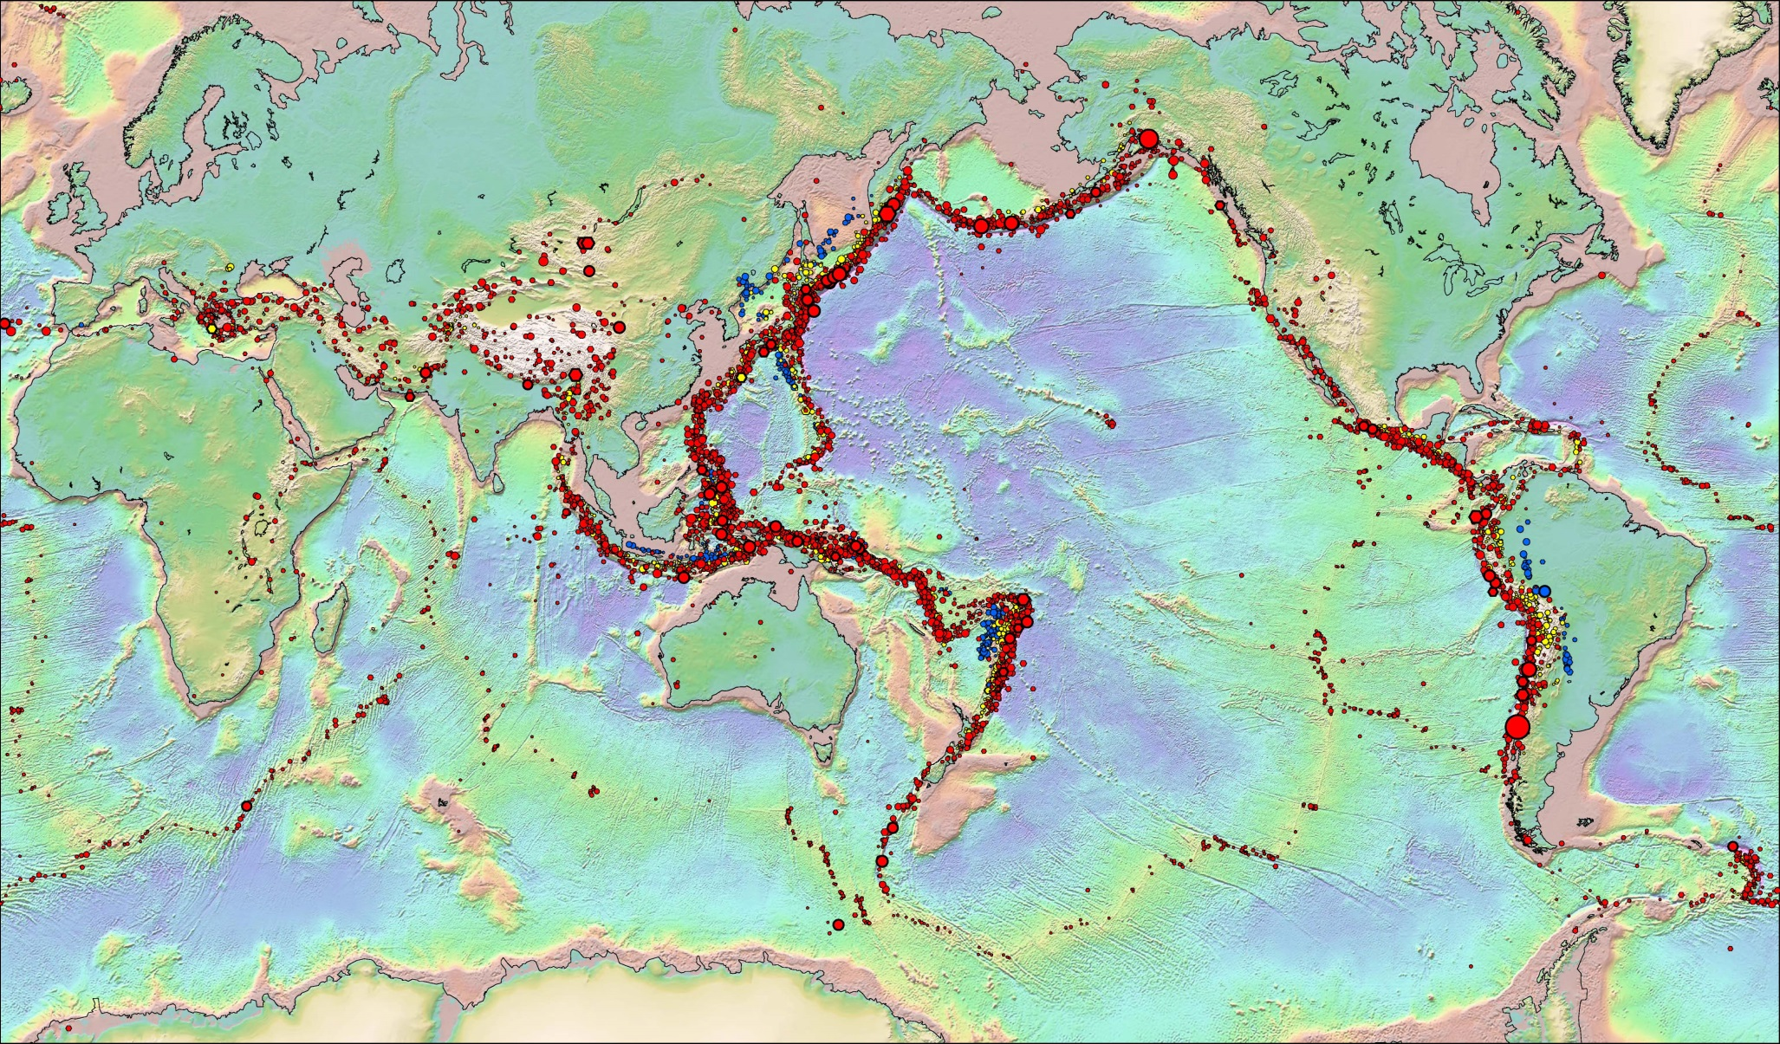
Earthquakes are not located randomly around the Earth

Slide 5
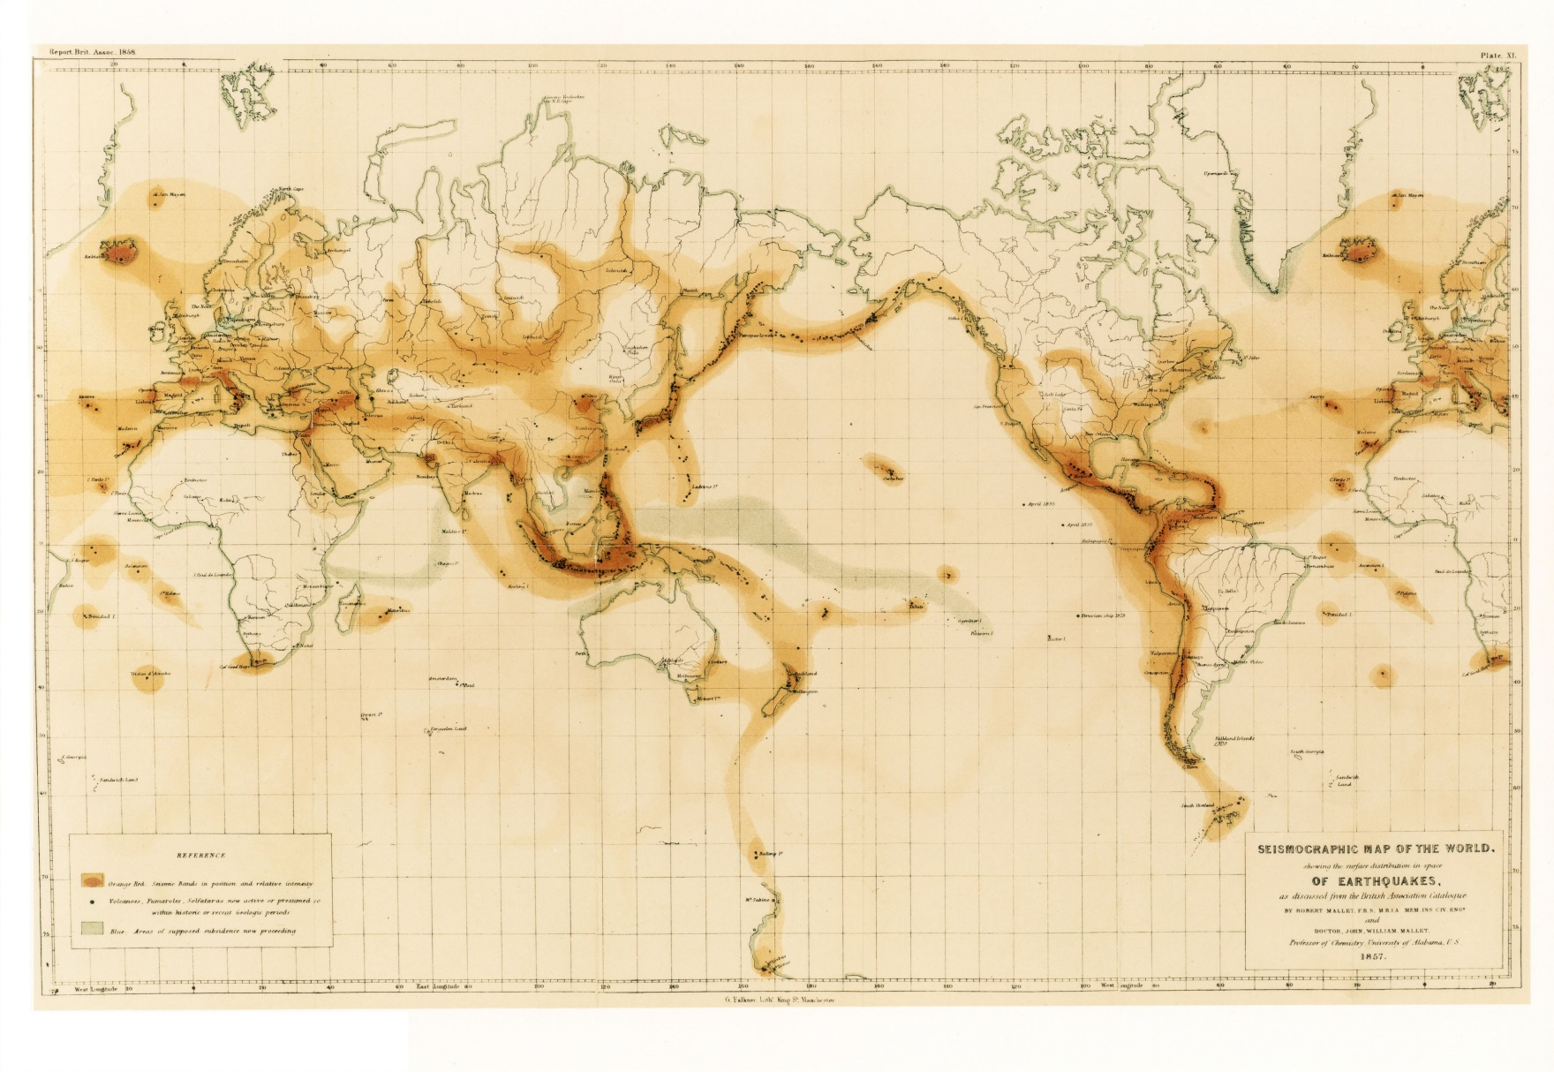
This was known in pre-instrumental days (Mallet, 1857)

Slide 6
Earthquake Origin Parameters

Slide 7
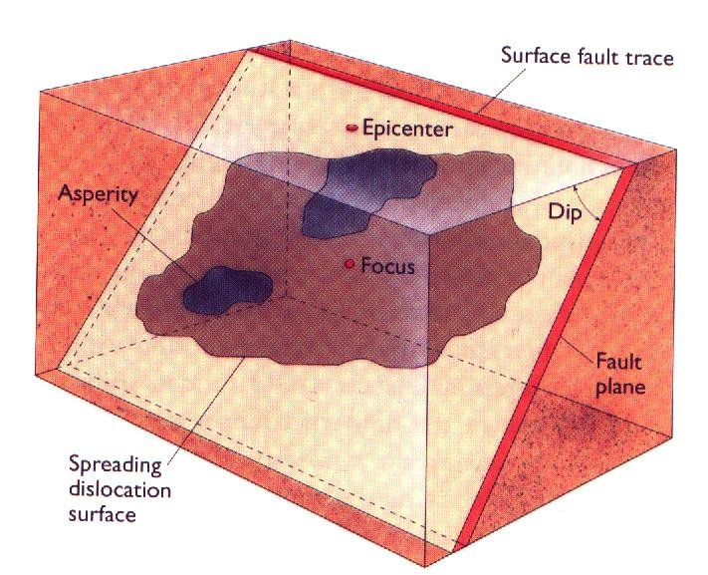

Slide 8
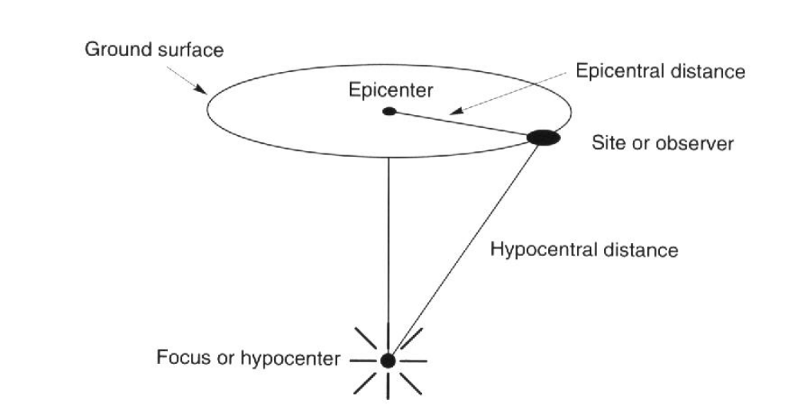
Focal depth

Slide 9
EARTHQUAKE ORIGIN
}
Epicentral Coordinates (Nº, Eº)
Focal depth, h (km)
Origin time, t_{o}
SPACE
TIME

Slide 10
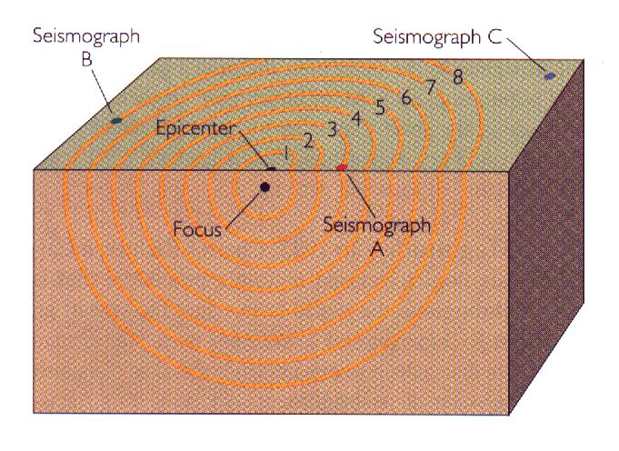
Basic idea: look at relative arrival times of phases at different stations (waves will arrive at A, then B, and then C)

Slide 11
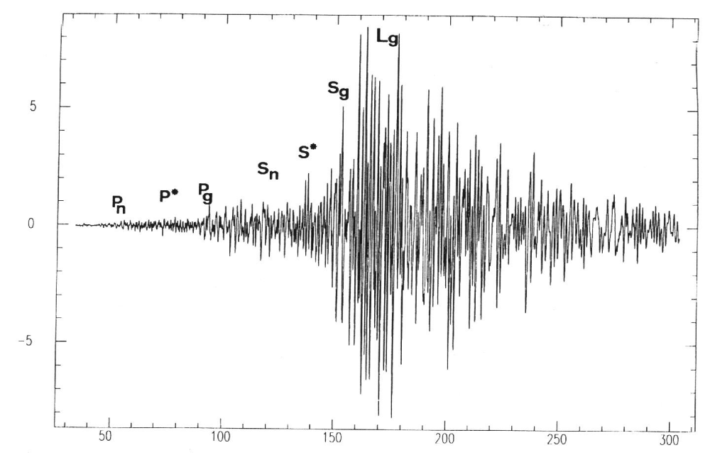
Phase arrival times (must identify the phase and use the proper travel time curves)

Slide 12
Application: Earthquake Location
We can use this simple understanding of wave propagation to understand how we locate earthquakes using seismograms.
We’ll examine a simple example, true calculations are more complicated, but the ideas are the same.

Slide 13
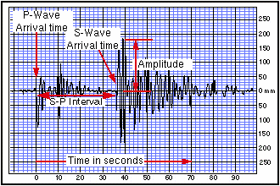
Seismograms

Slide 14
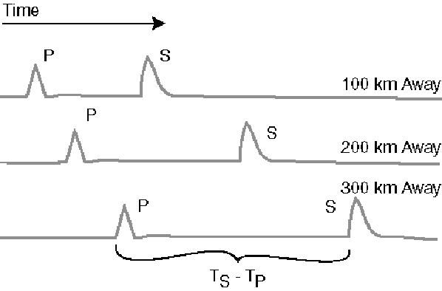
S-P Time Example

Slide 15
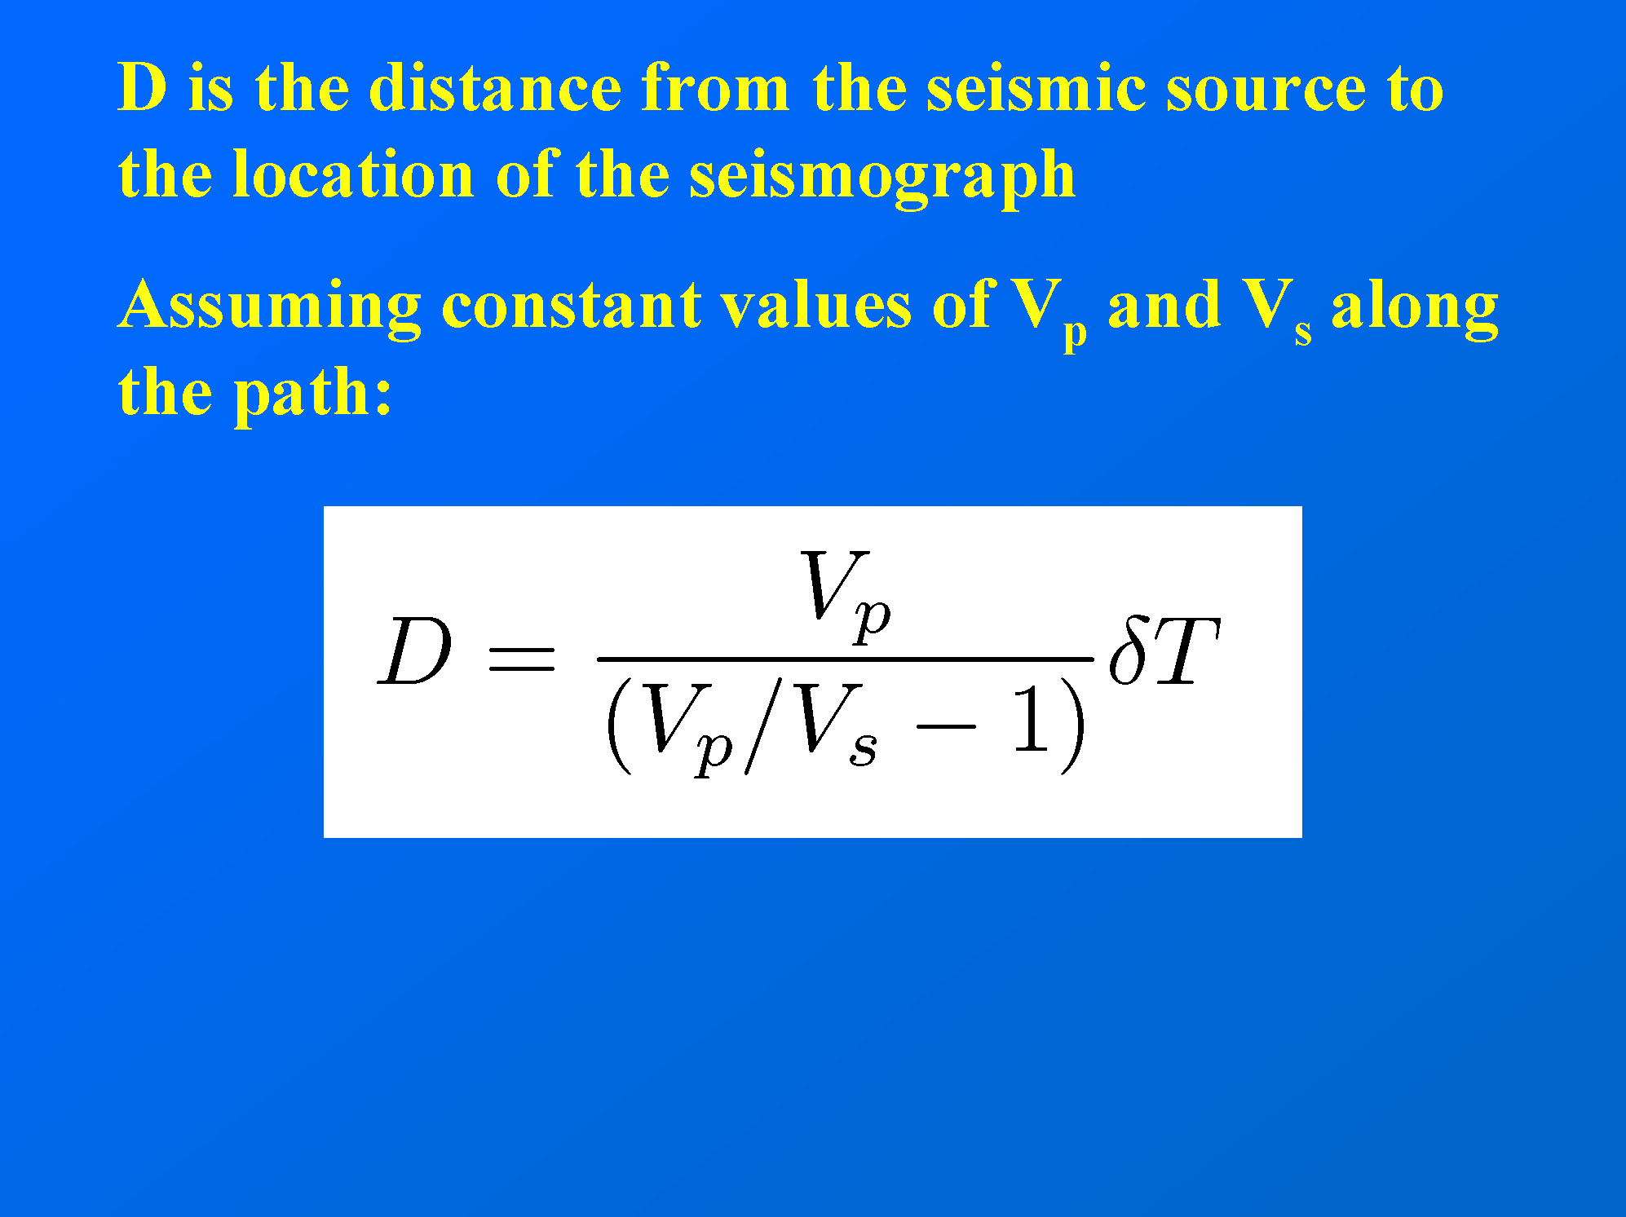

Slide 16
A “Rule of Thumb”
Because of the structure of Earth, for distance ranges between about 50 and 500 km, we can use a formula to estimate the distance from the observed S-arrival time minus the P-arrival time:
  distance = 8 x (S-P arrival time)
What about for closer distances? Factor is less than 8.

Slide 17
Example
If the arrival time of an S wave is 09:30:15.0 (GMT) and the arrival time of a P wave is 09:29:45.0 (GMT), then the time difference is 30 s. Thus, the earthquake is located about 240 km away from the seismometer.
But in which direction ???

Slide 18
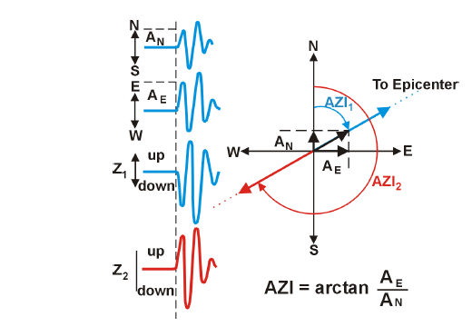
Before facing the problem of determining the earthquake locations from arrival times at different stations, what we can do when only one three component station is available?
Determination of the incidence direction
Amplitude
of P wave
With AN and AE we can determine the radial directions. Using the polarity of the vertical component we can fix the ambiguity of π. And the distance?
(Draw cross-section)

Slide 19
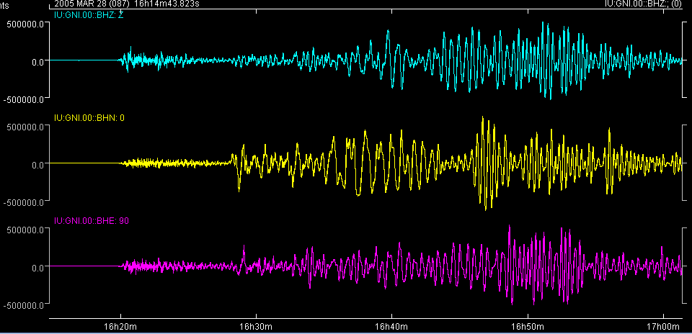
This also works for teleseisms
March 28, 2005 M8.7 Sumatra earthquake, as recorded at GNI station in Armenia (60 Degrees from the epicenter)
ts-tp is about 8 minutes
Courtesy of A. Kelly
Notes:
There are four unknowns in the problem of earthquake location – the origin time of the earthquake and the three geographical co-ordinates of the focus. The data used to resolve these unknowns are the recorded seismograms. The simplest solution comes from considering the phase arrival times. If we have a good velocity model the difference in time between the S and P arrival can be converted into distance.

Slide 20
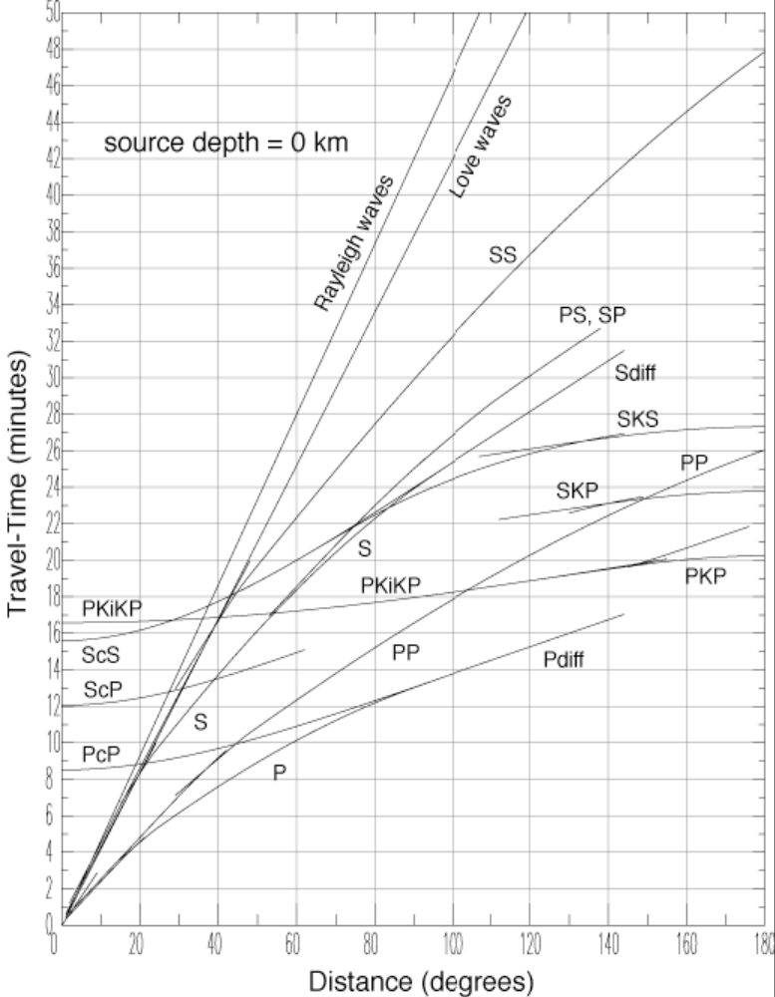
ts-tp is about 8 minutes
→ the travel time curves
provide a distance of 60°
(ok!)
at 60° the Love arrives approximately here and the Rayleigh here
PREM model, Dziewonski & Anderson, 1981
Notes:
Because P wave velocities are greater than S wave velocities, the separation between the phases increases with distance from the focus. Using this approach each station can be used to estimate the distance from the station to the focus.
A rough approximation of the relationship between S-P time and distance is D [in km]=8*(S-P) [in sec]

Slide 21
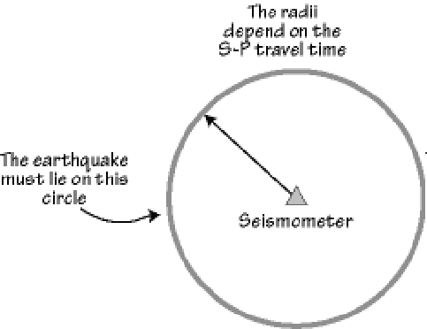
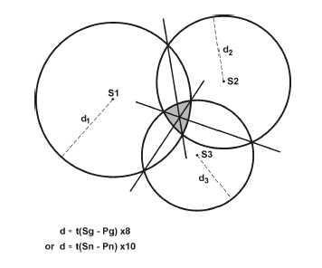
If more than 1 station is available (at least 3), then the epicenter can be estimated using a “triangulation” procedure:
NOTE: The circles do NOT intersect at a point because the depth is not 0.0.

Slide 22
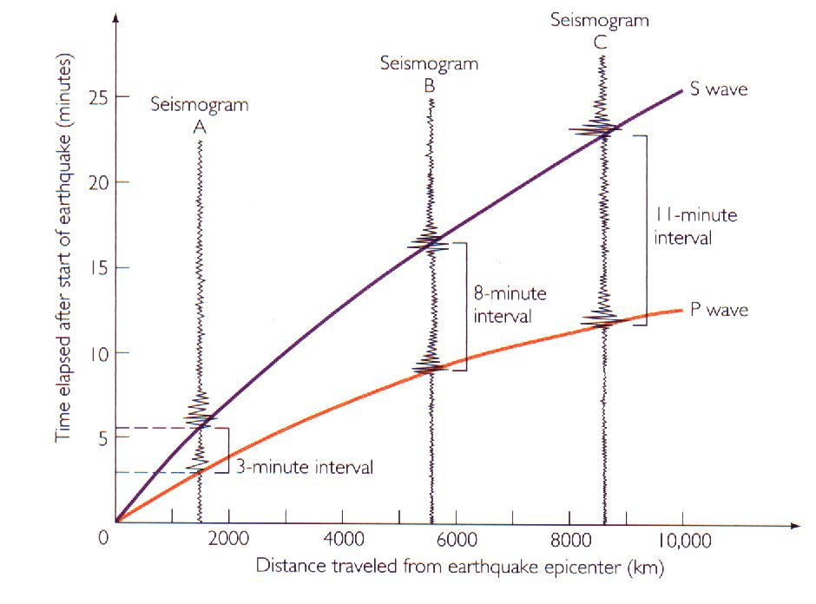
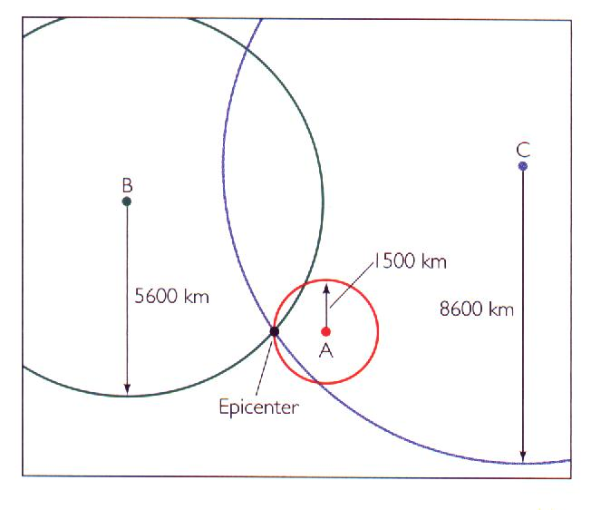
Note: remember that you can use the travel-time curves
to estimate the distances..
D. Boore
D. Boore

Slide 23
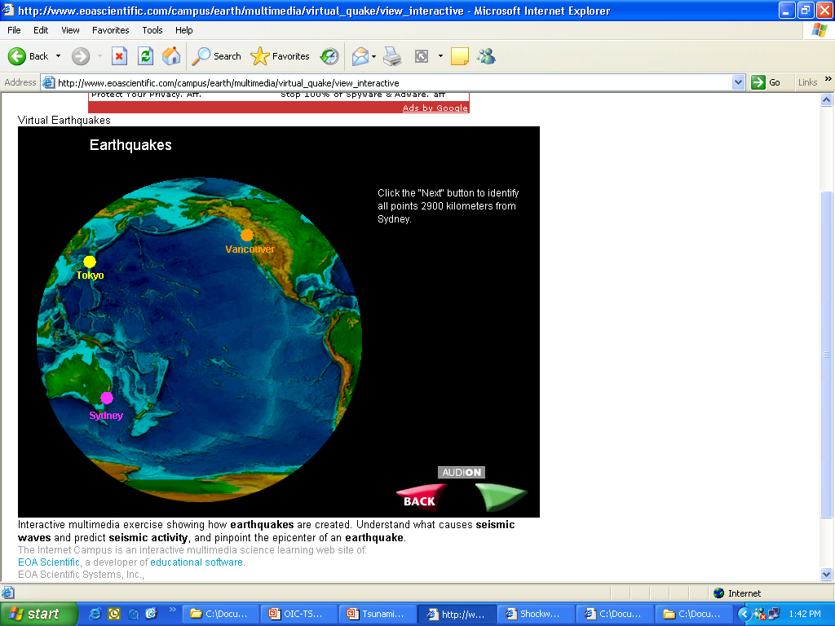
A. Kelly
Courtesy of Dr. Qamar-uz-Zaman Chaudhary
Pakistan Mteorological Dept.

Slide 24
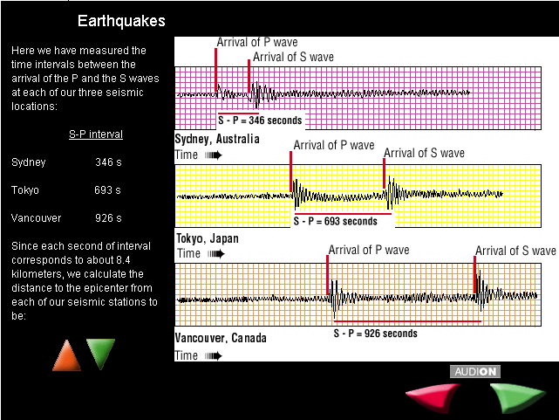
A. Kelly
Courtesy of Dr. Qamar-uz-Zaman Chaudhary
Pakistan Mteorological Dept.

Slide 25

A. Kelly
Courtesy of Dr. Qamar-uz-Zaman Chaudhary
Pakistan Mteorological Dept.

Slide 26
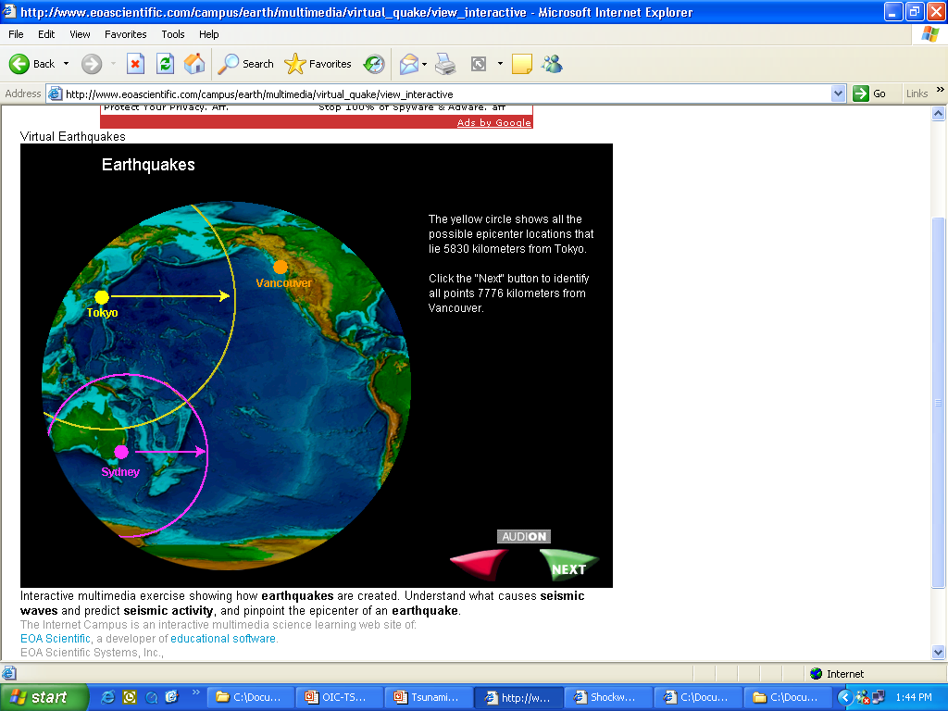
A. Kelly
Courtesy of Dr. Qamar-uz-Zaman Chaudhary
Pakistan Mteorological Dept.

Slide 27
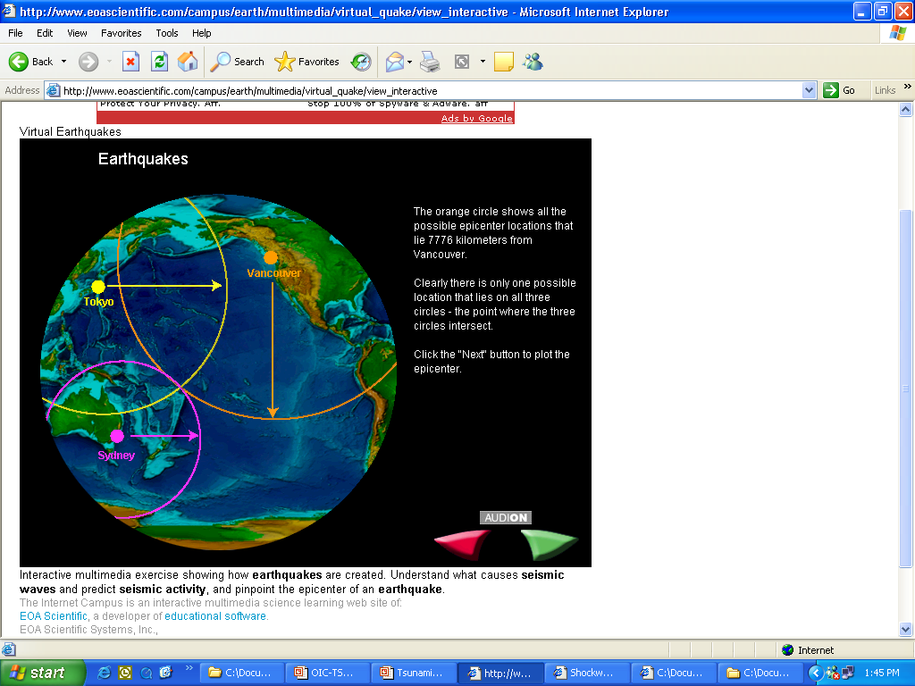
NOTE: The circles will NOT intersect at a point unless the depth is 0.0, so this slide is somewhat in error (but note the distance scale, so the area of non-intersection would be very small on this figure for reasonable depths).
A. Kelly
Courtesy of Dr. Qamar-uz-Zaman Chaudhary
Pakistan Mteorological Dept.

Slide 28
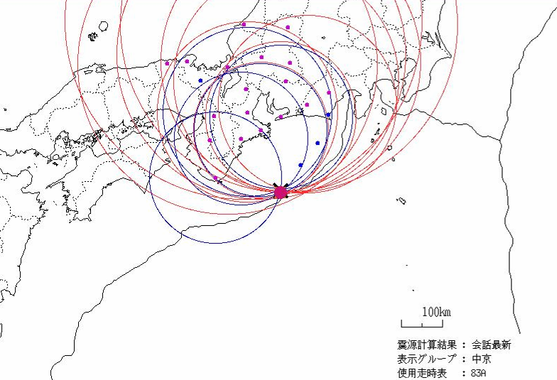
S-P method
1 station – know the distance - a circle of possible location
2 stations – two circles that will intersect at two locations
3 stations – 3 circles, one intersection = unique location
(in absence of errors...)
4+ stations – over determined problem – can get an estimation of errors
A. Kelly
Source: Japan Meteorological Agency
Notes:
With one station the S-P time gives a distance from the station to the source. The earthquake can therefore be anywhere on a circle, centered on the station and with a radius equal to the epicentral distance. With two stations there are two circles and two possible locations. Three stations allow a unique solution to the location. However, additional stations are useful as they reduce any uncorrelated errors (such as picking error).

Slide 29
Locations based on arrivals of individual phases (often just the initial P-wave)

Slide 30
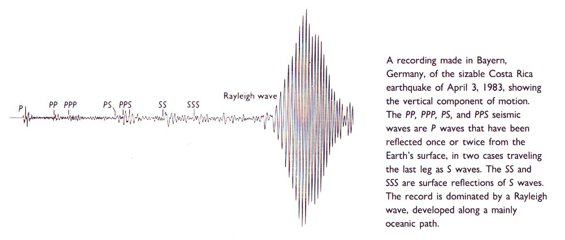
Wave Arrival Times Read from Seismographs Around the World

Slide 31
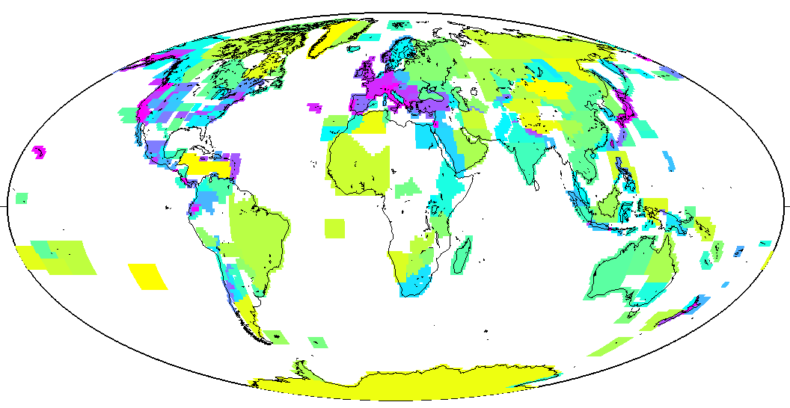
ISC
Stations Reporting 1997 Phases
0.75
3
12
48
192
Number of Stations per 10⁶km²,
averaged over Flinn-Engdahl Geographic Regions

Slide 32
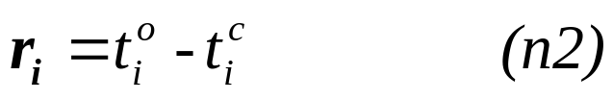
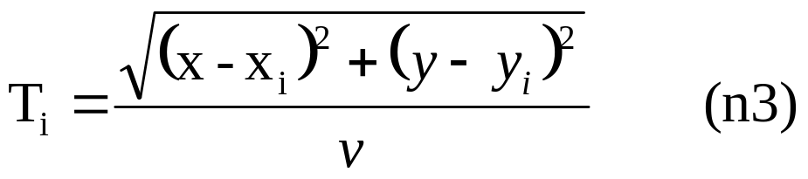
Numerical methods
The arrival time t_{i} at station i can be written as
Travel time
Station
Hypocenter
origin time
4 unknowns
If the arrival times for different stations are known, than the location problem can be solved in a least-squares sense (over-determined system). The minimized quantity is the residual between the observed and the computed arrival times. For station i, the residual is:
Problem: the travel time is a non-linear function of the parameters. For example, in the 2D case:
Do not forget: the travel time depends on the velocity model!!!

Slide 33
The Location Algorithm sometimes fails to produce a solution for the earthquake origin parameters, either because:
There is no convergence
or
The focal depth has a negative value.

Slide 34
The procedure followed in these cases is to fix the value of the focal depth and hold it constant during the iterations; ie, δh_{o} is assumed to be zero.
The focal depth is fixed from:
Depth phases
The appearance of the seismograms
An arbitrary value, such as 33 km.

Slide 35
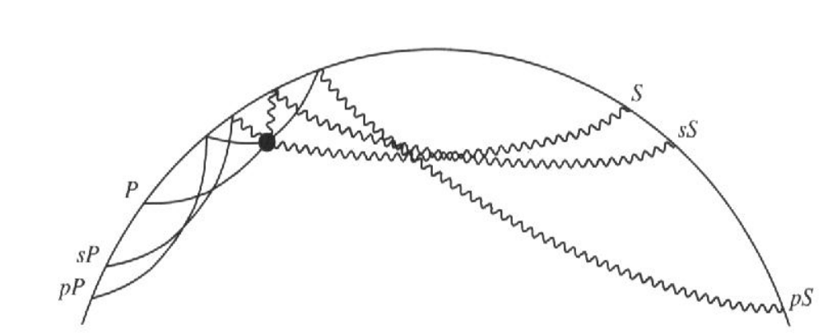
Depth Phases: pP, sS, sP, pS

Slide 36
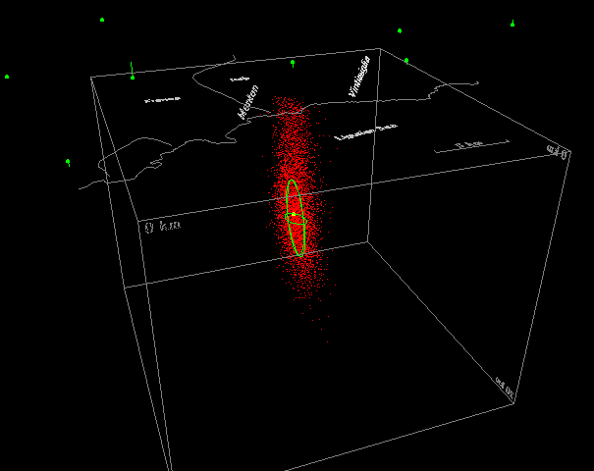
Antony Lomax - NONLINLOC- A probabilistic approach to
earhquake location-
A useful approach when the problem is strongly non-linear and then the Geiger approach is not suitable (e.g. in regions where the velocity model is strongly heterogeneous/ anisotropic)
(see the internet page of NonLinLoc for details)

Slide 37
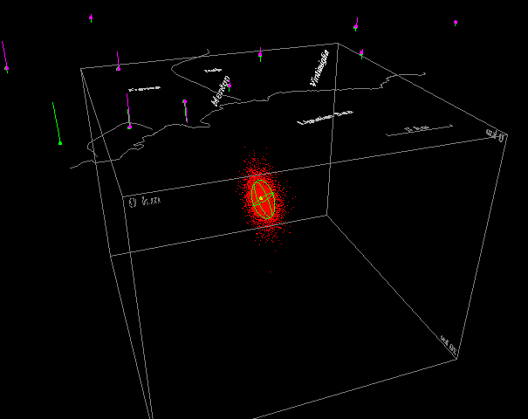
adding close stations the determination of depth is
improved

Slide 38
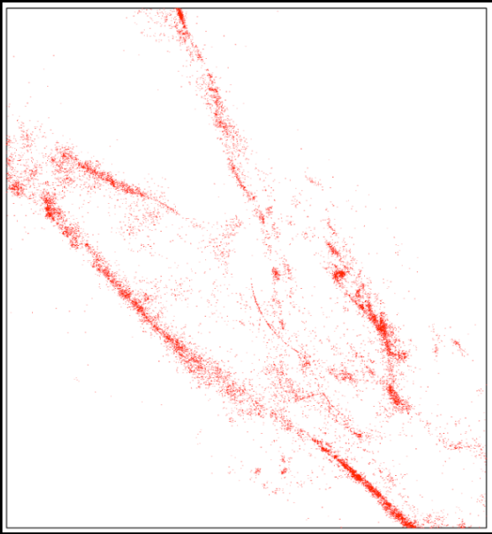
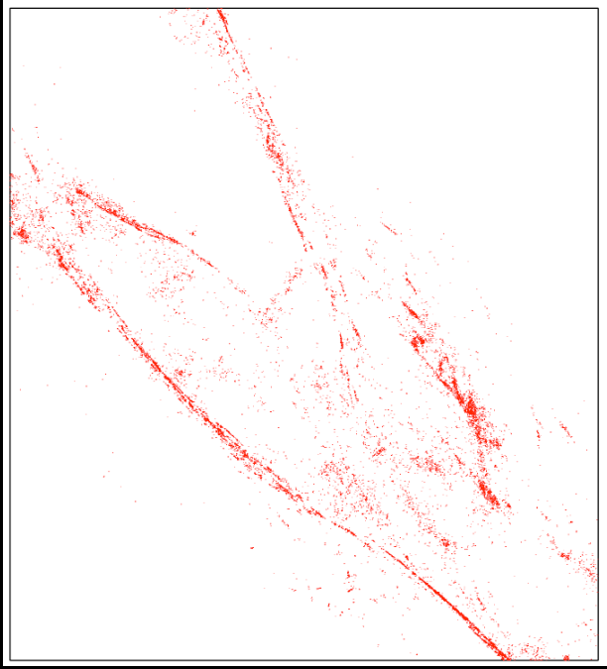
Relocation methods
A. Kelly, USGS, 2007 Indonesia Training Course
Network locations
Recalculate the locations using the relationship between the events.
  Master Event Method
  Joint hypocentral determination
  Double difference method
relocations
Waldhauser and Schaff “Improving Earthquake Locations in Northern California Using Waveform Based Differential Time Measurements”
Notes:
Although there will not be time to use relocation for tsunami warning purposes, it might be possible to analyze events more thoroughly afterwards. In this case, relocation methods might be of interest for better characterizing the source of the earthquakes. One of the main sources of error in the location is error in the velocity model; however if a number of events are very closely spaced (for example microearthquakes on a well instrumented fault, or aftershocks) then the ray paths from the source to the stations will be very similar for all the events. The total travel time for each individual event is subject to any errors in the velocity model, but the difference in travel time between events is related to the spatial distance between the sources. Therefore by comparing events the relative locations can be judged much more accurately than the absolute location. On the examples on the right, we can see that after relocation of events in Northern California the faults appear much sharper and artifacts like the arch of events seen in the original locations are removed. A better map of faults helps to better define the seismic hazard.

Slide 39
Master event relocation
A. Kelly, USGS, 2007 Indonesia Training Course
Select master event(s) – quakes with good locations, probably either the largest magnitude or event(s) that occurred after a temporary deployment of seismographs.
Assign residuals from this event as the station corrections.
Relocated other events using these station corrections.
Notes:
Master event relocation can be used to better resolve the relative distribution of a cluster of earthquakes (for example a main shock and the series of after shocks). Such work can be useful for defining the structure of faults or the area that slipped in a large earthquake. The basic idea is to take one of the events that is assumed to have the best location (often the main shock in a main shock-aftershock sequence – as this well have the best signal to noise ratio) and assume that the residual travel time misfits for the best location are due to deviations in the velocity structure. Then because the paths from events in the cluster will be similar for all events, these deviations in velocity model are assumed to be the same for all events. So the arrival times for other events in the cluster are adjusted using the master event residuals, and the events relocated.

Slide 40
Joint Hypocenter Determination (JHD)
A. Kelly, USGS, 2007 Indonesia Training Course
In JHD a number of events are located simultaneously solving for the station correction that minimizes the misfit for all events (rather than picking one “master event” that is assumed to have good locations).
Notes:
Master event relocation will force any picking errors in the master event into the location of the other events and so an alternative approach is to assume similar uncertainty for all events in the cluster and locate all events simultaneously. This is called Joint Hypocenter Determination

Slide 41
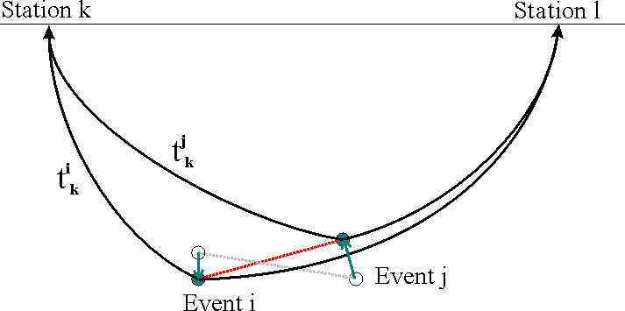
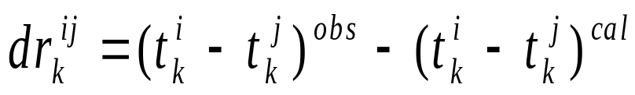
Double difference method
A. Kelly, USGS, 2007 Indonesia Training Course
Double difference for event k – aim to minimize this residual
Difference in observed arrival time for stations i and j
Difference in calculated arrival time for stations i and j
This approach doesn’t calculate station corrections.
Instead the relative position of pairs of events is adjusted to minimize the difference between the observed and calculated travel time differences
Notes:
A different approach is the double difference method. Rather then calculating a static station correction, pairs of events are relocated using the difference in arrival time between the two events. The relative difference in arrival time can be determined very accurately by cross-correlation of the arrivals, see next slide. The difference in calculated travel times comes from the velocity model and is assumed to be related only to the spatial separation between the events. So the double difference is minimized (for all stations and all events) by adjusting the vector between the events.

Slide 42
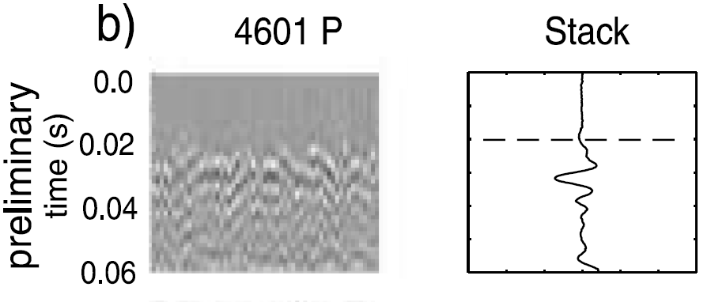
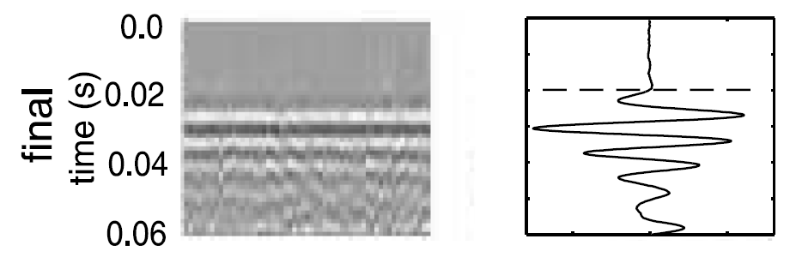
Cross-correlation to improve picks
A. Kelly, USGS, 2007 Indonesia Training Course
Phases from events with similar locations and focal mechanisms will have similar waveforms.
realign traces to maximize the cross-correlation of the waveform.
Analyst Picks
Cross-correlated Picks
Rowe et al 2002. Pure and Applied Geophysics 159
Notes:
If two or more records have similar waveforms (needs similar location and focal mechanism – e.g. a recurring event on the same fault, or recordings on an array) then the time of the phase onset can be very accurately determined by maximizing the cross correlation between the traces – this has been shown to be 10-100 times more accurate then manual picking of events, but it needs similar waveforms.

Slide 43
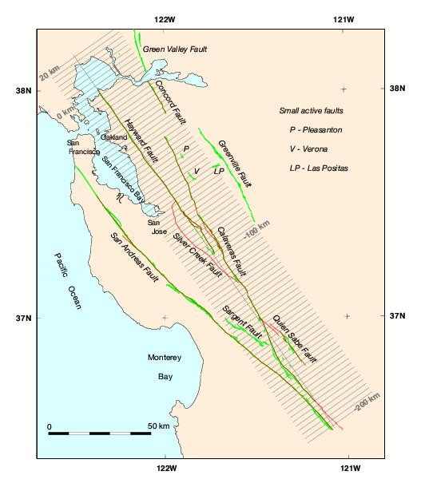
Precise locations of earthquakes using double-difference method reveals faults at depth

Slide 44
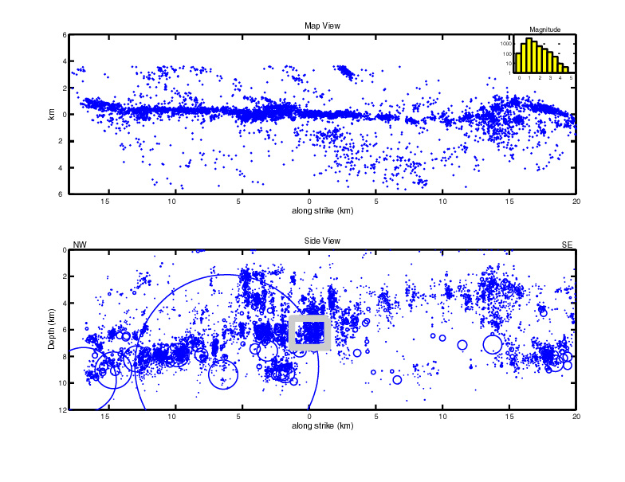
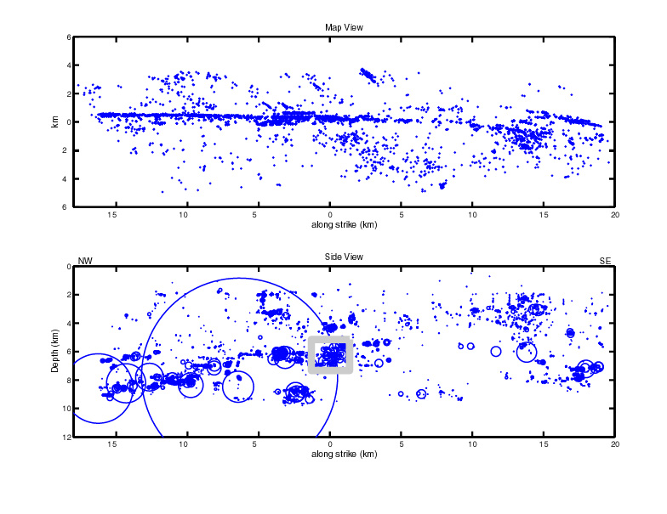
Previous location method
Using double-difference method
Precise locations of earthquakes using double-difference method reveals faults at depth
I obtained the two images on the next slide from http://pangea.stanford.edu/~beroza/movie.html, but this link is now dead.

Slide 45
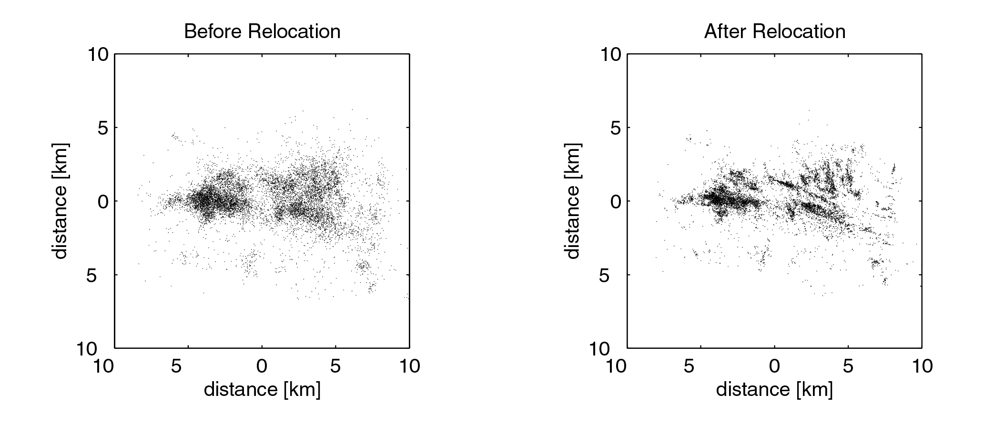
Another example
Waldhauser, USGS OFR 01-113

Slide 46
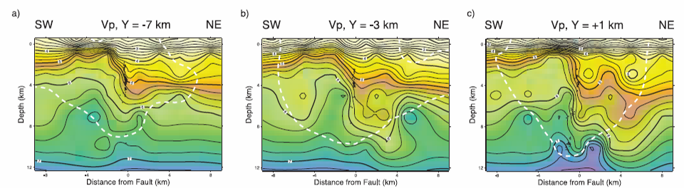
Simultaneous inversion
A. Kelly, USGS, 2007 Indonesia Training Course
Calculate the velocity structure and relocate the earthquakes at the same time.
Needs very good coverage of ray paths through the model.
Model for Parkfield California – 15 stations, 6 explosions, 453 earthquakes
Thurber et al. 2003. Geophysical Research Letters
Notes:
So far we have talked about locating earthquakes with an assumed velocity structure, but it is also possible to simultaneously solve for the velocity structure and the earthquake location, after making preliminary earthquake locations using a simple velocity model. Using seismic tomography to find velocity variations – effectively mapping the station corrections back into the velocity model. Such modeling requires very good coverage of ray paths across the model, so need a large number of events and seismometers.

Slide 47
END

