Slide 1
FUNDAMENTALS of ENGINEERING SEISMOLOGY
MEASURING GROUND MOTION

Slide 2
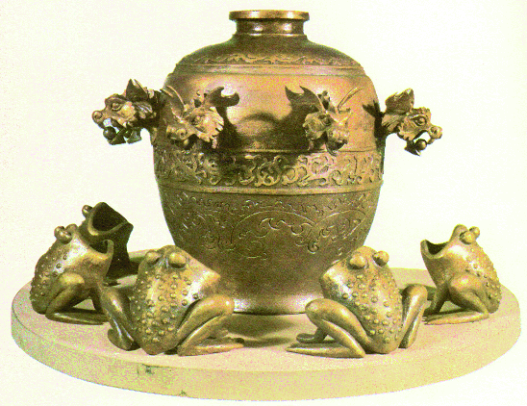
MEASURING EARTHQUAKES
The first known instrument for earthquakes measurement is the Chang seismoscope built in China in 132 B.C.
Balls were held in the dragons’ mouths by lever devices connected to an internal pendulum. The direction of the epicenter was reputed to be indicated by the first ball released.

Slide 3
Jargon
seismoscope – an instrument that documents the occurrence of ground motion (but does not record it over time)
seismometer – an instrument that senses ground motion and converts the motion into some form of signal
accelerometer – a seismometer that records acceleration, also known as strong ground motion
geophone – another name for a seismometer, commonly used in active source seismology

Slide 4
More Jargon
seismograph – a system of instruments that detects and records ground motion as a function of time
seismogram – the actual record of ground motion produce by a seismograph
seismometry – the design and development of seismic recording systems
data logger – device that converts analog to digital signal and stores the signal

Slide 5
Chronology of Instrumentation
132 – first seismoscope (Heng, China)
1751 – seismoscope which etched in sand (Bina, Italy)
1784 – first attempt to record ground motion as a function of time using a series of seismoscopes (Cavalli, Italy)
1875 – first true seismograph (Cecchi, Italy)

Slide 6
Chronology of Instrumentation
1889 – first known seismogram from a distant earthquake is generated (Rebeur-Paschwitz, Germany)
1914 – first seismometer to use electromagnetic transducer to sense ground motion (Galitzin, Russia)
1969 – first digital seismograph (data recorded in discrete samples on a magnetic tape) (U.S. researchers)
1990s – broadcast of real time seismic data via internet

Slide 7
How Seismometers Work
Since the measurements are done in a moving reference frame (the earth’s surface), almost all seismic sensors are based on the inertia of a suspended mass, which will tend to remain stationary in response to external motion. The relative motion between the suspended mass and the ground will then be a function of the ground’s motion
Havskov and Alguacil
Fundamental Idea: To record ground motion a seismometer must be decoupled from the ground. If the seismometer moves with the ground then no motion will be recorded.

Slide 8
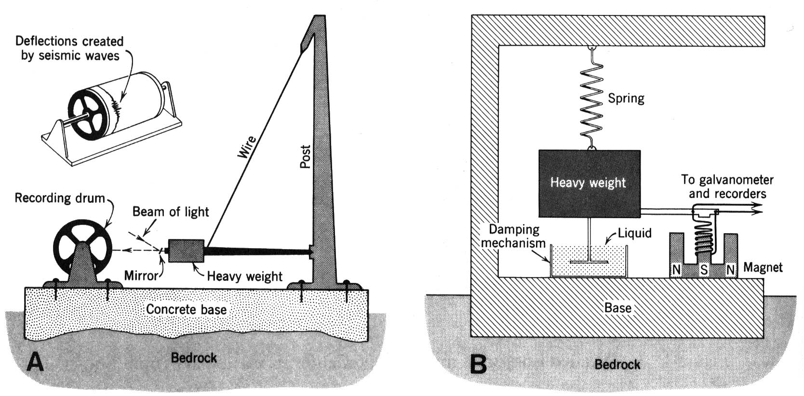
Principles of seismographs
Doors in CAR College (swing on tilted axis)

Slide 9
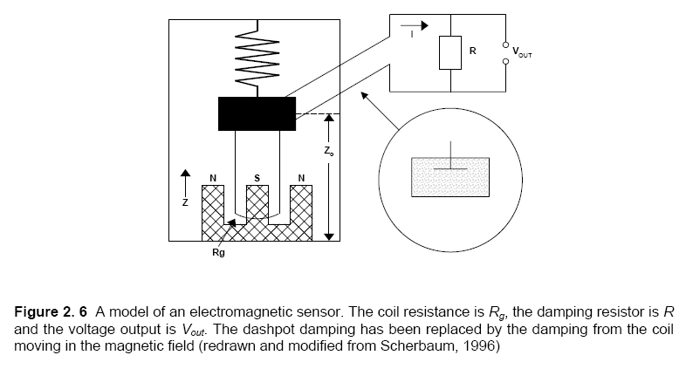
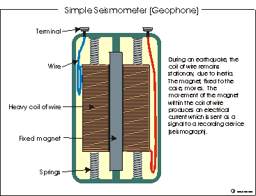
Electro-magnetic
sensor.
Velocity transducer:
moving coil within
a magnetic field
Havskov and Alguacil
The current is proportional
to the mass velocity

Slide 10
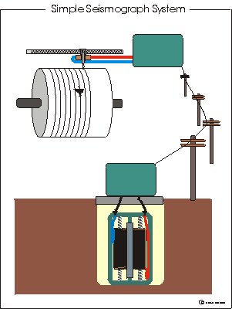

Slide 11
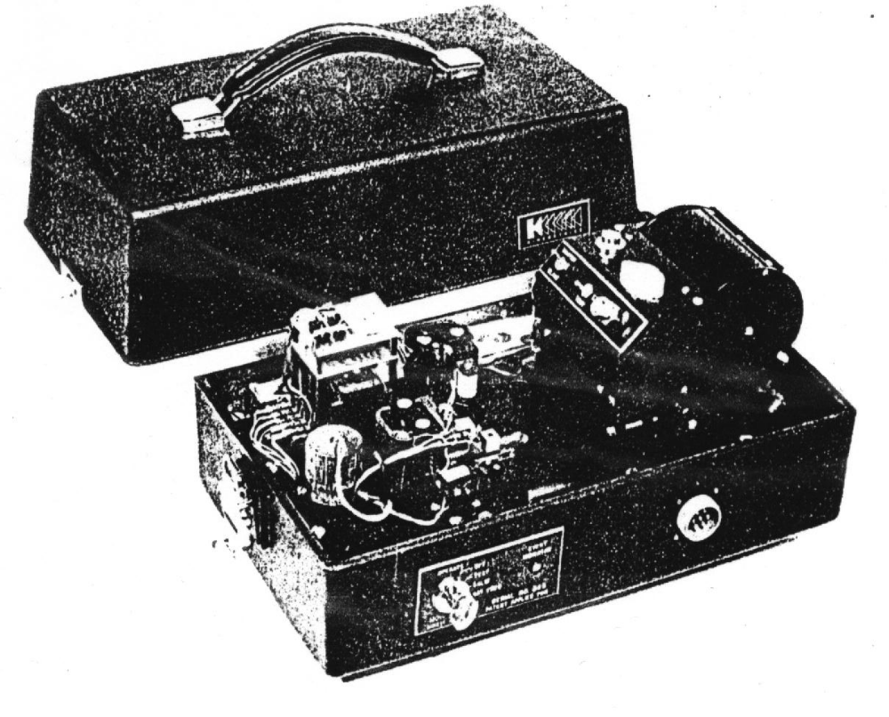
Analog Strong-Motion Accelerographs

Slide 12
Analog accelerographs
These instruments produce traces of the ground acceleration against time on film or paper. Most widely used analog instrument is the Kinemeterics SMA-1
Three important disadvantages of analog accelerographs:
Always triggered by a specified threshold of acceleration which means the first motions are often not recorded
The limitation of natural frequency of analog instruments. They are generally limited to about 25 Hz.
It is necessary to digitize the traces of analog instruments as they record on film or paper (most important disadvantage as it is the prime source of noise)
Strong Ground Motion Parameters – Data Processing
Dr. Sinan Akkar

Slide 13
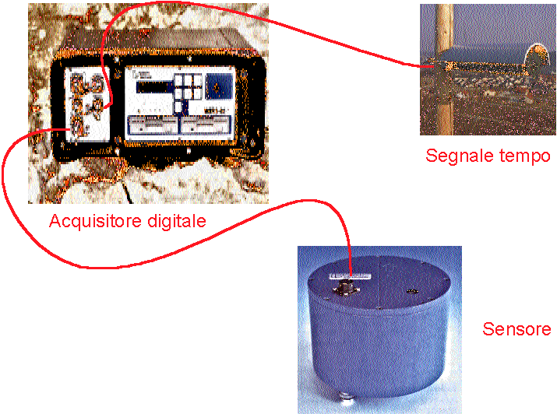
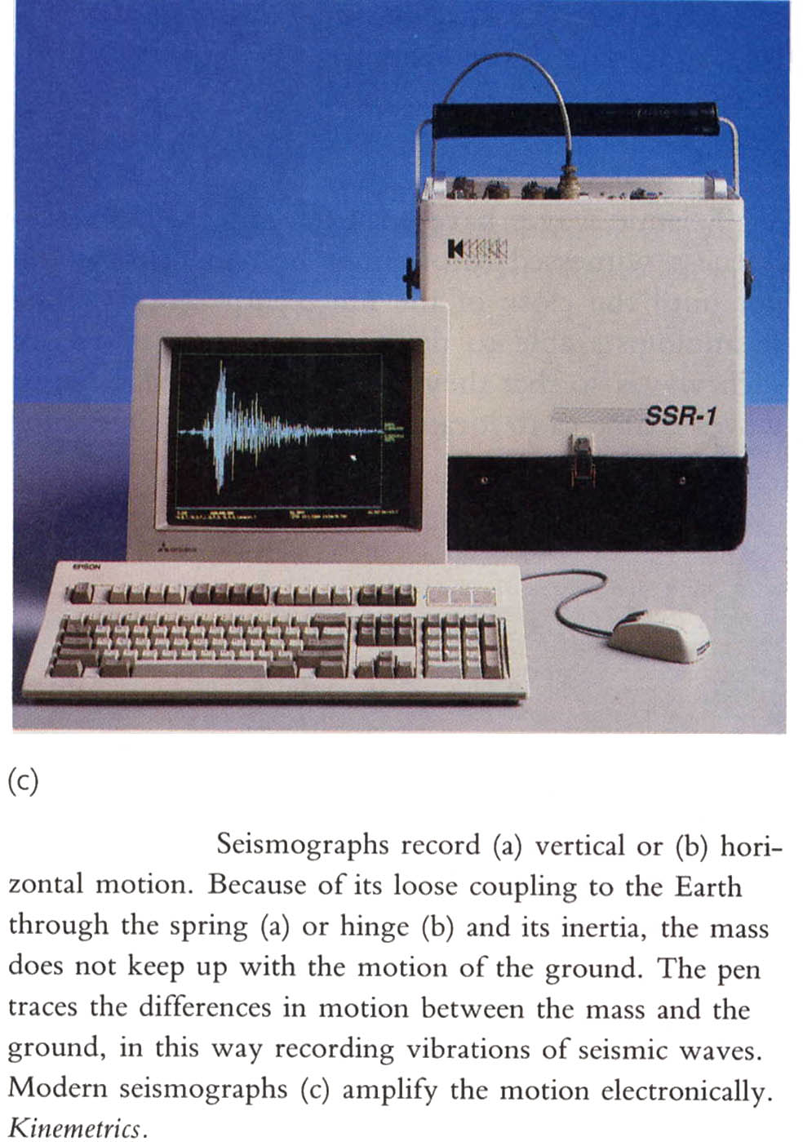
Modern seismic monitoring

Slide 14
Modern Seismometers
A conductive (metallic) mass is decoupled from surrounding magnets inside a protective casing.
Ground motion causes the mass to move relative to the surrounding magnetic field.
This creates an electric current with an amplitude that is proportional to the velocity of the mass.

Slide 15
Modern Seismometers
This electric current is transmitted to a digitizer which converts the analog (continuous) signal to a digital (discrete) signal.
Each discrete observation of the current is written to a computer disk along with the corresponding time.
These times series’ are downloaded to computers and processed/analyzed.

Slide 16
Digital accelerographs
Digital accelerographs came into operation almost 50 years after the first analog strong motion recorders. Digital instruments provide a solution to the three disadvantages associated with the earlier accelerographs:
1. They operate continuously and by use of pre-event memory are able to retain the first wave arrivals.
2. Their dynamic range is much wider, the transducers having natural frequencies of 50 to 100 Hz or even higher
3. Analog-to-digital conversion is performed within the instrument, thus obviating the need to digitize the records.
Strong Ground Motion Parameters – Data Processing
Dr. Sinan Akkar

Slide 17
Sensitivity
The sensitivity of seismometers to ground motion depends on the frequency of the motion.
The variation of sensitivity with frequency is known as the instrument response of a seismometer.

Slide 18
Amplitude and frequency range
The amplitude and frequency range of seismic signals is very large. The smallest motion of interest is limited by the ground noise. The smallest motion might be as small as or smaller than 0.1 nm. What is the largest motion? Considering that a fault can have a displacement of 10 m during an earthquake, this value could be considered the largest motion. This represents a dynamic range of (10/10⁻¹⁰) = 10¹¹. This is a very large range and it will probably never be possible to make one sensor covering it. Similarly, the frequency band starts as low as 0.00001 Hz (earth tides) and could go to 1000 Hz. These values are of course the extremes, but a good quality all round seismic station for local and global studies should at least cover the frequency band 0.01 to 100 Hz and earth motions from 1 nm to 10 m.
Havskov and Alguacil

Slide 19
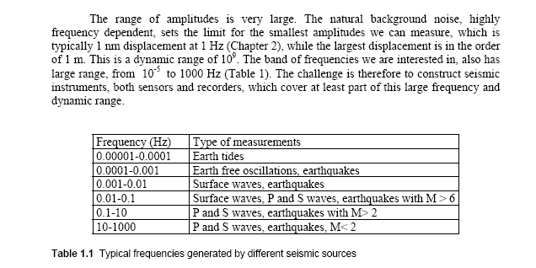
Havskov and Alguacil
It is not possible to make one single instrument covering this range of values and instruments with different gain and frequency response are used for different ranges of frequency and amplitude. Sensors are labeled e.g. short period (SP), long period (LP) or strong motion. Today, it is possible to make instruments with a relatively large dynamic and frequency range (so called broad band instruments (BB) or very broad band (VBB)) and the tendency is to go in the direction of increasing both the dynamic and frequency range.
Havskov and Alguacil

Slide 20
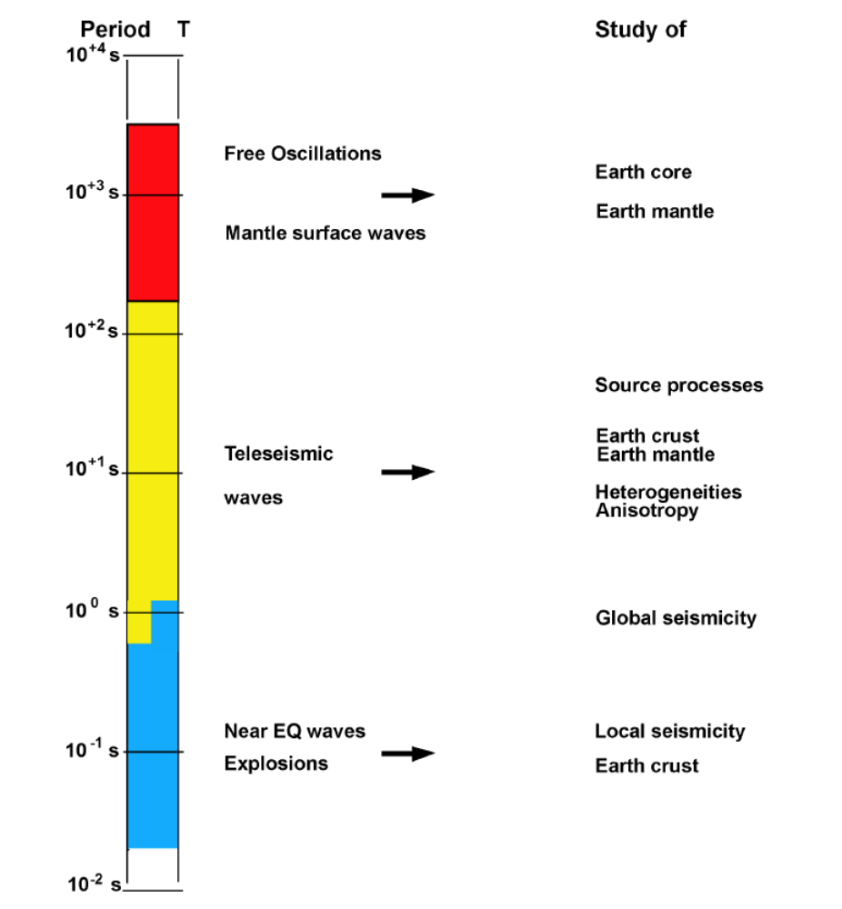
From IASPEI-NMSOP

Slide 21
Instrument Response
Seismometers that are sensitive to ground motions with high frequencies are called short-period seismometers. They are useful for recording nearby (within 2000 km) earthquakes and are also used in active source seismic experiments.
Seismometers that are sensitive to ground motions with long frequencies are called long-period seismometers. They are useful for recording teleseismic earthquakes, normal modes, and earth tides.

Slide 22
Instrument Response
The most advanced seismometers are called broadband seismometers and can record both high and low frequencies – they record over a broad band of frequencies.
Broadband seismometers are much more expensive, and more easily damaged, than short period seismometers.

Slide 23
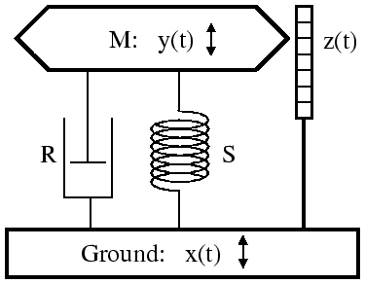
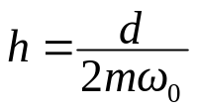
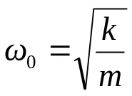


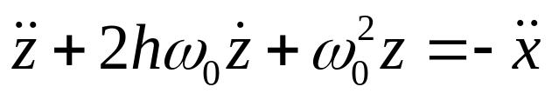
Mechanical sensor
Damping oscillator
constants:
z(t)= y(t)-x(t) relative displacement
Damping force
Spring force
Dino Bindi

Slide 24
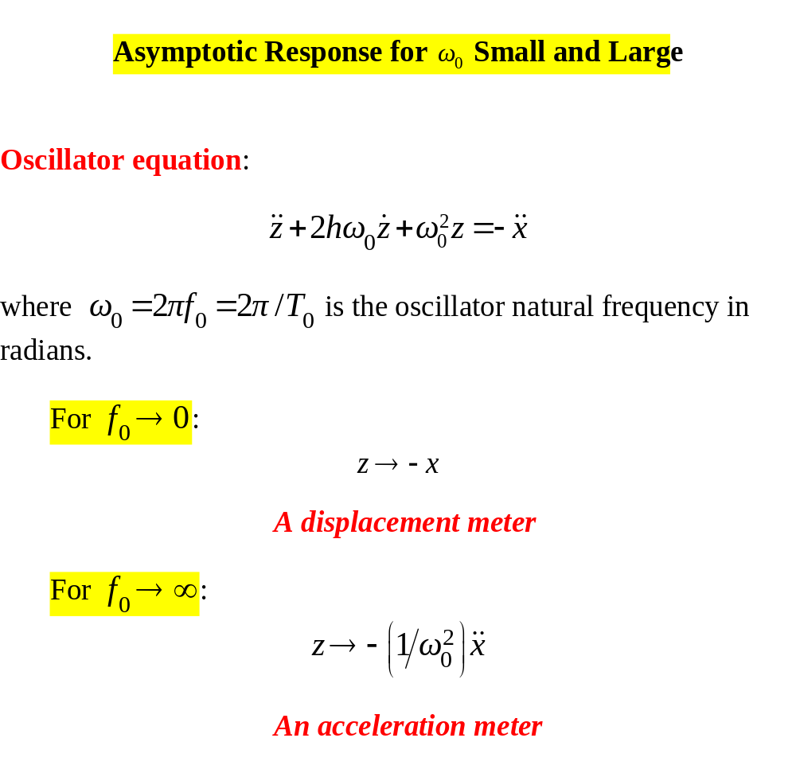

Slide 25
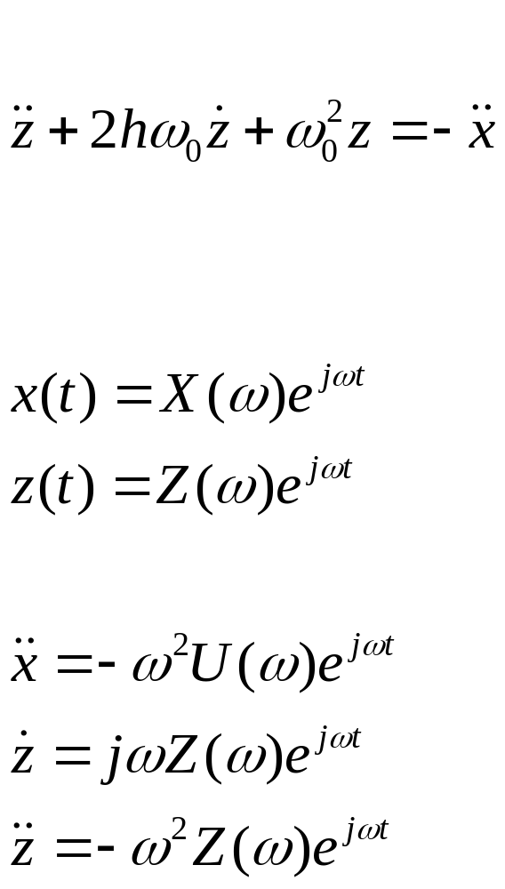
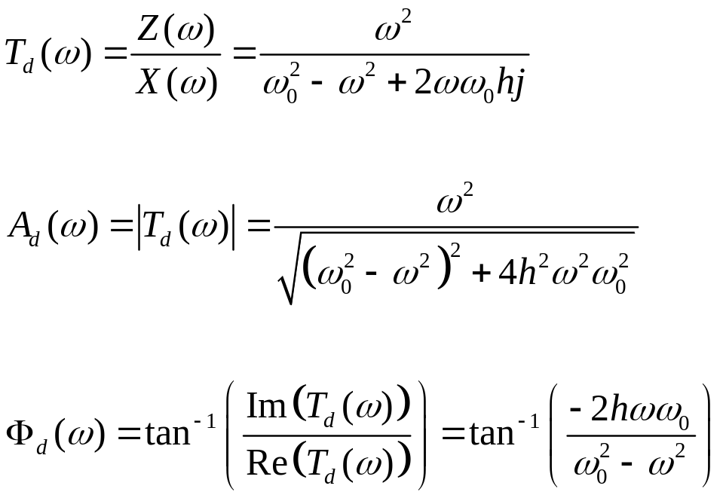
Mechanical sensor
Input harmonic motion
(frequency domain)
Dino Bindi

Slide 26
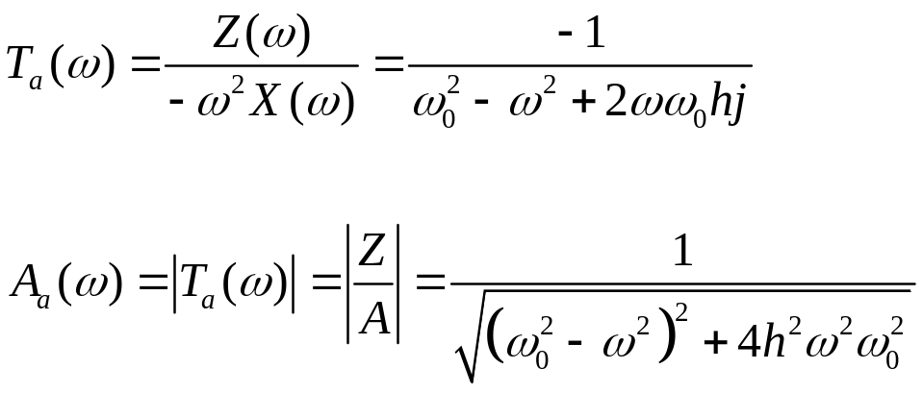
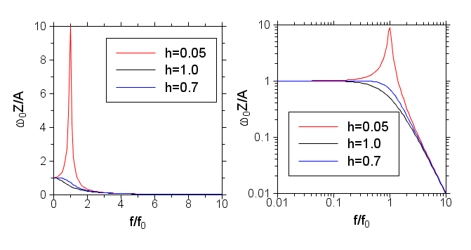

Slide 27
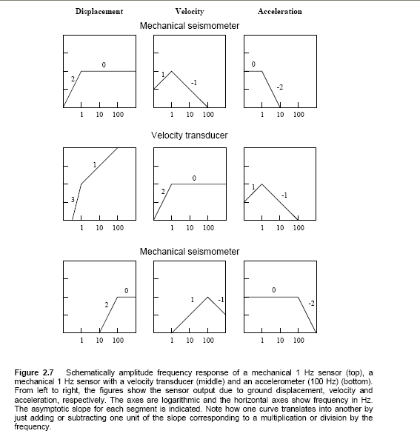
From displacement to velocity and to
acceleration: divide by the frequency
(remove a zero from the origin)
From mechanical seismometer to velocity
transducer and to accelerometer, multiply
by the frequency
(add a zero in the origin)
accelerometer
Low sensitivity in displacement
Flat response in acceleration
Havskov and Alguacil

Slide 28

Displacement at very low frequencies produce very low accelerations
( , where x is the ground displacement and f the frequency).
It is therefore understandable why it is so difficult to produce
seismometers that are sensitive to low frequency motion.
Today, purely mechanical sensors are only constructed to have resonance
frequencies down to about 1.0 Hz (short period sensors), while sensors
that can measure lower frequencies are based on the Force Balance
Principle (FBA) of measuring acceleration directly.

Slide 29
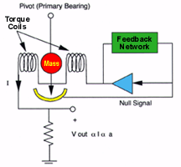
Force-balance (Servo) Sensors
The force-balance accelerometer is shown below where a pendulous, high-magnetic permeability mass is hung from a hinge. The "down" or "null position" is detected by the null detector and the counterbalancing force is provided by a magnetic coil.

Slide 30
“Broadband” seismometers (velocity sensors, using electronics to extend the frequency to low values) are starting to be used in engineering seismology: the boundary between traditional strong-motion and weak-motion seismology is becoming blurred (indistinct, fuzzy).

Slide 31
Digital strong-motion recording
Broadband: nominally flat response from dc to at least 40 Hz
  But noise/ baseline problems can limit low-frequency information
  High-frequency limit generally not a problem because these frequencies are generally filtered out of the motion by natural processes (exception: very hard rock sites)
High dynamic range (ADC 16 bits or higher)
Pre-event data usually available

Slide 32
ADC (Analog-digital conversion)
Quanta (least digital count)
Q = 2Y/2^{N}
Where ±Y = full-scale range and N = number of bits used in ADC
Dynamic Range (DR)
DR(decibels) = 20 log Y/Q = 20 log 2^{(N-1)}

Slide 33
Examples
Y = 2g = 2*981 cm/s/s
N = 12 bits
Q = .96 cm/s²
DR = 66 db
N = 24 bits
Q = 0.00023 cm/s²
DR = 138 db

Slide 34
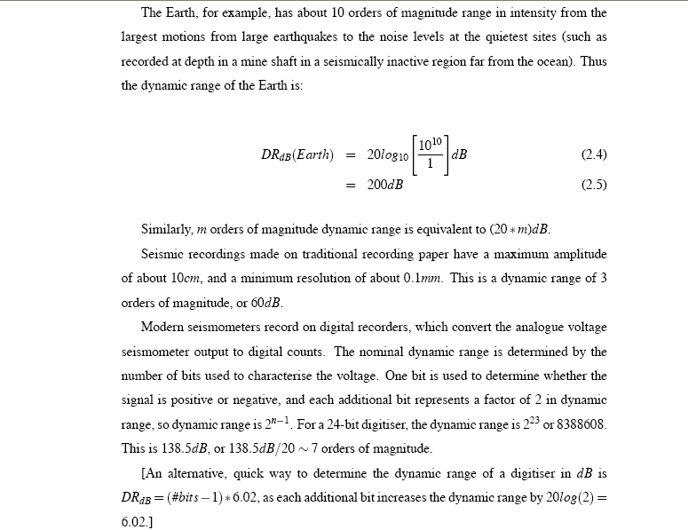

Slide 35
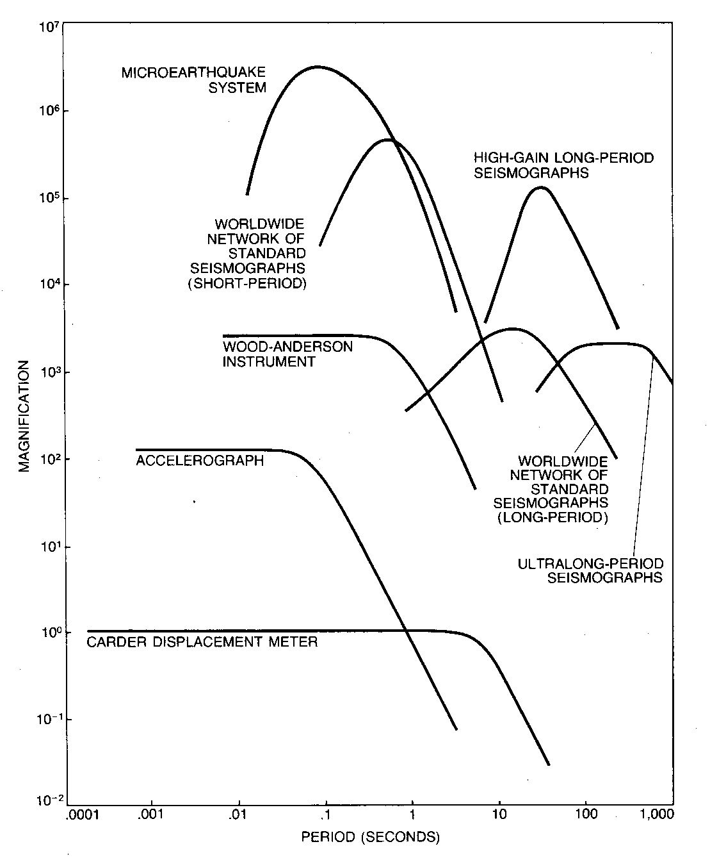
Magnification curves
Note notch, due to Earth noise; this noise can be seen in recordings from modern broadband instruments.
Not shown: broadband (0.02—DC sec)

Slide 36
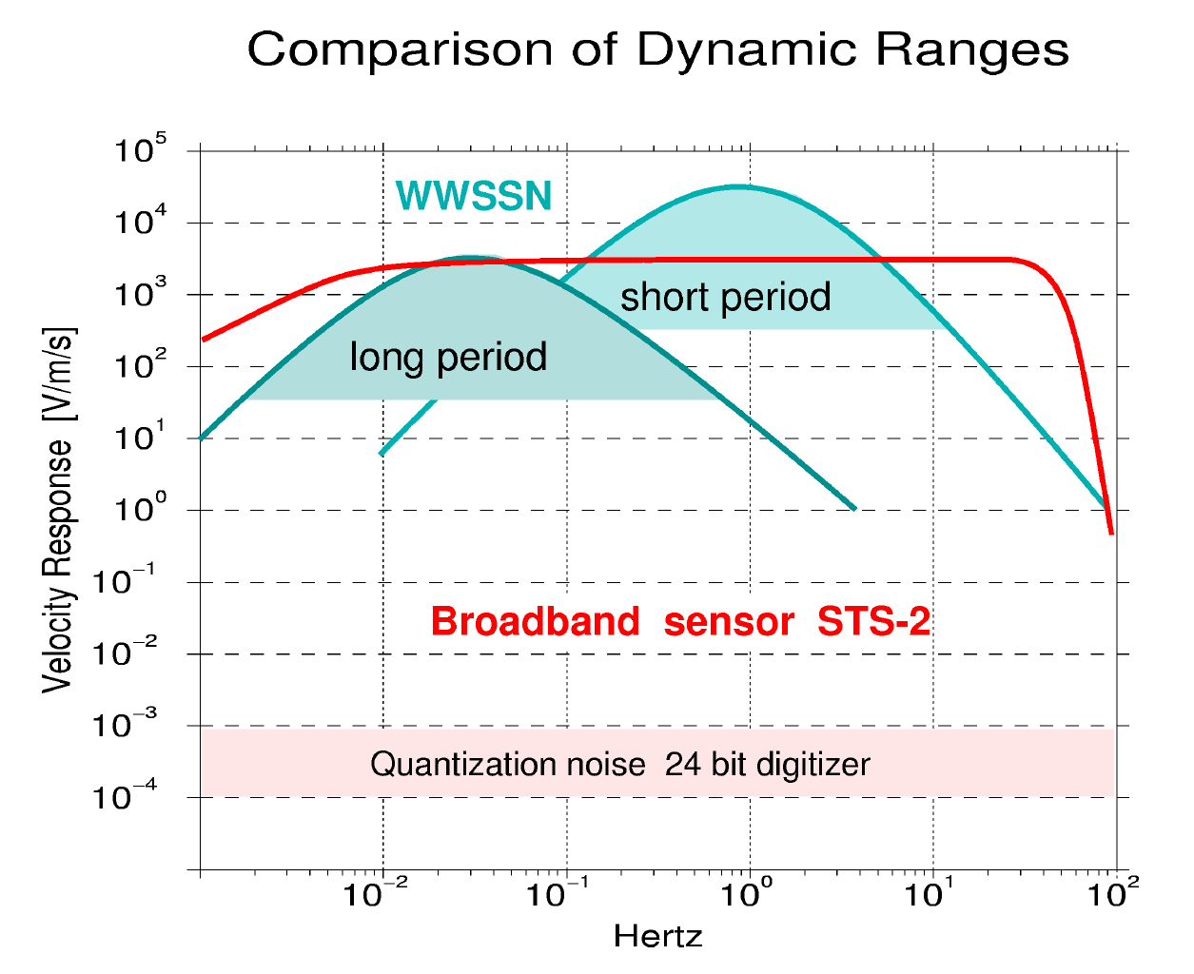



Seismic Sensors and Seismometry, Prof. E. Wielandt, Dr. C. Milkereit

Slide 37
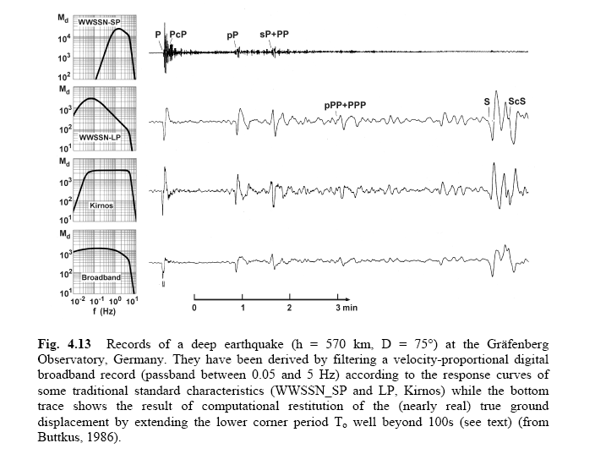
From New Manual of Seismological Observatory Practice- P. Bormann Editor

Slide 38
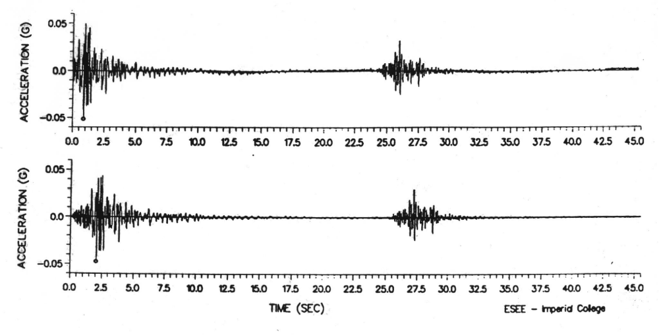
Analogue and Digital Records of small earthquake from Adjacent Instruments at Procisa Nuova (Italy)
P-arrival lost in analog recording

Slide 39
Summary
The first legitimate seismometer was built in 1875.
The first seismogram of a distant earthquake was recorded in 1889.
The first digital seismometers were deployed in the early 1970s.
The first broadband seismometers were deployed in the 1980s

Slide 40
Summary
Seismometers record motions as small as 1.0⁻⁹ m, at frequencies of about 0.001 Hz to 100 Hz.
There are over 10,000 seismometers around the world that are continually recording ground motion.

Slide 41
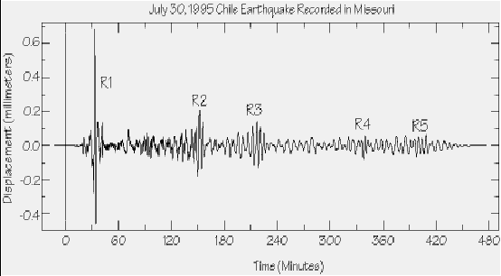
Seismograms
Seismograms are records of Earth’s motion as a function of time.

Slide 42
Seismograms
Seismograms record ground motion in terms of
  displacement
  velocity
  acceleration
Normally a seismometer samples ground motion about 20 times per second (20 Hz), but this number can be as high as 500 Hz. Modern accelerometers sample at 200 sps.

Slide 43
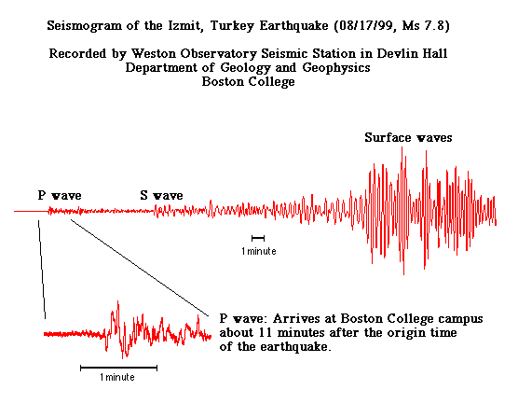

Slide 44
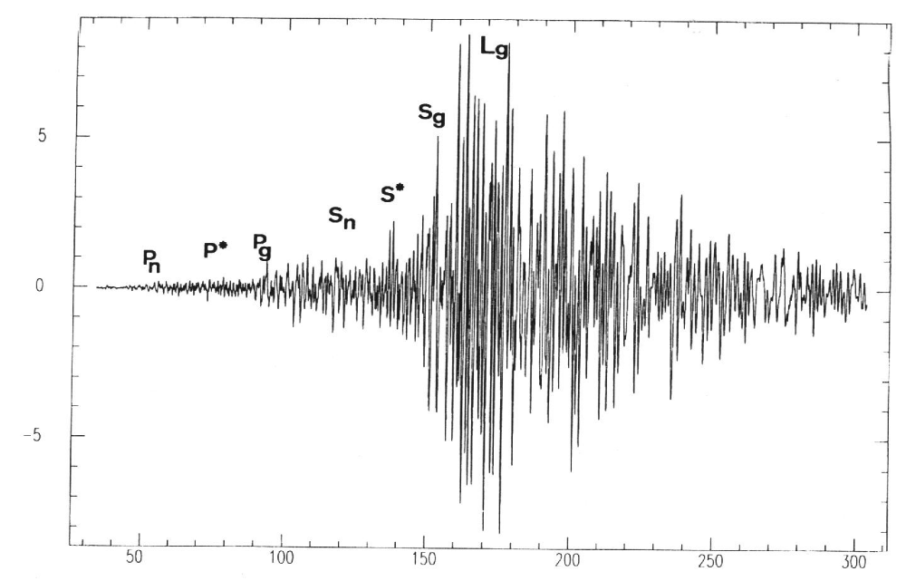
Seismograms are composed of “phases”

Slide 45
Seismograms
Ground motion is a vector (whether it is displacement, velocity or acceleration), so it takes 3 numbers to describe it. Thus, seismometers generally have three components:
  Vertical (up is positive)
  North-South (north is positive)
  East-west (east is positive)
}
horizontals

Slide 46
Components of Motion
There are simple mathematical operations that allow seismologists to rotate (abstractly) the horizontal components:
N
earthquake
Original Coordinate System
seismometer
W
E
S

Slide 47
Components of Motion
There are simple mathematical operations that allow seismologists to rotate (abstractly) the horizontal components:
Modified Coordinate System
The new components are called:
(1) Radial, R
(2) Transverse, T
Transverse
N
earthquake
seismometer
W
E
Radial
S

Slide 48
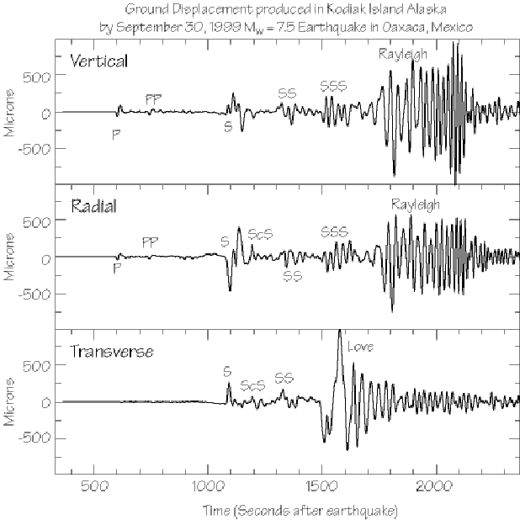
Oaxaca, Mexico earthquake recorded by seismometer in Alaska.

Slide 49
Networks and Arrays

Slide 50
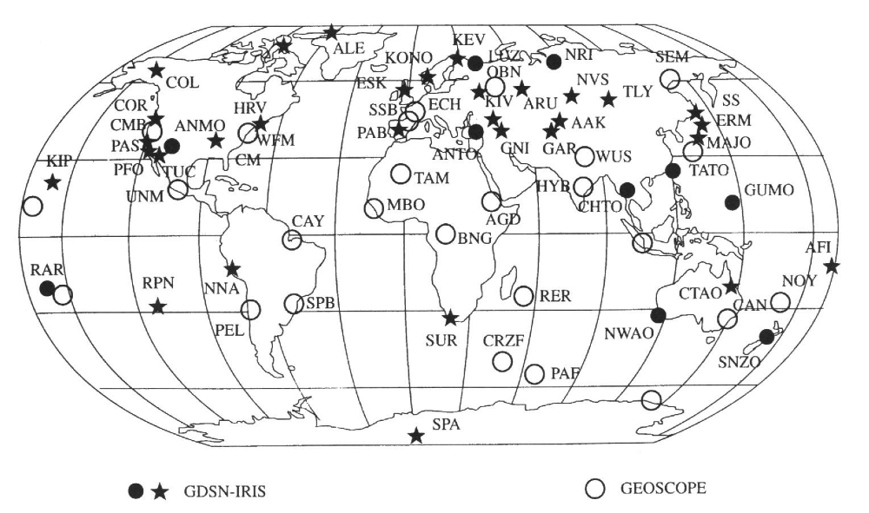
Broad-band Seismograph Networks

Slide 51
Many networks of instruments, both traditional “strong-motion” and, more recently, very broad-band, high dynamic-range sensors and dataloggers

Slide 52
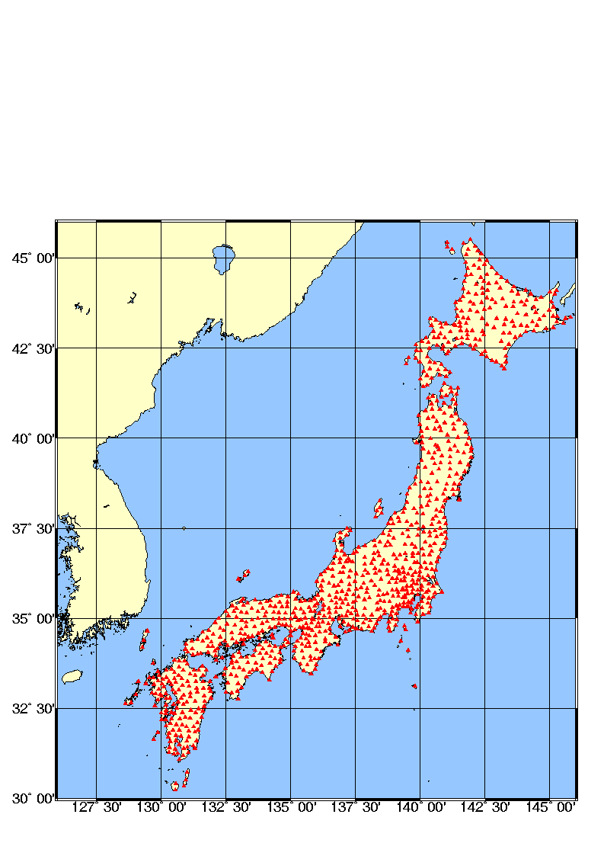
Kyoshin Net (K-NET)
Japanese strong motion network
http://www.k-net.bosai.go.jp
1000 digital instruments installed after the Kobe earthquake of 1995
free field stations with an average spacing of 25 km
velocity profile of each station up to 20 m by downhole measurement
data are transmitted to the Control Center and released on Internet in 3-4 hours after the event
more than 2000 accelerograms recorded in 4 years

Slide 53
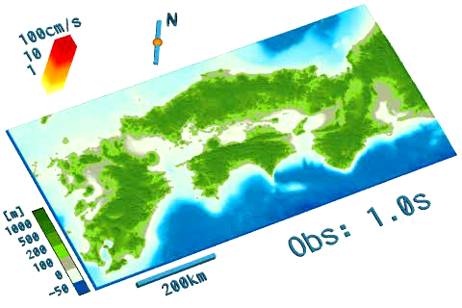
Reminder: Play Chuettsu and Tottori movies

Slide 54
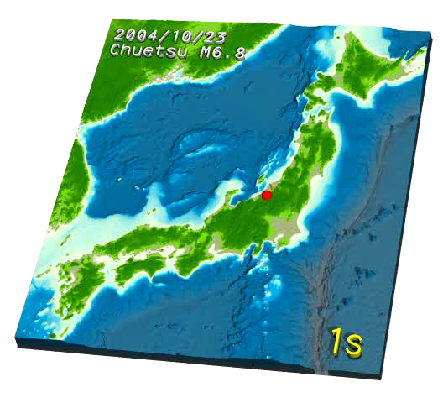
Chuetsu

Slide 55
Tottori

Slide 56
A number of web sites provide data from instrument networks
But no single web site containing data from all over the world.
An effort is still need to add broad-band data into the more traditional data sets.

Slide 57
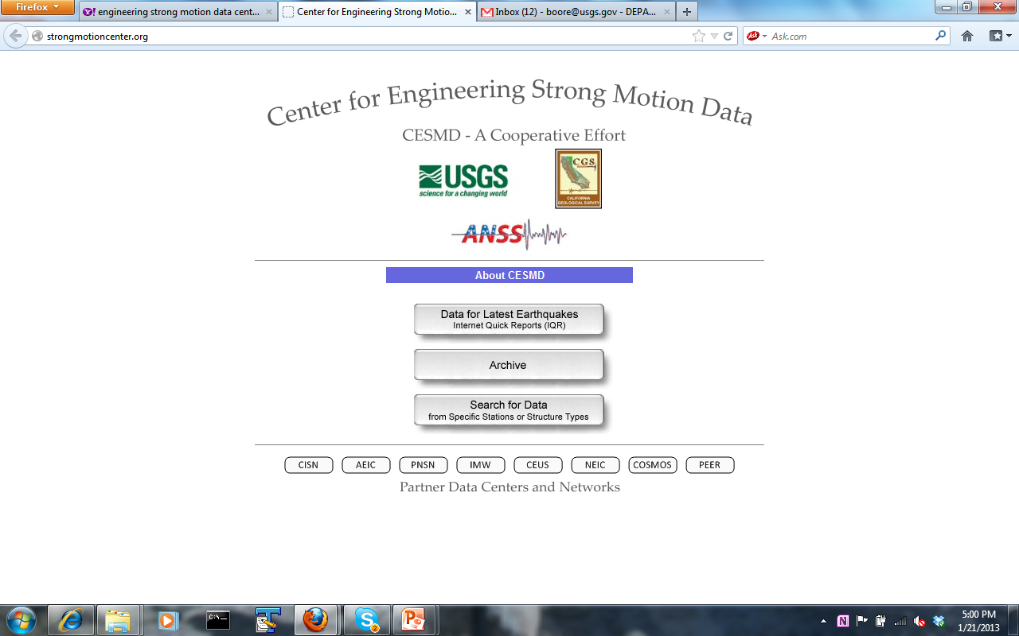

Slide 58
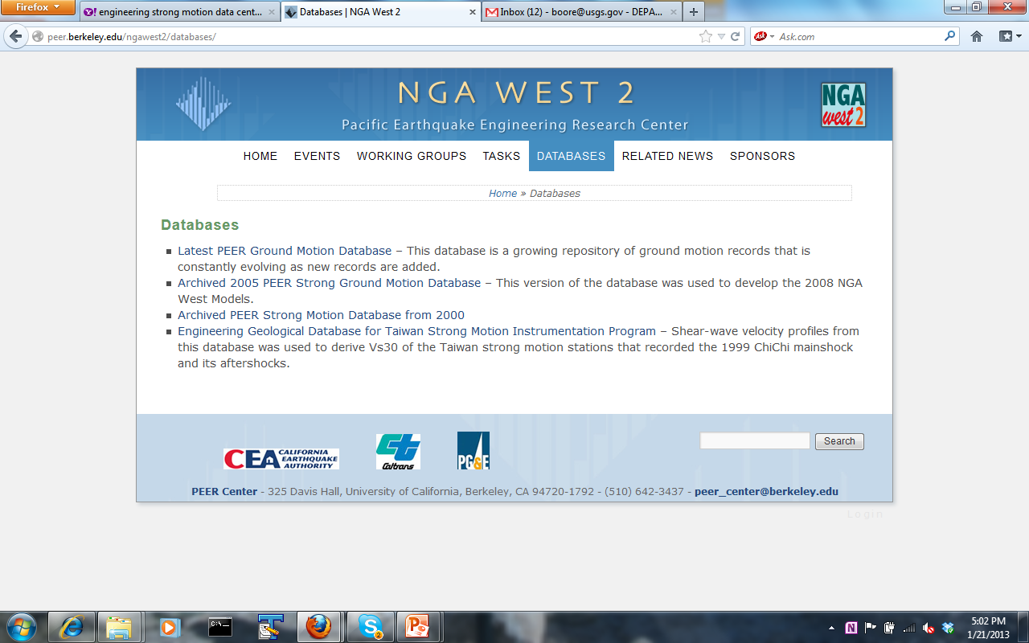

Slide 59
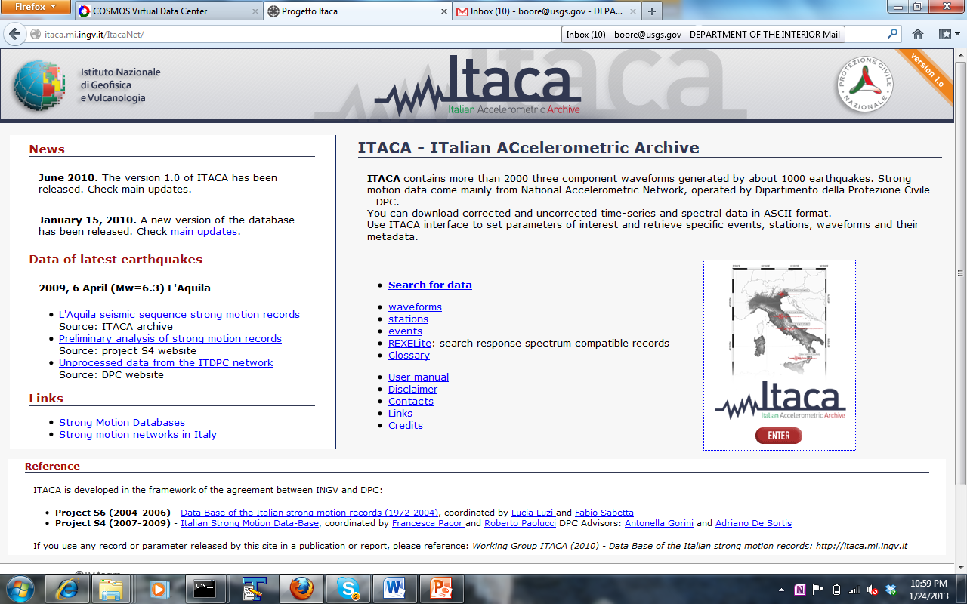

Slide 60
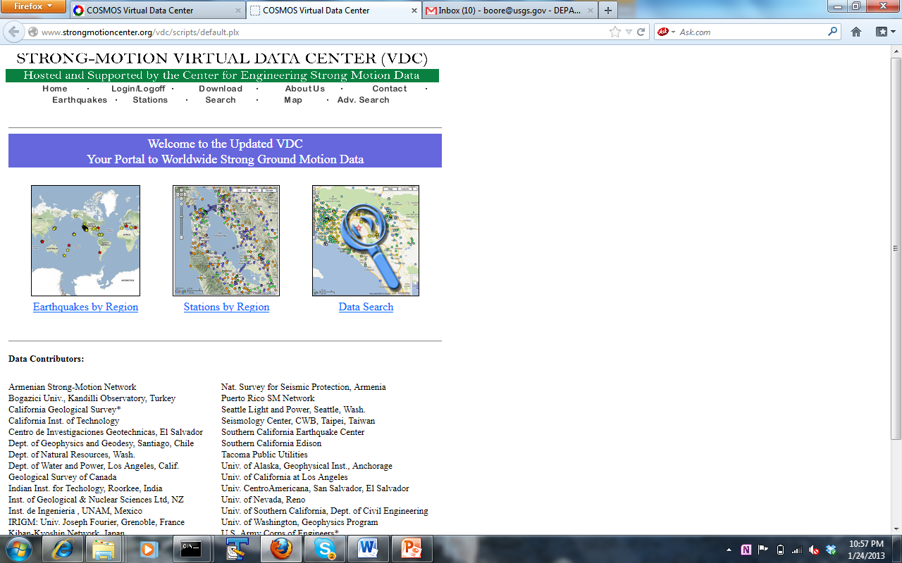

Slide 61
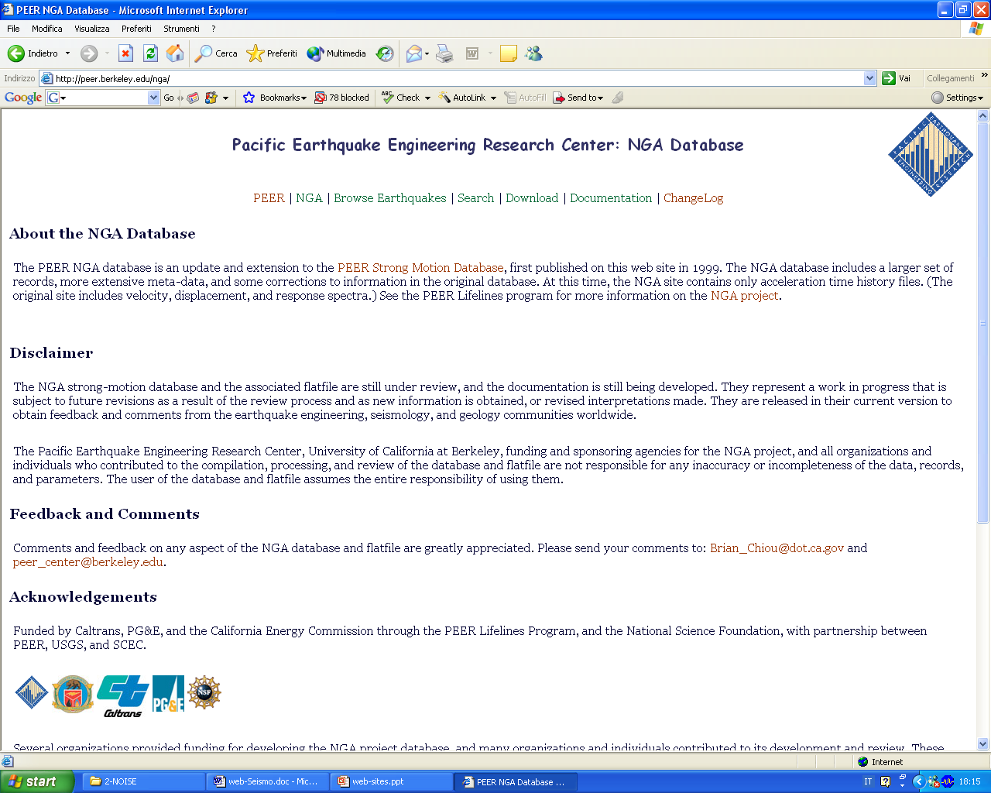
NGA - http://peer.berkeley.edu/nga/
WEB SITES – DATABASES

Slide 62
END

