Slide 1
FUNDAMENTALS of ENGINEERING SEISMOLOGY
SEISMIC WAVES, TRAVEL TIMES, AND GEOMETRICAL SPREADING

Slide 2
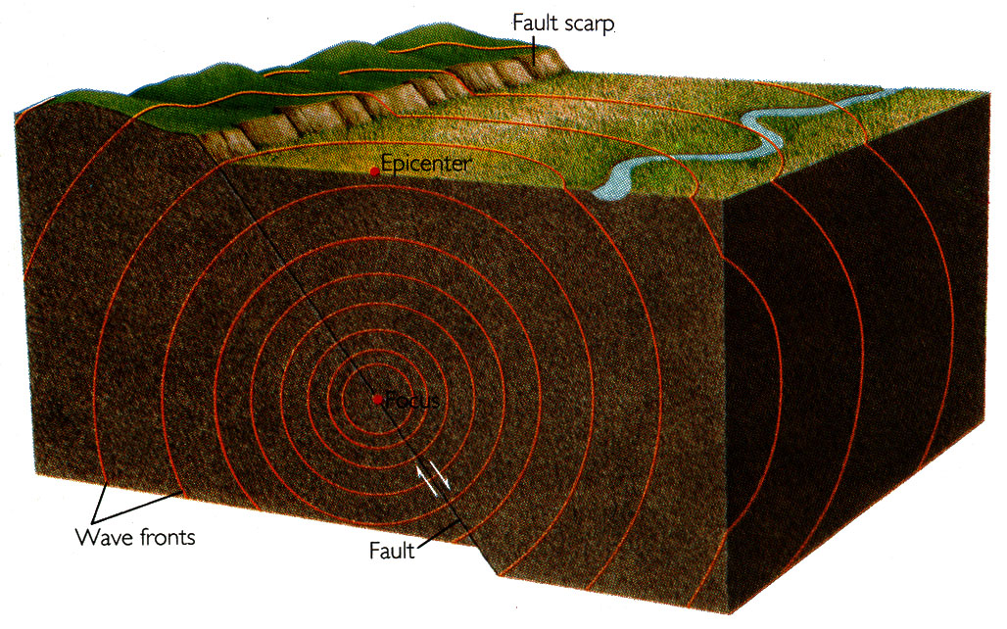
The release of the accumulated elastic strain energy by the sudden rupture of the fault is the cause of the earthquake shaking. A small fraction of the released energy is transmitted to the Earth’s surface via seismic waves. It is these waves that cause ground shaking and most of the damage associated with earthquakes.

Slide 3
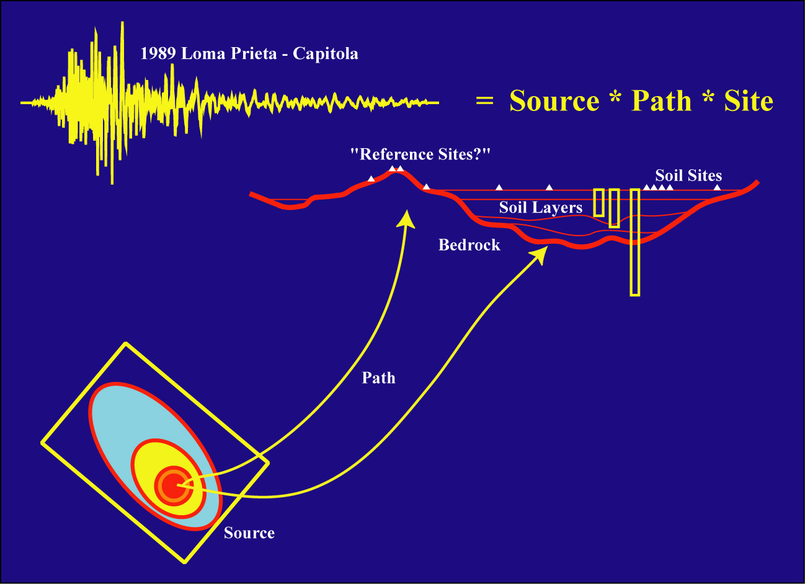
Ground Motion Deconvolution
(Steidl)

Slide 4
Seismic Waves
The wiggles on a seismogram are caused by seismic waves which are generated by the movement of the rocks along a fault.
The waves emanate from the “source” or earthquake, and travel:
  through the body of the Earth, and
  over the surface of Earth.

Slide 5
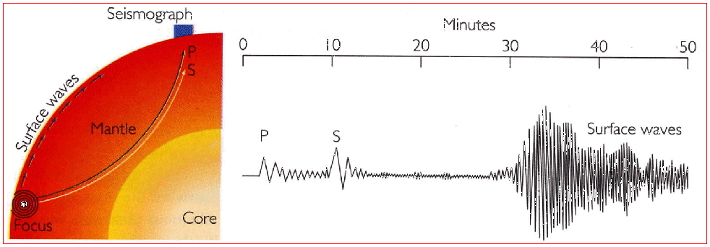
Seismographic recording of P, S and surface waves

Slide 6
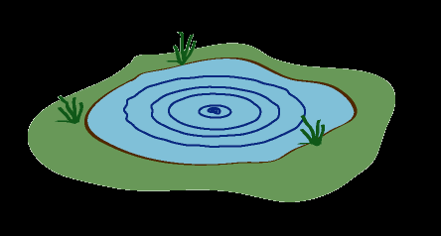
Waves in a pond
The idea is analogous to waves caused by tossing a stone in a pond.

Slide 7
Sound Wave Analogy
Seismic waves represent acoustic (sound) energy and so are analogous to speech:
Speech
Earthquakes
(1) Vocal cords vibrate
(2) Sound waves propagate
thru atmosphere
(3) Ears record these
vibrations
(4) Brain processes the
recordings
A locked fault segment fails (ruptures)
(2) Sound waves propagate thru the Earth
(3) Seismometers record these vibrations
(4) Seismologists process these recordings (seismograms)

Slide 8
What is a Wave ?
A wave is a disturbance that transfers energy.
Waves are common in nature:
  Light is a wave
  Sound is a wave
Waves are periodic in both space and time (they have wavelengths and periods)

Slide 9
Wave Terminology
Wavelength is a measure of the spatial extent of a wave (e.g., crest-to-crest or trough-to-trough). It has units of length (m, km).
Period is a measure of the duration of a vibration. Period has units of time (s)
Frequency is one over the period. It has units of one over time (s⁻¹≡Hz).
Amplitude is a measure of the height of the wave. It has units of displacement (cm, m).

Slide 10
Wavelength and Period
Wavelength
Period
Amplitude
Amplitude
Distance
from Source
Time
At a given instant in time, the
displacement is periodic in space(distance).
At a given fixed place, the
displacement is periodic in time.

Slide 11
Wave Speeds
The speed that a wave propagates at is not a dynamic quantity – it is a fixed material property. (like density)
For very distant earthquakes, no matter how big the earthquake, the seismic waves it produces will always travel at the same speed.
At closer distances, nonlinear wave propagation can result in amplitude-dependent propagation velocity
The seismic wave speed of a material depends mainly its upon:
    Temperature
    Pressure
    Composition

Slide 12
Elastic Waves
Seismic waves are also called elastic waves, because they deform the Earth elastically - the rock returns to its original shape and position after the seismic wave passes through.
An example of a non-elastic wave is a shock wave. This type of wave fundamentally changes the medium thru which it propagates (nonlinear propagation is important for strong-motion seismology).

Slide 13
Sources of Seismic Waves
Earthquakes generate seismic waves, but so do many other processes---for example:
  Volcanic eruptions
  Explosions
  Wind
  Surf
  Traffic
  Sonic Booms (planes, shuttle, meteorites)
  Humans

Slide 14
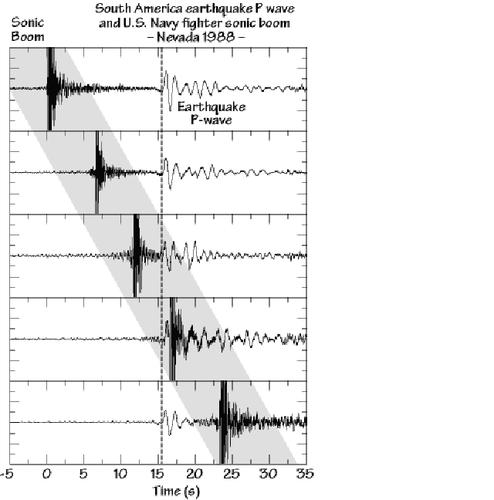
A Jet and an Earthquake
Note differences in apparent horizontal velocity
(discuss, drawing pictures on board)

Slide 15
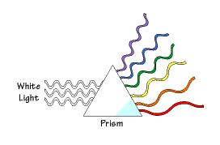
Multiple-Frequency Signals
Most interesting signals are composites of waves with many different frequencies. The range of frequency is sometimes called the “band” and we speak of bandwidth.
Light is a usually a multiple frequency signal, and the different frequencies correspond to what we call colors.

Slide 16
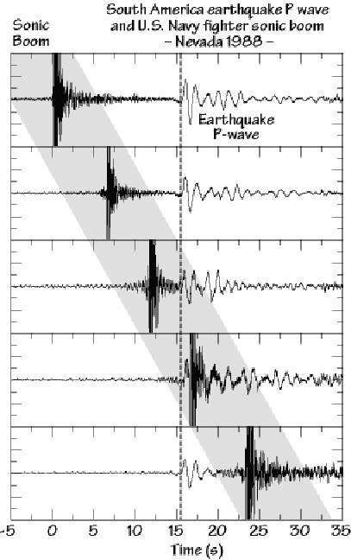
Sometimes we can use the observed frequencies to identify different sources of vibrations.
Which has higher frequency content, the sonic boom or the earthquake?

Slide 17
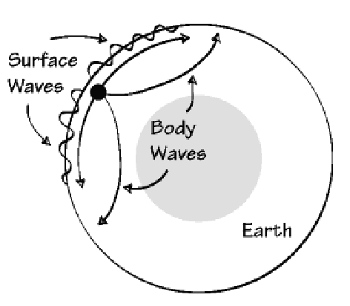
Seismic Wave Types
Seismic waves can be labeled by the paths they take in the Earth.
Surface Waves:
  (1) Love Waves
  (2) Rayleigh Waves
Body Waves:
  P waves
  S waves

Slide 18
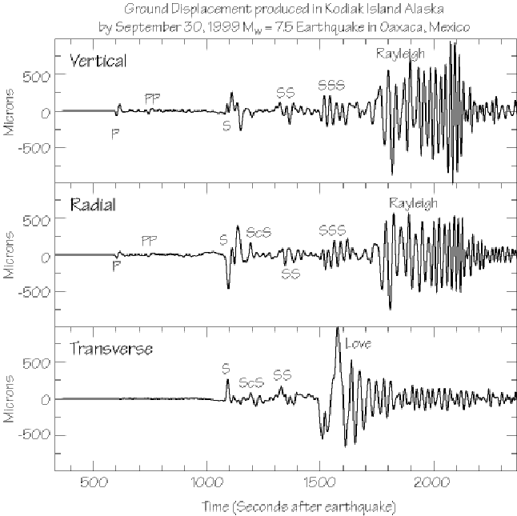

Slide 19
Seismic Wave Types
Body Waves
  Small amplitude
  Short wavelength
  Narrow frequency band
  Travel more quickly
  Produced by all earthquakes
Surface Waves
  Large amplitude
  Long wavelength
  Wide range of frequencies (large bandwidth)
  Dispersive
  Travel slowly
  Not produced by deep earthquakes

Slide 20
Seismic Wave Types
A second way we distinguish between waves is by the type of deformation (strain) they induce:
  Compressional waves cause changes in volume:
    Rayleigh wave (compressional surface wave)
    P wave (compressional body wave)
  Shear waves cause changes in shape:
    Love wave (shear surface wave)
    S wave (shear body wave)

Slide 21
Compressional Body
Waves ( P-waves )
“P” stands for primary, because they travel the fastest and are the first waves to arrive.
  They also travel through all types of materials including solids, liquids, gasses.
  Within Earth, P-waves travel at speeds up to 14 km/s (kilometers per second). The precise velocity depends on the rock type.

Slide 22
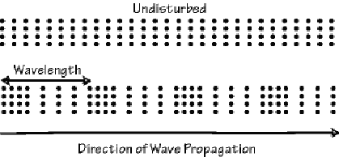
Compressional Wave Vibrations
The motion produced by a P-wave is an alternating compression and expansion of the material.
The ground is deformed along the direction that the wave is traveling.
P-waves are sound waves, but most seismic P-waves are at too low a frequency for humans to hear.

Slide 24
Shear Body
Waves (S-Waves)
“S” stands for secondary, and these waves travel second fastest. S-waves are often called shear waves.
  S-waves also travel through solids but not through liquids or gasses.
  Within Earth, S-waves travel at speeds up to 8 km/s (kilometers per second). The precise velocity depends on the rock type.

Slide 25
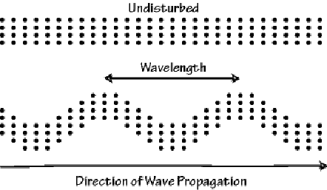
Shear-Wave Vibrations
S-waves vibrate the ground in a shearing motion, with movement perpendicular to the direction that the wave is traveling.
They are often the largest waves close to an earthquake, and they usually do the most damage.

Slide 27
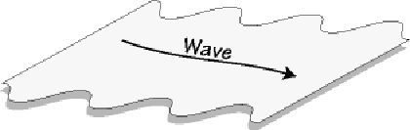
Shear Surface Waves (Love Waves)
Loves waves are the faster of the two surface waves.
  They vibrate the ground from side-to-side with no vertical movement.

Slide 28
Notice dispersion

Slide 29
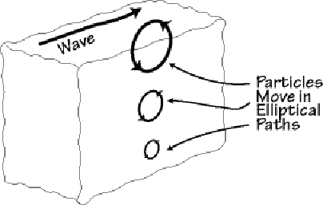
Compressional Surface Waves (Rayleigh Waves)
Rayleigh waves are the most complex wave, and they are also the slowest.

Slide 31
Summary
Seismic waves are traveling vibrations that transport energy from the earthquake “source” region throughout the Earth.
We distinguish between 4 types of waves, the body waves P and S, and the surface waves, Love and Rayleigh.
Each wave travels with a characteristic speed, and vibrates the ground in a specific manner.

Slide 32
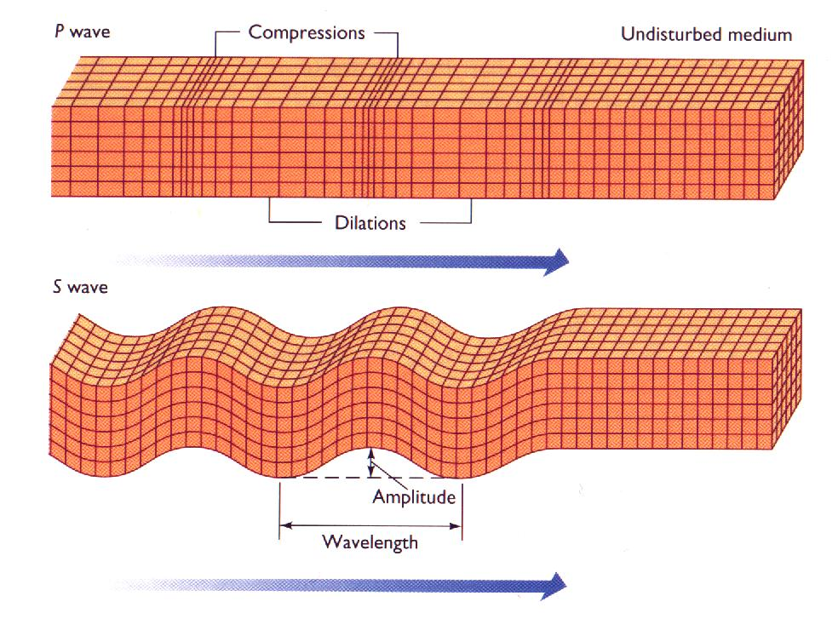

Slide 33
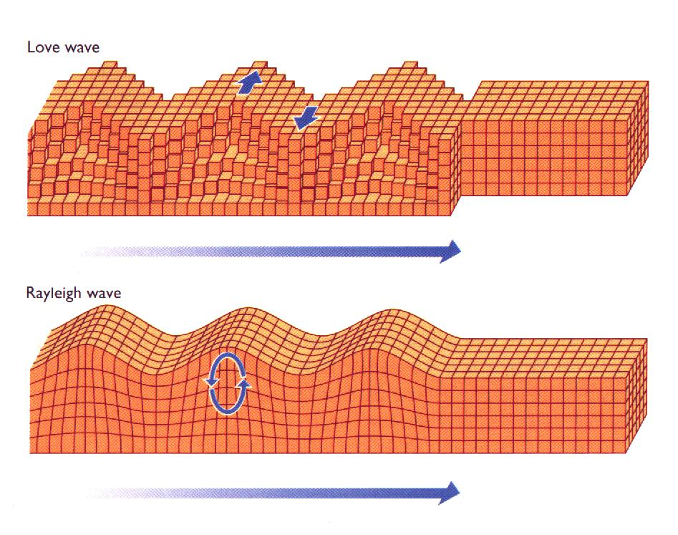

Slide 34
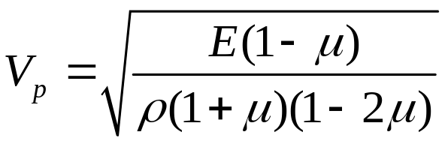
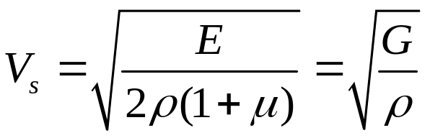
Relating wave speeds to elastic constants
E = Young’s modulus
μ = Poisson’s ratio
G = modulus of rigidity
The relation between rigidity, density, and shear-wave velocity is important.
Ratio of Vp and Vs given by Poisson’s ratio (generally between 0 and 0.5; 0.25 common for rocks; see daves_notes_on_poissons_ratio.pdf on http://www.daveboore.com/daves_notes.html for more information).

Slide 35
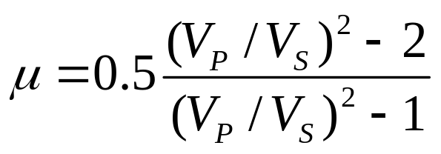
What is Poisson’s ratio for a liquid (V_{S}=0)?

Slide 36
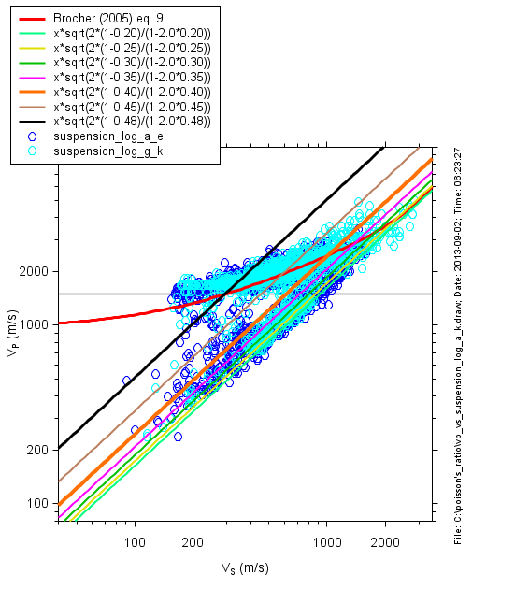

Slide 37
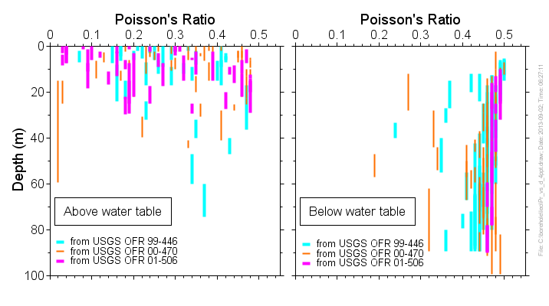

Slide 38
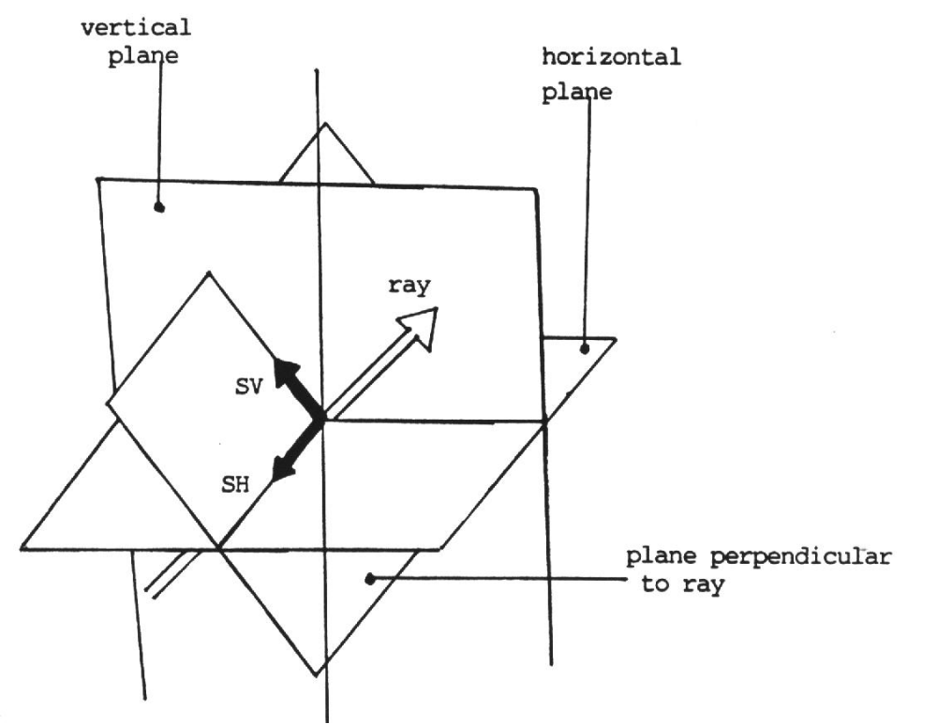
Polarisation of S-Waves: SH and SV

Slide 39
Wave Propagation
Notes:
1

Slide 40
Wave Propagation
As seismic waves travel through Earth, they interact with the internal structure of the planet and:
  Refract – bend / change direction
  Reflect – bounce off of a boundary (echo)
  Disperse – spread out in time (seismogram gets longer)
  Attenuate – decay of wave amplitude
  Diffract – non-geometric “leaking” of wave energy
  Scatter – multiple bouncing around

Slide 41
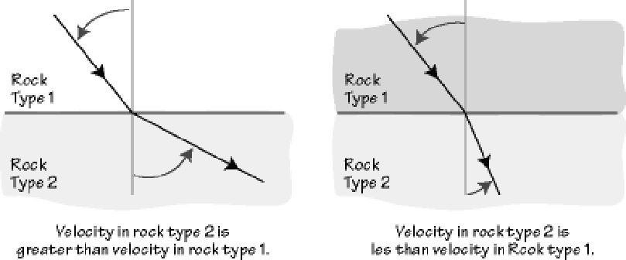
Wave Refraction
The direction in which a seismic wave is traveling can be changed if the wave travels from one material into another. The change in direction is often described as a change in “angles” at the boundary between the different rocks or materials
The reverse of this situation (with upward traveling waves) is more relevant for engineering seismology).

Slide 42
Refraction
Question: What is a real life example of refraction ?
Answer: Stick your arm in a fish tank and you will notice that the angle of your arm “looks funny”. The speed of light is different in water than in air, so the light rays refract across the fish tank boundary.

Slide 43
Snell’s Law (very important)
i₁
sin(i₁)
sin(i₂)
=
velocity₁
velocity₂
velocity₁
velocity₂
i₂
For horizontal interfaces,
any combination of wave types
(velocity₂ > velocity₁)

Slide 44
Snell’s Law
Question: At the Moho the P-wave velocity jumps from 6 km/s (in the crust) to 8 km/s (in the mantle). If a ray has an angle of incidence (i₁) of 20º, what is the angle of refraction (i₂)?
Answer:
  sin(i₂) = (velocity₂ / velocity₁) x sin(i₁)
  sin(i₂) = ( 8 / 6 ) x sin(20º) = 0.456
  i₂ = sin⁻¹(0.456) = 27.1º

Slide 45
Snell’s Law
Question: At the Moho the P-wave velocity jumps from 6 km/s (in the crust) to 8 km/s (in the mantle). What angle of incidence (i₁) produces critical refraction (i₂=90°)?
Answer:
  sin(i₁) = (velocity₁ / velocity₂) x sin(i₂)
  sin(i₁) = ( 6 / 8 ) x sin(90º) = 0.75
  i₁ = sin⁻¹(0.75) = 48.6º

Slide 46
Refraction
What happens if we have several layers with increasing velocities?
Curved Ray Paths !
earthquake

Slide 47
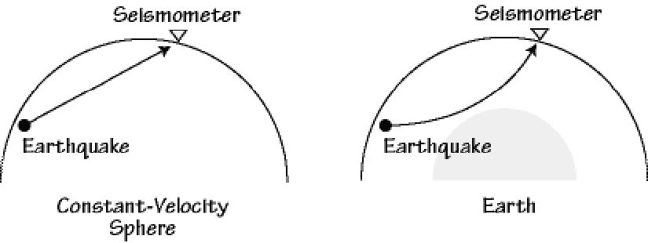
Refraction in Earth
Refraction plays a big role in body wave wave propagation because the velocity changes with depth in Earth.

Slide 48
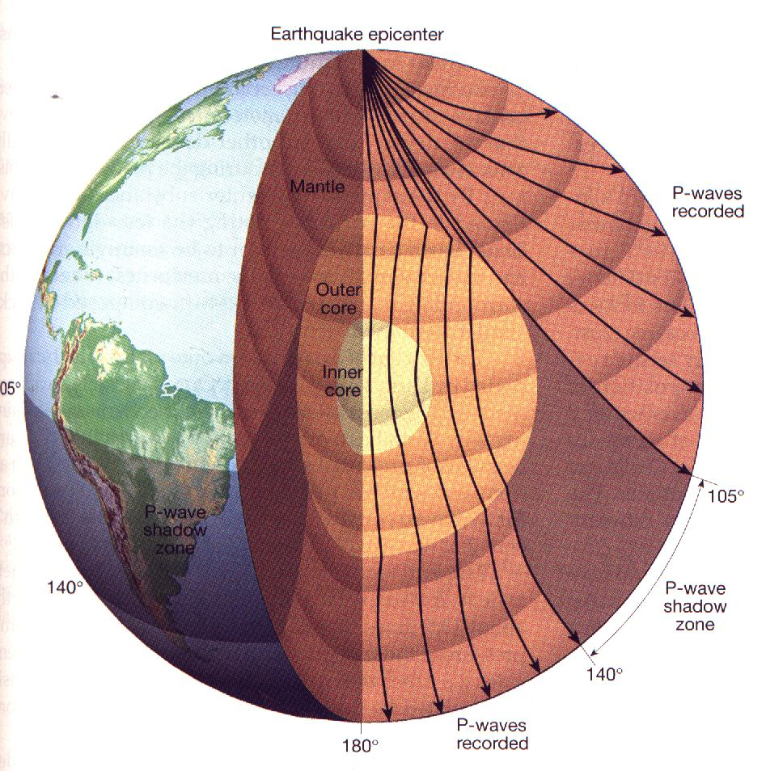
P-Wave Refraction

Slide 49
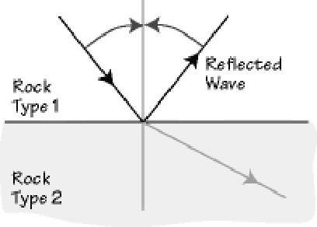
Wave Reflection
Reflections are like echoes. When a wave hits a boundary between two materials, part is refracted and part is reflected.
The reflected angle is equal to the incident angle.

Slide 50
Wave Reflection (Echoes)
i₁ = angle of incidence
i₂ = angle of refraction
i₃ = angle of reflection
i₁
i₃
velocity₁
i₁ always equals i₃
velocity₂
i₂

Slide 51
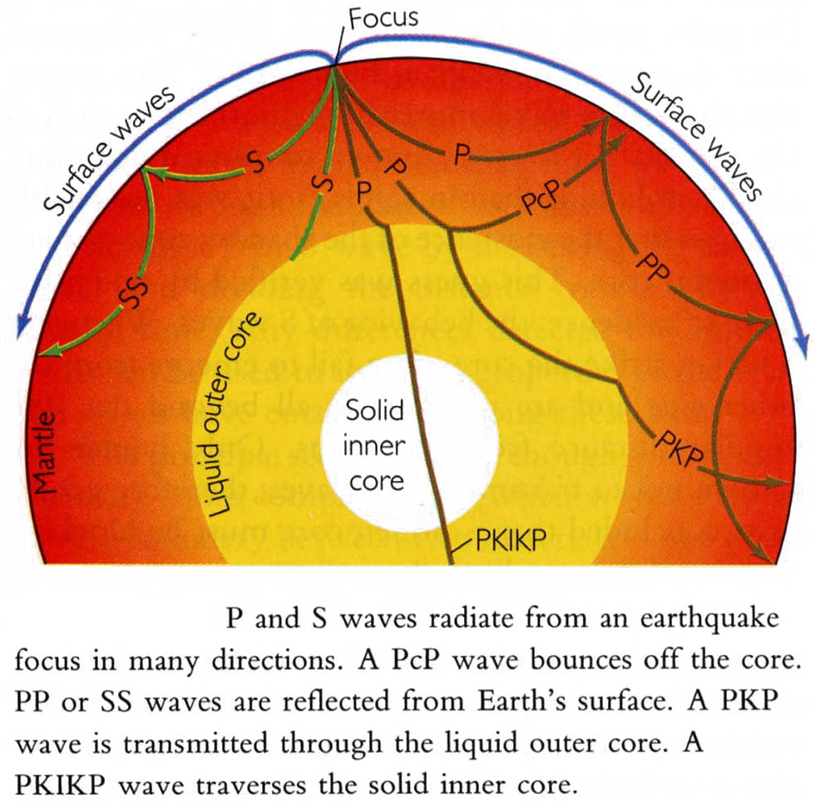
Reflection and refraction of seismic waves
A beam of light is refracted or reflected when it crosses the boundary between air and water. Seismic waves behave similarly at boundaries within the Earth.
P and S Waves radiate from an earthquake focus in many directions
from Press and Siever (1994)

Slide 53
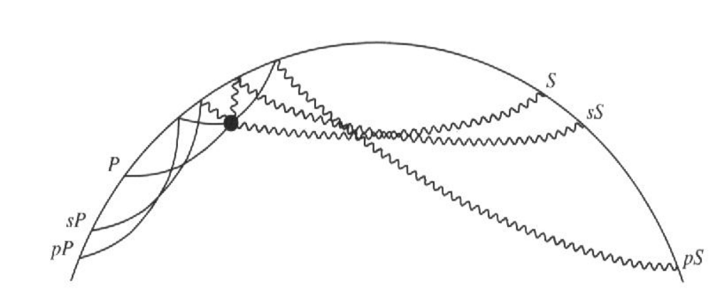
Depth Phases: pP, sS, sP, pS

Slide 54
Crustal & Regional Phases

Slide 55
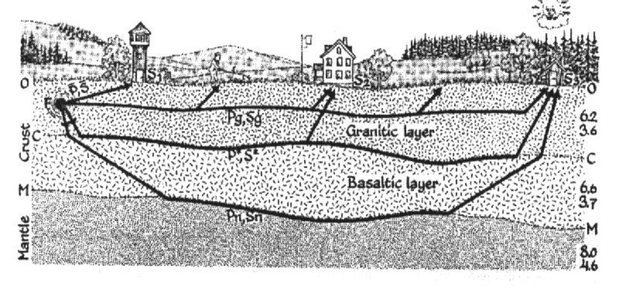
Crustal Seismic Phases

Slide 56
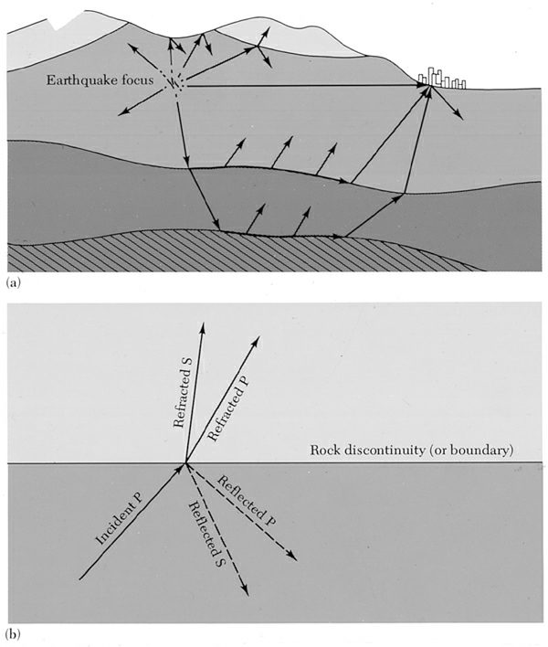
Seismogram Complexity: Reflection and refraction of seismic waves
Picture of the paths of seismic P or S waves being reflected and refracted in rock structures of the Earth's crust.
Reflection and refraction of a longitudinal (P) wave in an earthquake after it hits a boundary between two types of rock. Note conversion from P to S (angles determined by Snell’s law)

Slide 57
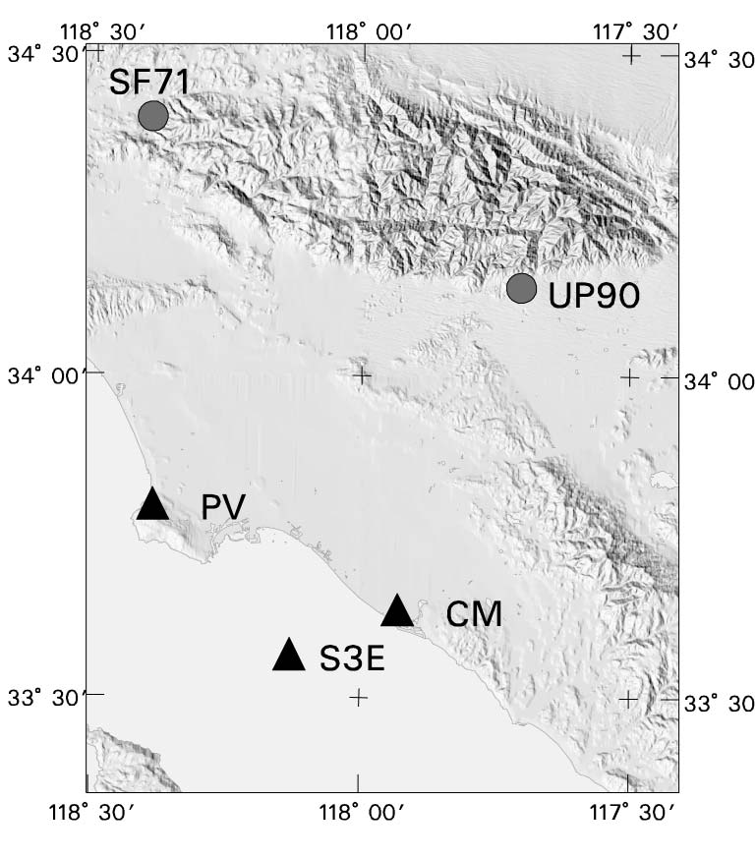
Basin Surface Waves

Slide 58
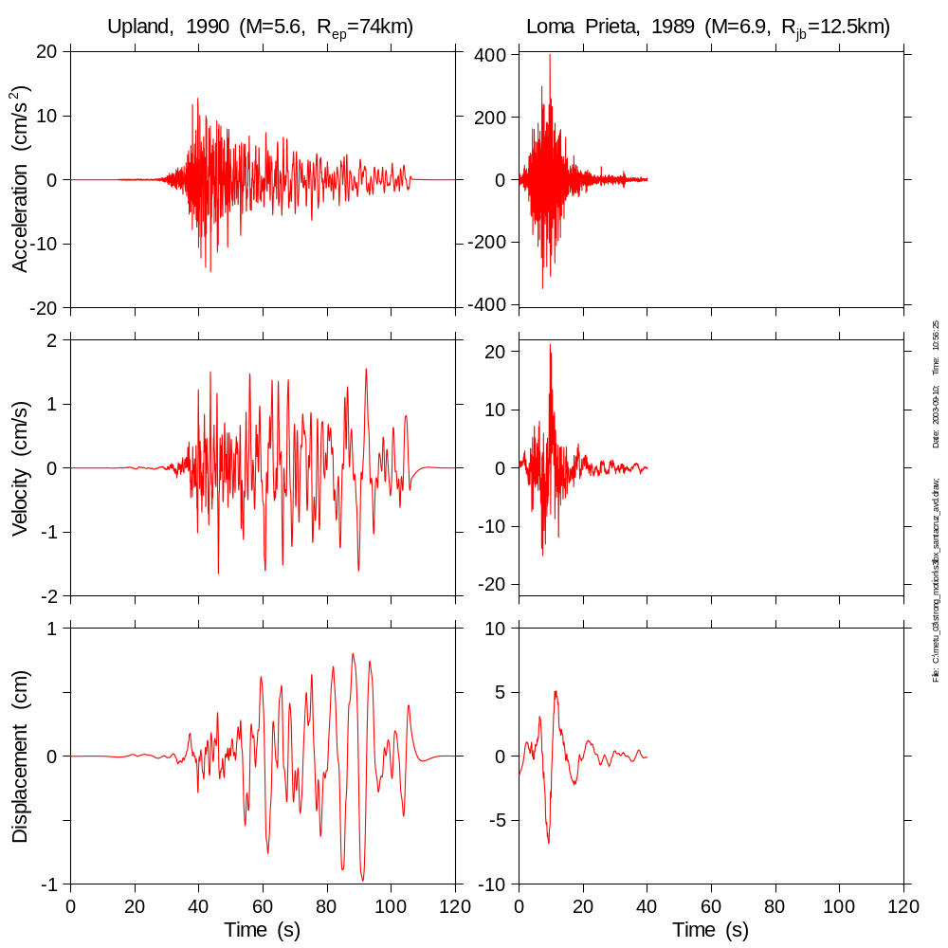
Surface waves (basin waves) lead to “nonstationarity” (long period energy arrives later than high-frequency energy). Note contrast with records from 1989 Loma Prieta earthquake recorded at Santa Cruz
Important concept: integration is like high-cut (low-pass) filtering

Slide 59
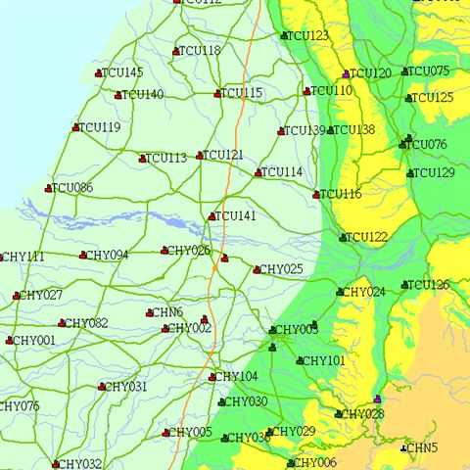
Surface waves on Taiwan coastal plain

Slide 60
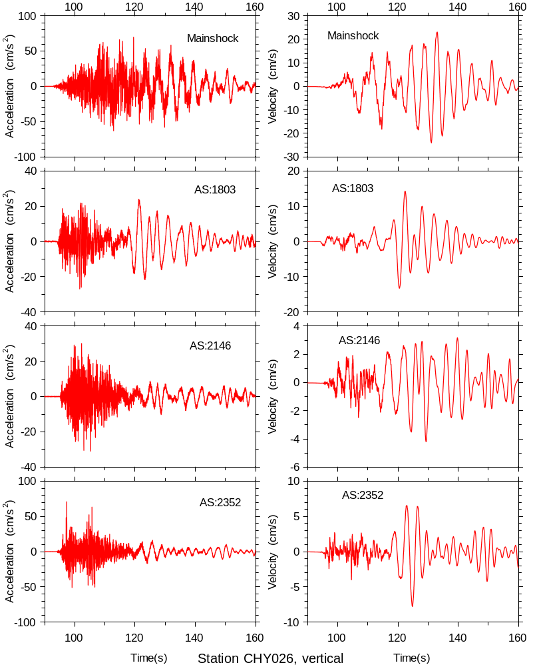

Slide 61
Travel Time
Travel time, T, is defined as
    T = distance / velocity
Example: the travel times of P- and S-waves are
    T_{p} = distance / P-velocity
    T_{s} = distance / S-velocity
Since P-waves travel faster than S-wave, the time separation between the two is larger at greater distances.

Slide 62
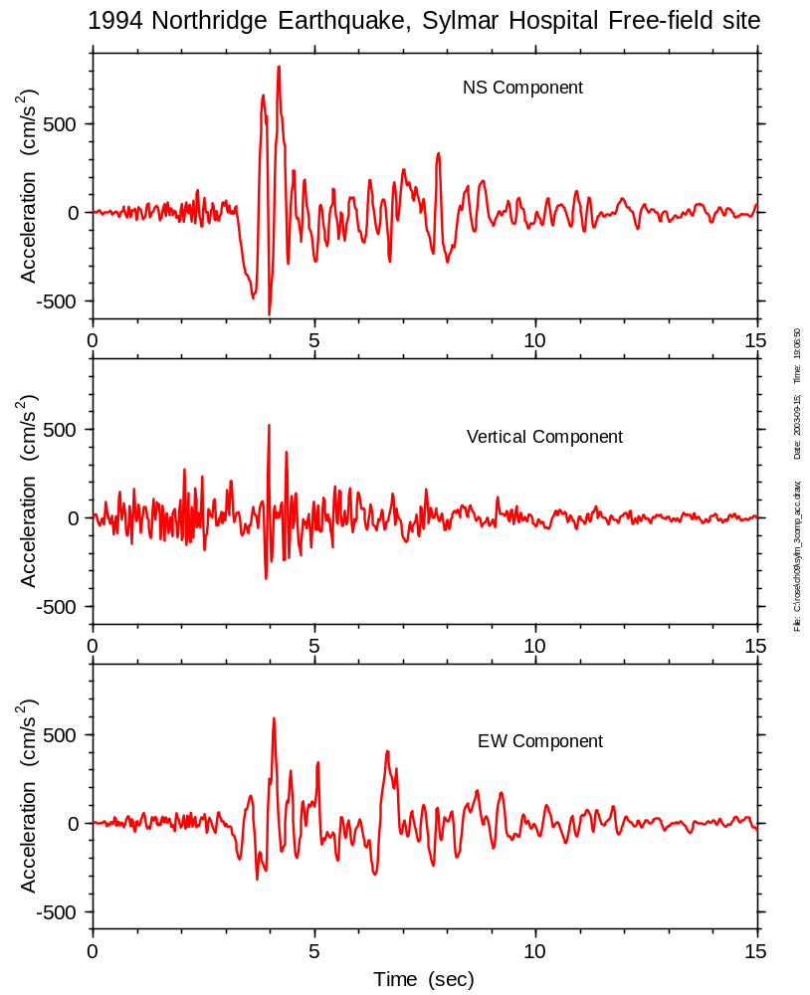
P wave arrives before S wave. S-Trigger time = 3.2 sec, hypocentral distance between approx. 5*3.2= 16 km and 8*3.2= 26 km
P-motion much higher frequency than S, and predominately on vertical component.
Dominant motions are S waves.

Slide 63
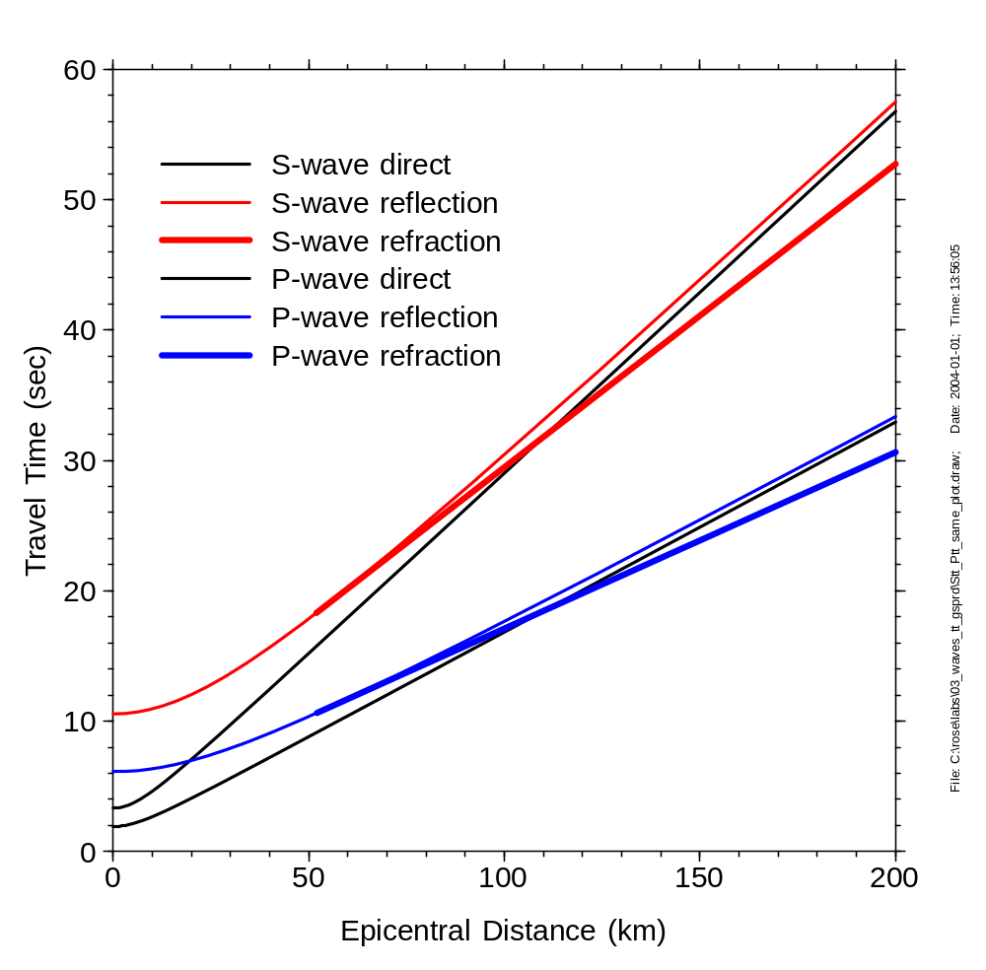
Travel-time curves: crustal phases, layer over halfspace
(Draw picture of rays on board for critical angle refraction)

Slide 64
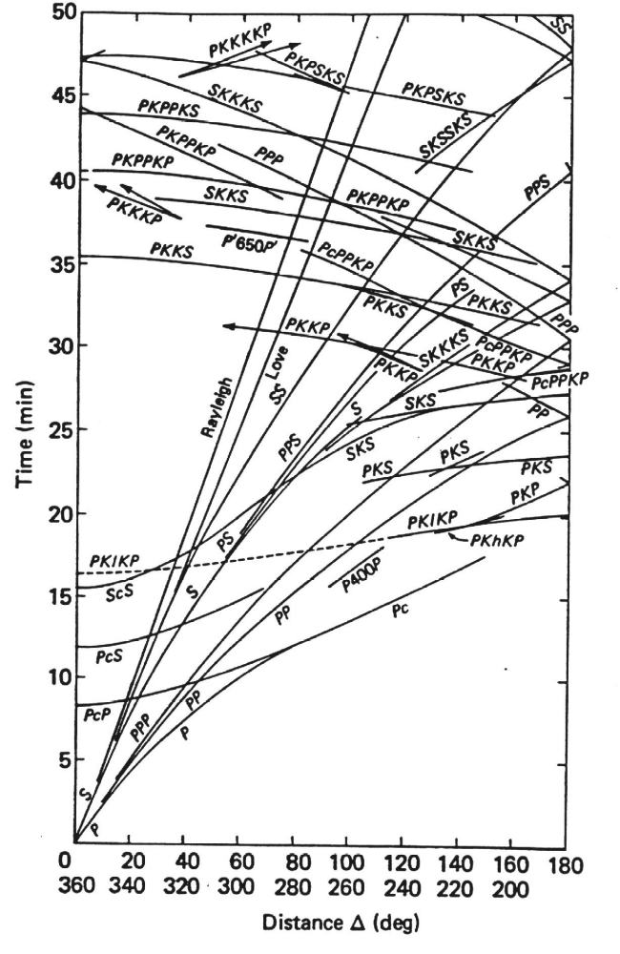
Travel-Time Curves for Global Seismic Phases

Slide 65
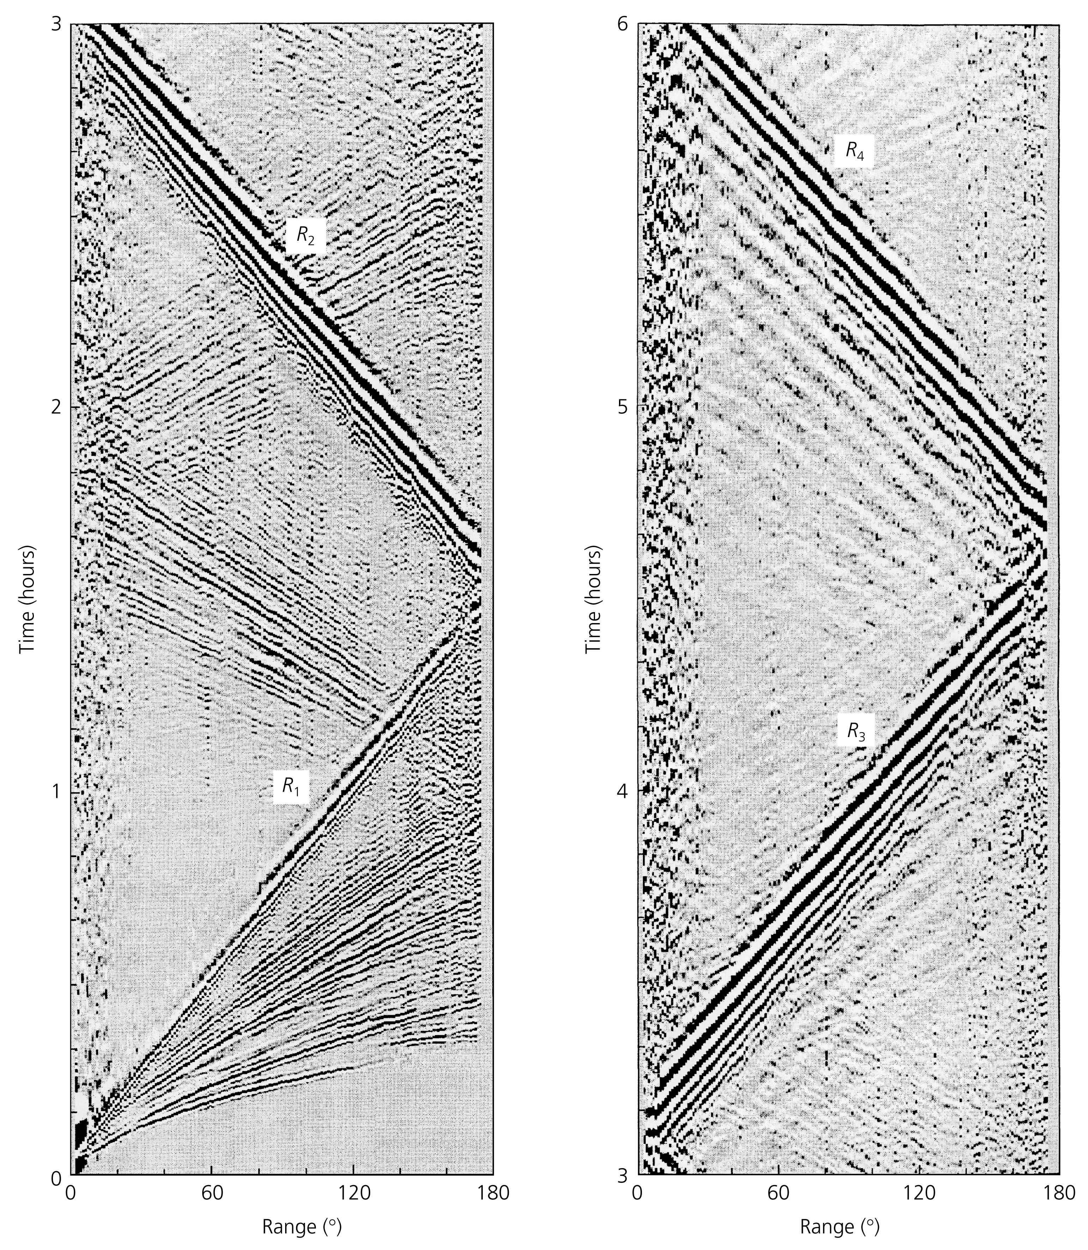
The travel time curves were pieced together in a long, painstaking, study. Modern networks make the job much easier.
(Stein & Wysession, Fig2_7_04)

Slide 66
Seismogram Complexity
The complexity of seismograms is a result of the many different waves that arrive at the seismometer at different times.
With experience, and an understanding of seismic waves and propagation, you can identify the various wiggles using their arrival time and the direction of ground vibration.

Slide 67
Summary
As they travel through Earth, seismic waves interact with Earth structure (where the boundaries between rocks types are located and how big are the changes in properties).
A number of different processes occur, including reflection, refraction, dispersion, attenuation, and diffraction.
By studying the propagation of waves, we are able to estimate Earth’s internal structure.

