Slide 1
Rose School Lectures – 2013
S. Akkar and D. M. Boore
Engineering Seismology & Seismic Hazard Assessment
HAZARD and RISK, TECTONICS, EARTHQUAKES and FAULTS

Slide 2
“Civilisation exists by geological consent, subject to change without prior notice.”
William Durant, historian

Slide 3
SEISMIC HAZARD
is the possibility of potentially destructive earthquake effects occurring at a particular location within a specified period.
Hazard, Risk,Tectonics,Faults
Dr. Sinan Akkar

Slide 4
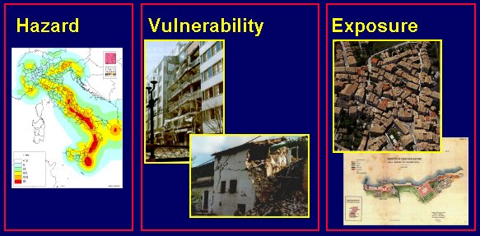
RISK = HAZARD * EXPOSURE * VULNERABILITY
The HAZARD is controlled by NATURE.
VULNERABILITY and EXPOSURE are controlled by HUMANS.
Nature
Engineers
Planners
Hazard, Risk,Tectonics,Faults
Dr. Sinan Akkar

Slide 5
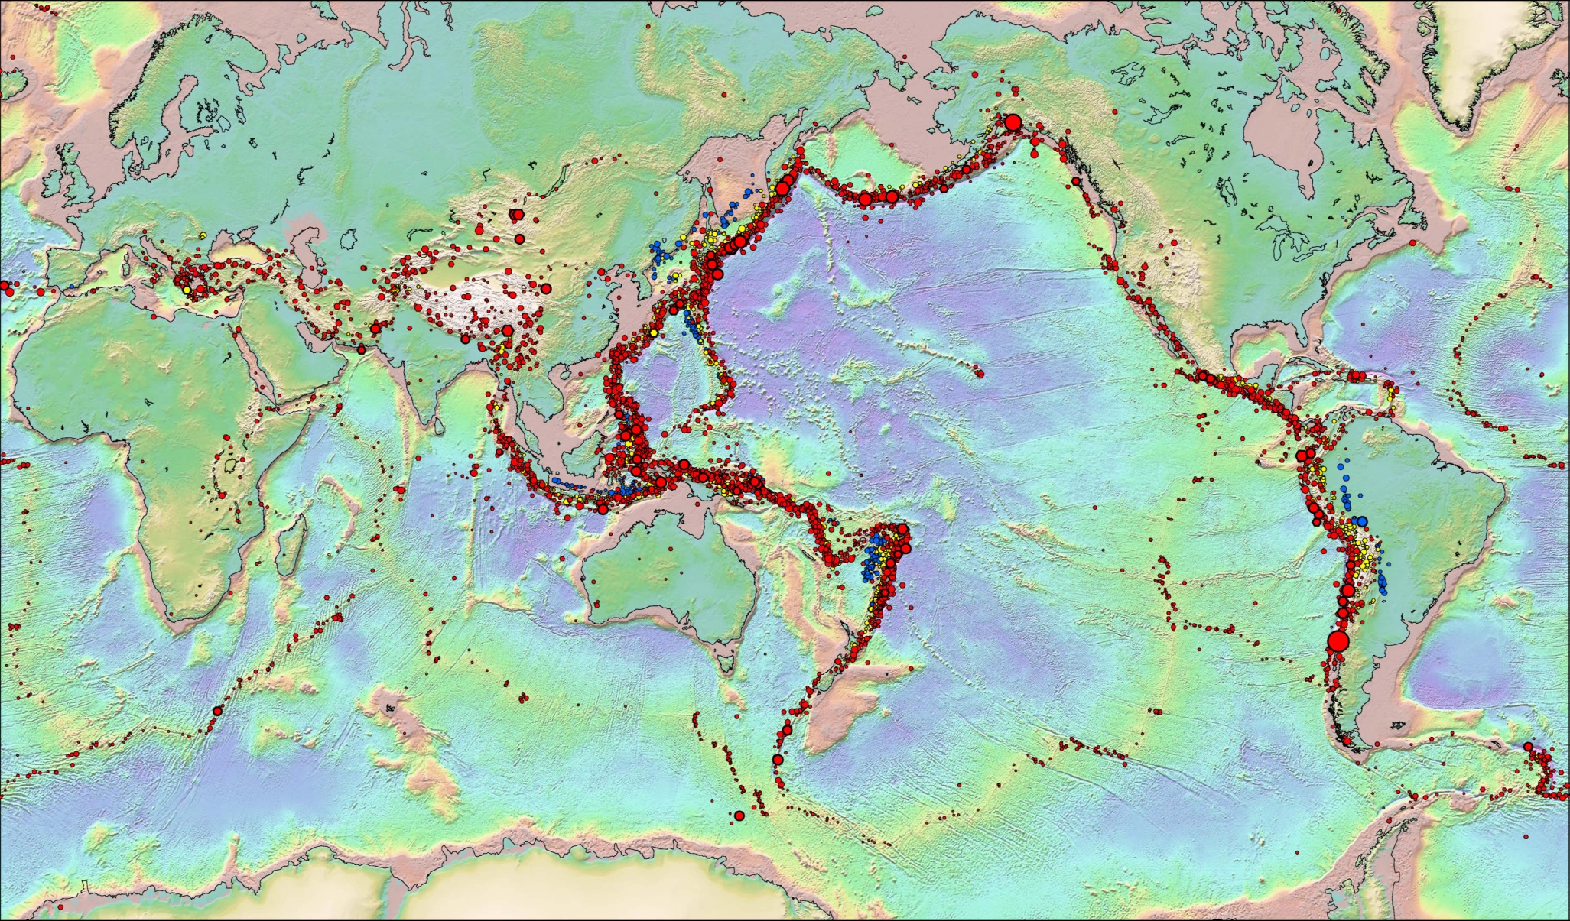
Earthquakes are not located randomly around the Earth
Hazard, Risk,Tectonics,Faults
Dr. Sinan Akkar

Slide 6
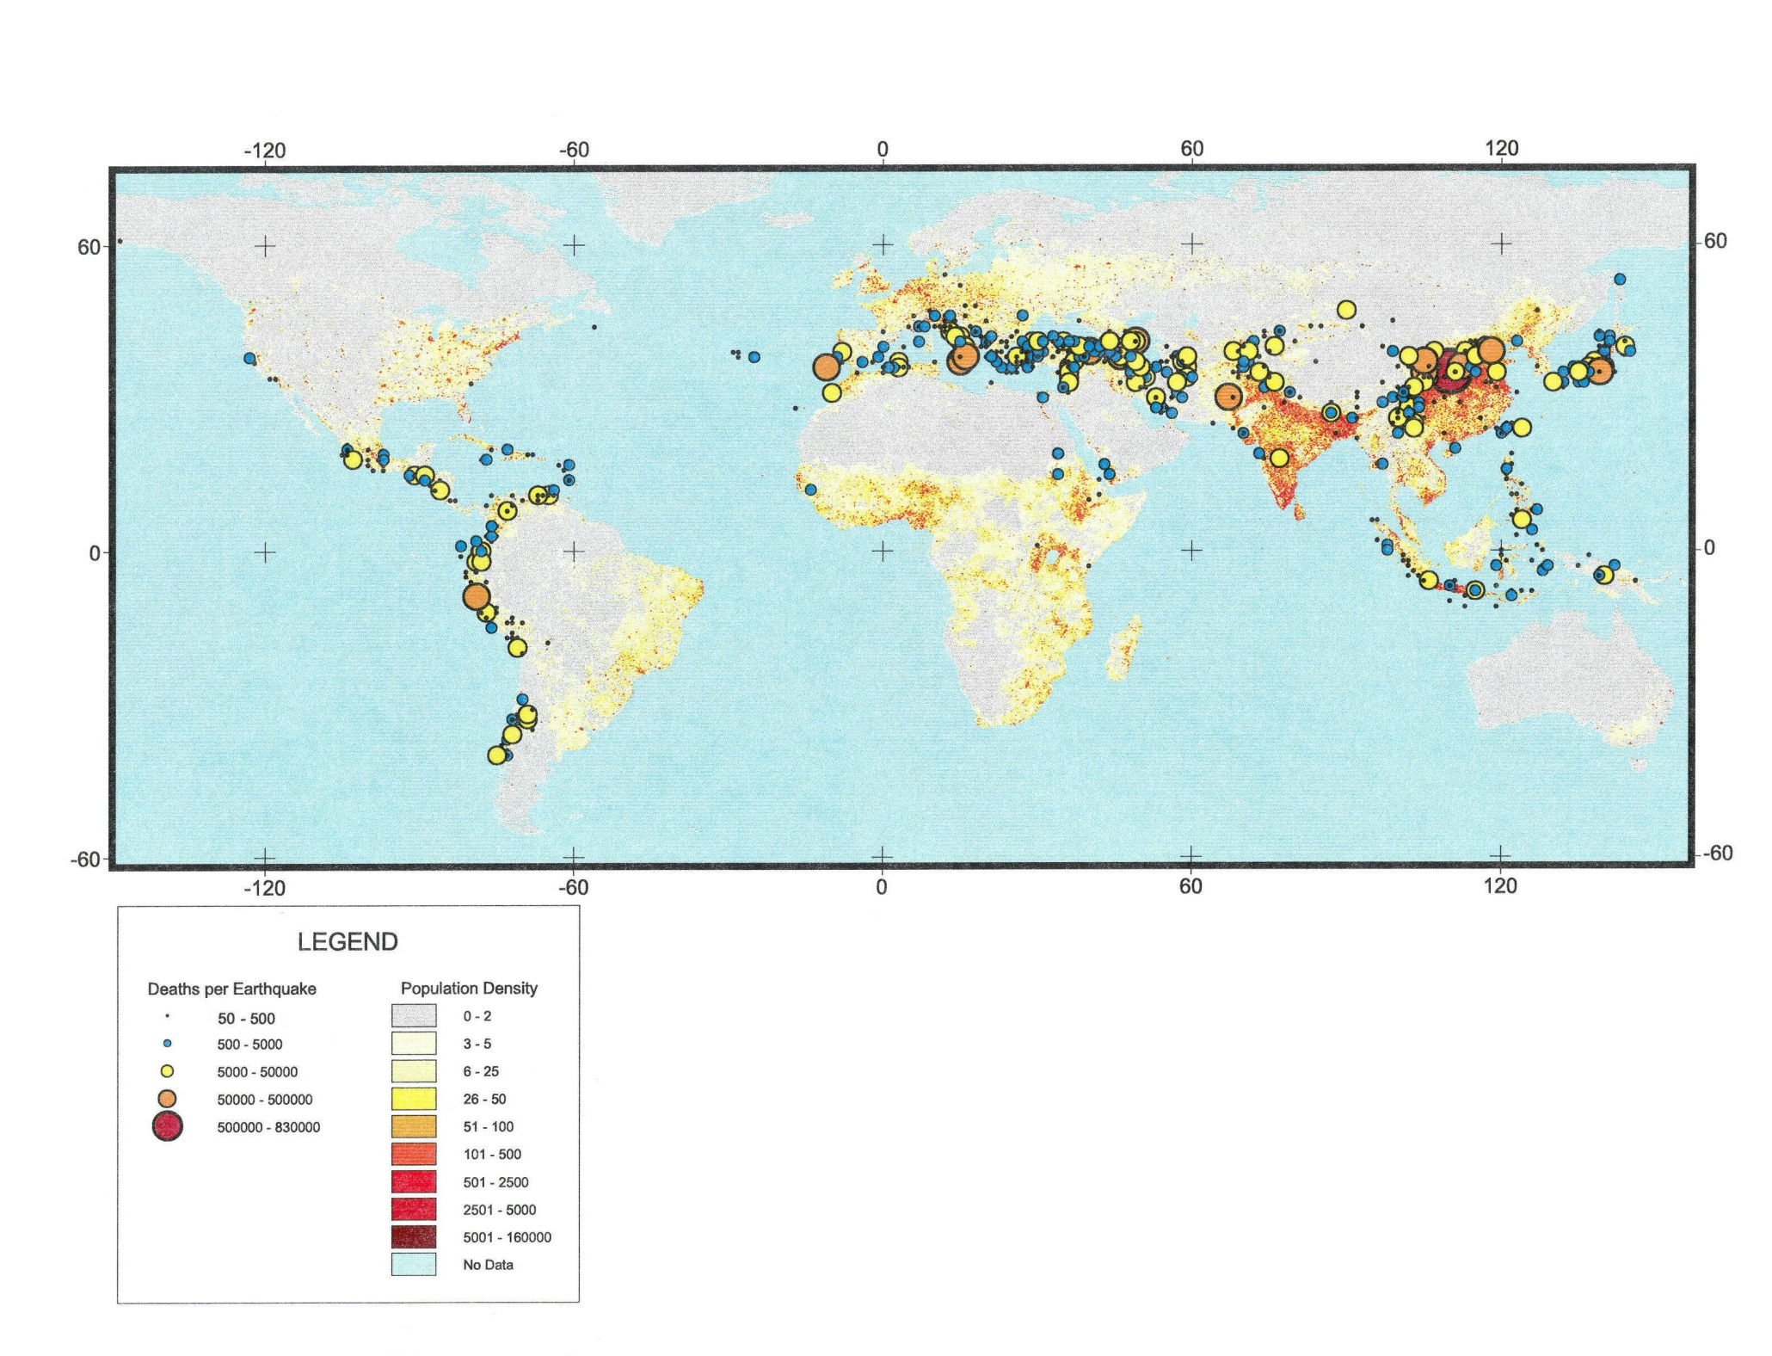

Union of earthquakes, population, & poorly built structures = casualties
Note lack of deaths along seismically active coast of N. America, Alaska and densely populated but relatively inactive India
Hazard, Risk,Tectonics,Faults
Dr. Sinan Akkar

Slide 7
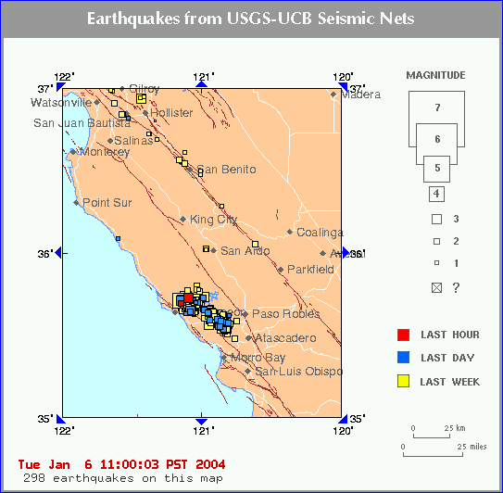
2003 San Simeon earthquake (M 6.5): 2 deaths in Paso Robles
0.48g

Slide 8
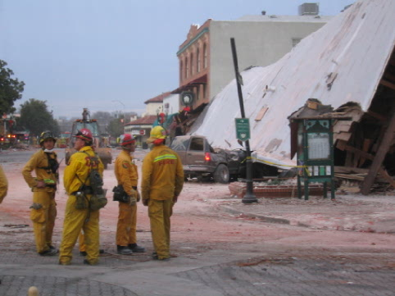
Damage in Paso Robles, CA, due to collapse of unreinforced masonry building (2 lives lost) during the 2003 San Simeon earthquake

Slide 9
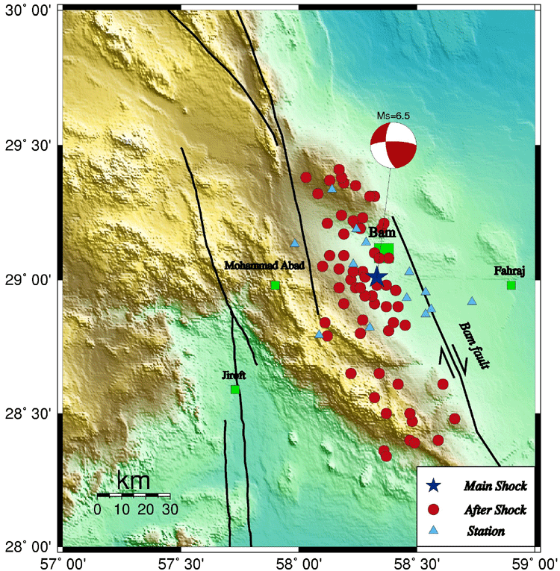
Contrast damage with that in Bam, Iran (M 6.6)
>30,000 deaths
Why so many deaths, compared to Paso Robles?
  Was ground motion higher than in Paso Robles? (Yes: 0.98g pga in Bam; 0.48g 10 km from Paso Robles)
  Was the construction less earthquake resistant?
0.98g

Slide 10
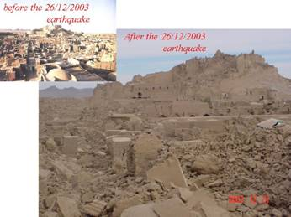

Slide 11
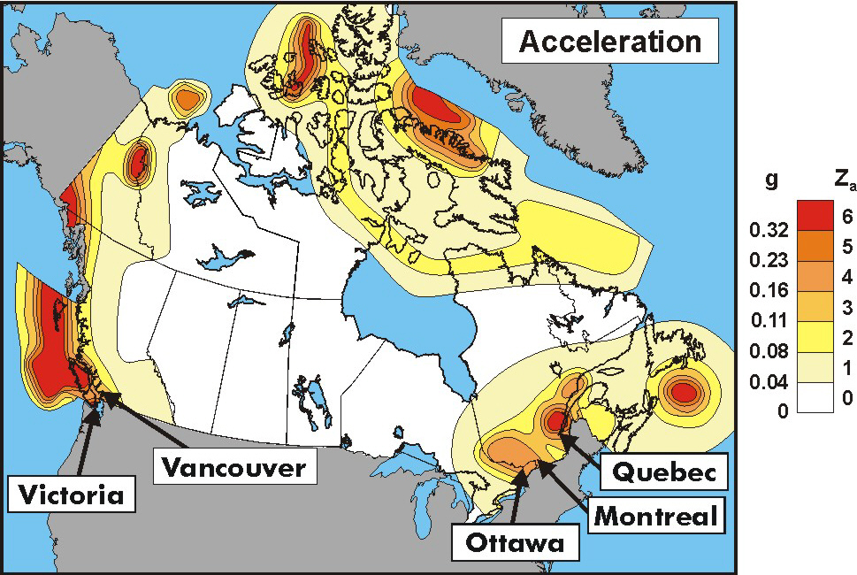
Hazard
Hazard, Risk,Tectonics,Faults
Dr. Sinan Akkar

Slide 12
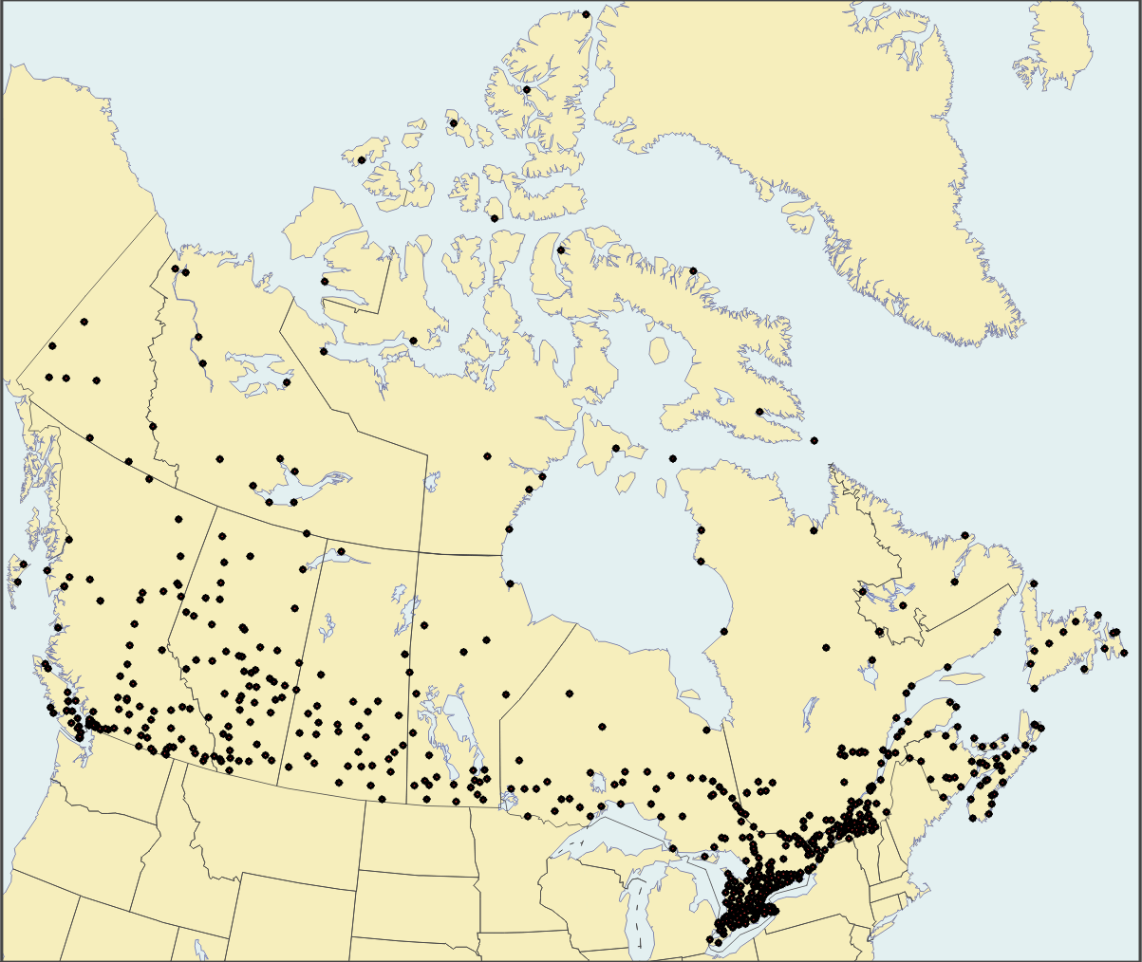
Population
NBCC communities
Hazard, Risk,Tectonics,Faults
Dr. Sinan Akkar

Slide 13
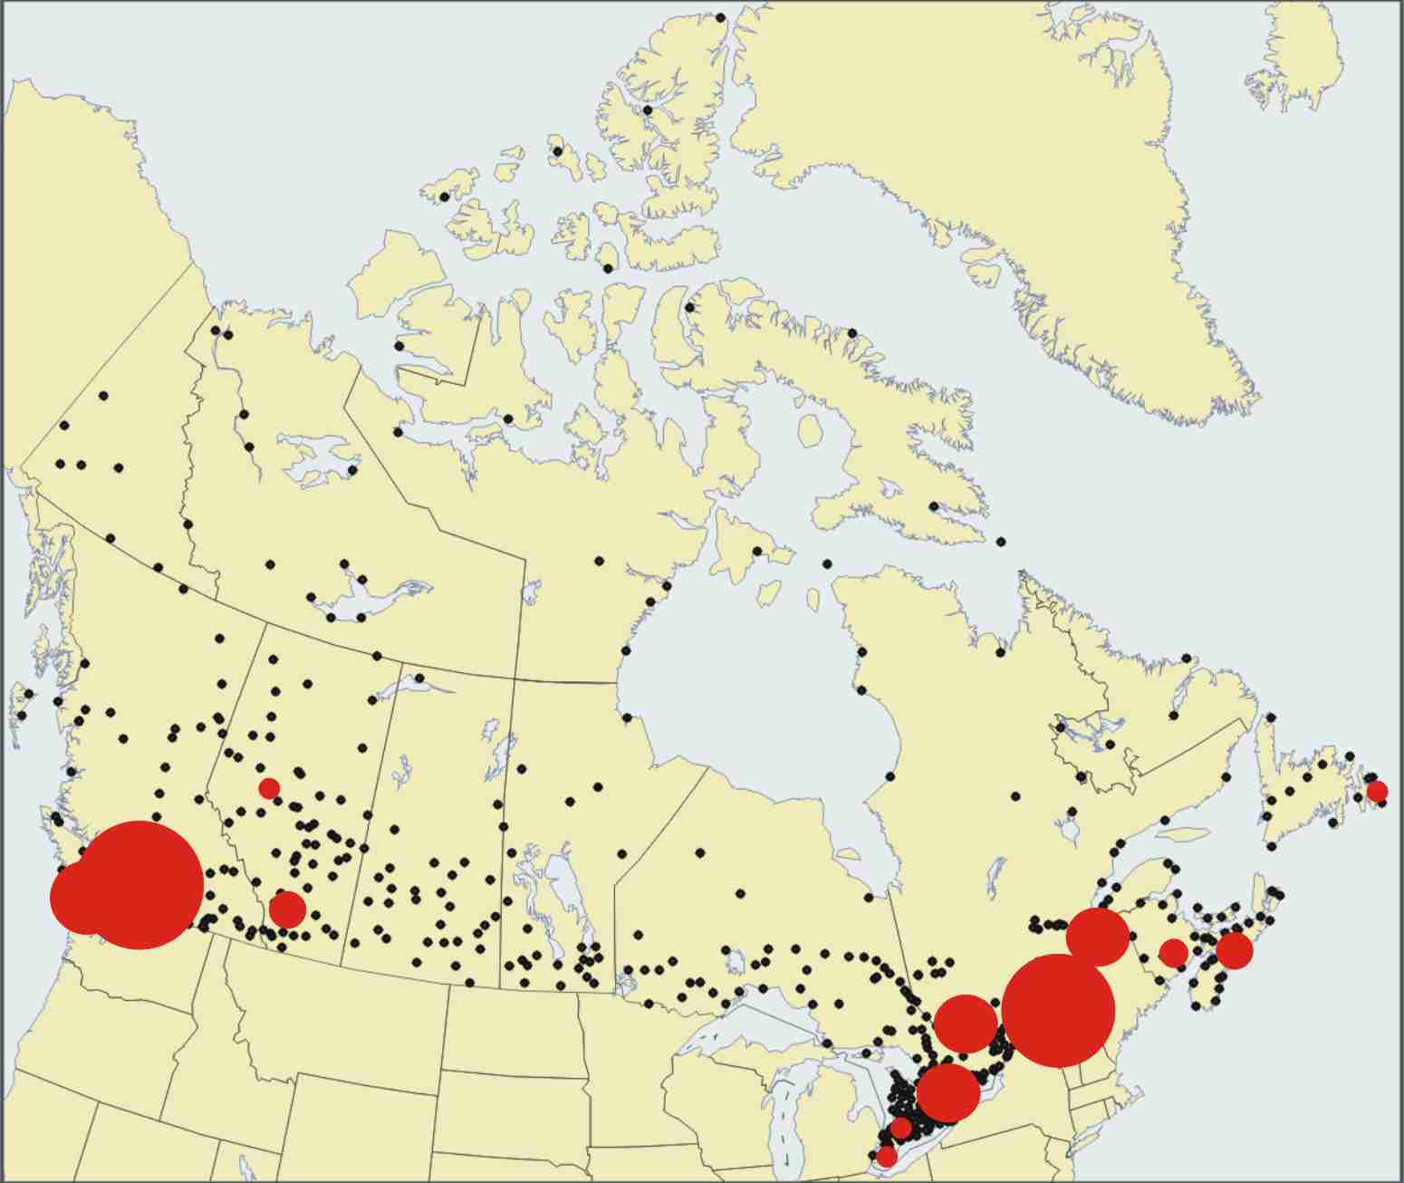
“Risk”
Hazard, Risk,Tectonics,Faults
Dr. Sinan Akkar

Slide 14
Seismic Hazard: shaking irrespective of consequence
Seismic Risk: Hazard * Exposure * Vulnerability
Place | Hazard | Exposure | Risk
Baffin Island | high | low | low
Vancouver | high | high | high
Toronto | low | high | moderate
Hazard, Risk,Tectonics,Faults
Dr. Sinan Akkar

Slide 15
Earthquake Disasters
2010 Haiti (M7.0): 250,000 (?)
1976 Tangshan China (M7.5): 243,000
2004 Sumatra (M9.1): 228,000
2008 Sichuan China (M7.9): 88,000
2005 Pakistan (M7.6): 86,000
1990 Western Iran (M7.4): 50,000

Slide 16
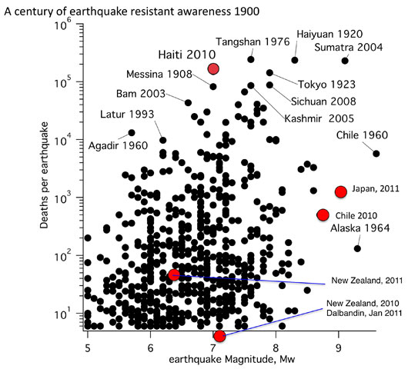

Slide 17
Note
M7s can be more deadly than M9s!
M7s much more common than M9s
Death tolls approaching 1,000,000
Big earthquakes can have low death tolls
Earthquake impact:
1) location, location, location
2) (population exposure)
3) vulnerability

Slide 18
Bigger Population →
Bigger Death Tolls
Earthquake casualties are not decreasing

Slide 19
There is no evidence for an increase in seismicity,
but there is clear evidence for increase in exposure – particularly in the developing world –
and at least no significant reduction in vulnerability.
Increased RISK
Hazard, Risk,Tectonics,Faults
Dr. Sinan Akkar

Slide 20
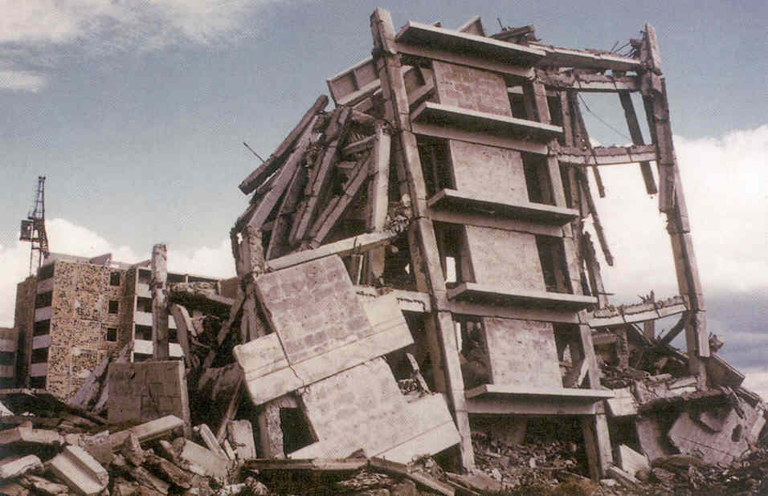
Spitak, Armenia (1988) – magnitude 6.7 earthquake, death toll of at least 25,000 due to collapse of extremely vulnerable high-rise buildings
Hazard, Risk,Tectonics,Faults
Dr. Sinan Akkar

Slide 21
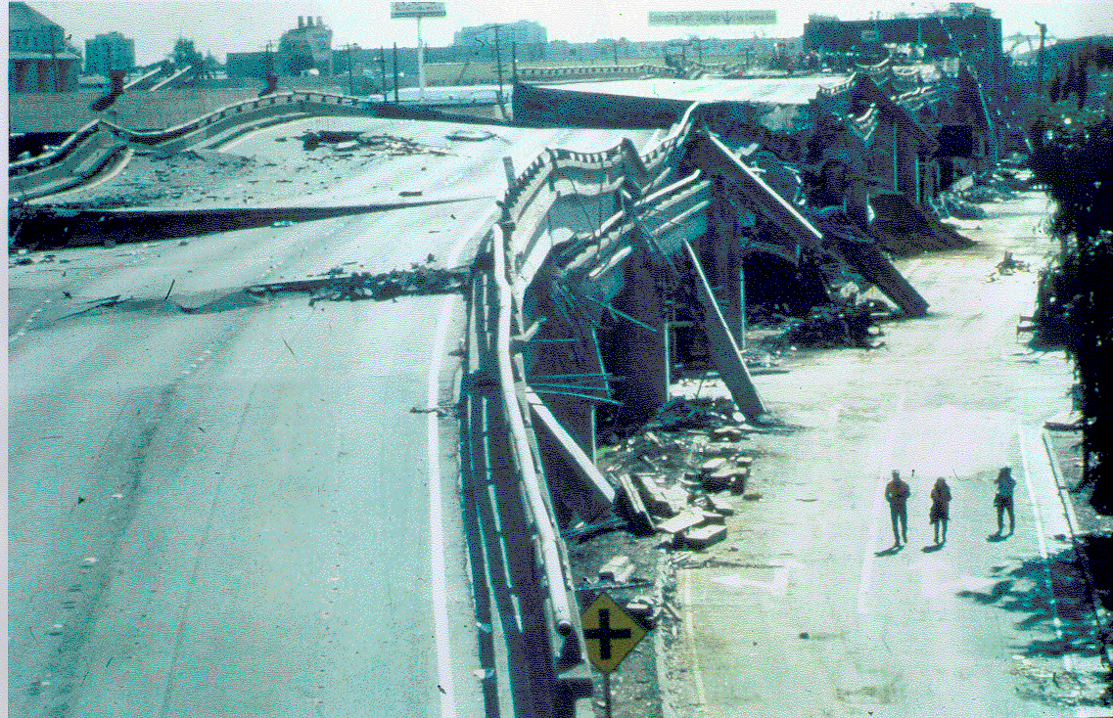
Loma Prieta, California (1989) – magnitude 6.9 earthquake, with death toll of less than 70; most fatalities due to collapse of Cypress Viaduct
Hazard, Risk,Tectonics,Faults
Dr. Sinan Akkar

Slide 22
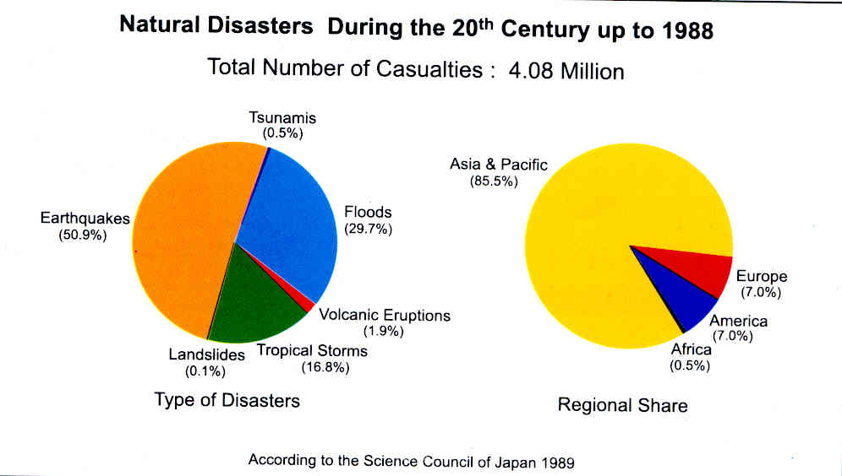
“Natural” Disasters and Casualties
Hazard, Risk,Tectonics,Faults
Dr. Sinan Akkar

Slide 23
→Natural Disasters are
Not Natural!
Death toll/damage is a consequence of the built environment.
Urbanization + ignorance (and/or corruption) = risk
During rapid modernization, good building codes critical

Slide 24
Seismic Risk Mitigation
HAZARD * EXPOSURE * VULNERABILITY * COST
Assess
Control
Reduce
Balance
Hazard, Risk,Tectonics,Faults
Dr. Sinan Akkar

Slide 25
Any rational and cost-effective program of seismic risk mitigation, whether it be:
Seismic design of a critical facility (e.g. nuclear powerplant (NPP))
Drafting of a building code
Strengthening of a hospital for emergency care
Insurance against earthquake losses
Siting of new developments and infrastructure
Must necessarily begin with a quantitative assessment of seismic hazard. And learning how to do so is the goal of this course.
Hazard, Risk,Tectonics,Faults
Dr. Sinan Akkar

Slide 26
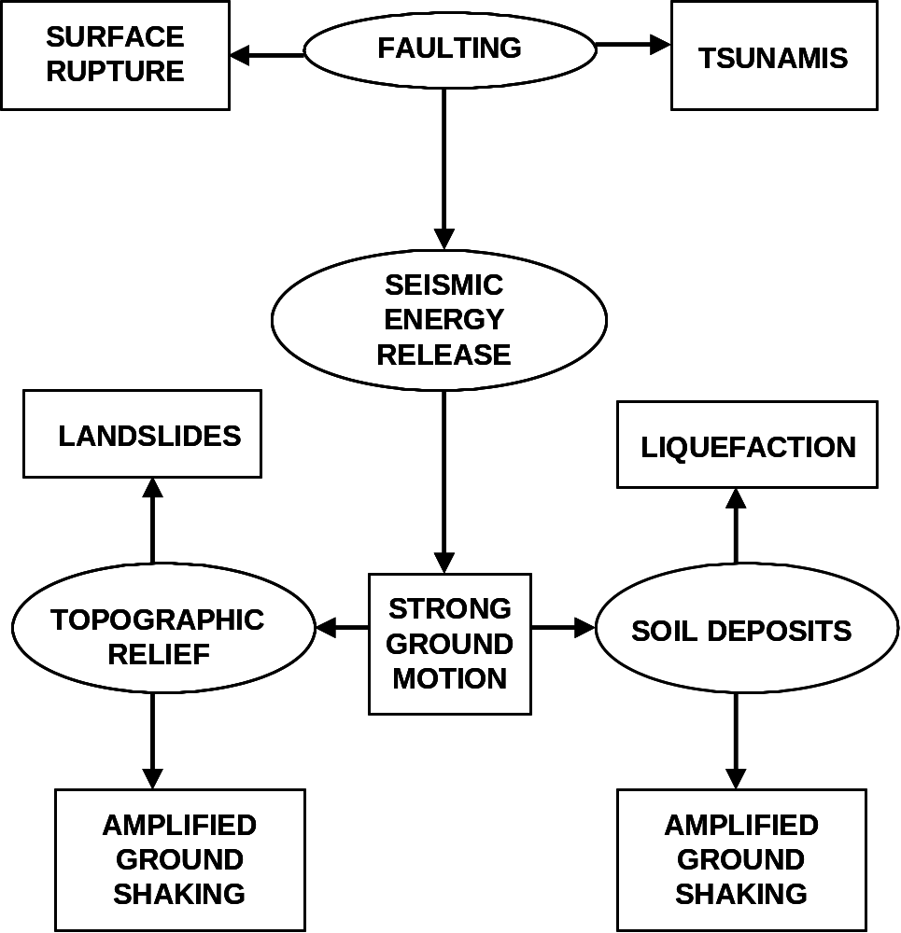
Hazard, Risk,Tectonics,Faults
Dr. Sinan Akkar

Slide 27
What Controls the Level of Shaking?
Magnitude
  More energy released
Distance
  Shaking decays with distance
Local soils
  amplify the shaking
Hazard, Risk,Tectonics,Faults
Dr. Sinan Akkar

Slide 28
But first need an understanding of …
Earth structure
Tectonics
Plate motions and interactions
Hazard, Risk,Tectonics,Faults
Dr. Sinan Akkar

Slide 29
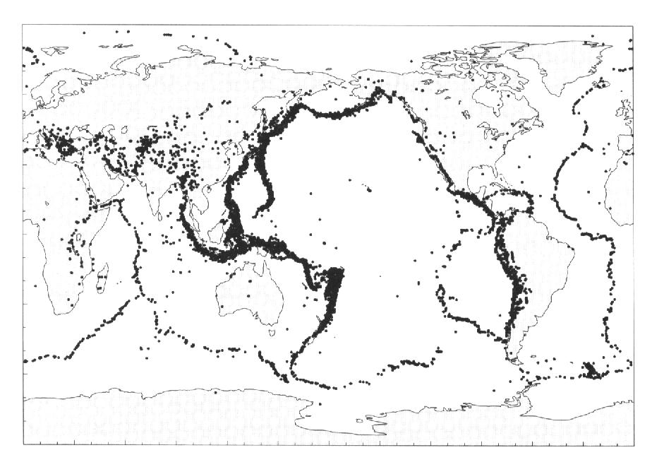
Earthquake activity around the world (1977-1994)
Zones in and around Atlantic (1/5 of the global seismicity)
Mediterranean Sea, Portugal, Spain, northern Africa countries, Italy, Turkey, Iran, Pakistan, Northern India, Nepal and China
Pacific Circumfrence (3/4 of the global seismicity)
Western coasts of South, Central and North America, along Kurile islands, the Aleutian arc, Japan, Philippines, Papa New Guinea and New Zealand
Pacific Ocean
Indian
Ocean
Atlantic
Ocean
Shearer, 1999 (courtesy of Dr. J. Bommer)
Earthquake activity is not distributed uniformly around the world. It is mainly confined to relatively narrow bands of intense seismicity that enclose areas within which very few earthquakes occur.
(Map shows the earthquake activity around the major bands of interplate seismicity)
Hazard, Risk,Tectonics,Faults
Dr. Sinan Akkar

Slide 30
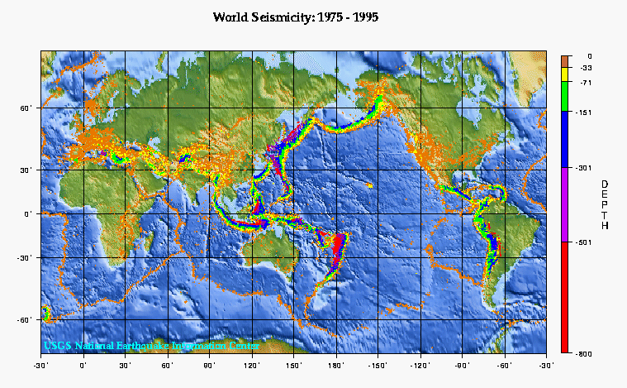
More in colors ... (look at the depth distribution)
Hazard, Risk,Tectonics,Faults
Dr. Sinan Akkar

Slide 31
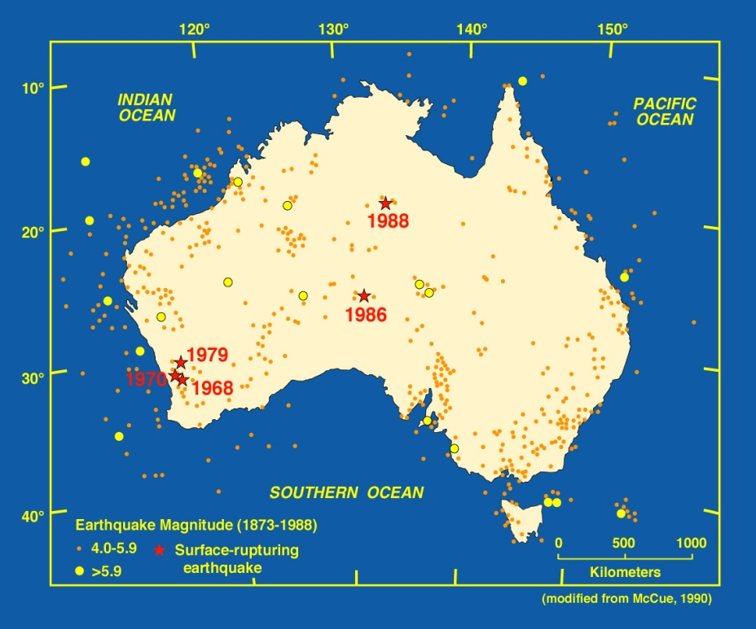
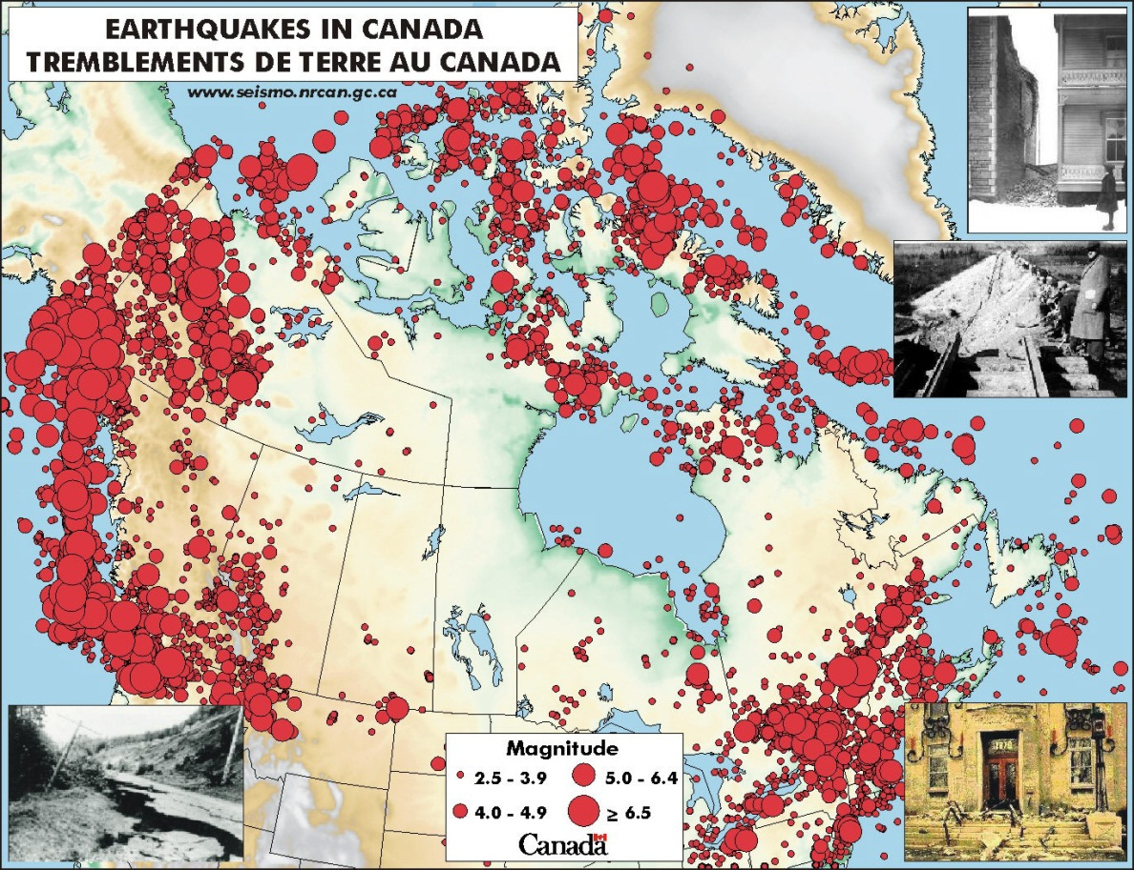
There are a few earthquakes that are remote from the major bands of seismic activity (intraplate earthquakes).
Examples: earthquake locations in Australia, eastern North America, central India, northeast Brazil.
Hazard, Risk,Tectonics,Faults

Slide 32
SEISMICITY and PLATE TECTONICS
The majority of earthquakes occur at locations on or close to the boundaries between tectonic plates:
~75% on the circum-Pacific belt (“ring of fire”)
~22% on the Alpine-Himalayan region
~2% on the oceanic spreading ridges
Therefore, knowledge of the direction and velocity of plate motions is fundamental to understanding earthquake processes
Hazard, Risk,Tectonics,Faults
Dr. Sinan Akkar

Slide 33
Things that plate tectonics (mostly) explains
Distribution of earthquakes on the globe (including depth)
Geographic differences in the types of earthquakes
Spatial distribution of the largest earthquakes
Relative frequency of earthquakes

Slide 34
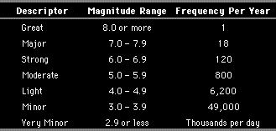
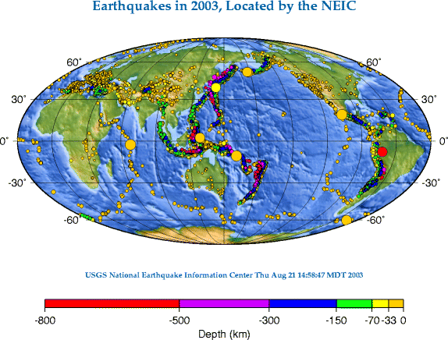
Earthquakes occur quite often. However, large magnitude earthquakes are infrequent...
Big yellow and red circles show earthquakes M > 7
Hazard, Risk,Tectonics,Faults
Dr. Sinan Akkar

Slide 35
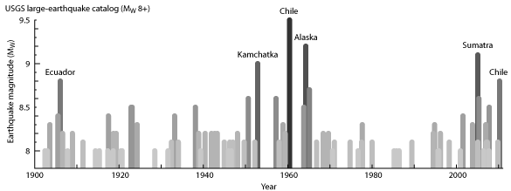
Global Earthquakes
Earthquake activity since 2004:
Cluster by chance?
Significant clustering?

Slide 36
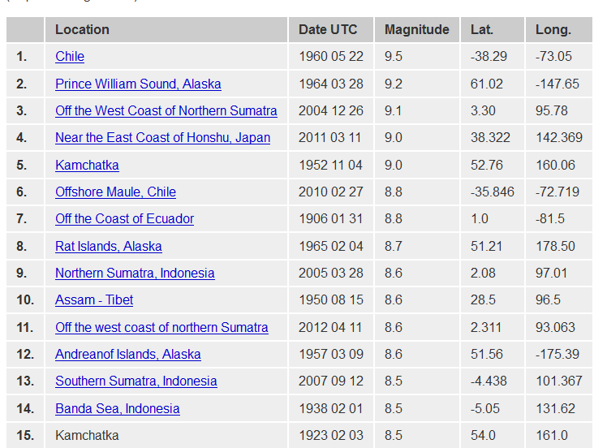
15 Biggest Earthquakes Since 1900:
6 since 2004!

Slide 37
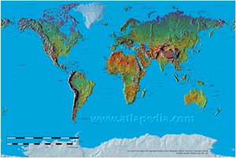
Concept of continental drift...
There is apparent match between the eastern coastline of South America and the western coastline of Africa, suggesting that these two continents had once been joined together.
A German meteorologist, Alfred Wegener (The Origin of the Continents and Oceans, 1915) demonstrated that the two sides of the Atlantic Ocean had indeed once been joined together. He included similarity of geological structures and mineral deposits and identical fossils of both flora and fauna. Despite the extensive evidence that Wegener presented to prove that Africa and South America, as well as many other continents, had once been joined, his theory was rejected by the scientific community at the time not because of questions regarding the validity of the evidence he provided for the relative movement of the continents but rather because he failed to provide a convincing explanation for how this movement came about.

Slide 38
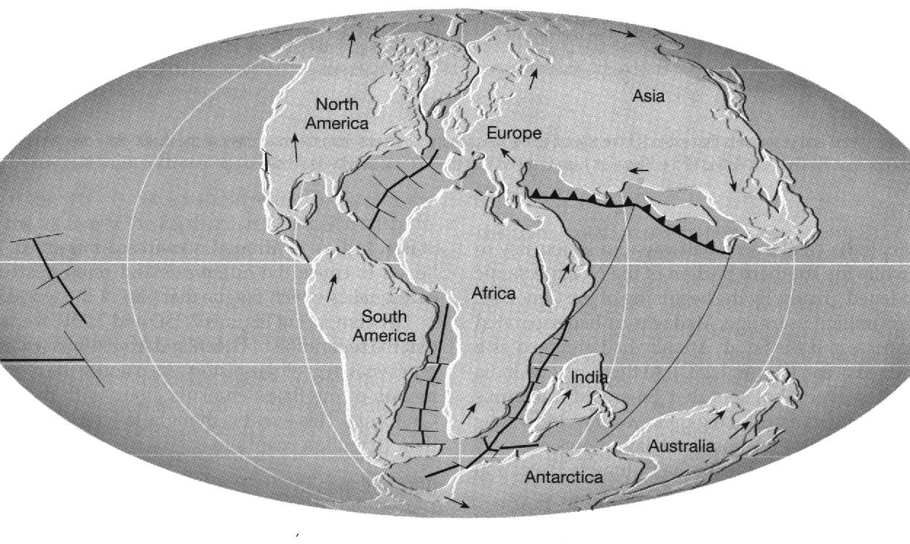
Continents about 100 million years ago before the present
Tarbuck & Lutgens, 1997 (courtesy of Dr. J. Bommer)
Over the years further evidence was gathered by geologists and other scientists, which confirmed that once upon a time Africa and South America had been joined as a single continent. This evidence also showed that 200 million years ago all of the continents had formed a single landmass, one giant continent called Pangaea. This continent began to break up, initially forming two continents, Laurasia and Gondwanaland, about 150 million years ago. By 100 million years ago, Laurasia had split into the continents of North America and Eurasia, and Gondwanaland had divided itself into the continents of India, South America, Africa, Antarctica and Australia. These continents have continued to move to bring about their current configuration, including the collision of India with Eurasia about 50 million years ago.

Slide 39
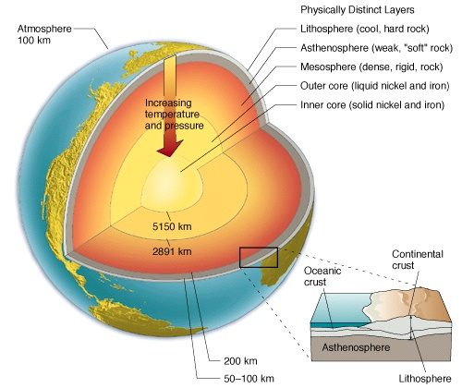
A knowledge of the internal structure of the Earth is important in understanding plate tectonics

Slide 40
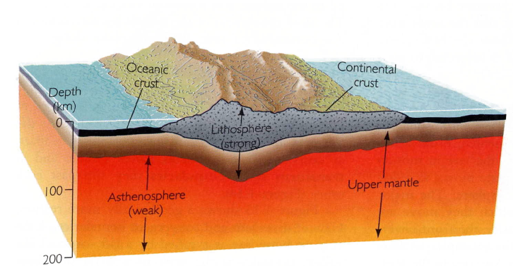
Different types of crust can determine plate interactions

Slide 41
Continents can be thought of as rafts which ride along on tectonic plates. Continental material is virtually permanent once it has been formed. Oceanic material is continuously recycled and only temporarily exists near the surface. That is why continental crust can be very old, over 4 billion years old whereas oceanic crust is much younger. The oldest oceanic crust on Earth is about 200 million years old - this is 20 times younger than the oldest continental crust. Oceanic crust, and lithosphere, is so young because it is constantly being recycled. Over a 200 million year time span, oceanic lithosphere is:
  - produced at a mid-ocean ridge
  - moved across the asthenosphere
  - buried at a subduction zone
Hazard, Risk,Tectonics,Faults
Dr. Sinan Akkar

Slide 42
Comparison of continental and oceanic crusts in terms of thickness
Continental areas are much thicker than oceanic areas.
Continental crust can be 70-80 km thick; oceanic crust is at most 10-15 km thick
Continental lithosphere can extend to 300-400 km in depth; oceanic lithosphere extends only to 100-150 km in depth.
Comparison of continental and oceanic crusts in terms of buoyancy
Continental lithosphere is less dense than oceanic lithosphere (think of them as rafts, floating over the asthenosphere).
Because they are lighter, continents never get buried beneath one another; in other words they do not subduct.
Continental material can remain at the Earth’s surface indefinitely.
Hazard, Risk,Tectonics,Faults
Dr. Sinan Akkar

Slide 43
Summary of differences between continents and oceans
Continent Material
  thick
    crust up to 70-80 km
    lithosphere up to 300-400 km
  old
    over 4 billion years
  light
    never (rarely) subducts
Oceanic Material
  thin
    crust 10-20 km
    lithosphere 100-150 km
  young
    younger than 200 million years
  heavy
    always subducts eventually
Hazard, Risk,Tectonics,Faults
Dr. Sinan Akkar

Slide 44
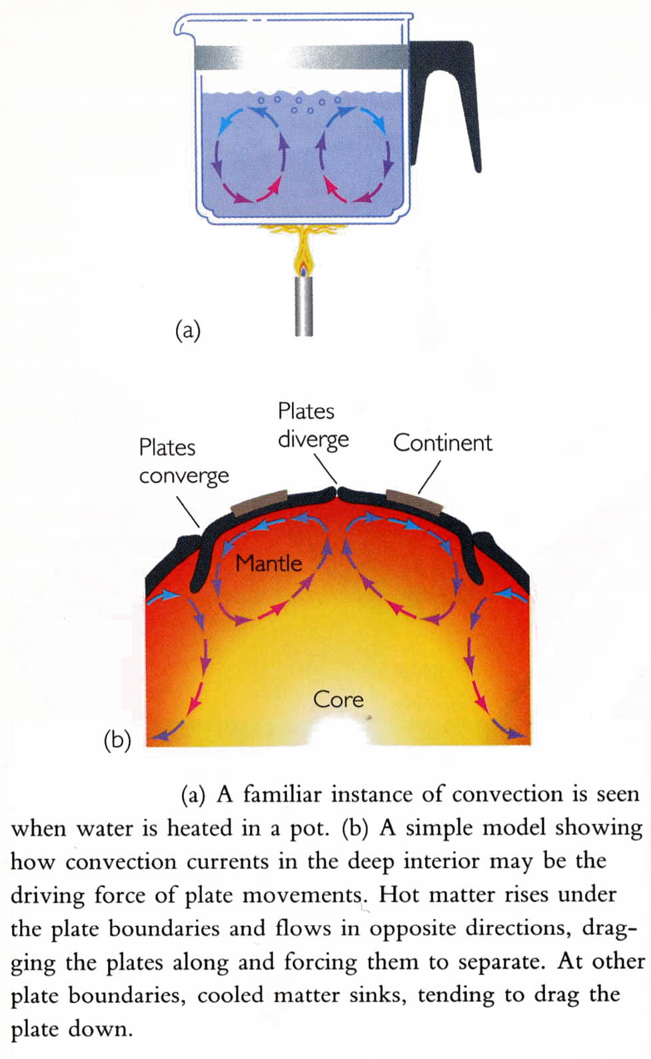
The interior of the earth is in constant motion, which is driven by heat ...
Within the crust temperatures increase at the rate of about 1°C with every 30 m of depth and then the rate of increase gradually reduces within the Earth. It is estimated that within the core temperatures are in excess of 6,000°C. The source of this heat is radioactivity within the core.
The temperature gradient across the Earth sets up a flow of heat towards the surface; in the outer core, which is liquid, the mechanism of heat transfer is convection. The mantle is solid, although materials are close to their fusion point, hence heat transfer would be expected to take place by conduction. However, the thermal conductivity of the materials that make up the mantle is inadequate to account for the very large flow of heat from the core and the heat is actually transferred across the mantle by very slow convection currents. These in turn give rise to convection currents within the asthenosphere, which in turn give rise to movement of the lithosphere
Press and Siever, 1986 (courtesy of Dr. J. Bommer)

Slide 45
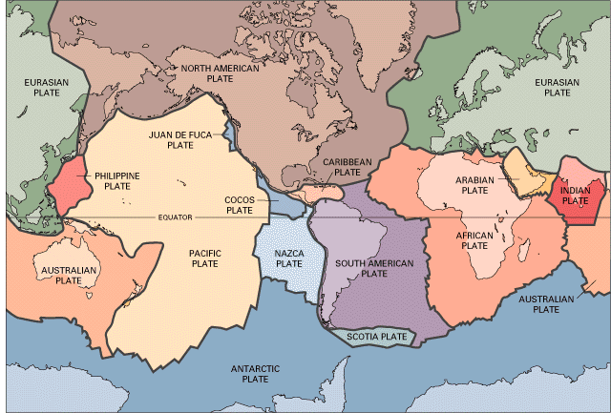
Plates Today
The lithosphere is broken up into slabs, called tectonic plates
USGS Earthquake Hazards Program
Hazard, Risk,Tectonics,Faults
Dr. Sinan Akkar
Notes:
Pattern of earthquakes defines the boundaries of tectonic plates
About 23 major plates
Can you see where we are?
Boundary between two plates
We’ll come back to this later

Slide 46
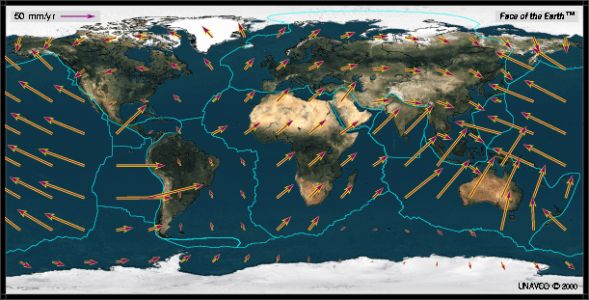
The plates move relative to one another; their interaction produces earthquake
Hazard, Risk,Tectonics,Faults
Dr. Sinan Akkar

Slide 47
Types of Plate Boundaries
Divergent
Convergent
Transform

Slide 48
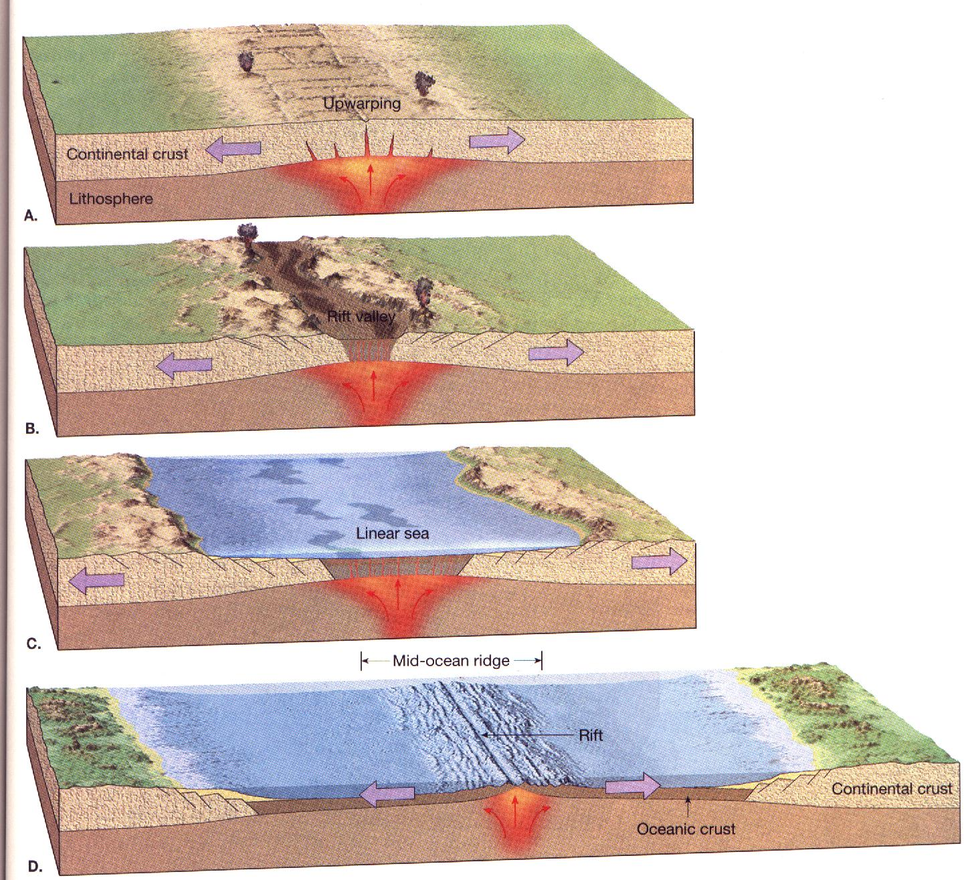
Divergent Plate Boundaries
these are regions where plates move away from one another. Mid-ocean ridges are the “birthplace” of oceanic lithosphere. The newly formed oceanic crust and lithosphere are pushed sideways to make room for hotter upwelling material. This sideways motion continues as the plates age and become cooler and heavier.
passive margin

Slide 49
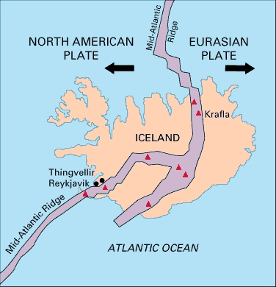
Divergent boundaries
Hazard, Risk,Tectonics,Faults
Dr. Sinan Akkar

Slide 50
Convergent Plate Boundaries
When two tectonic plates converge often one will get buried or subducted beneath the other. The plate boundary regions where this occurs are called subduction zones. There are two types of lithosphere, oceanic and continental, so there are three possibilities at a convergent boundary:
  - oceanic and oceanic
  - oceanic and continental
  - continental and continental
  Subduction zones only occur at convergent boundaries between oceans and continents, and oceans and oceans (why not between continent and continents?) When oceanic lithosphere converges with continental lithosphere it is the oceanic material that is always subducted beneath the continental material. When the convergent boundary is between two oceans it is the older (heavier) plate which usually subducts.

Slide 51
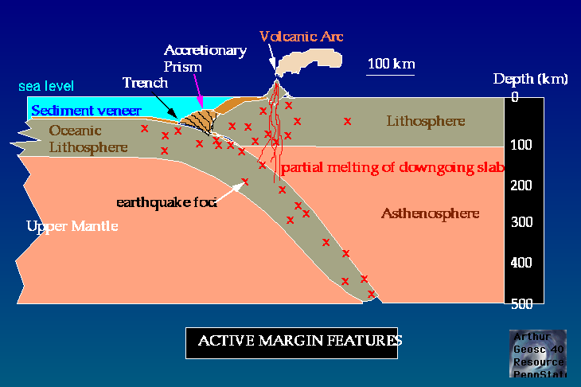
Examples of subduction zone. Result of converging plates are “trenches” on the surface.

Slide 52
Examples of an oceanic lithosphere subducting beneath a continental lithosphere:
  South America subduction zone: Nazca plate (oceanic) subducting beneath South American plate (continental)
  Aleutian subduction zone: Pacific plate (oceanic) subducting beneath North American plate (continental) – in Alaska
Examples of oceanic lithosphere subducting beneath oceanic lithosphere of another plate:
  Marianas subduction zone: Pacific plate subducting beneath Phillipine Sea plate in western Pacific
  Tonga subduction zone: Pacific plate subducting beneath Australian plate in western Pacific

Slide 53
Two dominant features associated with subduction zones are:
  deep earthquakes
  volcanoes
Subduction zones and deep earthquakes:
Earthquakes can only occur in brittle material (high viscosity). It follows that most earthquakes happen only in the lithosphere, which is usually 100-200 km thick. However, we observe earthquakes down to a depth of 700 km ??? It turns out the deep earthquakes we observe (depth > 200 km) are occurring in lithosphere that has been subducted. Deep earthquakes do not occur in any place except for subduction zones since this is the only place where brittle material (lithosphere) exists below its normal depth. Deep earthquakes occur in planar (2D) arrangements called Wadati-Benioff Zones. Seismologists use the locations of deep earthquakes to map out the geometry of subducting lithosphere.

Slide 54
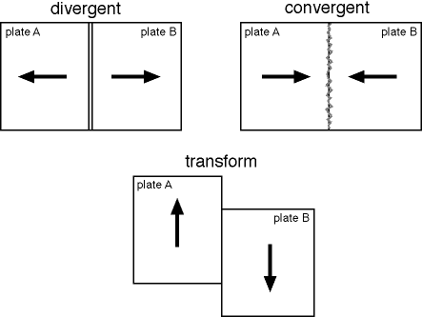
Transform Plate Boundaries
Not all plate boundaries are convergent or divergent; many are defined by lateral relative movement. These types of plate boundaries are called transform boundaries. Here, material is not being created (as it is at ridges) and is not being buried (as it is as subduction zones). Like divergent and convergent plate boundaries there is significant seismicity associated with transform faults (earthquakes). Unlike the other types of boundaries there is relatively little volcanism.

Slide 55
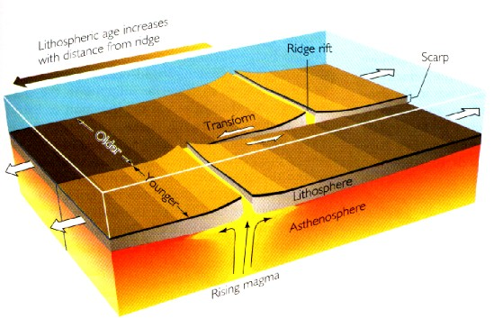
Since no material is being created or destroyed transform boundaries are also referred to as conservative boundaries. Another name is a strike-slip boundary. Transform faults occur most often as connecting segments between spreading ridges

Slide 56
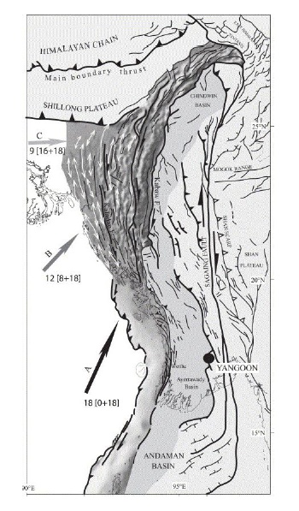
An example of a transform fault: the Sagaing fault

Slide 57
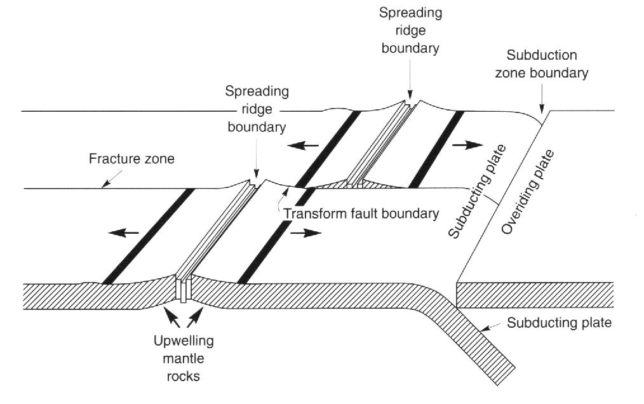
OVERALL SUMMARY FOR PLATE BOUNDARIES
The plates interact at their boundaries in one of three ways depending on their relative directions of motion.
At the ocean ridges, plates move apart from each other and hence these are divergent plate boundaries. Where plates collide, at convergent boundaries, one plate will usually be driven below the other in the process of subduction. Oceanic plate is subducted below continental plate along the Pacific coast of South and Central America; oceanic crust is subducted below oceanic crust in the Caribbean arc.
Mechanisms of interaction between tectonic plates
Shearer, 1999 (courtesy of Dr. J. Bommer)

Slide 58
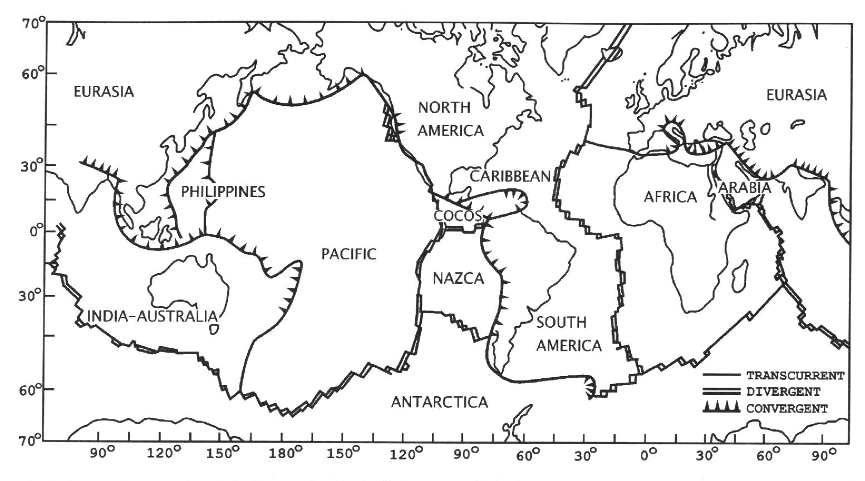
OVERALL SUMMARY FOR PLATE BOUNDARIES
Main lithosperic plates and the nature of their boundaries
Udias, 1999 (courtesy of Dr. J. Bommer)
When two continental plates collide, there is enormous deformation and thickening of the lithosphere along the boundary: the clearest example of this is the Himalayas. It is also possible for two plates to move horizontally past one another. Such boundaries tend to be clearly marked by long and well-defined faults such as the San Andreas fault in California, which is the boundary between the North American and Pacific plates, the North Anatolian fault in Turkey, and the Sagaing fault in Myanmar. Figure above shows the global distribution of the three different types of plate boundaries, which can be related to the motions depicted in the previous slides.

Slide 59

Comparison: the dense bands of seismicity around the world coincide with the boundaries between tectonic plates.
Earthquakes occurring on the boundaries between plates are generally referred to as inter-plate events. There are earthquakes, however, such as the New Madrid earthquakes that occur far from the boundaries of tectonic plates and which do not appear therefore to be directly related to the interaction between tectonic plates. Such events are generally referred to as intra-plate earthquakes.

Slide 60
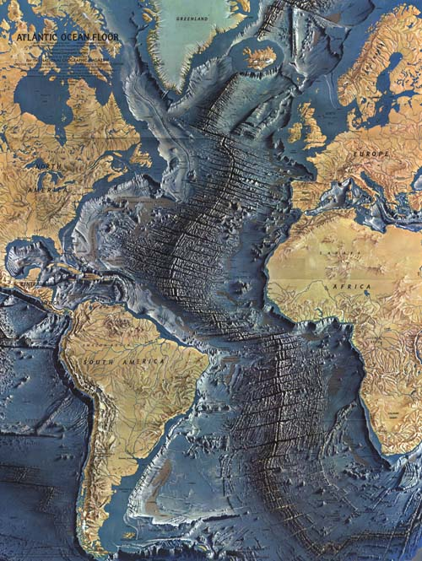
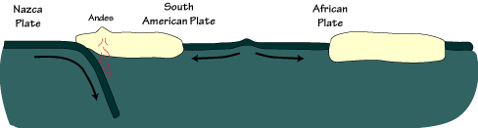
The mechanism for continental drift
The sea-floor spreading is observed clearly.
Since new material is created at the mid-ocean ridges and Earth is not expanding, somewhere material must be removed from the surface. It turns out that old ocean floor is “subducted” into the mantle at subduction zones.

Slide 61
A detailed look at one region

Slide 62
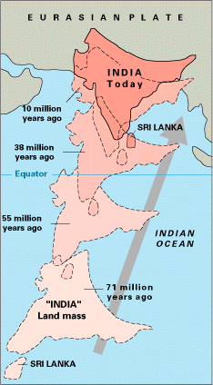

Slide 63
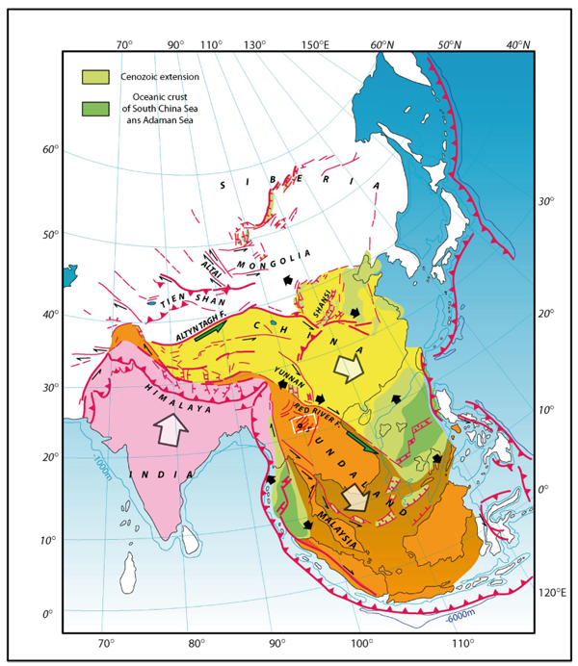
http://www.earthobservatory.sg/media/news-and-features/295-myanmar-earthquake-of-march-24th-magnitude-68.html

Slide 64
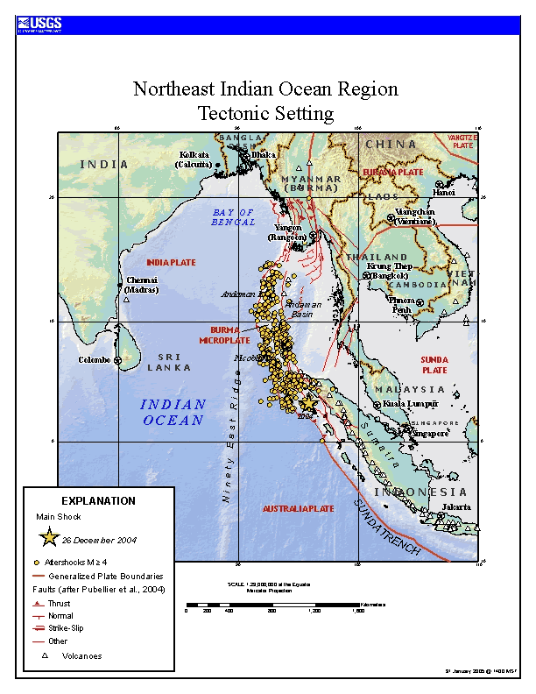

Slide 65
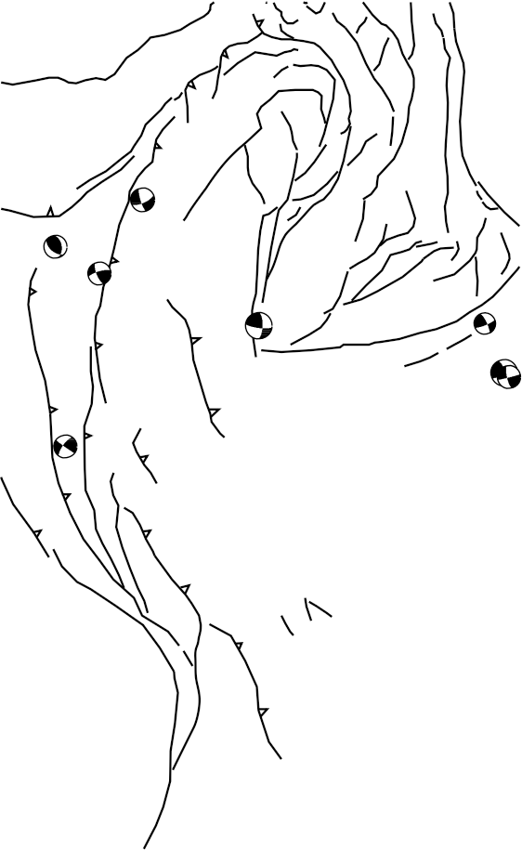
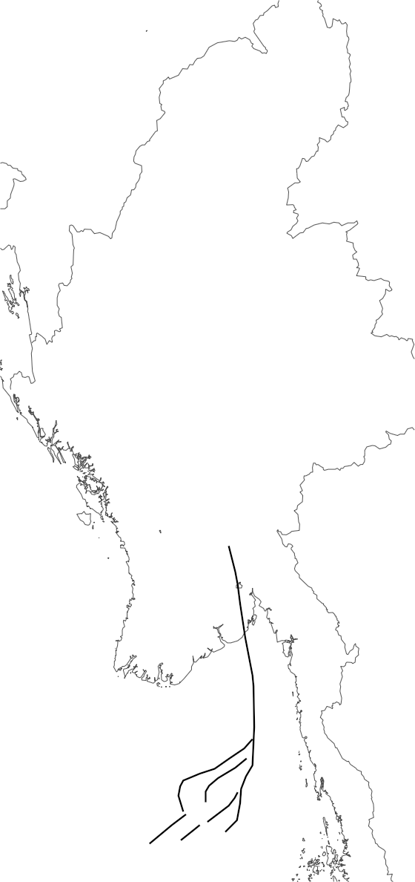
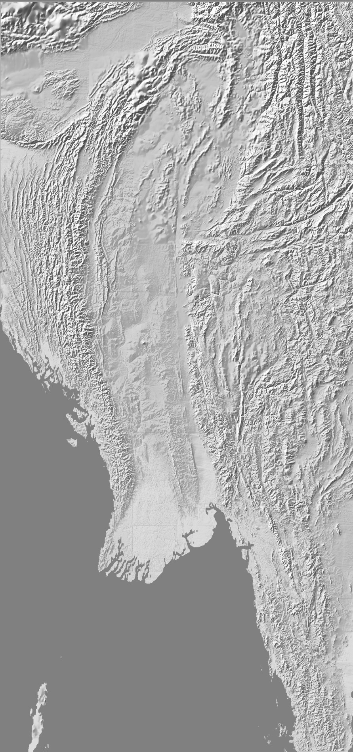


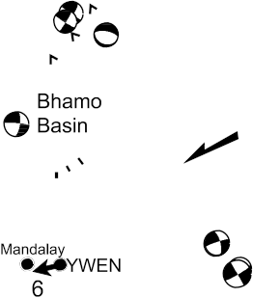
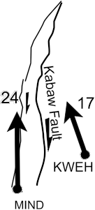


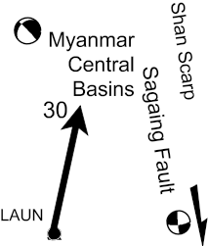



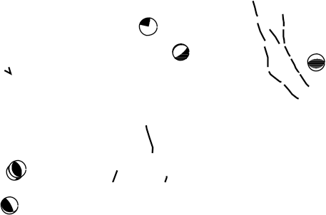
Figure 4. Main Myanmar structures, shallow CMT focal mechanisms, and GPS velocities with respect to the Sunda Plate (black arrows).
(Socquet et al., 2006)

Slide 66

http://www.earthobservatory.sg

Slide 67
Tectonic Plate Motions
Nowadays it is possible to determine the motions of tectonic plates using satellite observation and other geomatics techniques, such as:
Satellite Laser Ranging (SLR)
Very Long Baseline Interferometry (VLBI)
Doppler Orbitography & Radiopositioning
Integrated Satellite (DORIS)
Global Positioning System (GPS)
Hazard, Risk,Tectonics,Faults
Dr. Sinan Akkar

Slide 68

Plate Motions – Euler Pole Concept...
Tectonic Plates are Rigid
“Caps” not Flat, Planar Sheets
Geologic observations are usually able to tell the velocity of two plates relative to each other. Thus, Plate Tectonics use the relative velocity concept to explain the motions of plates. Mathematical modeling of plate motion requires a fixed reference system and this is achieved by defining the Euler pole concept.
Hazard, Risk,Tectonics,Faults
Dr. Sinan Akkar

Slide 69

The most general way to describe the movement of a rigid plate (cap) on a sphere is through rotation about a fixed pole which is described by Euler’s Fixed Point Theorem
Example of Euler pole describing the relative motion of Africa from a fixed, North American reference frame.
The pole of rotation for plate motion is an abstract mathematical concept, it is not a physical feature. The point representing the pole is known as an Euler pole. Working with Euler poles also clearly indicates that the velocities of plates are vectorial quantities with magnitudes and directions.
Hazard, Risk,Tectonics,Faults
Dr. Sinan Akkar

Slide 70

Hazard, Risk,Tectonics,Faults
Dr. Sinan Akkar

Slide 71
The use of GPS measurements from both permanent global stations and local temporary stations can allow very rapid and accurate measurements of tectonic plate motions, not only of the major plates but also of smaller lithospheric units called microplates.
Hazard, Risk,Tectonics,Faults
Dr. Sinan Akkar

Slide 72

Observed motions from GPS, relative to Eurasia (note that motions are not uniformly increasing away from the apparent Euler pole)
Nye & Thatcher, 2004
Hazard, Risk,Tectonics,Faults
Dr. Sinan Akkar

Slide 73

Predicted motions based on 4 microplate model relative to Eurasia. Yellow arrows show residuals (observed – predicted)
Nye & Thatcher, 2004
Hazard, Risk,Tectonics,Faults
Dr. Sinan Akkar

Slide 74
Summary
Simple Plate Tectonic Theory can explain most of the observed spatial and size distributions of earthquakes
Some observations are not well explained by plate tectonics
  Intraplate earthquakes
  Hotspot volcanism

Slide 75
Summary
New ideas are continually being patched into plate tectonics to make it more robust
This is a perfectly normal example of how science progresses
Will a new model take over that explains things to a greater detail and precision than Plate Tectonics?
Hazard, Risk,Tectonics,Faults
Dr. Sinan Akkar

Slide 76
Geological Faults and Earthquakes
Hazard, Risk,Tectonics,Faults
Dr. Sinan Akkar

Slide 77
What produces earthquakes?

Slide 78


Slide 79


Slide 80
The first physical, rather than supernatural, theories for earthquakes were provided by the philosophers of ancient Rome and Greece.
For example, in the fifth century B.C., Democritus attributed earthquakes to the action of water entering a cavernous Earth and forcing its way from areas where it was in excess to dry caverns.

Slide 81
In the fourth century B.C. Aristotle provided an alternative theory claiming:
“… neither water nor earth can be the cause of temblors, but it could be the wind, when it flows back in what has been exhaled out”.

Slide 82
“Diseased nature oftentimes breaks forth
In strange eruptions; oft the teeming earth
Is with a kind of colic pinch’d and vex’d
By the imprisoning of unruly wind
Within her womb; which, for enlargement striving
Shakes the old beldam earth, and topples down
Steeples and moss-grown towers.”
William Shakespeare, King Henry IV, Act 1

Slide 83
Or is it the release along faults of strain energy stored in the Earth?

Slide 84
Earthquakes only occur in the outermost layer of the Earth, the lithosphere, which is the only brittle part of the planet

Slide 85
This includes the relatively cold subducted lithosphere
From Keith Koper, Saint Louis University (http://www.eas.slu.edu/People/KKoper/EASA-123/2003/)

Slide 86
EARTHQUAKES and GEOLOGICAL FAULTS
Plate tectonics, which explains the underlying cause of most earthquakes, was formulated as a coherent theory in the 1960s.
More than 50 years earlier, the mechanism of earthquakes had been determined as the sudden rupture of geological faults.

Slide 87
The 1891 Mino-Owari earthquake in Japan produced an 80 km rupture across the island of Honshu.
Displacements of as much as 3 m vertically and 8 m horizontally were measured in the field.
Japanese geologist Bunjiro Koto suggested that the rupture was actually the cause of the earthquake.

Slide 88


Slide 89

The 1906 San Francisco earthquake was associated with a rupture of the San Andreas fault over a distance of more than 400 km.

Slide 90

Offsets were measured by observations of objects traversed by the fault along the length of the rupture

Slide 91


Slide 92

Observed slip along San Andreas fault from 1906 earthquake

Slide 93
Elastic Rebound
The investigators of the San Francisco earthquake also went back to geodetic surveys of northern California carried out in 1851-65 and 1874-92.
It was found that in the decades prior to the fault, survey points on opposite sides had moved relative to one another.
The pre-earthquake deformations matched, in direction and magnitude, the slip measured on the fault rupture after the earthquake.
We’ll return to elastic rebound after a short digression on stress and strain and material behavior

Slide 94
Stress and Strain
Two of the key physical concepts used to understand earthquakes and seismic waves are:
  Stress
  Strain

Slide 95
Stress
Stress is a force per unit area:
stress = force / area
where
force = mass x acceleration
Units for stress used in seismology:
MPa (mega-pascal) (10⁶N/m²)
Bar (dyne/cm²)
1 MPa = 10 bars

Slide 96
Stress
When a material is stressed it can respond in different ways:
  deform (change shape or volume) – this is often elastic behavior and the material returns to its former shape when the stress is eliminated. (In plastic deformation that material does not return to its original state).
  flow - this would be viscous (fluid) behavior. The material does not return to its former shape when the stress is eliminated. This is ductile behavior.
  fracture – this is brittle behavior, and can only occur in solids. The material does not return to its former state when the stress is eliminated.

Slide 97
Strain
Strain is the deformation in a solid that has been induced by an applied stress.
Strain has no units, it is dimensionless.

Slide 98
Strain
Example: If I take a rubber band that is 5 cm long and I stretch it so that it becomes 6 cm long the strain is:
Strain = 1 cm / 5 cm = 0.20 or 20%
There are no units for strain.

Slide 99
Stress-Strain Relation
Some materials will strain a lot in response to a tiny stress while others will strain very little in response to a large stress
The relationship between stress and strain is thus a material property (like density)
This stress-strain relationship is known as the rheology of the material.

Slide 100
Rock Deformation
Rocks slowly deform as a result of Earth’s convection and thermal cooling.
Where the rocks are cool and “brittle”, they can stick together along faults that fracture causing earthquakes.
Deep below Earth’s surface, where it is hot, the rocks bend and flow like taffy.

Slide 101

Rock Deformation
The specific style of rock deformation depends on
    Composition
    Temperature
    Pressure
    Strain Rate

Slide 102
Rock Behavior
In general, rocks will either “flow” or fracture depending on their temperature.
  However, even cold rocks can sustain some strain before they break.
  If the strain is released before the strength of the rock is exceeded, the rock returns to its original shape.

Slide 103

Rock Fractures (Faults & Joints)
A joint is a fracture across which the sides have not moved (e.g, a crack formed from stress relief when overburden is removed by erosion)
A fault is a crack across which the two sides have moved.

Slide 104

Fault Structure
We don’t have many examples of what faults look like far below Earth’s surface, but here’s an example.

Slide 105
Elastic Energy
When you strain an elastic material, it stores the energy that you used to deform it.
When given an opportunity, an elastic material can release the stored energy.

Slide 106
Earthquakes & Strain
An earthquake is the catastrophic release of strain energy stored in the rocks around a fault.
Where does the energy come from?
  Moving plates which are driven by gravity and heat from Earth’s interior.

Slide 107

A “Creeping” Fault

Slide 108
Fault Friction
Friction is a stress that resists motion. As plates slide past one another along a fault, the friction on the fault holds the plates together.
The moving plates store elastic strain energy in the rocks surrounding the fault. The strained rocks exert a stress on the fault.

Slide 109

A Locked Fault
This is a “snapshot” of the strain surrounding a fault at an instant of time.

Slide 110

The release of the accumulated elastic strain energy by the sudden rupture of the fault is the cause of the earthquake shaking

Slide 111
Earthquake Energy
During an earthquake, most of the strain energy is converted to heat, only a few percent is converted to seismic waves.
But that’s still enough to generate the powerful shaking that topples structures.

Slide 112
Reid’s Elastic Rebound Model
Soon after the 1906 San Francisco earthquake, H. F. Reid proposed a hypothesis to explain earthquake occurrence.
Reid’s elastic rebound model includes earthquakes in a cycle of strain build-up and strain release.

Slide 113

Elastic Rebound: basic earthquake mechanism

Slide 114

Stress is applied to a locked fault by the relative motion of the tectonic plates.
The material near the fault deforms in response to these stresses and is strained.
When the stress becomes too large the fault fractures and relieves (drops) the stress. This is an earthquake.
As the material near the fault releases the elastic energy it has stored up it “snaps” back into place.
The fault does not snap perfectly back into place and the new configuration increases the stress in certain patches of the fault.
These new, smaller, stresses cause strains which are often released in more “snaps” (aftershocks), which cause smaller aftershocks themselves in a cascade of earthquakes.

Slide 115

Reid’s Earthquake Cycle
(give example of conglomerates from Loma Prieta)

Slide 116
“Snapshot” of the strain surrounding a fault at an instant of time.
Summary of Basic Earthquake “Machine”
As plates slide past one another along a fault, the friction on the fault holds the plates together.
The moving plates store elastic strain energy in the rocks surrounding the fault. The strained rocks exert a stress on the fault.
During an earthquake, most of the strain energy is converted to heat, only a few percent is converted to seismic waves.
But that’s still enough to generate the powerful shaking that topples structures.

Slide 117
CAUTION: EARTHQUAKES ARE MORE COMPLEX
(Elastic Rebound Theory is the most simple way of explaining the earthquake event)
Earthquakes do not follow the simplest form of the elastic rebound theory.
A number of complications make the deformation cycle difficult to predict. For example:
    Variations in fault strength and structure
    Fault interactions
Unraveling these is difficult because our observations are short.

Slide 118
Types of Faults; Describing Fault Geometry and the Slip on Faults

Slide 119

Earthquakes and Faults
Earthquakes occur on faults, but not all of the fault ruptures during each earthquake.
The hypocenter (or focus) is the place where the rupture begins, the epicenter is the place directly above the hypocenter.
Hazard, Risk,Tectonics,Faults
Dr. Sinan Akkar

Slide 120



Faulting terminology
Dip-Hanging Wall-Foot Wall
Strike
Slip
The orientation of the fault surface with respect to Earth’s surface is defined by the fault dip.
Strike is an angle use to describe the orientation of the fault surface with respect to North.
Rake is the angle used to describe the orientation of the movement of the hanging wall relative to the foot wall.
SLIP DIRECTION:
If the slip is in the direction of the dip, we call it a dip-slip motion. If the slip is in the direction of strike, we call it a strike-slip (or transform) motion.
Hazard, Risk,Tectonics,Faults
Dr. Sinan Akkar

Slide 121




FAULTING STYLES
Block on the upper side of the fault.
The hanging wall slides down the fault - as you would expect (that’s why it’s called “normal”).
The hanging wall is pushed up the fault - not what you would expect (that’s why it’s called “reverse”).
The hanging wall horizontally (no motion in the direction of fault dip).
There are 2 cases depending on how the rocks on the other side of the fault move - right lateral and left lateral.
A combination of dip-slip and strike-slip motion.
Hazard, Risk,Tectonics,Faults
Dr. Sinan Akkar

Slide 122

Reverse faulting, El Asnam earthquake
(reverse faults from moderate to large ‘quakes are often buried (e.g., S. Cal) or become imbricated near the surface, resulting in no scarp or a complicated set of surface breaks)
Hazard, Risk,Tectonics,Faults
Dr. Sinan Akkar

Slide 123

Left-Lateral Strike-Slip Offset
(1990 Luzon, Philippines)
Hazard, Risk,Tectonics,Faults
Dr. Sinan Akkar

Slide 124



Faulting and stresses: style of faulting tells us about the stresses acting within Earth
At any place there are three principal stresses acting on a fault.
If the vertical (compressional) stress:
Largest - Normal Faulting
Smallest - Reverse Faulting
Intermediate - Strike-Slip Faulting

Slide 125

Recordings of seismic waves can be used to draw “beach balls” that reveal the type of earthquake mechanism
Tension –
Divergent motion
Compression –
Convergent motion
Hazard, Risk,Tectonics,Faults
Dr. Sinan Akkar

Slide 126

Convergence of Cocos and Caribbean plates in the Middle America subduction trench off the Pacific coast of Central America
Hazard, Risk,Tectonics,Faults
Dr. Sinan Akkar

Slide 127

Direction of lateral movement at transform boundaries can also be determined from fault plane solution “beach balls”
Hazard, Risk,Tectonics,Faults
Dr. Sinan Akkar

Slide 128



Along plate boundaries, faulting reflects the motion of plates.
  Divergent Boundary = Normal Faulting
  Convergent Boundary = Reverse Faulting
  Transform Boundary = Strike-Slip Faulting
Normal faults
Reverse faults
Transform faults
Hazard, Risk,Tectonics,Faults
Dr. Sinan Akkar

