Slide 1
Rose School Lectures – 2013
S. Akkar and D. M. Boore
Engineering Seismology & Seismic Hazard Assessment
HAZARD and RISK, TECTONICS, EARTHQUAKES and FAULTS

Slide 2
Instructors
  Sinan Akkar
  David Boore
Teaching Assistant
  Luis Rodriguez

Slide 3
My Contact Information
David M. Boore
boore@usgs.gov
http://www.daveboore.com

Slide 4
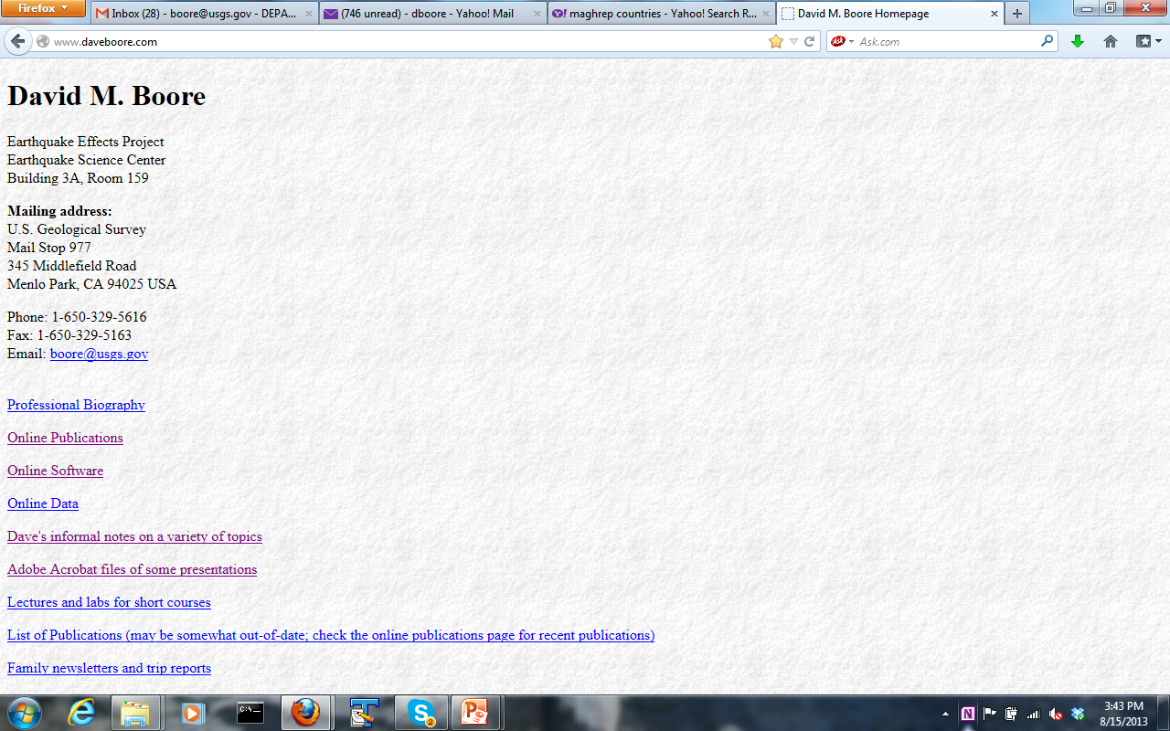

Slide 5
Online Software
SMSIM (stochastic model simulations and site amplification using full resonant and square-root impedance simulations)
TSPP (a collection of FORTRAN programs for processing and manipulating time series )
BSSA14_GM_TMR (Evaluate the recent Boore et al. PEER NGA ground-motion prediction equations (GMPEs))

Slide 6
Course Schedule: Week 1
DAY | DATE | MORNING ( ) | Lecturer | AFTERNOON ( ) | Prepared by
Monday | 2nd September | Hazard and Risk; Tectonics; Earthquakes & Faults | DMB | Practicum 1: SeisVol, Relative plate motion | DMB
Tuesday | 3rd September | Seismic Waves and Seismographs, Earthquake Location | DMB | Practicum 2: Waves; Travel-time curves; Geometrical spreading | DMB
Wednesday | 4th September | Magnitudes & Mechanism | DMB | Practicum 3: Location exercise using real data; fault plane solutions | DMB
Thursday | 5th September | Earthquake Source Parameters, | DMB | Practicum 4: Calculation of magnitude, moment and Δσ | DMB
Friday | 6th September

Slide 7
Course Schedule: Week 2
DAY | DATE | MORNING ( ) | Lecturer | AFTERNOON ( ) | Prepared by
Monday | 9th September | Characterisation of Strong-Motion (Processing of data) | DMB | Practicum 5:Processing of Strong-Motion Accelerograms | SA
Tuesday | 10th September | Properties of data from observations (source, path and site effects on gm) | DMB | Practicum 6: Estimating Scaling & Attenuation Parameters | DMB
Wednesday | 11th September | Ground Motion Simulations | DMB | Practicum 7: Strong-Motion Regressions; Predictions Eqns | DMB
Thursday | 12th September | Ground Motion Prediction Equations form Observations | SA | Practicum 8: Simulations (SMSIM & EXSIM) | DMB
Friday | 13th September

Slide 8
Course Schedule: Week 3
DAY | DATE | MORNING ( ) | Lecturer | AFTERNOON ( ) | Prepared by
Monday | 16th September | Site Effects on Ground Motion | SA | Practicum 9: Site amplification (STRATA) | DMB
Tuesday | 17th September | Seismicity: Data and Models Macroseismic Intensity & Source Characterization | SA | Practicum 10: Earthquake Catalogues & Recurrence | SA
Wednesday | 18th September | Seismic Hazard Assessment: Overview | SA | Practicum 11: Construction of Seismic Scenarios and PSHA | SA
Thursday | 19th September | Probabilistic Seismic Hazard Assessment | SA | Practicum 12: Review of published hazard assessments CRISIS 2007, SEISRISK III | SA
Friday | 20th September

Slide 9
Course Schedule: Week 4
DAY | DATE | MORNING ( ) | Lecturer | AFTERNOON ( ) | Prepared by
Monday | 23rd September | Hazard Maps and Seismic Design Codes | SA | Practicum 13: Logic-trees for PSHA & Code Spectra | SA
Tuesday | 24th September | Selecting and scaling accelerograms | SA | Practicum 14: Hazard Assessment Workshop | SA
Wednesday | 25th September | Presentations on Hazard Assessment | SA-DMB | Practicum 15: Presentations on Hazard Assessment | SA-DMB
Thursday | 26th September | Final Examination | SA-DMB |  | SA-DMB
Friday | 27th September

Slide 10
Course evaluation based on 3 elements:
Tutorials and exercises (45%)
Group oral reports on seismic hazard assessment project on 25th September (30%)
Final examination (25%)

